Slide 1
Race for Glory: Greek Civilization Under Rome
Andrew Scholtz, Instructor

Slide 2
Agenda. Intro....
Questions
To course focus (time, place, themes)
To course particulars (course sites, procedures, etc.)
To Thur’s assignment
Plus academic honesty...

Slide 3
Question…

Slide 4
How does envy win?

Slide 5
Another question…

Slide 6
Why doesn’t envy vanquish fortune?

Slide 7
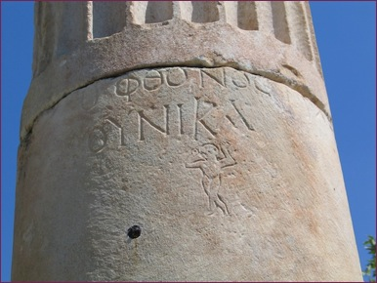
Ho phthonos tukhēn ou nikai
“Envy does not vanquish fortune!”
Portico column, agora, Aphrodisias, ca. 500 CE

Slide 8
A question about a quotation…

Slide 9
“Are we to believe … that democracy nurtures greatness, and great writers flourished with democracy and died with it? … We of the present day … seem to have learned in infancy to live under justified slavery. … We end up as flatterers in the grand manner.”
(Longinus On the Sublime 44.2–3. Original in Greek, 1st cent. CE)
Why would the author write that?

Slide 10
What is this all about?

Slide 11
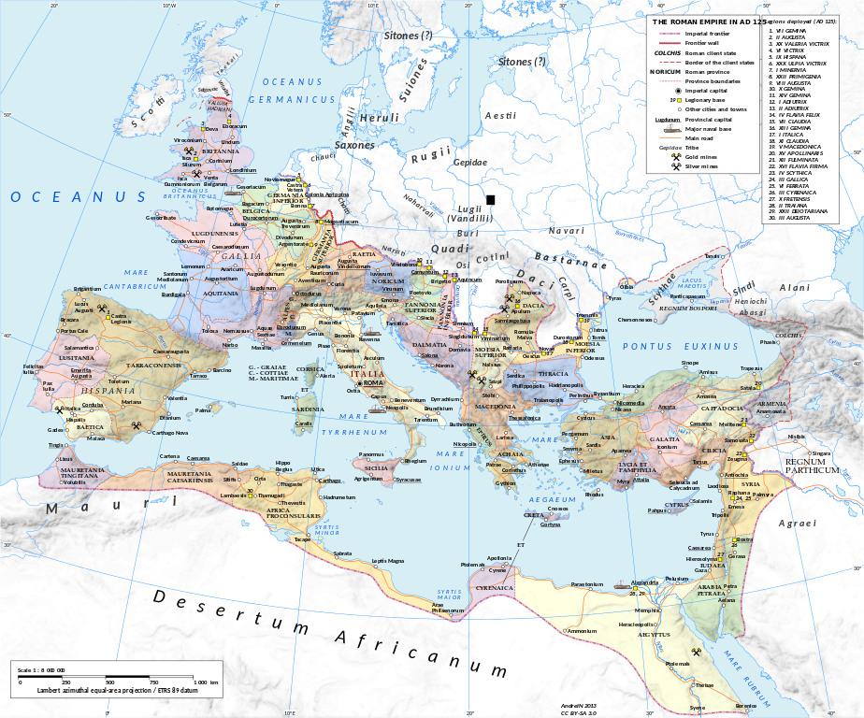
Roman Empire in 125 CE.
Andrei N. Creative Commons Attribution-Share Alike 3.0 Unported license
Ephesus

Slide 12
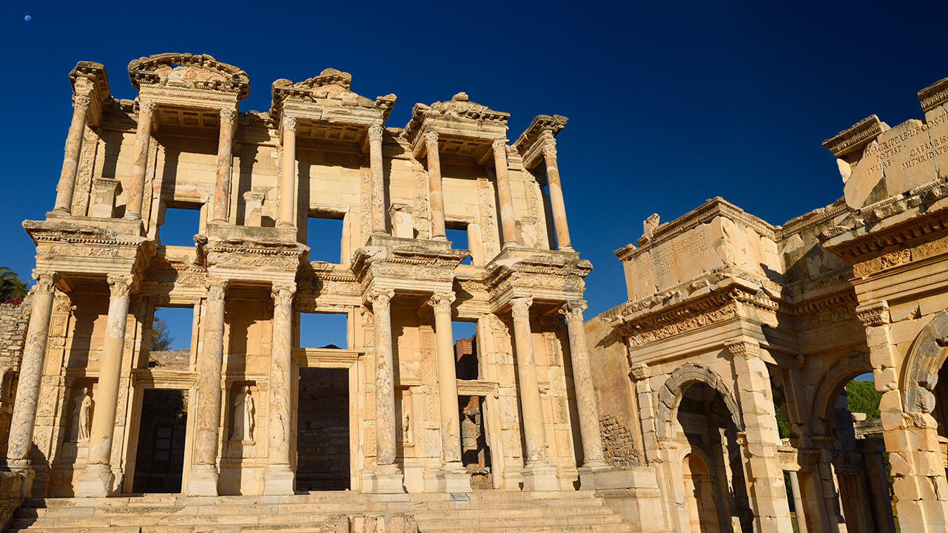
Library of Celsus, Ephesus, Turkey. Completed 1st half 2nd cent. CE
Notes:
from:
https://web.archive.org/web/20130520064544/http://classics.uc.edu/~johnson/libraries/celsus.html
Circumstances of construction
The library serves as a grave monument, rather like many churches, and in the tradition of the entombing of heroes and celebratory family monuments. At the back right of the monument is the entrance into a sepuchral chamber that contained the remains of Celsus. The library is dedicated by Ti. Iulius Aquila (cos. 110) to his father Ti. Iulius Celsus Polemaeanus (cos. 92, procos. Asia 106, native of Asia, presumably of Ephesos). When the library was completed is not known, but prob. Hadrianic. (115 to 150 are the range of dates proposed; but even later is possible for the completion.) The original editors suppose that Celsus was voted heroic honors, and for that reason a spot close to the city agora was allowed for "hê Celsianê bibliothêkê."
Note the fasces, statues of riders on either side, armed military statue, etc. that bespeak the celebration of the consular and proconsular honors of man and family.
Four statues were found that belong to the facade. From the inscriptions, we know these to be depictions of Sophia of Celsus, Arete of Celsus, Ennoia of Philip (!), and Episteme of Celsus. (Philip is a mystery; the editors of FE guess the architect.) These stood in the niches on the lower story. Also found were statues of a bearded man in military dress (Celsus?), and a tragic Muse (Melpomene). The placement of these is uncertain; perhaps the upper story, perhaps not.

Slide 13
Agonism
agōn, “contest”
Athletics
Diplomacy
Politics
Philanthropy
Rhetoric
Social life
Business
Anything!
Alexander and Helix, champion pancratiasts. Ostia Antica, Italy. Between 210 and 235 CE
Notes:
Gaius Perelius Aurelius Alexander. of Thyatira, Lydia. Pankratiast, ca. 200 CE. High priest of the association of Athletes, Rome.
Aurelius Helix, Phoenicia. ca. 200 CE. pancratiast and wrestler. Victor at the Olympics, Capitolia.

Slide 14
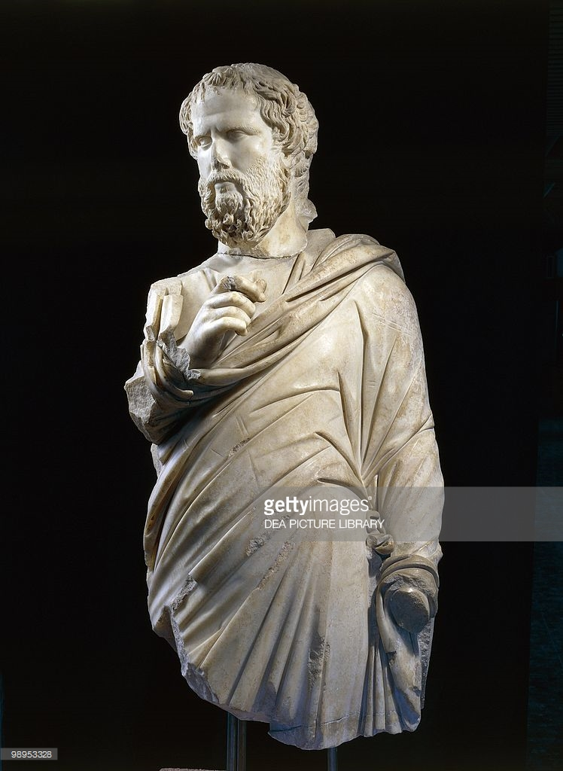
“Second Sophistic”
1st–3rd cent. CE
Rhetoric
paideia
Sophist, Ephesus

Slide 15
Guiding question…

Slide 16
How to be Greek under Rome?

Slide 17
Race for Glory: Greek Civilization Under Rome
AMS 382E / COLI 331J / PPL 380m / RHET 450G. Andrew Scholtz, Instructor (ascholtz@binghamton.edu). TR 10:05-11:30. LN 2405. Competitive culture — rhetoric, athletics, literature, philanthropy, etc. — in the Greek-speaking Roman East, 1st-3rd cent. CE. Lecture, discussion, online journals, exams, rhetorical exercises (spoken, written). Course counts toward "H" (humanities), "O" (oral) GenEds; Harpur "W" (writing). Students with special needs are asked to inform the instructor.

Slide 18
Dual Websites
Brightspace
“Bingweb”
https://brightspace.binghamton.edu/d2l/home/204082
Announcements
PDF readings
Writing upload
https://bingweb.binghamton.edu/~ascholtz/ams381a/
Syllabus
Assignments
Other informational pages
PPT lectures

Slide 19
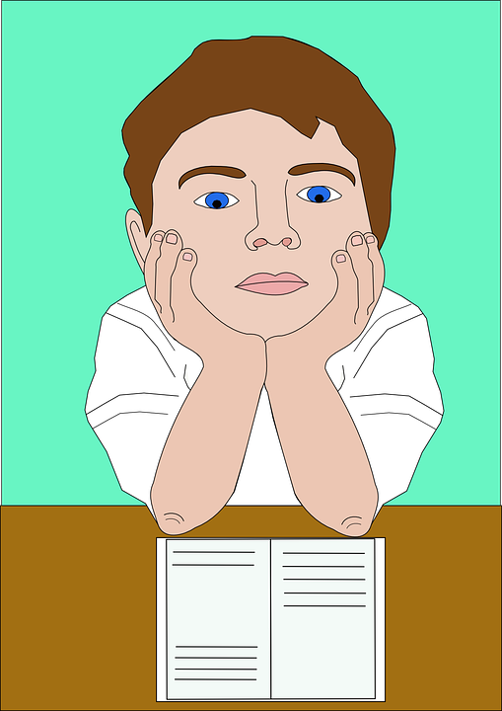
Let’s Start the First Assignment!
Lucian Dream
My first “quiz response” journal entry

