Slide 1
Citizen-Sponsored Public Works in the Roman East

Slide 2
Agenda
Discussion
Why might privately sponsored public works have caused “harm”?
Citizen-Sponsored Public Works
Types and Purpose
Euergatism
Case Studies (Philostratus Lives, McManus “[Women] Civic Donors”)
Eternal Fame
The Library of Celsus

Slide 3
Discussion
Why might privately sponsored public works have caused “harm”?

Slide 4
“... I pray to the immortals that my children, my city and my country will always celebrate these festivals, unharmed.... Many have put up fair prizes for cities, after they were dead, but, in his own life, no mortal man. I alone dared do this.... So, abating your criticism, all those who have dread Envy, look upon my statue with emulous eyes” (Euarestos inscription, from van Nijf 2004)
Notes:
What kind of cultural capital did euergetism buy? How might euergatism as philanthropy have activated ideologies of agōn? What were those ideologies, judging from the evidence of these and other readings? Does the ambiguity surrounding liturgy and euergatism in the Roman East, ca. 100 CE on, complicate matters? How will gender have figured in?

Slide 5
Citizen-Sponsored Public Works
Types and Purpose

Slide 6
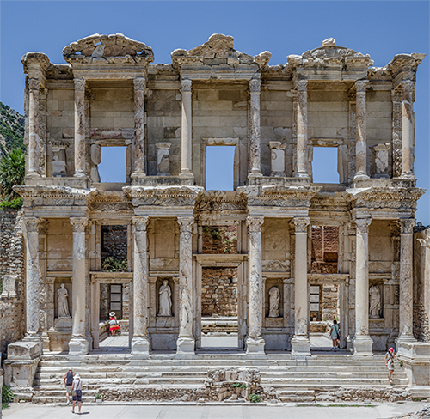
Types, Purpose (studied for today)
Euergetism
Liturgy
Funerary Monument
Library of Celsus
Notes:
how are these the same?
how are they differe3nt?

Slide 7
Euergatism
Case Studies (Philostratus Lives, McManus “[Women] Civic Donors”)

Slide 8
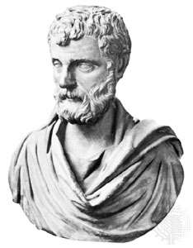
Herodes Atticus
Panathenaic stadium, Athens
Stadium, Delphi
Odeion, Athens
Reconstruction of Odeum in Corinth
Statues (Isthmus, Olympia)
Support for towns
Aqueduct for Canusium (Italy)
Aqueduct, baths: Alexandria Troas

Slide 9
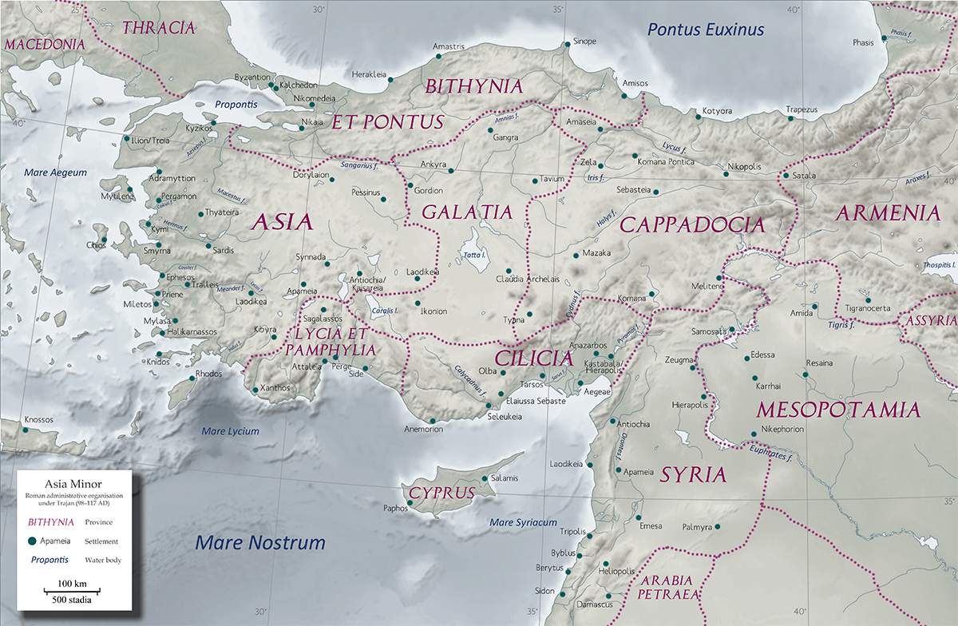
Alexandria Troas
Ephesus
Perge

Slide 10
“… when Herodes was governor of the free cities in Asia, … he wrote to the Emperor Hadrian … to give [Alexandria Troas] three million drachmae to procure a water-supply…. But when the outlay had reached the sum of seven million drachmae, … the officials who governed Asia kept writing to the Emperor that it was a scandal.” (Philostratus Lives p. 143)
Notes:
Philostratus:
“his same Atticus [Herodes' father] was also distinguished for his lordly spirit. As an instance, at a time when Herodes [the son] was governor of the free cities in Asia, he observed that Troy* was ill-supplied with baths, and that the inhabitants drew muddy water from their wells, and had to dig cisterns to catch rain water. Accordingly he wrote to the Emperor Hadrian to ask him not to allow an ancient city, conveniently near the sea, to perish from drought, but to give them three million drachmae to procure a water-supply, since he had already bestowed on mere villages many times that sum. The Emperor approved of the advice in the letter as in accordance with his own disposition, and appointed Herodes himself to take charge of the water-supply. But when the outlay had reached the sum of seven million drachmae, and the officials who governed Asia kept writing to the Emperor that it was a scandal that the tribute received from five hundred cities should be spent on the fountain of one city, the Emperor expressed his disapproval of this to Atticus [Herodes' dad], whereupon Atticus replied in the most lordly fashion in the world: "Do not, Ο Emperor, allow yourself to be irritated on account of so trifling a sum. For the amount spent in excess of the three millions I hereby present to my son, and my son will present it to the town." (p. 143)
Kuhn 2012
“His large-scale projects in Alexandria Troas involved the building of an aqueduct, a nymphaeum and an impressive bath-gymnasium complex. However, because of his notorious philotimia and lavish attitude, Herodes exceeded the approved budget considerably. When complaints about the waste of tributes for this one colony came to Hadrian’s ears from the procurators of Asia, Herodes’ father Atticus intervened on behalf of his son and simply topped up the budget from his own pockets....”
“... his magnanimity in Alexandria Troas, where he acted in the capacity of both an imperial agent and a private benefactor, was undoubtedly primarily aimed at advertising and increasing his family’s public esteem, which now extended beyond Greece into Asia Minor”
“... a project of such scale inevitably outshone the local eminence of the colony’s own elite families – above all, that of the Quintilii.”

Slide 11
Alexandria Troas
Perge

Slide 12
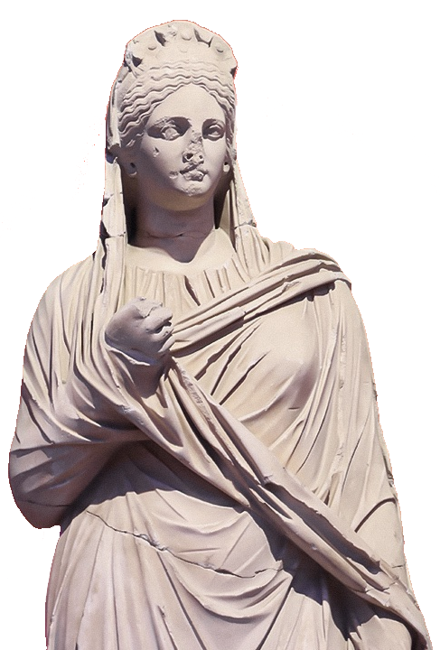
Plancia Magna (active 117-138 CE)
Fragmentary inscription:
“Plancia Magna, daughter of Plancius Varus and of the city, official in charge of building (dēmiourgos) and of the gymnasium (gumnasiarkhos)
· · · on account of philanthropy shown toward the province”
Plancia Magna, with crown adorned with emperors heads
Notes:
McManus “"Plancia Magna, Aurelia Paulina, and Regilla: Civic Donors“ page:
“Plancia Magna was a Roman citizen, a member of the Plancii from Latium in central Italy who had emigrated to Perge sometime during the late Republic. The family had risen to prominence and great wealth over several generations to become members of the elite in Perge. Plancia's father, Marcus Plancius Varus, became a member of the Senate in Rome and rose to the position of praetor; he served as proconsular governor of the province of Bithynia (see map) during the reign of Vespasian.”
as chief priestess Artemis Pergaia, person to deal with.
“she bears the title demiourgos (“one who works for the demos, the people”), which indicates that she was an annual eponymous magistrate whose name was used in dating (a very high honor for a woman)”
“two inscriptions indicate that she was also a priestess of the imperial cult, and in the extant statue she wears a diadem adorned with small busts of emperors, symbol of that office (see this priest's crown with seven imperial busts and trailing ribbons, depicted on a bronze Cilician coin of Elagabalus).”

Slide 13
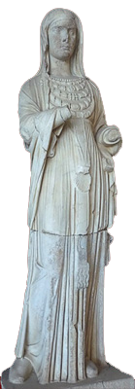
Aurelia Paulina (active ca. 200 CE)
Syrian
Citizen
Priestess (Artemis, Imperial cult)
Impressive fountain
Scaenae frons
Statues of
Julia Domna
Caracalla, etc.
Aurelia Paulina, with Syrian necklace

Slide 14
Eternal Fame
The Library of Celsus

Slide 15
Alexandria Troas
Ephesus
Perge

Slide 16
Ephesus
Ionian foundation 1086/5 bce (trad.)
Artemision, 7th Wonder of the World
Leading city, Roman Asia

Slide 17
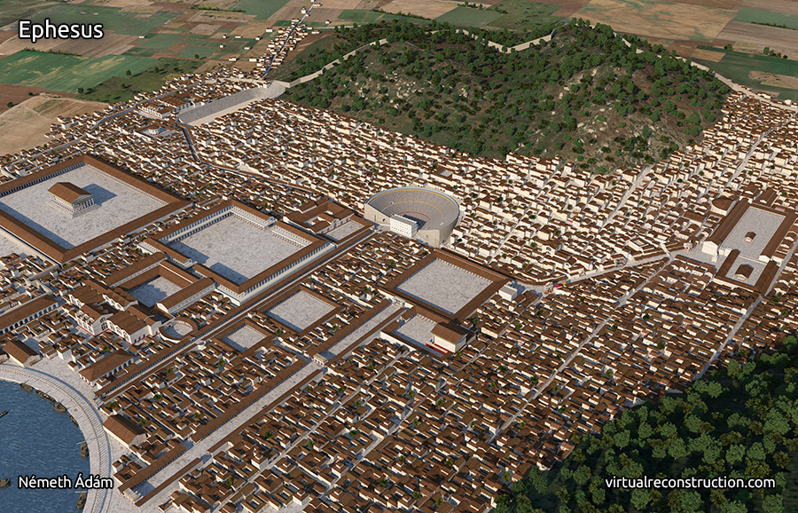
Artemision
Library of Celsus
Roman Ephesus

Slide 18
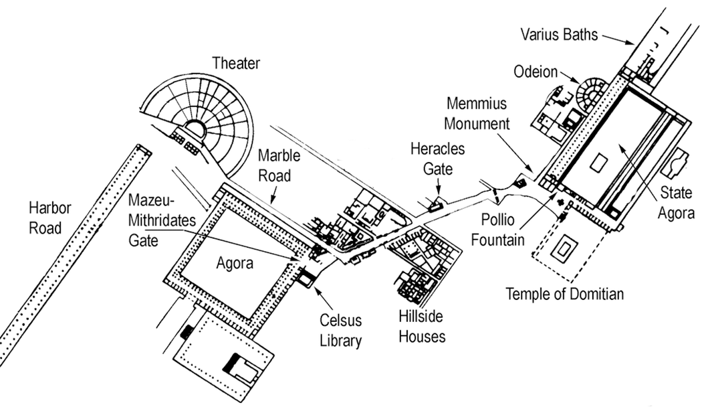
North
Temple of Artemis
Curetes Street

Slide 19
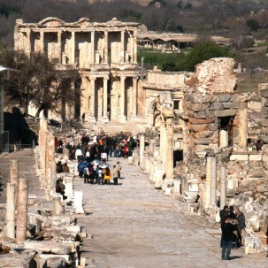
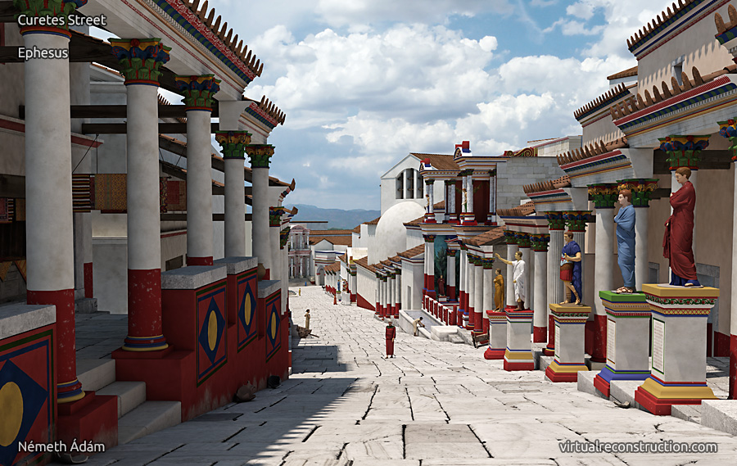
Curetes Street, Imperial period

Slide 20
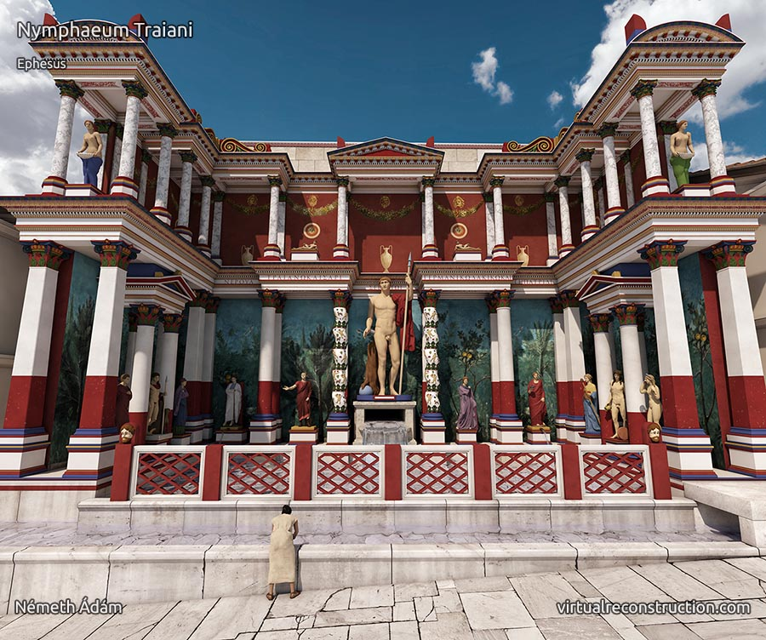
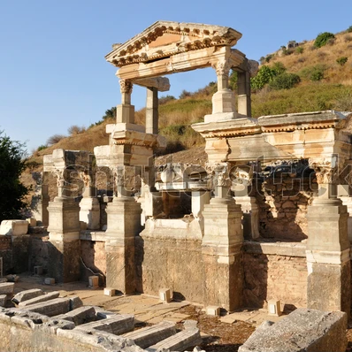
Fountain (nymphaeum) of Trajan

Slide 21
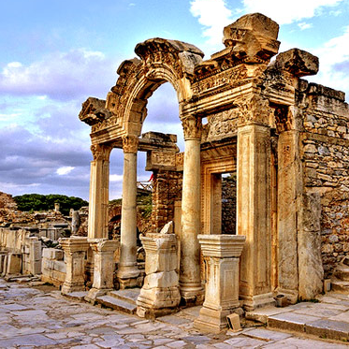
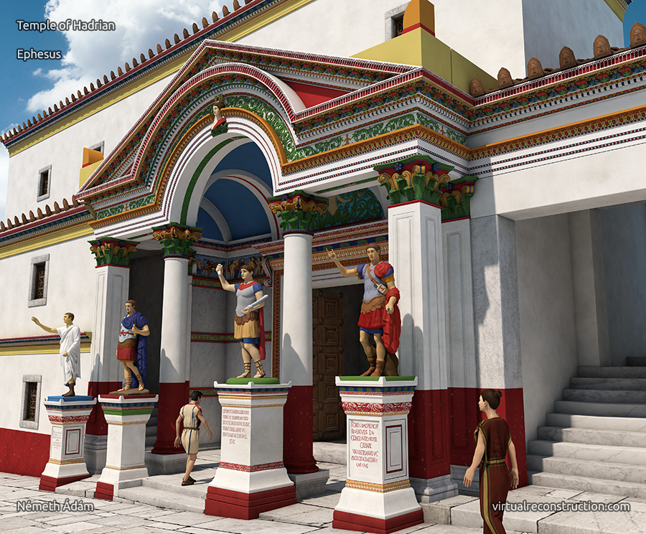
Temple of Hadrian

Slide 22
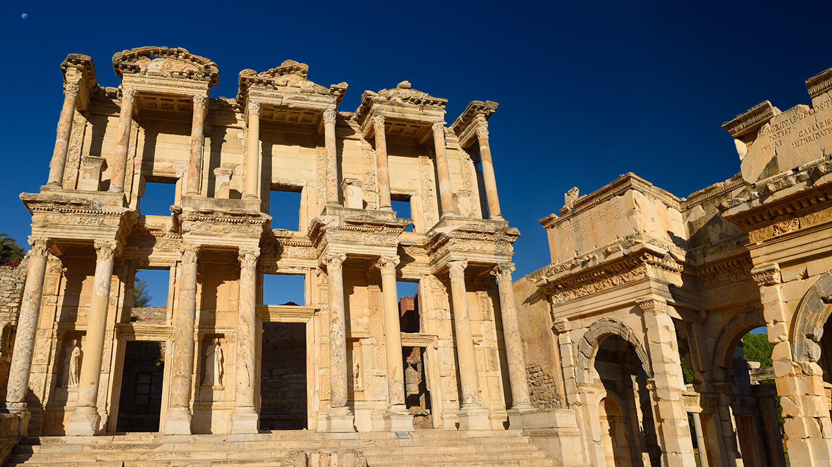
Library of Celsus. Completed 1st half 2nd cent. CE

Slide 23
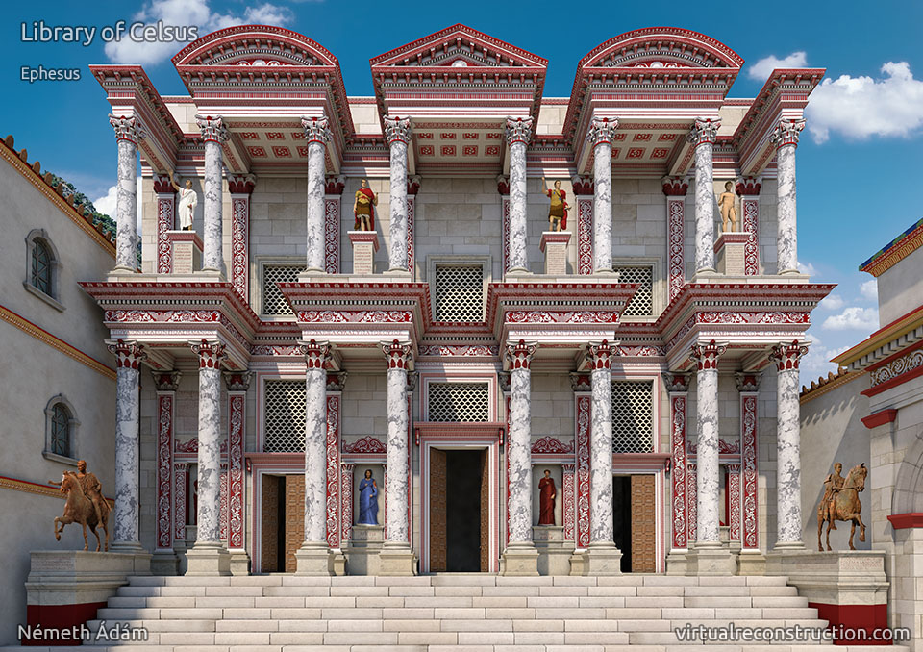
2016 virtual reconstruction, Ádám Németh

Slide 24
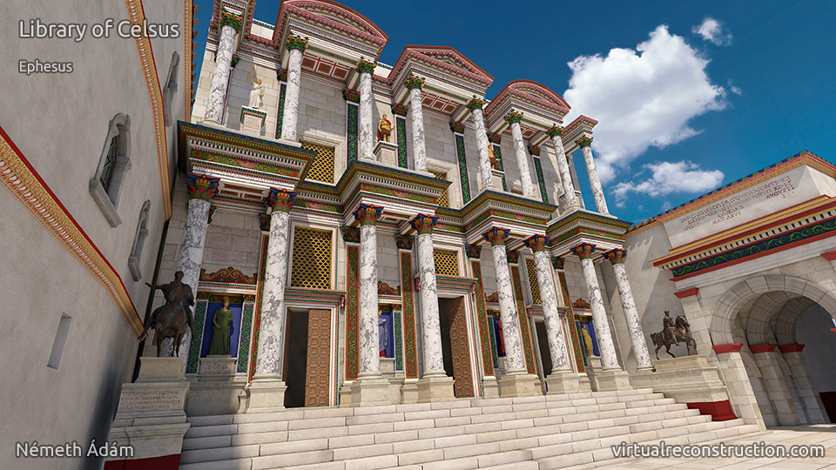
2018 virtual reconstruction, Ádám Németh (new color scheme)

Slide 25
History
Honoring
Tiberius Iulius Celsus Polemaeanus, general, senator, consul, and governor of Asia (died before 114 CE)
Commissioned by
Son Tiberius Julius Aquila, senator, consul AD 110
Library of Celsus
Notes:
brill’s [II 40] Ti. I. Celsus Polemaeanus From Sardeis, official end of 1st cent. AD
From Sardeis; later strong connections with Ephesus. He supported Vespasian in AD 69 as tribune of the legio III Cyrenaica. Entered the Senate; legatus iuridicus in Galatia-Cappadocia 79/80; after occupying several praetorian offices under Domitian cos. suff. in 92; curator aedium sacrarum; proconsul of Asia c. 105/6. On his death interred in a sarcophagus in the library in Ephesus, which had been erected by his son I. [II 17]. He and his virtutes are represented in images, including two equestrian statues. IEph VII 2, 5101-14; Halfmann, 111f.; PIR² J 260.

Slide 26
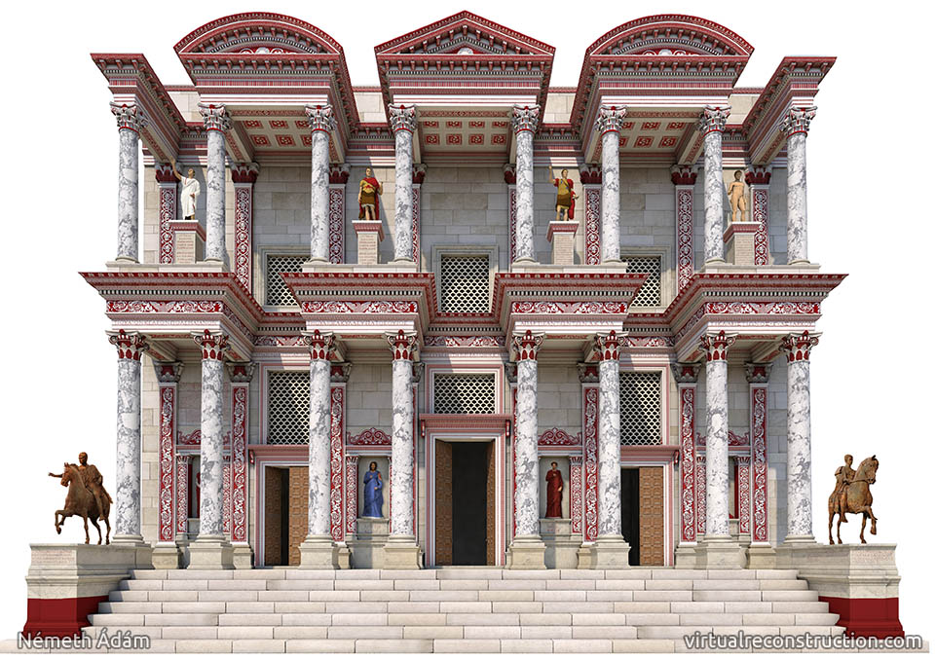
(Probably) male figures: Celsus in Greek dress
(Probably) male figures: Celsus in Roman dress
Celsus
Celsus
Greek bio
Latin bio

Slide 27
Labeled personifications, Greek virtues (Celsus’)
Knowledge, Intelligence
Wisdom, Valor
Notes:
sophia, arete, episteme, ennoia

Slide 28
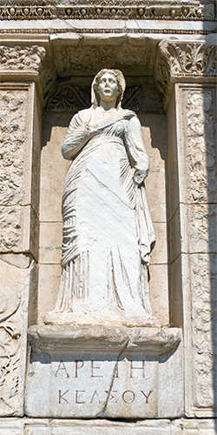
“Celsus’ Valor/Excellence/Virtue”
aretē Kelsou

Slide 29
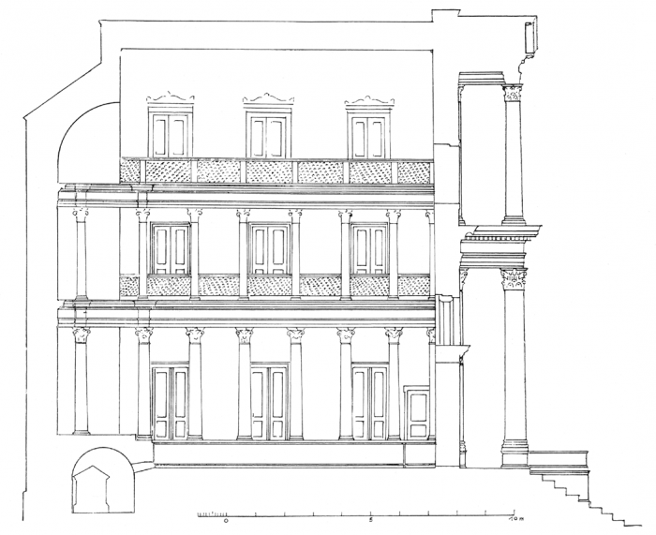
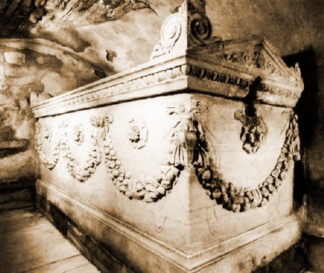
Library, interior plan
Statue (Athena? Apollo? Emperor?)
Tomb of Celsus

