Slide 1
Plato’s Phaedrus 2 “The Birth of Rhetoric”

Slide 2
Agenda
Discussion
Rhetoric and Soul
Recap and Update
Bigger Picture, Plato’s Phaedrus
Wrap-Up
What the Cicadas Are Saying…

Slide 3
Discussion
Rhetoric and Soul

Slide 4
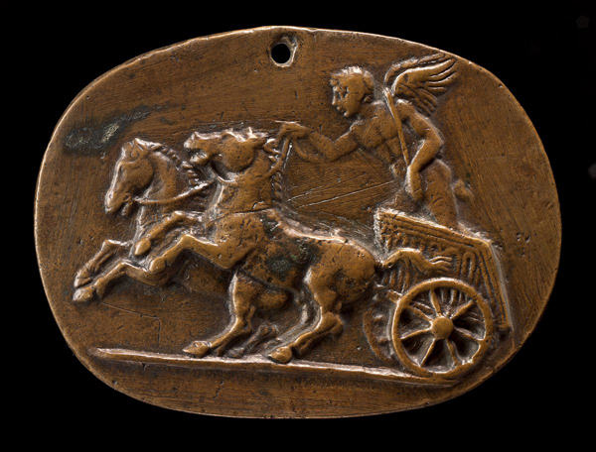
Notes:
so, what do we have here?
[students explain that this is a representation of plato’s myth of the soul as chariot. explain soul,
how does Socrates define rhetoric in the Phaedrus?
[next slide]

Slide 5
Is not rhetoric, taken generally, a universal art of enchanting the mind [tekhne psukhagogia, "psychagogic art"] by arguments [logoi]; which is practiced not only in courts and public assemblies, but in private houses also, having to do with all matters, great as well as small, good and bad alike, and is in all equally right, and equally to be esteemed — that is what you have heard?” (Socrates in Plato Phaedrus 261a–b)

Slide 6
Discussion: Dēmos as “Soul”
Journal Prompt: “How ... might Socrates' discussion of rhetoric, which Socrates' defines as ‘soul guidance/enchantment,’ relate to that? Is soul guidance like demos-guidance, is it democracy? Is the unruly horse's resistance to guidance like democracy — is the unruly horse a dēmos? Will the ones guiding the horses really be looking out for his ‘beloved,’ the dēmos, or themselves?”
Notes:
In Soc's scheme, though, what/whom is leadership for: the totality (the city) or just that unruly horse? Is rhetoric rhetoric as a tekhne if only that greedy, lustful horse is being served? Is democracy democracy if it serves only interest groups, not the totality?

Slide 7
Recap and Update
Bigger Picture, Plato’s Phaedrus

Slide 8
Course Focus
Persuasion, democracy
Archaic-classical Greece
Classical Athenian democracy
Thinking, writing, speaking
Notes:
Course focus
Persuasion, its role and attitudes toward it ancient (archaic, classical greece) ca 750-300 bce
especially, emergence of speech-based democracy in ancient athens, 500-300
see time line>>
Thinking, writing, speaking
critical thinking
expository essay
oral presenting (and use of powerpoint)
Intro phase
Basic issues
the role of persuasion and speech in political process, especially democratic process
in ancient greece as a lab for…
human society more generally
… how speech and communication – idea and information sharing – play a key role
how they potentially can undermine the process
Critical approaches
we’re not just reading/looking at things and talking about them. we’re doing so using “lenses,” readings (4-Oct, 23-Oct) in modern theory that, when you look at the primary source material through it, tends to place a certain structure on it, and to lead to certain kinds of explanations of it.
Consider Ober's mass-elite model: public speech as a way for leaders and led to define roles and bridge the gap between them to make democracy work (Mass and Elite, Princeton 1989). what does that help us see when we read, say, thucydides? does the thuc reading provide validation for ober’s theory?
Instructor-class introductions
first exercise... (phaedrus essay-ppt)

Slide 9
Analysis: Plato’s Phaedrus
Part 1: epideixis
Part 2: didaxis
Prelude
erōtikoi logoi (“love speeches”)
Lysias’
anti-erōs
Socrates’
Lysianic re-do
Socratic recantation
Cicadas (interlude)
Systematization
definition, dialectic
psychology
rhetorical elements
Superiority of
Speaking to writing
Dialectic to rhetoric
Philosophy to sophistic
Notes:
explores rhetoric through three examples of rhetoric, which become basis for a preliminary theory of rhetoric as psychological influence exercised through human speech.
the speeches are love speeches, but they really represent courtroom and political speeches, the two main areas of thhe practice of ancient rhetoric.
as political speeches: they seek to influence the decidion of someone to do something or not to do it
as courtroom speeches, they in effect put eros - but also logos - on trial.
Seduction (prelude)
eros for logos. socrates’ ostensible purpose will be to cure phaedrus of his eros for rhetoric
Speeches: Go with erastes?
>> the point here is to illustrate the potential and the limits of monological, rhetorical discourse. all three speeches are monological rhetoric and thus inferior to dialectic. all three seek to argue a counter-intuitive point, to make the seemingly weaker argument stronger. all three are in a sense sophistic.
Lysias
No. (a formally messy attempt to spin “friends with benefits” as more prudent than consorting with lovers)
Socrates
No. (a formally more systematic version of preceding.)
Yes but… (yet more systematic still, it presents the more acceptable thesis morally, but still buts up against common opinion: that love as madness is carries serious drawbacks)

Slide 10
Analysis: Plato’s Phaedrus (cont’d)
Part 1: epideixis
Part 2: didaxis
Prelude
erōtikoi logoi (“love speeches”)
Lysias’
anti-erōs
Socrates’
Lysianic re-do
Socratic recantation
Cicadas (interlude)
Systematization
Definition of rhetoric
Psychology of rhetoric
Elements of rhetoric
Superiority of…
Speaking to writing
Dialectic to rhetoric
Philosophy to sophistic
Notes:
Part 2: didaxis
(instruction)
myth of the cicadas
systematization
rhetoric like meds. again, a response to sophs. (270b)
definition, dialectic
writing versus speaking
myth of Thoth
writing inferior because the mere static image of discourse. writing can only be a pastime. conversation - dialectic - the true occupation of the philosopher.

Slide 11
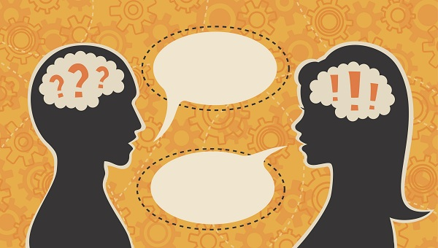
Phaedrus: Dialectic v. Rhetoric
Dialectic
Rhetoric
Focus
Opinion-doxa
Means
“Enchanting the mind (psukhagōgia) by arguments (logoi)”
Requirements
Mastery of topic
Mastery of psychology
Mastery of presentation
Mastery of philosophy
Notes:
It isn’t stated in myth of cicadas that orators expected to be philosophers as well, but that seems to be the implication. Thus the necessary prerequisite for rhetoric would seem to be dialectic, the art of systematizing knowledge.
dialectic is essential to determine the difference between
the non-debatable (axiomatic premises, shared “truths”)
the debateable
. . . and establish share definitions
ultimately, dialectic is superior to rhetoric, as it requires a dynamic interchange between perspectives, so that propositions can receive a proper testing (elenchus).
yet “mere knowledge of the truth will not give you the art of persuasion” (260d). this an attempt to lay the groundwork for a better, i.e., more beneficially efficacious, rhetoric. think of socratic rhetoric as the higher seduction.
socrates account of socratic rhetoric makes a number of key concessions to sophists:
that rhetoric deals in doxa
that it is like an enchnatment applied to the minds (“souls”) of others
but he parts company as to need to base persuasion on wide-ranging technical knowledge.
the real knowledge that practitioner must master.
ELEMENTS & RULES OF SYSTEMATIZED OR “SOCRATIC” RHETORIC:
ARRANGEMENT:
(proem, etc.). argumentational modes (e.g., probability). topoi.
RHETORICAL RULES:
know your subject matter.
likeness to truth will produce more persuasive deception. so knowledge of subject matter essential.
define topic area - be on same page as audience. be sure you’re clear where the divide lies between the mutually accepted and the to-be-persuaded. nature of love debatable; its def. not. speech 3 a paignion, but still illustrates clear definition of terms and dialektike.
know your audience – audience psychology.

Slide 12
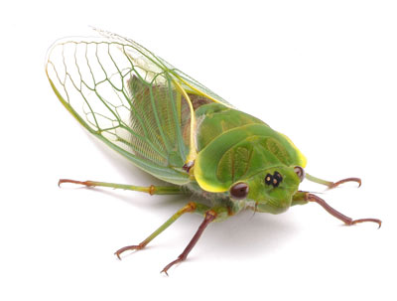
Wrap-Up
What the Cicadas Are Saying…
Notes:
CRICKETS AIM TO STEER AWAY FROM SPEECH ADDICTION AS IF AWAY FROM SEXUAL EROS AS MERE SATISFACTION OF A VULGAR DESIRE FOR ENTERTAINMENT. (That highlighted in Phaedrus’ reference to pleasure in mere satisfaction of bodily appetites.) Hence the Myth of the Cicadas. Privileges philosophical discourse – dialectic – over rhetoric. how? the cicadas contain the souls of humans of long ago who, ravished eros – insatiable dsesire – for the music of the goddesses of song, expired from self-neglect. now their souls reincarnated in the bodies of the cicadas police us humans to determine whether we waste our speech on trivial pursuits or use to to achieve higher knowledge.
what socrates evidently seeks is to cure phaedrus of his addition to – his eros for – rhetoric. but why? even if rhetoric for its own sake serves little purpose, is there nothing that rhetoric is good for? and if rhetoric does in fact serve some purpose, is that a legitimate or a sketchier sort of purpose?
so my own purpose in starting out with plato’s phaedrus is to introduce key problems and issues addressed by this course:
the connection, one sensed by greeks themselves, between the growth of democracy and the emergence of the art of verbal persuasion.
how persuasion – political persuasion in particular – happens, and its basis in social interaction.
persuasion as an asset to, indeed, a defining feature of, democracy, but also as a danger to itself and to the system that it was supposed to support.
while there exist forms of discourse higher than monological speechifying, those (dialectic, philosophy) won’t fly in any number of real-life situations, in court, in politics, etc., an appealing – i.e., quasi-sexy – sort of persuasiveness cannot but be deployed. that requires, according to plato’s socrates, talent, knowledge, and technical skill. human beings aren’t so stupid that their instincts for reading appearances – the faculty of doxa – can easily be bamboozled. in fact, knowledge is necessary to spin minimally, and thus convincingly. but the speaker cannot at the same time simply ignore human predications, biases, eros. hence no surprise that socrates identifies pericles the erudite and psychologically astute pericles as the consummate orator. as you’ll remember, in the FO written for him by thuc, he makes selfless sacrifice seem like the ultimate self-indulgence. is he deceiving his public? maybe. but whether you or i believe it fit and noble for peri’s athenians to have fought and died, the orator himselof clearly did.
so i really want you to consider whether “that old black magic” that we call peitho is quite as wicked a thing as some may take it to be. the romans defined the orator as “a good person skilled at speaking.” now, i don’t know if they were right, but the mere fact that they could even think that perhaps suggests that we should give rhetoric a chance, too.

