Slide 1
Juvenalian Satire
Who’s to Guard the Guards?

Slide 2
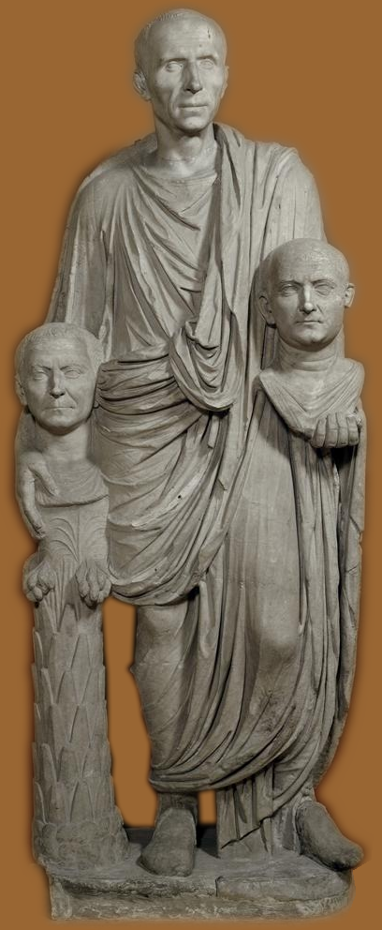
Quis custodiet custodes?
“But who is to keep guard / Over the guards themselves?” (Juvenal Satire 6 p. 140)
Notes:
in satire 6, juvenal’s misogynistic effusion, the speaker recommends that a husband, to keep his wife under control, “lock her up / and bar the doors.” but that same speaker then asks, Quis custodiet custodes? “But who is to keep guard / Over the guards themselves?”
and although he’s talking there about watchers whom the wife will bribe to look the other way when she goes off to have fun, that line, “But who is to keep guard / Over the guards themselves?” clearly sounds the theme of both the satires I had you read for today. for both engage the idea of a breakdown of traditional morality, the mos maiorum, the roman “script” regarding comportment in a variety of areas, including gender and sexuality. here, the script, the “way of the ancestors,” is supposed to be internalized in the adult roman man or woman, and to be performed in the that roman’s words and deeds. but if a cynical and reckless generation begin to feel themselves cut loose from the constraints imposed by that script, if those who are to keep watch – romans, in other words – in order to uphold traditional values fail to do so, then what’s going to be the upshot? would it, as finnis might tend to see things, threaten a radically antisocial self-centeredness hostile to the inherent social goods of institutions like marriage? or, as nussbaum might prefer to see, does the gender-sexual moral system on view in these poems present us with a value system divergent from our own?

Slide 3
Agenda
Discussion?
What would Juvenal say?
Recap and Update
Roman Values: Sexuality and Gender
Juvenal 2, 6
Context, Genre, Issues
Notes:
that’s what we’ll be asking ourselves as we explore the following topics…

Slide 4
Discussion?
What would Juvenal say?

Slide 5
What would Juvenal say about Finnis or Nussbaum?
Notes:
What would Juvenal (or more accurately, the dramatized speaker's voice in Juvenal's satires) say about either Finnis or Nussbaum? I'm not interested in whether he would speak abusively of them (doubtless he would), but whether the value systems oridea systems animating Juvenal would "resonate" (agree) in any way with Finnis/Nussbaum? Why or why not?

Slide 6
Let’s focus…
Are Juvenal’s and Finnis’ value systems similar regarding…
Sex?
Gender?
Marriage?
Other?
Would Finnis’ gender/sex constructs have been available to Juvenal?
Can you share a moralist perspective with someone, just not their values?

Slide 7
Discussion
mixed
agree homosexuality wrong
both v homosexuality but not in same way
disagree on j’s misogyny
difference: j is hung up on the gender thing
v the emasculated husband (wife)
finnis interested in institution of marriage
j & f interested in a social/political institutional dimension
f government can only recommend
j touching more upon direct legislative intervention

Slide 8
Recap and Update
Roman Values: Sexuality and Gender

Slide 9
Sex-Gender-Status-Dichotomies
senior v. junior
active v. passive
vir v.
femina
puer
cinaedus
matrona v.
virgo
meretrix
ingenuus/ingenua v.
servus/serva
libertus/liberta
patronus v. cliens

Slide 10
Stuprum versus pudicitia
stuprum
debauchery
lewdness
violation (incl. rape)
pudicitia
modesty
chastity
virtue
from Lewis and Short, A Latin Dictionary
Notes:
stuprum
Debauchery, lewdness, violation … implying the infliction of dishonor, … not used of dealings with prostitutes, etc. [especially sexual].
pudicitia
Shamefacedness, modesty, chastity, virtue [i.e., sexual integrity].
stuprum as violation of citizen’s pudicitia
forced sex by male with
citizen male
non-marital citizen female
citizen’s willing sexual self-compromise (??)
adultery (non-marital consensual sex with freeborn Roman woman)

Slide 11
Holt Parker’s “Teratogenic Grid”
Holt Parker. “The Teratogenic Grid.” Roman Sexualities. Eds. Judith P. Hallett, and Marilyn B. Skinner. Princeton: Princeton University Press, 1997. 47–65. Print.
Notes:
“The Teratogenic Grid”
Judith P. Hallett and Marilyn B. Skinner, Roman Sexualities (Princeton University Press: Princeton, 1997) 47–65.
“The Romans divided sexual categories for people and acts on the axis of active and passive. … The one normative action [what normal sex will be] is the penetration of a bodily orifice by” the male sexual organ. normal for men: to penetrate. for women: to be penetrated.
the preservation of sexual-corporeal integrity (sexual and otherwise) paramount for roman-male respectability political vialbility
“not to be penetrated” the golden rule of roman male sexual morality
but women’s marital-sexual dutifulness (which extends beyond fidelity to production of citizens and upholding of roman values in the household) could enshrine women’s sexuality as a public exemplum and goes along with an elite woman’s higher visibility in roman contexts
so far that sounds familiar from our study of classical greek – athenian especially – sexuality. but what is striking is the abundant vocabulary and there the precision with which sexuality can be defined for romans.
indeed, parker’s “tertogenic grid” takes issue with the f’s idea that sexual acts in greco-roman antiquity weren’t systematically categorized and differentially valorized, at least in the roman world.
with the result that certain normative exemplars and scare figures are produced
or in more familiar terms, this is a system that tends to produce monsters

Slide 12
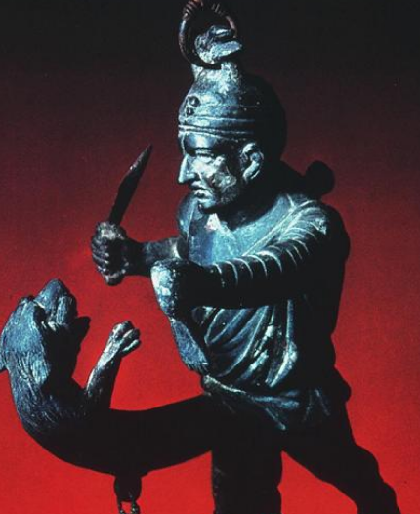
Rome and the Monstrous
Barton, Carlin A. The Sorrows of the Ancient Romans: The Gladiator and the Monster. Princeton: Princeton University Press, 1993.
A gladiator fights his own phallus. (1st-cent. CE Wind-chime from Pompeii)
Notes:
I would like to suggest that the cultural system within which these roman gender/sexuality scripts were performed was one that constantly felt itself scrutinized by the inevitably disapproving ancestors, yet was constantly fascinated by deviance, by those monsters.
the literary/artistic sources show a peculiar fascination with opposites
abjection/subjection
otium/negotium
tradition (mos maiorum) / violation thereof
that can be connected with the roman fascination with
the monstrous
the grotesque
e.g., the gladiator
as negative paradigms, “scare images,” exemplars of social positions/associations to be avoided at all costs…
and therefore sources of seductive fascination.
WITHOUT INFAMIA, THERE CAN BE NO HONESTAS.

Slide 13
Sexual-Social Ideology/Law
Matrimonial ideology
Mens matrimonii, maritalis affectio, adfectio coniugalis
Univira reverentia
Obsequium
Concordia, consortium, societas
Lex scantinia (149 BCE)
Augustan marriage legislation
Lex iulia et papia (18 BCE, 9 CE)
Lex iulia de adulteriis coercendis (9CE)
Notes:
Lex scantinia (149 BCE)
A law reportedly enacted in 149 BCE (i.e., mid-late Republic), it was, according to C. Williams, originally intended to address stuprum "as a whole" (RH 120), i.e., against protected persons generally: legal minors (male or female) of citizen status, citizen women (unwed daughters, wives), and so on. This law perhaps also prosecuted citizens, male or female, alleged to have allowed themselves to be sexually compromised. That, it seems, will have included homoerotic penetration. (Compare Laronia's speech in Juvenal's Sixth Satire.) Still, evidence like that provided by Catullus (poems 24 and 48) suggests that Romans at some level could have at least tolerated (??) pederastic liaisons (but with full sexual consummation?) with freeborn citizen youths.
Augustan marriage legislation
Lex iulia et papia (18 BCE)
Thus do ancient Roman jurists in their writings refer to what were originally two laws: the lex Iulia de maritandis ordinibus ("Julian [i.e., Augustan] legislation concerning marriage and rank," 18 BCE), and the lex Papia Poppaea (law proposed by the suffect consuls of 9 CE, though on the urging of Augustus). In other words, Augustus' marriage legislation dealing with who could marry whom (lex Iulia etc.) and the privileges and liabilities accruing to citizens who either will or won't have produced a certain minimum number of legitimate children.
Most citizens could marry freed slaves under this legislation, but persons of senatorial rank (i.e., the political elite) were forbidden to. This legislation further outlawed marriage between free persons and persons marked by infamia: prostitutes, actors, gladiators, etc. It also regulated marriage between close blood relatives.
This legislation further entitled the parents of three or more legitimate Roman children to additional privileges (ius trium liberorum): for the mother, freedom from guardianship (tutela); for the father, preferential treatment in the awarding of political offices like the consulship. (Privileges also accrued to freed slaves with four or more children.)
Lex iulia de adulteriis coercendis (9 CE)
("Julian [i.e., Augustan] law concerning the punishment of adultery," 18 BCE.) Legislation of which Augustus was the author, it provided that an adulterous wife and her lover be punished by relegation to an island (separate islands for each); the convicted wife could not remarry and was assigned to the status of prostitute. It was the injured husband's responsibility to prosecute; husbands failing to do so were liable to prosecution for pimping their wives (lenocinium).

Slide 14
Ovid Art: Selected Themes, Issues
Lascivi amores
“wanton passions”
“Safe love, legitimate liaisons” (p. 167)
venerem tutam concessaque furta …, / nullum … crimen
Masculinity
“Cybele’s Votaries”
Guilty Menelaus (p. 203)
Mos maiorum
On Cosmetics: “Young girls didn’t cultivate their persons in the old days. … Let others worship the past; I much prefer the present” (bk3, p. 217)
Feminine treachery
Pasiphae et al.
Erotic asymmetry, violence
Rape of the Sabine Women
“It’s all right to use force…”
Adultery (?)
“to please your lady’s escort” (viro placuisse puellae) (p. 184)
“Husbands allow this latitude to lawful wives…” (p. 207)
Notes:
we see a great deal of that in ovid’s art of love.
Feminine treachery
Pasiphae et al.
Erotic asymmetry, violence
Rape of the Sabine Women
“It’s all right to use force…”
Deidamia & Achilles
“To be forced was what she desired”
Adultery (?)
“to please your lady’s escort” (viro placuisse puellae)
“Husbands allow this lattitude to lawful wives…” – hence you have to forgive girlfriend’s furta
COMPARE: 1.387 FF.:
Hoc unum moneo, siquid modo creditur arti, Nec mea dicta rapax per mare ventus agit: Aut non rem temptes aut perfice; tollitur index, Cum semel in partem criminis ipsa venit. 390
“Safe love, legitimate liaisons | Will be my theme. This poem breaks no taboos” (p. 167)
“These Caesars come to courage young” (p. 171)
“The harvest’s always richer / In another man’s fields, the herd / Of our neighbors has fuller udders” (p. 176)
“Husbands allow this latitude to lawful / Wives - they nod off, let sleep assist the fun” (p. 207)
“I hate it unless both lovers reach a climax: / That’s why I don’t much go for boys” (p. 211)
“Let others worship the past, I much prefer the present” (p. 217)
“Let brides be guarded securely: that's proper: / Modesty, law, and our Leader so prescribe. / But watch you? A woman still barely used to her freedom (vicdicta)? Intolerable!” (p. 232)
Parties: “Delay enhances charm, delay’s a great bawd” (p. 237 = 752 grata mora venies; maxima lena mora est)

Slide 15
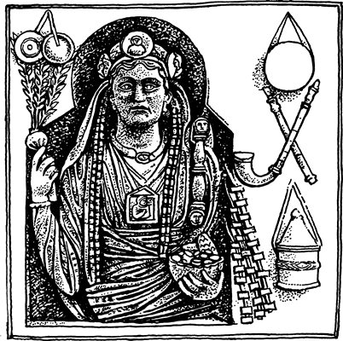
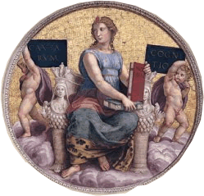
Cybele, Gallus
Cybele (modern representation) Magna Mater Deorum, “Great Mother of the Gods”
Gallus: Eunuch priest of Cybele
2013-11-05
15
Notes:
Cybele
magna mater deorum
brought to Rome 205/4
ecstatic cult, like a female Dionysus
Attis
her lover
castrated and (?) killed
Gallis
not permitted to be Roman citizens until the reign of Claudius
note
timbrels and other instruments, noise makers
pomegranate (life)
shrine with image of Attis around neck
bowl of (phallic, fertility-related) nuts with pinecone
whip (self-flagellation)

Slide 16
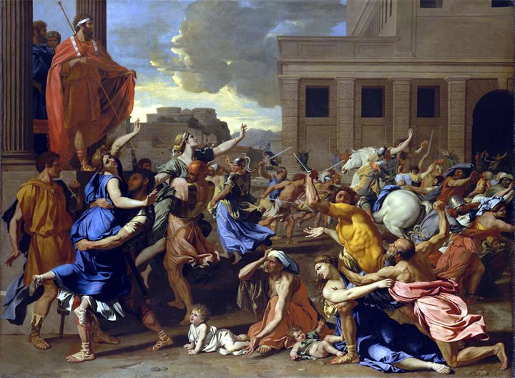
Rape of the Sabine Women - Poussin
“… even so, many contrived | to make panic look fetching” (p. 169)
Notes:
what meaning in poem the rape??

Slide 17
Juvenal 2, 6
Context, Genre, Issues

Slide 18
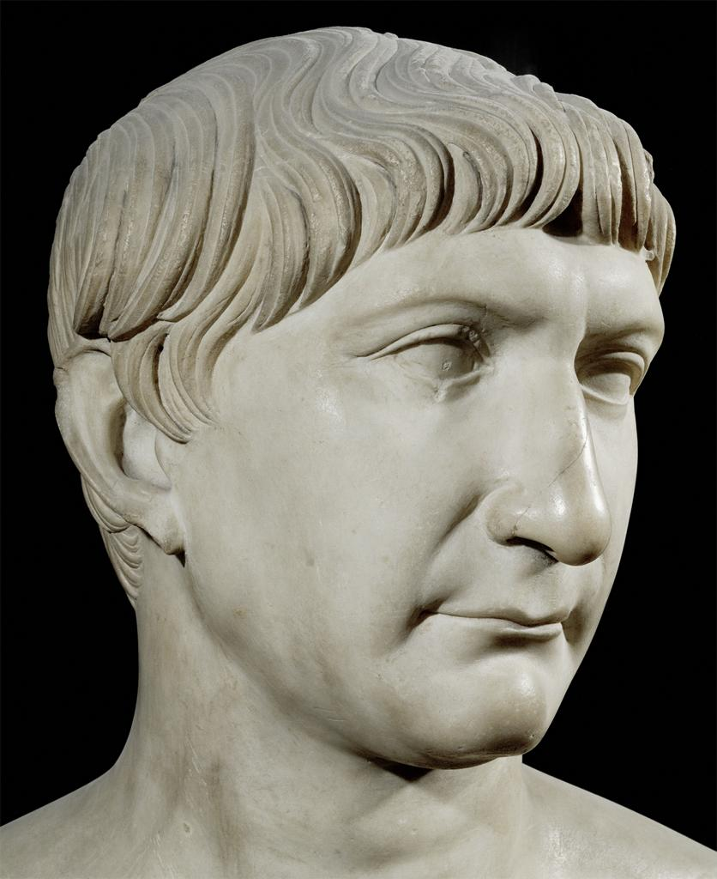
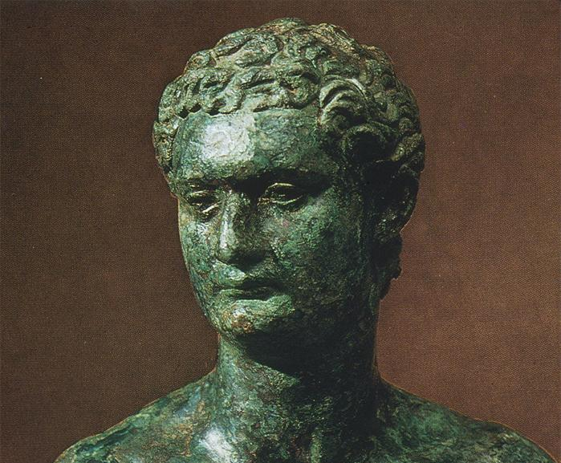
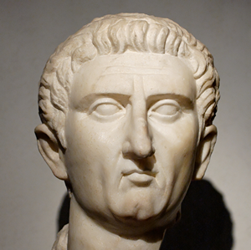
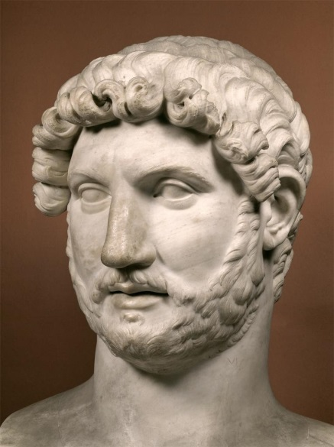
Domitian (r. 81–96)
Trajan (r. 98–117)
(Nerva r. 96-98)
Hadrian (r. 117–138)
Notes:
All that we can say with reasonable assurance about Decimus Junius Juvenalis is that he "was either the son, or the adopted son, of a wealthy freedman, and 'practiced rhetoric till about middle age" (Green's translation, intro., p. 10), and that he wrote probably during the 110s through 120s CE under the emperors Trajan and Hadrian. Though his writing can be nasty and obscene, it clearly is intended for a well-educated, sophisticated audience expecting from our author a highly finished and clever example of satire. So the extremism of Satires 2 and 6 will involve a significant element of poetic self-dramatization, one might say self-fictionalization: the satirist-speaker as both an outraged traditionalist and as an over-the-top bigot.
apart from that, aspects of sat 2 reflect the age of domitian (r. 81-96), particularly as regards his efforts to revive the augustan marriage legislation and to institute a correctio morum, and reform of roman morals. yet domitian, himself evidently a rapist of his own niece, instituted a reign of terror targeting the senatorial (i.e., aristocratic) class.

Slide 19
Sat. 2, 6: Genre, Structure, Theme
Satire 2
Hypocritical moralists…
Philosophers
Cinaedic cinaedus-bashers
Imperial reformer
Pathic lawyer
lex iulia et papia
Roman contagion
Satire 6
Misogyny gone wild…
Pudicitia’s loss
Matrimonial folly
Gallery of women
impure maids
lust for infamia
imperial prostitute
imperious wives
adulterous wives
etc. etc.
Notes:
GENRE: connections to rhetoric and the themes of declamation, philosophical diatribe, older traditions of platonic dialogue. thus a combined disputatious, didactic focus, an ironic preceptor, in sense, like ovid. so, too, discourse saturated by ideology.

Slide 20
Juvenalian Bipolarity?
Traditionalism
“Saturn’s reign” (Satire 6)
Cynicism
“I’d far rather marry a penniless tart than you, Cornelia, Mother / of Statesmen, so haughty a prig for all your virtues, your dowry / weighted down with triumphs” (Satire 6)
Notes:
didactically/dangerously, they feel around the edges of a roman’s tolerance for pleasure whose attractions and dangers must be magnified in culturally meaningful ways for the exercise to mean anything.
they offer, therefore, a kind of mirror of roman attitudes and mindsets, though like looking through a glass darkly.
hence, e.g., in sat. 6, the exaggerated nostalgia for the golden age of saturn’s reign and rome’s beginnings, combined with over-the-top cynicism for an iconic figure like Cornelia, mother of the Gracchi – plus a seemingly complete rejection of all the usual justifications for roman marriage in favor of self-indulgent pleasure with slave boys.
yet at the same time, satiric critique centering traditional morality and familiar shame/honor sensitivities.

