Slide 1
Ancient Athenian Tragedy
Origins, Context, Practice

Slide 2
Today’s readings, do they explain Antigone? How?

Slide 3
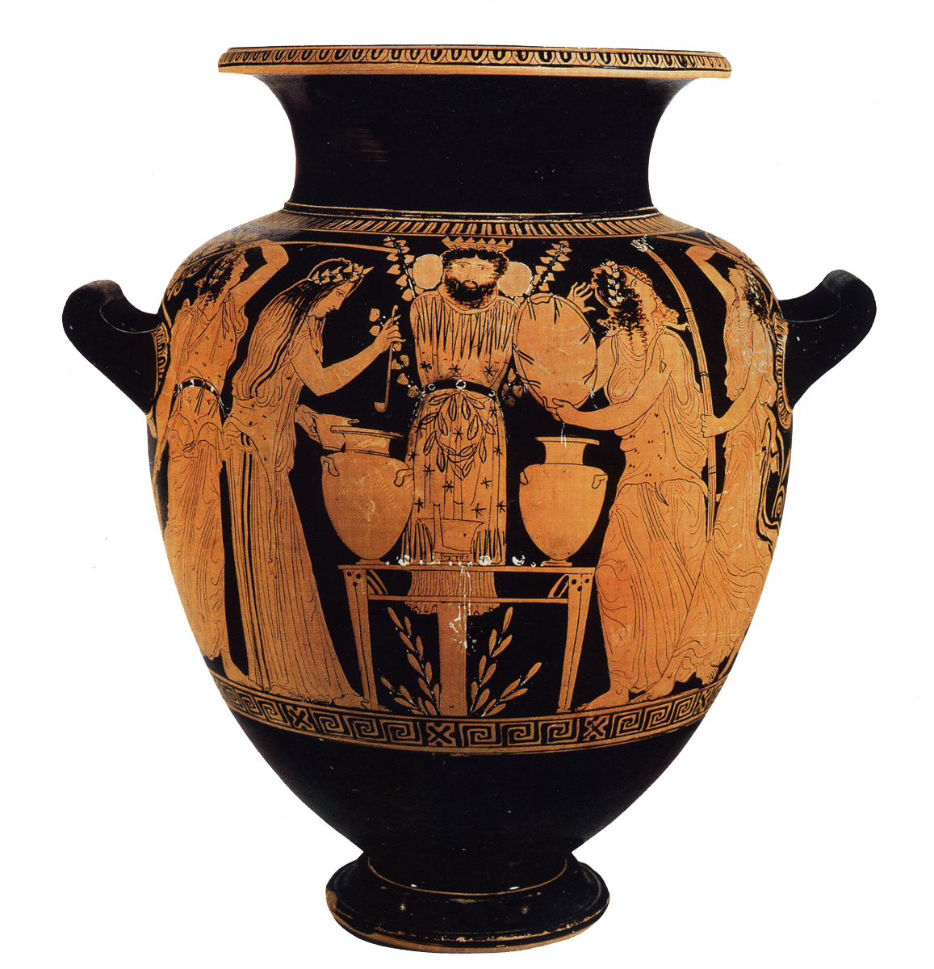
What do you see?

Slide 4
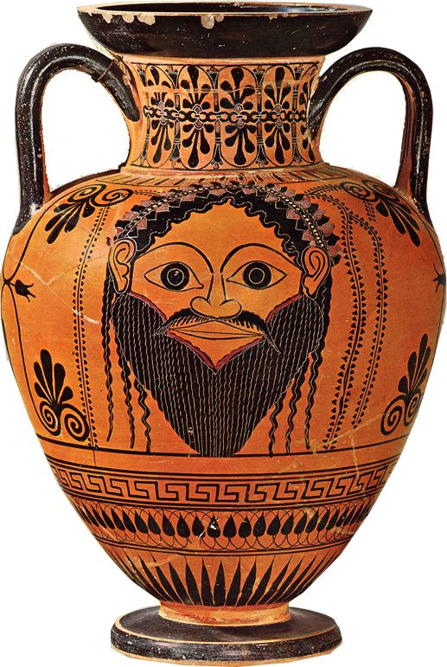
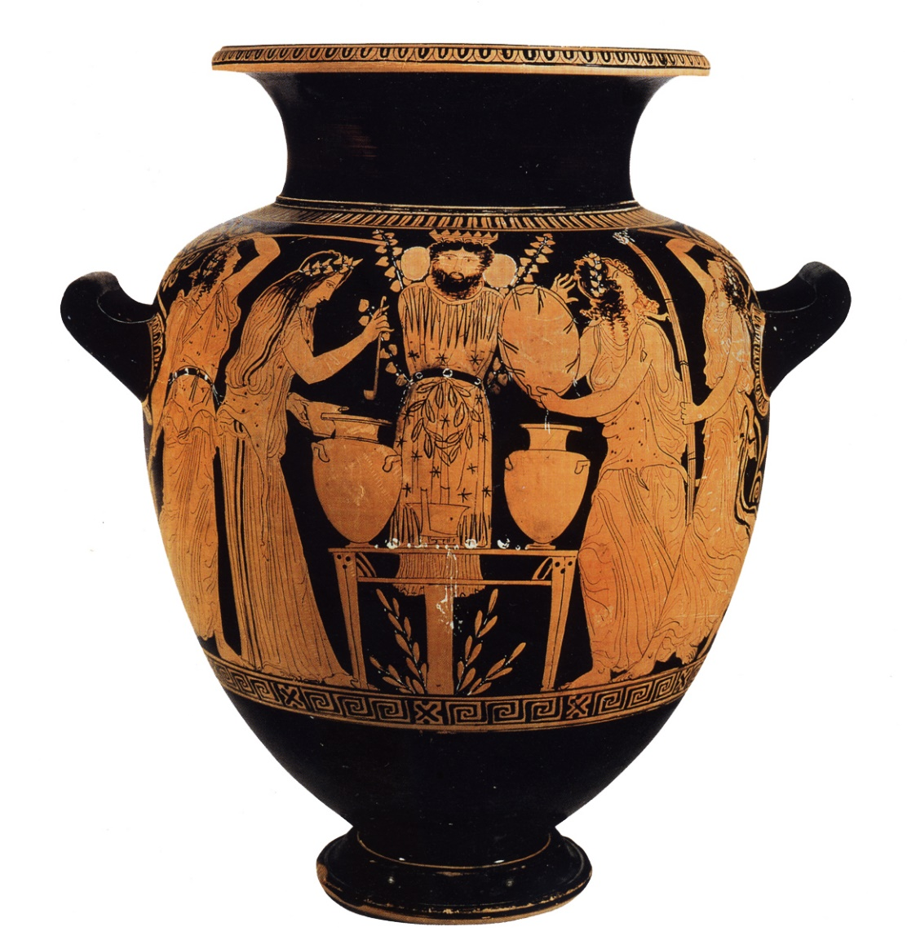
Dionysian Masks
Black-Figure Athenian Vase, 500s BCE
Red-Figure Athenian Vase, ca. 430 BCE
Notes:
masking and impersonation
left, archaic vase with a Dionysos or satyr mask; right an athenian lenaean vase, women dressed as maenads worshipping a Dionysus mask, late 400s bce.
dramatic masks: function
visual/auditory projection?
suppression-concealment?
embodiment-externalization?
surface manifestation
are dramatic masks, considering their cultic origins, going then to be way of
making performer more visible?
submerging personality of performer?
John Jones (On Aristotle and Greek Tragedy):
mask, like the face (prosopon) does not conceal, but imitates and externalizes total personality (prosopon) of the character (prosopeion, prosopon)
Martha Johnson 992
angle of the mask, combined with body stance and gesture, varies emotional expression more powerfully than the unmasked face
ultimately, we are exploring cultural production (here, dramatic literature) as itself a kind of performance, a kind of MASK
so i don’t think we’re going to be trying to “unmask” drama as much as explore its power to reveal, to conceal, to clarify, to distort.

Slide 5
Tragedy: Ritualized Secularism
Dual focus
Ambivalent affirmation
Mythic, archetypal
Contemporary, topical
Dramatists on trial
City on trial
The city represents/judges itself, to/for itself
Notes:
THIS IS THE “TAKE-AWAY” FOR READINGS AS TO THE CONTEXT OF ATHENIAN TRAGEDY. . .
Dual Focus
ancient, mythic, heroic, archetypal
contemporary, political, communal, skeptical
Ambivalent affirmation
Vernant
Hall
Ambivalent affirmation
Vernant
Hall
athenian drama – tragedy especially - as civic-communal experience
Dramatists on trial
City on trial
paraphrasing vernant: "when past heroes become incorporated into contemporary tragedy, they turn into problems and cease to be models“
v quote: "tragedy is a debate with a past that is still alive.“
but cf. “Edith Hall’s notion of tragic dialogue as a polyphony of voices rising up to challenge assumptions cherished by tragedy’s target audience, yet constituting a discourse — that of tragedy — celebrating the very values tragedy put on trial”

Slide 6
Agenda
Tragic Origins
Cult, kōmos, Phallic Procession
Athenian Tragedy
Who, What, Where, When, How
Tragedy Theorized
Aristotle’s Poetics

Slide 7
Tragic Origins
Cult, kōmos, Phallic Procession
Notes:
why does the question of tragic origins matter? i would suggest that it doesn’t matter so much for its own sake. rather, a look into tragic origins – which, it should be emphasized, becomes the same question as GREEK THEATER origins – suggests that at athens and elsewhere, certain THEMATIC resonances. the connection between the dionysian, the tearing down of barriers, esp. between grand tyrants and also, close connections arouse between:
religious worship
collective festivity and performance
impersonation
at athens, we shall see those connections become particularly strong and dynamic in relation to the worship of DIONYSUS. my suggestion later in this lecture will arguably hold relevance to a theory of tragedy as a collective actualization-celebration of imitation .

Slide 8
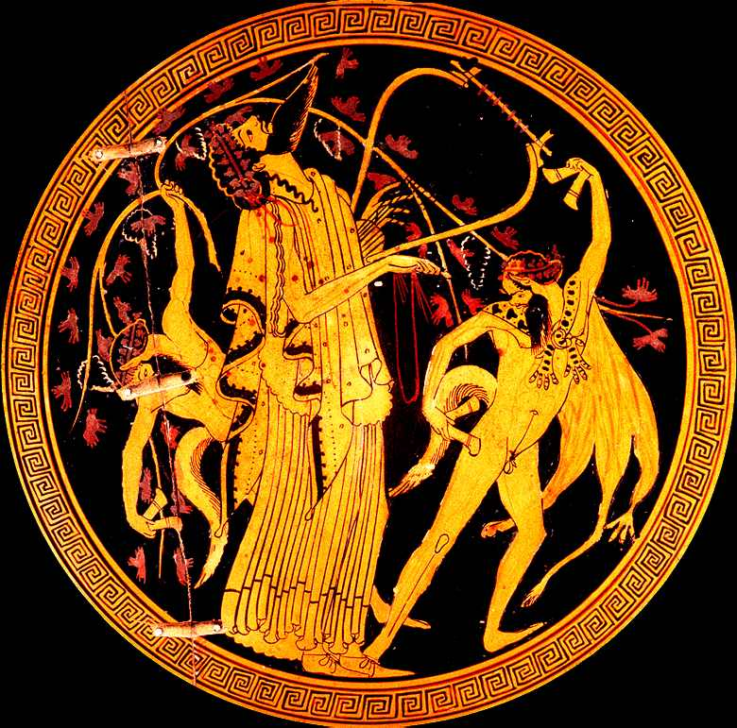
Dionysus with Satyrs, Athenian cup (“Brygos painter”) circa 510 BCE
Notes:
discussions of athenian tragedy need to begin with dionysus. though greek drama doesn’t seem to have arisen exclusively in connection with dionysus (so, for instance, your readings show proto-drama connected with Artemis at the greek city of sparta), at athens and elsewhere, the dionysian connections are extremely strong.
so who – or what – was dionysus?
wine
release
sociality, boundary-crossing

Slide 9
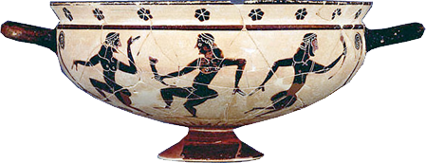
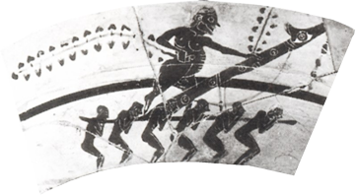
Proto-Dramatic Performance
Kōmos, Satyrs
Phallic procession
Komasts: archaic Corinthian vase
Satyrs, Maenads, Dionysus. Athenian, early 500s BCE
Procession of the Phallus Pole
Notes:
RELEASE, SOCIALITY, IMPERSONATION
kōmos
drunken (not necessarily dionysian) revel
Dionysian procession, often with ritual abuse
evidently, an official term for dramas in classical Athens (csapo)
kōmōidia = “komos-song” or comedy
artistic evidence suggests existence of drama from earlier than our texts
komasts
costumed, masked cult dancers-performers: many parallels, ca. 630 bce-classical times
in Greek world, festivals of Dionysus associated with
padded dancers, satyr-impersonators
i.e., ordinary folk in costume and mask
satyrs
cf. phallic procession, e.g., the bf florence cup showing phallophoria with fatman/komast + satyr figure each side of vase
phallus bearers
costume
masked, phallic
non-masked phallos bearers
ritual mockery of spectators (germ of comedy??)

Slide 10
Athenian Tragedy
Who, What, Where, When, How

Slide 11
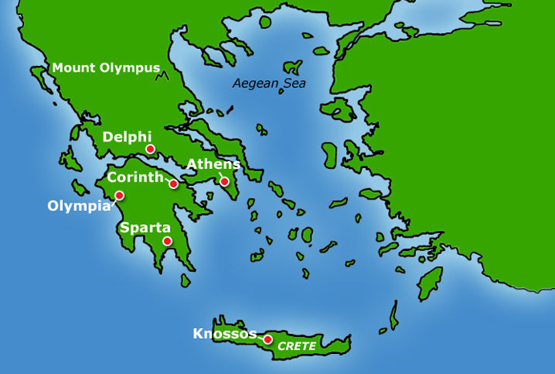
Map of Ancient Greece

Slide 12
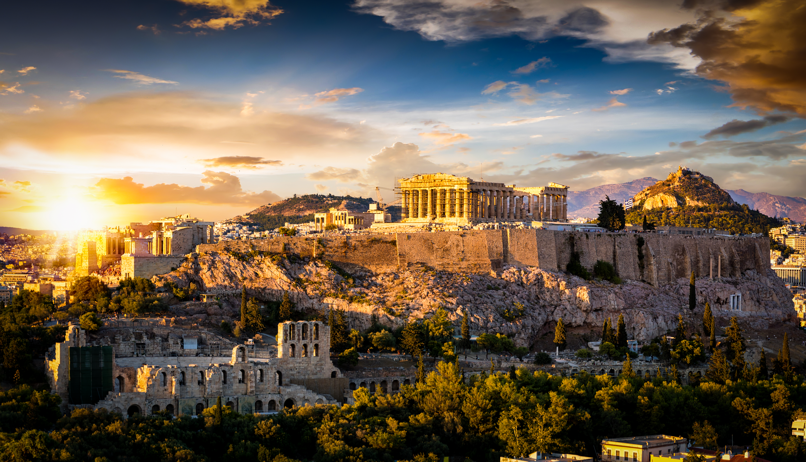
Acropolis, Athens

Slide 13
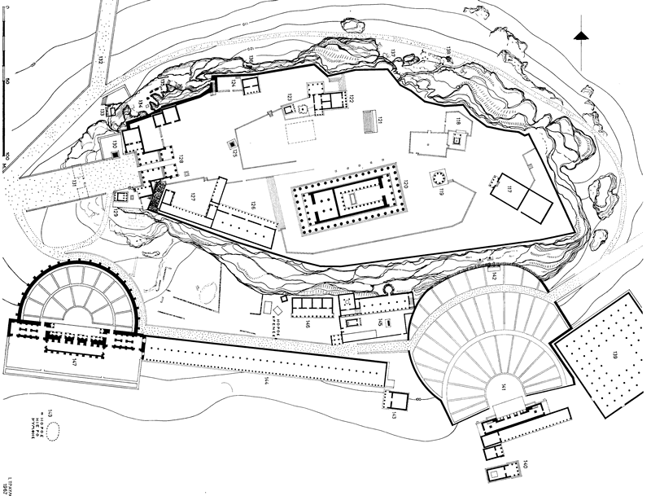
Athenian Acropolis
N
Parthenon
Ōideion
Roman Theater of Herodes Atticus
Temple of Dionysus Eleutherius
Theater of Dionysus

Slide 14
South Slope, Acropolis, ca, 420 BCE
Recital Hall (ōideion) of Pericles
Theater of Dionysus

Slide 15
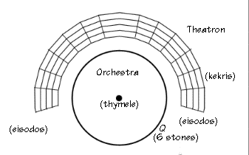
Theater of Dionysus ca. 420 BCE
theatron (“viewing place,” auditorium, theater)
wooden bleachers
stone seats (dignitaries)
orkhēstra (“dancing space” for chorus)
kerkis (“wedge” seating section)
altar
entry (parodos)
entry (parodos)
Low wooden stage with steps, skene (from ca. 420 BCE)
skene (stage building)
Notes:
http://didaskalia.berkeley.edu/stagecraft/greek.html
theatron
outdoor, public space
Theater of Dionysus at Athens: ca. 12-20k capacity
political-civic space
producer (khoregos) a state office
performance, judging, a state function
sacred space
Theater of Dionysus at Athens:
in precinct of Dionysus
seating by tribes (probably). men, women, children (girls??). free and slave. citizen and foreigner. but in comedy, the audience addressed as “gentlemen.” notional audience of citizen men. ideological exclusion of all others. proportion of women could have been low.
BRILL’S:
"... as a type of building, the Greek theatre was a new creation built for a particular purpose, namely, as the place where Greek plays were to be performed (see below III.). In principle, dramatic performances were possible even without the permanent structure of a theatre. It is all the more noteworthy that the first theatres were already being built shortly after the emergence of tragedy toward the end of the 6th cent. BC. The best-preserved early example, dating from around 500 BC, is the theatre of Thoricus in Attica [3], a replica of the somewhat older (but not preserved) Theatre of Dionysus in Athens.“
Common to all the early Greek theatres is the fact that they adapted to the given features of their natural surroundings. For the spectators' area, a natural slope was always chosen; the orchestra (ὀρχήστρα; orchḗstra), i.e. the dance area for the chorus, was a level area laid out in front of the spectators, sometimes with the help of a retaining wall. There were not yet any permanent stage structures. This is shown not only by archaeological documentation but also by the word used for it: skēnḗ (σκηνή, literally 'tent').
circular orch, semi-circ seating no earlier than mid-4th, prob orig athenian.
admission, tickets. at first, admissions, maintainence of the theater, seems to have been contracted out to private companies. admission probably 2 obols, but the state may have subvented admission already from an early date, maybe to control prices more than to guarantee admission (many more potential spectators than seats).
by the end of the 5ht cent bce, the principle dramatic festival, the greater Dionysia, was well attended by foreigners. by the end of the 4th, administering the theater in Athens had become a state monopoly. the chjoregus was responsible for distributing food and drink to spectators. seems to have been a constant supply of wine for spectators. audiences were rowdy. “rod holders” kept them under control.

Slide 16
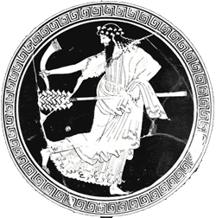
Dramatic-Dionysian Festivals (Athens)
Rural Dionysia (Dec.)
Lenaea (late Jan/Feb)
City/Greater Dionysia (late March)
Dionysus
Notes:
Attic dramatic festivals:
all could (Greater Dionysia did) involve drama
Rural Dionysia (DECEMBER, early jan). phallic processions. some – not all – demes had drama.
Lenaia. JAN. unlike city dionysia, supervised by the king archon. at lenaion, then after 440, at theater of dionysus. non-citizen khorēgoi and choreuts allowed. comedy, tragedy.
tragic khorēgoi responsible only for two tragedies (not three + satyr play)
City Dionysia (LATE MARCH). improved weather promoted international attendance.
non-restrictive audience theater of d could hold 14k – 20k (5-7% of 310k – 110k slaves, 28.5k residnet aliens):
women
slaves
foreigners
boisterous, free food and drink, rhabdooukhoi
theoric fund perhaps as old as 5th cent
prohedria and bleachers until late 4th

Slide 17
City Dionysia: Program
Dramatic preliminaries
“Showtime”
Pre-festival
chorus assignments
Proagōn
“Introduction”
Pompē (procession)
Ceremonies
Dithyramb: 10 + 10
Men’s choruses of 50
Boys’ choruses of 50
Comedies: 5
Tragedy: 3 tetralogies
Notes:
prelims
Assignment of choruses
months earlier, under auspices of the “eponymous archon” for city dionysia (king archon for lenaea), criteria? not known for sure, but clearly not simply quality. past failures could perhaps count against aspiring competitor.
Proagōn (8th elephabolion)
preview of plays, after 440 bce, in pericles’ odeon. playwright, actors, chorus. galanded, no masks or costumes. discussed plays.
“Introduction” processional (on before 9th)
to and from Academy. the icon of dionysus eleutherios, a pole with a mask. for the procession, dressed in costume, garlanded in ivy. carried from temple of d eleuth on n slope to academy. then returned to temple.
10th. Official parade (pompē). citizens, resident foreigners, wine skins and cake baskets carried. finally, men carrying large phalloi – thus a phallic procession. prisons opened, prisoners on bail to attend fest.
the seeming contradiction between leveling and special honors attached to various elements of parade
Preliminary ceremonial
sacrifice of special bull.
theater purified by peristiarchoi using piglet blood
wine libation
public honors to individuals + golden crowns
tribute displayed (until loss of empire)
Poetic/dramatic contests (note that awards were given for first and second place plays. poet and producer (choregos) awarded separate prizes. eventually prizes for actors and pipers. but prizes principally understood as going not to plays but productions. hence criteria for judging neither confined to literary/aesthetic merits of a script, nor really systematized in any way. compare elections for high school office – could have been very much like that. judges chosen, one from each if 10 tribes. there is reason to assume 2 things: (1) that judges considered strongly crowd reaction, and (2) that an element of the judging involved chance.
showtime
At the Dionysia, there were 20 dithyrambs on the first day and five or three comedies on the second day, and the last three days were reserved for tragedies. The tragic poets competed with one tetralogy each. In 5th-cent. Athens, tragedies could only be performed once; an exception was made for Aeschylus' tragedies which were staged again after his death. After 386 it became officially allowed to stage previously performed pieces anew in an agon that was specially created for the purpose (TrGF I DID A 1, 201)."
Dithyrambic choruses (10 + 10)
Comedy (5 plays)
Tragedy (3 tetralogies)
tetralogy = sequence of…
3 tragedies
1 satyr drama
by an individual poet, and presented in a single day
dithyrambic productions by far the most expensive.

Slide 18
Chronology: Athenian Tragedians
525-455 BCE Aeschylus
1st victory 484
2nd actor added
ca. 496-ca. 406 Sophocles
1st victory 468
3rd actor added
484?-406 BCE Euripides
1st victory 441
Solo arias (“monodies”)
Dionysus

Slide 19
Tragic Tetralogy (Greater Dionysia)
Four plays per playwright
Aeschylus’ Oresteia (458 BCE)
1. Tragedy
2. Tragedy
3. Tragedy
4. Satyr drama
1. Agamemnon
2. Libation Bearers
3. Eumenides
4. Proteus
Three playwrights, ten citizen judges
Notes:
csapo 157-160. judging. "one needs to consider the manner in which judging took place and the factors that might influence a judge's decision. above all, one must keep in mind that the perize was not awarded to a play but to a production: though the poet and choregos each won separate prizes, a single decision determined the success of both together."
157 ff. on how of judging. note "degree of public participation and public scrutiny." more like "national elections than ... Nobel Prizes."
efforts to make maximally democratic and minimally corrupt. each of 10 tribes furnish the Athenian council with names. the council approves them. the king archon chooses at random one name from each of ten tribes. for tragedies, perhaps as few as five votes drawn from the jar could determine a sole winner. if a tie, keep drawing until a majority emerges. evidence suggests the non-expert judges responded to audience reactions.
element of sortition and even randomness at the final drawing of votes allowed for Dionysus to enter into the process.
method for determining second and third is harder to conjecture. second and third did not win prizes

Slide 20
Production: Personnel
poet (words, music) | poiētēs, “maker”
producer | khorēgos
director | didaskalos, “teacher”
actors | hupokritai
chorus, “chorus leader” | khoros, koruphaios
piper | aulētēs
All men
Notes:
at some point the number of speaking actors (not silent characters or choreuts) fixed at three. persians requires 2. Oresteia, 3.
institution of acting prizes (449) may have fixed the number permanently. (three actor rule often violated in comedy.)
actors can play multiple roles; roles can be shared by diff actors in a play.
the 3 actors get rank names. (prot, deut trit). only the prot paid by state or qualified to win prize.
CHORUS
decline of use of chorus in Athenian drama. choruses continued to be amateur even when the acting was professional. (amateur chorus out by end of 300s.) khoregoi had powers to compel chorus service – was a burden. serving in a chorus could exempt one from military duty; tragic choruses likely made up of young men.
aeschylus seems to have had a chorus of 12; sophocles to have increared number to 15. quasi-military formations used in their movements –this seems to fit other evidence.
victorious khorēgoi won tripods, which would then be dedicated to Dionysus.
“The decree of the deme Aixone honours Auteas son of Autokles and Philoxenides son of Philippos, successful choregoi for their choregia in the local Dionysia, and awards each of them a 100-drachmai gold crown. The stele was to have been set up in the local theatre (lines 11-13 The relief depicts a young satyr carrying an oinochoe toward a seated figure of Dionysos, who holds a kantharos in his right hand. The satyr is depicted as a nude boy with a short tail. The youthful Dionysos sits on a rock, with his left hand raised and holding a sceptre. A long lock of hair hangs down over his left shoulder, and he wears a wreath. Carved in low relief on the architrave above the relief panel are five comic masks.” Carol L. Lawton, Attic Document Reliefs, Art and Politics in Ancient Athens (Selections). http://www.perseus.tufts.edu/hopper/text?doc=Perseus%3Atext%3A1999.04.0005%3Achapter%3D1%3Acatalogue%3DB%3Aentry%3Dcat154

Slide 21
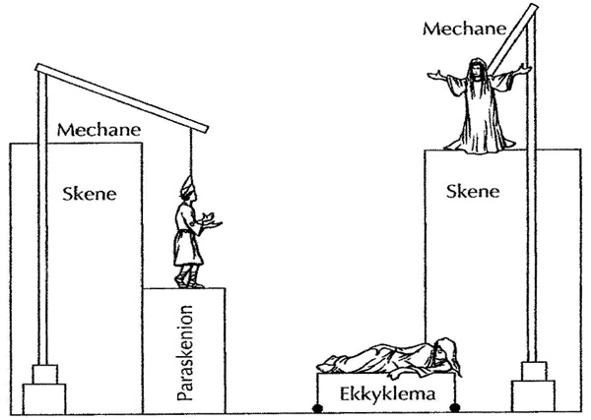
Production: Gear
Masks
Costumes
Music
Props
Scenery
Special effects
mekhanē
ekkuklēma

Slide 22
Tragedy Theorized
Aristotle’s Poetics

Slide 23
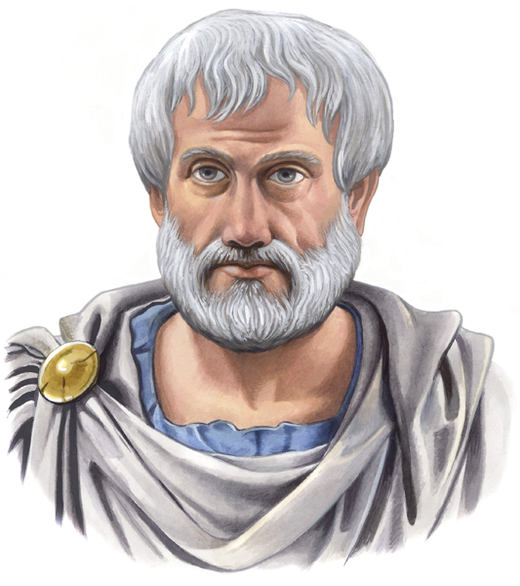
Aristotle
384-322 BCE
Student of Plato
Philosopher, scientist, scholar
Notes:
Aristotle offers 2 benefits for us, given the semester-long class project of developing, both individually and collectively (we’re going to work on this collectively, but in the end you’ll be sharing your ideas with me individually), a theory of tragedy.
those benefits are:
insight into how those in his world, classical Athens, saw tragedy – how it resonated with them and their world.
starting point – positive and negative – for a theory of tragedy.
ari’s theoretical contribution is basically critical: he wants to systematize criteria, standards, according to which specific tragedies (and other poems) are to be evaluated/assessed.
not so much about the how to of tragedy-writing, though you could take those criteria as prescriptions.
but the poetics also seeks to set forth what tragedy (and other poetry) is, to describe its nature.

Slide 24
Poetics: Aims
To theorize tragedy
To defend tragedy
To educate audiences
To educate poets (??)
Notes:
To theorize tragedy
definition, aim (imitation), elements, etc.
To defend tragedy
against charge that imitation is deceitful/untruthful. that tragedy is vulgar (in comparison to epic)
116. against the suggestion that tragedy inferior to epic, basically, around the question of drama's reliance on visual elements of performance: gesture, etc. tragedy the "younger" and thus less legit poetry; epic more "cultivated." responds to association of tragedy with vulgar, epic with refined entertainment. social-political class thing in that. thus the poetics is partly about how to tragedy can be seen as classy.
117. but tragedy perfectly capable of being read just like epic, and just as vivid thus. plus, more concentrated and unified. ergo, tragedy higher
118. poetics as answer to "critics"
To educate audiences
to make them critics of tragedy superior to vulgar, democratic judging
To educate poets (?)

Slide 25
Aristotle: Evolution of Tragedy
Phallic procession → poetic imitation
Improvisation → through-composition
Rude → refined imitation
Satyr-play-like drama → tragedy proper
“Tragic” epic (Homer) → tragedy proper

Slide 26
Aristotle on Genre Distinctions
Tragic
Not Tragic
Imitative
Poetry
Dialogic-dramatic
Serious-elevated
Truth (tragedy)
General-philosophic
Non-imitative
Prose
Narrative (epic poetry)
Low-vulgar (comedy)
Truth (history)
Specific-factual
Notes:
Serious-elevated. e.g., vis-à-vis characters.

Slide 27
Poetics: Elements of Tragedy
Plot (Greek muthos, like “myth”)
Character
Diction
Thought
Spectacle
Song
Notes:
Plot (muthos)
its completeness has to do with its having beginning, middle, end. its magnitude needs to be in between for it to be beautiful. you need to be able to comprehend it all at once, such that parts won't disappear from memory. plus, long enough to involve a change of fortune.
63. reversal and recognition as the most "powerful" elements of plot action.
Character
"Character reveals moral purpose”
Diction
Thought
"the faculty of saying what is probable and pertinent in given circumstances." as in political rhetoric (thought closer to logical or rhetorical argument)”
Spectacle
depreciation of spectacle suggests we may be more concerned with texts than with performance. note how near end ari notes that you can read just as well as watch a tragedy
Song

Slide 28
“Tragedy, then, is an imitation of an action that is serious, complete, and of a certain magnitude; in language embellished with each kind of artistic ornament, the several kinds being found in separate parts of the play; in the form of action, not of narrative; through pity and fear effecting the proper purgation (katharsis) of these emotions.”
Notes:
fear is connected to the "relatability" of a character's suffering.
pitiful action. friends killing friends/close relatives more pitiful. (ari would have us believe this inherently more tragic, and thus the nature of the tragic determined that tragedy would favor the kinds of downfall-of-a-house type plots that it did.) in composing plot, poet should leave basic framework of incident as-is, but show invention in the details. the relationship between recognition and realization. (not the same as "recognition.") best deed is perpetrated in ignorance, realization later.

Slide 29
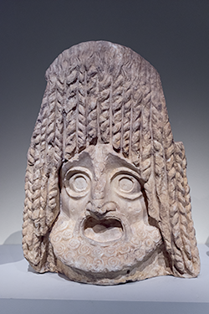
Parts of Tragedy (part xii)
prologue
parodos
stasimon (plural, stasima)
kommos (plural, kommoi)
exodos

Slide 30
Plot
Less Good
Better
Episodic
Simple, lacking…
Reversal (peripeteia) and/or
Recognition (anagnorisis)
Diffuse
“Epic” time-span
Multiple story lines
Logical, plausible
Complex, possessing…
Reversal (peripeteia) and/or
Recognition (anagnorisis)
Unified
24-hour time-span
Single story line
Notes:
WHAT’S THE VALUE-ADDED OF ARI’S POETICS? WHAT’S THE TAKE-AWAY?
basically, a theory of tragedy that begins help us understand it in relation to its ancient historical development and ancient ways of experiencing it.
but also a theory of it that combines notions of its utility with pleasure3 derived therefrom – indeed, a way of theorizing pleasure as, potentially, at least, pleasurable.
87. how best to go about conceiving a plot.
90. complication, unraveling. complication = plot up to reversal. then unraveling.
reversal should concern "the character between these two extremes [the very noble and the very wicked] - that of a man who is not eminently good and just, yet whose misfortune is brought about not by vice pr depravity, but by some error or frailty [hamartia]." but aristotle means mistake. (76)
79-80. we're seeing recognition not simply of another's identity, but with that, of the moral implications, previously unknown, of a given action as connected to identity. so for instance there is no recognition in antigone, strictly speaking. but there is a point in the play when the delusion falls away from creon and he realizes just what he has been doing: he has been destroying himself, and it is his self-wrought reversal he notices. this dimension of learning in characters and in spectators only lightly touched on in ari, but a central theme of the tragedies themselves. see p. 85.
84. on recognition. relatively unimaginative-artistic: from tokens. (atekhnoterai.) this is about either recognition of, or employment of, tekhne, technical skill.
85. even less artistic, blatant "i am." (i.e., artificial.) ari likes recognition by inference. note that recognition can be of fate etc., not just ID.
86. best: from plot action - e.g., soph's OK.

