Slide 1
The Masks of Dionysus
Euripides Bacchae 2

Slide 2
Agenda
How to Play?
Pentheus’ Maenadic Rehearsal (4th episode)
Recap and Update
Aristotle, Dionysus, Antigone, Bacchae
What Does Bacchae Say About...
Gender and Ethnicity?

Slide 3
How to Play?
Pentheus’ Maenadic Rehearsal (4th episode)

Slide 4
“Imbue him with a dizzy fantasy. / Sane, he never will consent / to put a woman’s clothing on.” (Dionysus to Chorus, p. 430)

Slide 5
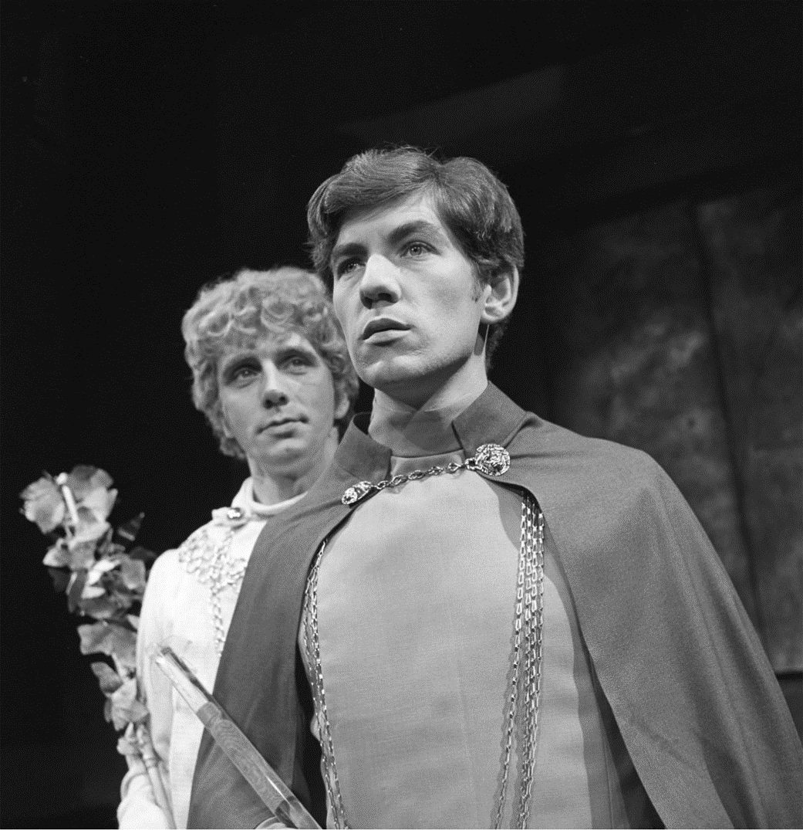
Signet pp. 432-436 ≈ Kindle 8564 ff.
Ian McKellen, Pentheus. Desmond Gill, Dionysus-“Stranger.” 1969
Notes:
pp. 432 ff.
play it for laughs?
problem of transformations – esp pen. credible?
problem of gender issues – are roche’s (not Euripides!) stage directs workable this day and age? (1960s/70s)
Dionysus, is he now evil? is the bull necessary?

Slide 6
Lost in Translation?
DIONYSUS: Come on out, you perverted man, so passionate for what is not for sight and acts that are not right . . .
Literally:
“You who are eager for what it is not right to see, seeking what should not be sought....” (Euripides Bacchae lines 911-912)
Notes:
Lesson? Translation is always interpretation.

Slide 7
Recap and Update
Honig, Aristotle, Dionysus, Antigone, Bacchae

Slide 8
Readings in Honig Antigone, Interrupted
Finding meaning that may or may not have been meant to be there?
Notes:
The line “You always think there is more to things than there is” really struck me because that is most of the work that I do at university: finding meaning in things that may or may not have been meant to be there.
interpretive paradox: interpretation always involves added meaning.

Slide 9
“Numberless Wonders”
Numberless wonders
terrible wonders walk the world but none the match for man. . . .
Man the master, ingenious past all measure
past all dreams, the skills within his grasp— he forges on, now to destruction
now again to greatness.
(polla ta deina chorus, 1st stasimon, Sophocles’ Antigone)
Notes:
numberless wonders: Is the chorus already commenting on the ending of the play here, near the beginning? Or could this (also?) be them just trying to process things before they have the full picture?
seaford v aristotle. ari clearly won! what’s the seaford about and how might it relate to antigone??

Slide 10
Dionysus, Dionysianism, Bacchae
Dionysian initiation
Maenads, bakkhoi
Cross-dressing
Mystic knowing
Ritual rebirth
Rapture
Sparagmos, Omophagia
Oresibasia
Thyrsus. . .

Slide 11
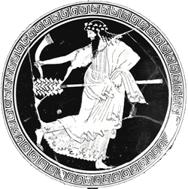
Dionysus and Antigone?
“Nothing to do with Dionysus!” (Quoted by Chamaeleon, fr. 38. Criticism of “tragic” Athenian tragedy?)
Dionysus

Slide 12
Dionysus, Dionysianism
Dionysian initiation
Maenads, bakkhoi
Cross-dressing
Mystic knowing
Ritual rebirth
Rapture
Sparagmos, Omophagia
Oresibasia
Thyrsus. . .

Slide 13
Euripides’ Bacchae: Analysis
prologue (starts p. 395)
Dionysus
parodos (398): “Asian” (modern Turkey) Bacchants. Cult hymn
1st episode (402)
Tiresias, Cadmus, Pentheus
1st stasimon (412)
Pentheus’ impiety
2nd episode (414)
Servant, Pentheus, Dionysus (in disguise)
2nd stasimon (417)
Thebes’ rejection of Dionysus
Choral dialogue (418): Chorus & D
Earthquake
Trochaic dialogue, D & Leader (420)
“messenger” scene
3rd episode (422)
Short dialogue, D&P
Messenger scene: hubris in the hills
Notes:
prologue (starts p. 395)
Dionysus. I am changed, a god made man, d’s boundary-crossing aspect. cf. dress-up, geographical-cultural boundary-crossing, etc. he is a foreign god (“I come from Lydia” etc.) coming to conquer Greece. yet he is a native greek. (barbarian-greek divide.)
parodos (398): “Asian” (Anatolian) Bacchants. Cult hymn. celebrates the double birth of god: at thbes, on crete (p. 400, “p chamber of curetes”)
1st episode (402)
Tiresias, Cadmus, Pentheus. note the comedy of c and t, old geezers, done up in Dionysian garb.
tir: humanity has 2 blessings: demeter (earth, food), d (wine). encomium of wine: anodyne, soporific. the wine is d and vice versa. when we drink we are possessed.
286. t defends myth of 2ble birth. a mystic interpretation hinging on pun: meros/homeros. z, harboring d on olympus and thus angering hera, gives to h a piece of sky (aither) as "hostage." but the crowd understands that as meros, "thigh." the myth associates dionysus with the heavenly element, i.e., with zeus. aither is used to make the facsimile of helen, too. note that this interpretation is important: d is the god of facsimile, of the simulacrum. there is, in a sense, no real god there, only air. the process of imitation manifests the god.
1st stasimon (412)
Pentheus’ impiety
2nd episode (414)
Servant, Pentheus, Dionysus (in disguise)
soldier describes the miraculous escape of the Bacchae. note the quasi-sexual appreciation of d’s implicitly effeminate beauty. yet d is the bull god, the roarer, the quintessentially phallic deity. d plays at being an emissary of himself. he is playing someone other than himself, yet in so doing at a deeper level is very much himself. (p casannot see the god though he is looking at him – d is “where I am.) you are d if you are not yourself. this is the essence of Athenian drama.
2nd stasimon (417)
Thebes’ rejection of Dionysus
Choral dialogue (418): Chorus & D
Earthquake. self-freed’s power. adoration of him by bacchants.
Trochaic dialogue, D & Leader (420)
“messenger” scene. d describes his destruction of the palace of pentheus. note that the women, the bacchants of Anatolia, think d is a human worshipper of god. god’s playacting.
3rd episode (422)
Short dialogue, D&P
Messenger scene: hubris in the hills. the foreign women of the chorus are in town. the women of the town have burst free and, led by the royal sisters, wreak hubristic havoc in the countryside. here the fennel rods-thursoi-prove truly hubristic.

Slide 14
Analysis (con’t)
3rd stasimon (431)
Hope restored, do not mock the god
4th episode (432)
D&P. Pentheus’ maenadic make-over
4th stasimon (436)
Excited song of vengeance
5th episode (438)
Messenger (servant on death of Pentheus)
5th stasimon (442)
Short song of triumph
exodos (443)
Agave’s mad scene
lyric dialogue
Cadmus’s return with Pentheus
recognition, reversal
Lament for Pentheus
[“6th choral ode,” added by translator]
Deus ex machina
Notes:
[first briefly review plot devleopments of second half of play]
4th episode (432)
D&P. Fitting scene
4th episode. ritual feminization preceding p's death. but also representing a stage in p’s “initiation” into the mysteries of dionysus. initiation itself as a kind of ritual death. p sees double. to him d seems a bull. tyrannical-masculine-aggressive p now feminized, effeminate d now hyper-masculinized. p now wants to be publically conducted through thebes. public ritual humiliation.
one is tempted to ask whether that scene serves properly as comedy or tragedy. but the comic element is sort of unmistakeable. yet this is no comic relief with low characters on stage, as in shakespeare, whatever else, this has to be made to fit into the play’s tragic trajectory!
5th episode (438)
Messenger (servant on death of Pentheus)
messenger speech. p's killing by bacchants. p's curiosity. d's miraculous strength as he pulls down tree. d disappears to address thiasos from sky. women go to pelt p etc. (fail), then to uproot tree. p, a "climbing animal," believed will spread secrets. sparagmos and near omophagia, ironically, of agave’s own son.
3rd stasimon (431)
Hope restored, do not mock the god
this choral number offers a point of departure pondering the moral horizon against which the play looks upon the behavior of a p. on the one hand, the obvious: honor the gods if you don’t want to incur their wrath. but wouldn’t p and others have followed that in d’s regard had they just known? maybe it was their arraogance that made them blind, but it’s not at all clear that p and others had more to work from than the claims of Semele.
competition between agave and her sisters for chief honors in the hunt may offer insight. the sisters participate sort of on equal footing with others in their unrestrained celebration of god. but their competition suggests competition within the family for preeminence. just as p suspects the “stranger” competes with him, just as creon and later oed suspect challenges to their power. just as d, also a member of this messed up family, sees p as a impediment to his power at thebes.
so we seem to have something like one of the chief conflicts moving the plot of soph’s ant forward: paternalist power versus the world of women and of the gods. again, a dialectic dramatizing the extremely painful birthpangs of a political and social order retaining patriarchy but subsuming the household and the gods within it. note how acceptance of Dionysus is the acceptance of what is simultaneously domomestic and foreign. through the punishment of p and of ag and family, honoring the gods and attendant benefits will no longer be a mere matter of luck.
exodos (443)
Agave’s mad scene
lyric dialogue
agave’s call to the feast – no entirely explicit, but clearly to feast on Pentheus. (omophagia).
cf.also below
Cadmus’s return with Pentheus. Lament for Pentheus
Cadmus “Murder is what your tragic hands have done. Beautiful the victim cut down by the gods: the sacrificial feast you call me to and Thebes.”
agave comes to her wits, knowledge too late. agave and everyone’s reversal. the kissing scene is also kind of sick
[the chorus p. 452 was made up by the translator]
Deus ex machina
deus ex machina (ex tecto??). (had already begun in lost segments with establishment of cult. translator wrong in rejecting lines. Cadmus and Harmonia to become snakes, to drive chariot to barbarian land. shall lead barbarians in attack on delphi. shall die and be transported to the islands of the blest.
“DIONYSUS: Too late to know me now; you did not when you should.” (knowledge too late)

Slide 15
4th Stasimon (“Choral Lyric”)
Dochmiac rhythm:
♪ ♩ ♩ ♪ ♩ ♪ ♩ ♩ ♪ ♩
⏑ − − ⏑ − ⏑ − − ⏑ −
“The old kan-ga-roo, he lives in the zoo.”
♪♪ ♪ ♩ ♩ ♩ ♪ ♪ ♪ ♩ ♪ ♩
ite thoai Lussas kunes, it’ eis horos
“Hurry you hounds of hell to the mountains where The “daughters of Cadmus hold their wild seance ...”

Slide 16
4th Stasimon (“Choral Lyric”)
“Hurry you hounds of hell to the mountains where The
“daughters of Cadmus hold their wild seance.
“Worry them into a frantic trance Against the man
“disguised in the dress of a woman:
“A roaring one who comes to spy on the Maenads.”
(p. 436 ≈ Kindle location 8646)
Notes:
⏑ ⏑ ⏑ − − − ⏑ ⏑ ⏑ − ⏑ −
Χο. ἴτε θοαὶ Λύσσας κύνες, ἴτ’ εἰς ὄρος,
⏑ ⏑ ⏑ − ⏑ − ⏑ − − ⏑ −
θίασον ἔνθ’ ἔχουσι Κάδμου κόραι·
⏑ − − ⏑ ⏑ ⏑
ἀνοιστρήσατέ νιν
⏑ ⏑ ⏑ − ⏑ − ⏑ − − ⏑ −
ἐπὶ τὸν ἐν γυναικομίμωι στολᾶι
− − − ⏑ − ⏑ − − ⏑ −
λυσσώδη κατάσκοπον μαινάδων.

Slide 17
Aristotle and Bacchae
concept | Bacchae
ēthos “character” (Pentheus)
hamartia “error”
desis “complication”
lusis “unraveling, solution”
anagnorisis “recognition”
peripeteia “reversal (of fortune)”
katharsis “purification”
learning?
pleasure?
Notes:
ethos “character” (Pentheus)
character traits revealed through speech and action, and thus presumed to motivate same.
arrogant, paranoid. very much like a creon. misogynist? (we’ll have more to say about pentheus next class.)
hamartia “error”
what is pentheus’ tragic mistake? it is surely to have resisted the worship of the god. mistake of agave and her sisters? to accuse Semele of an illicit human union – again, to deny the god.
note how this is hubris—insult—for the god.
desis “complication”. this can include external and internal devleopments.
thus surely the arrival of Dionysus and his new cult – what that means for thebes. but the family is clearly enmeshed in all sorts of dysfunction—anticipates the later line of labdacus (Cadmus => polydorus => labdacus [Chrysippus story] => Laius => Oedipus)
one way – not exactly Aristotle’s – is to view tragic action as less a solution to a desis than an atonement/purification [quasi-aristo] – see next.
lusis “unraveling, solution”
all the action leading to calamities experienced by … more soon.
anagnorisis “recognition”
more soon. but is there non-recognition in the scenes we have read?
peripeteia “reversal (of fortune)”
more soon
catharsis “purification”
more soon
learning?
more soon
pleasure?
more soon. [what’s fascinating is that the play dramatizes dress-up, impersonation, and spectating – all of which p does. p is tragedy….]

Slide 18
What Does Bacchae Say About...
Gender and Ethnicity?
Notes:
LEADER: [in a cry of triumph]
Lord Bromius, your godhead is made manifest. MESSENGER: What was that?
Woman, do you mean to say my master’s end can give you
joy? LEADER: Oh, let me shout my song in foreign tunes:
a foreigner who need no longer tremble in fear of fetters. MESSENGER: But do you reckon the men of Thebes such cowards
that . . . LEADER: It is not Thebes but Dionysus, son of Zeus, who rules
me.
ETHNICITY
Cadmus is foreign
dio is quasi-foreign
the hubris is distributed
pen’s et al’s “bad” hubris
dio’s and the Bacchae’s “good” hubris?

Slide 19
In Bacchae, Is Dionysus...
Greek?
Foreign? (barbarian)
Masculine?
Feminine?
Dionysus

