Slide 1
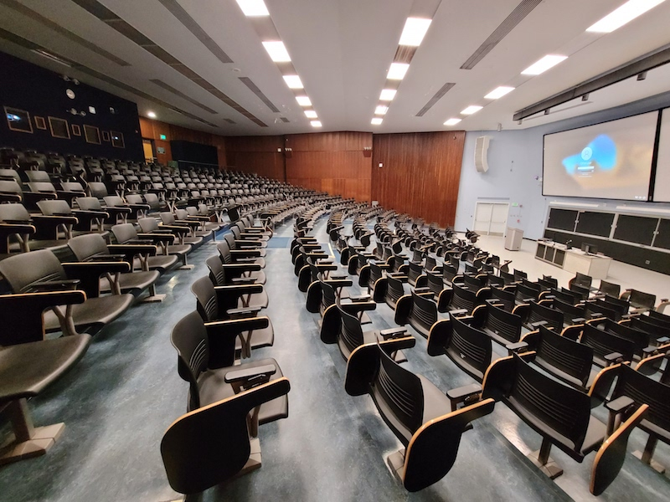
Team CLY on LEFT
Judges FRONT CENTER
Team OREST on RIGHT

Slide 2
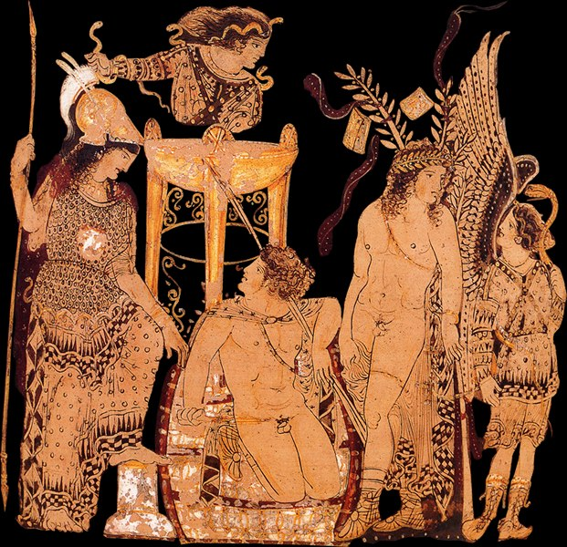
Aeschylus’ Eumenides
Closure at Last?
Notes:
Tragedy a vehicle for putting the city and society on trial, whether for the purpose of validation, critique, or both. So, for instance, Edith Hall’s notion of tragic dialogue as a polyphony of voices rising up to challenge assumptions cherished by tragedy’s target audience, yet constituting a discourse — that of tragedy — celebrating the very values tragedy put on trial. (Concordia Discors) Agamemnon as such a tragedy, one that validates the city and its institutions, yet challenges cherished assumptions
FURIES: And the brutal strife,
the civil war devouring men, I pray
that it never rages through our city, no
that the good Greek soil never drinks the blood of Greeks,
shed in an orgy of reprisal life for life -
that Fury like a beast will never
rampage through the land.
Give joy in return for joy,
one common will for love,
and hate with one strong heart:
such union heals a thousand ills of man. chorus p. 274.
Aeschylus. The Oresteia: Agamemnon; The Libation Bearers; The Eumenides: Agamemnon, The Libation Bearers, The Eumenides (Kindle Locations 3742-3746). Penguin Publishing Group. Kindle Edition.

Slide 3
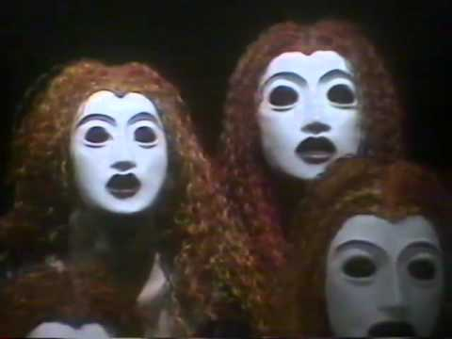
ATHENA: My thanks! And I will speed your prayers, your blessings -
lit by the torches breaking into flame
I send you home, home to the core of Earth,
escorted by these friends who guard my idol
duty-bound.
...
... Girls and mothers,
trains of aged women grave in movement,
dress our Furies now in blood-red robes. (p. 276)

Slide 4
Is Eumenides tragedy? Is Oresteia tragedy? What is tragedy?

Slide 5
Agenda
Cold Open
Justice triumphs — yay?
Tragedy in Performance
Clytemnestra, Furies, pp. 236–238
Recap & Update
From Darkness to Light
Justice on Trial
Eumenides Debate
Notes:
That in essence is our project for today, namely, to ponder the lusis, the “resolution” this play, Aeschylus’ Eumenides, proposes to the great complication posed in the Oresteia by justice-as-hubris – and to consideration that resolution from multiple standpoints:
the political.
the social.
the gender-related.
so, is justice in the eumenides “just”? does the play, as aristotle stipulates it should, resolve the complications, indeed, paradoxes, posed earlier? and if, in so doing, it achieves its goal without the aid of some horrific catastrophe, if the play, the cycle of three plays, actually ends happily, is this really tragedy.
which reminds me, what is tragedy?
well, i hope that by the end of today’s class we’re just a little closer to knowing. in the process, we can expect to address the following. . .

Slide 6
Tragedy in Performance
Clytemnestra, Furies, pp. 236–238

Slide 7
CLYTEMNESTRA: Hear me, I am pleading for my life.
Awake, my Furies, goddesses of the Earth!
A dream is calling — Clytemnestra calls you now.
FURIES: (sleepily) Mmmmmmmmm...
CLYTEMNESTRA: Mutter on. Your man is gone, fled far away.
My son has friends to defend him, not like mine.
FURIES: (louder) MMMMMMMMM!...

Slide 8
They mutter again. You
sleep too much, no pity for my ordeal.
Orestes murdered his mother — he is gone.
FURIES: (still louder) GRRRRRRRR!...
CLYTEMNESTRA: Moaning, sleeping — onto your feet, quickly.
What is your work? What but causing pain?
Sleep and toil, the two strong conspirators,
they sap the mother dragon’s deadly fury —
FURIES: (very loud) labe labe labe labe phrazou!

Slide 9
Recap & Update
From Darkness to Light

Slide 10
Eumenides: Analysis
Prologue 232 ff.
Pythia, Apollo, Orestes, Clytemnestra, Furies
1st parodos 237 f.
Furies mad for the hunt
1st episode 238 ff.
Apollo, Leader – angry exchange
2nd parodos 242 f.
Track Orestes to Athens!
2nd episode 243 ff.
Orestes, Leader
1st stasimon 245 ff.
Binding song
3rd episode 248 ff.
Athena, Leader, Orestes
2nd stasimon 253 ff.
“Furious” justice
4th episode 255 ff.
Agon (trial). Athena, Apollo, Leader, Orestes
Lyric agon 266 ff.
Athena speaking
Chorus singing
5th episode 270 ff.
Athena, Leader
Blessing song 272 ff.
Athena chanting
Chorus singing
Spoken transition 276
Athena
Lyric exodos 276 f.
Chorus of Athena’s cult personnel
Closing triumphal parade

Slide 11
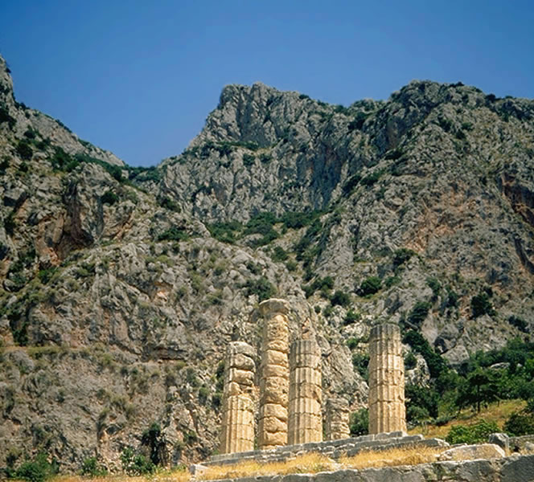
Temple of Apollo, Delphi
Notes:
Πρῶτον μὲν εὐχῇ τῇδε πρεσβεύω θεῶν
τὴν πρωτόμαντιν Γαῖαν
“First of the gods I honour in my prayer is Mother Earth, | the first of the gods to prophecy, and next I praise | Tradition, second to hold her Mother’s mantic seat…”
Speaking the prologue is the Pythia, the priestess of Apollo and mouthpiece for the god's prophecies. She is in Delphi, at the temple of Apollo at Delphi, and is telling about the succession of gods who have ruled over this place of prophecy: Mother Earth, "Tradition" (Themis), an unnamed female Titan (early race of Greek gods), yet another Titan named Phoebe, Phoebe's grandson Apollo (aka, Phoebus — Phoebe and Phoebus mean "bright").

Slide 12
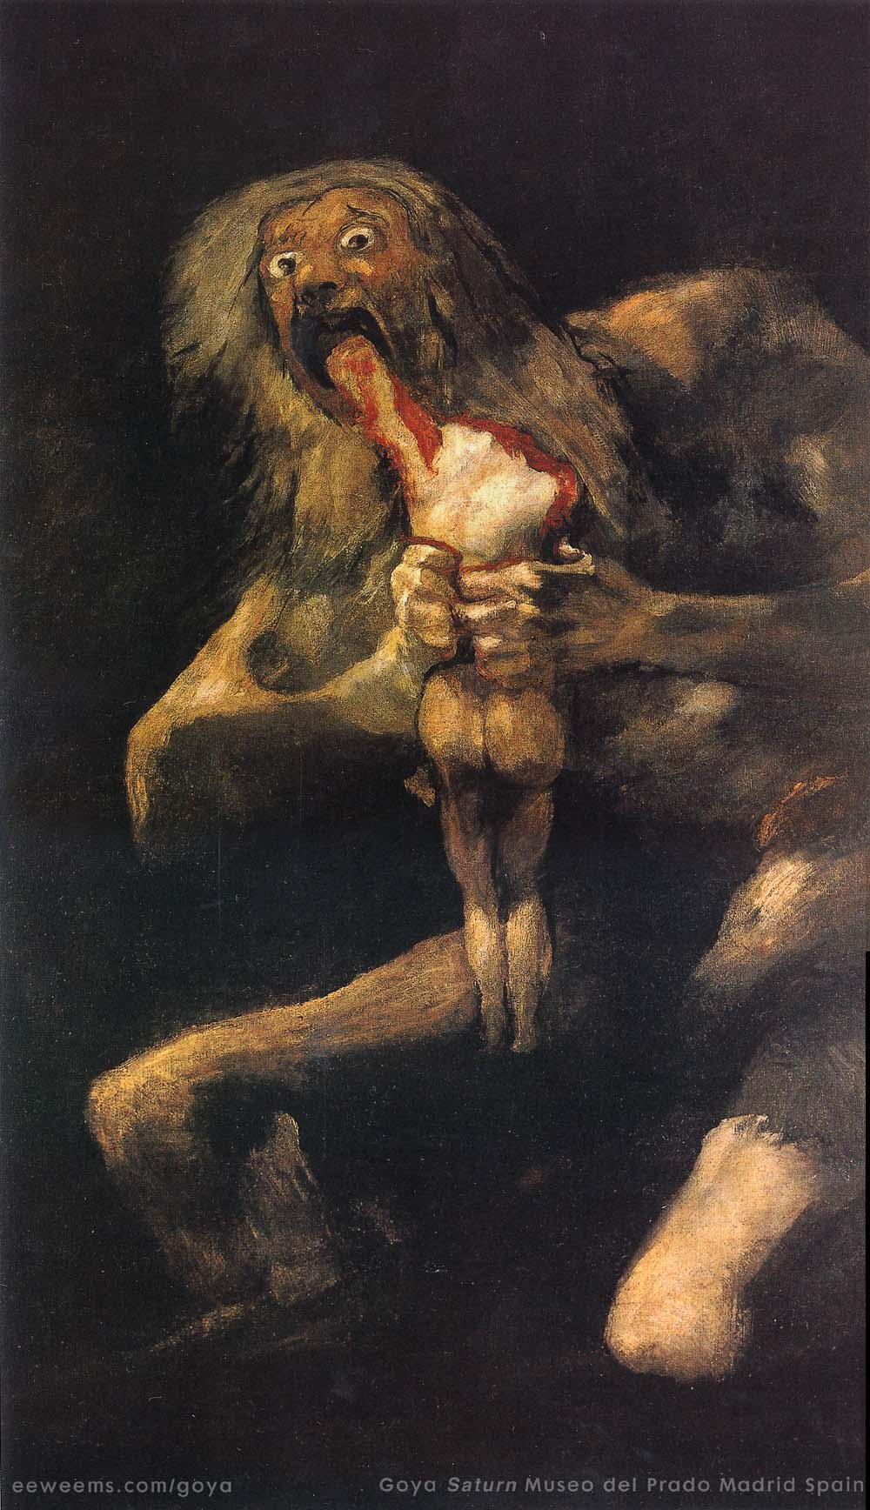
SUCCESSION MYTH
Ouranos (sky) sexually smothers Gaia (Earth)
Kronos (Titan) castrates father Ouranos, eats his own children (Olympian gods).
Zeus (Olympian) overthrows Kronos, forces regurgitation of other Olympians, rules universe.
Notes:
What is interesting is that this account changes the usual one, which has Apollo violently evict Earth or Themis from Delphi. is that a deliberate act of suppression, of divine propaganda, by the Pythia and her boss, the god Apollo? Hard to say. what we can say is that the story unspoken by the Pythia, that of a sky god wresting control of this holy place, the center of the world, from an earth god, maps elements of another myth, one relevant to this play: the succession myth, according to which … "Such is your triumph, you young gods. . .,“ to quote a fury on p. 238.
The Pythia, in other words, seeks to put in place a narrative legitimizing her master’s place in the larger scheme of things – a narrative suddenly thrown into confusion by the arrival of the Orestes hounded by a horde of snakey haired Erinyes, earth goddesses charged with punishing blood guilt, and deities, as we later learn in today’s play, closely allied to the forces of the earth (just as the titans were) and deeply at odds with the current regime of Olympians ruling the world.
put differently, the play dramatizes a primeval mythological struggle as a political struggle of the here and now, a struggle that cannot but affect the race of humans dwelling upon the earth—a struggle pitting wife against husband, mother against son, god against god, and justice (the system of vendetta justice) against justice, a new system of judging to emerge from the play’s action.
so this is the play that seeks to bring closure to this ongoing nightmare of violent vendetta – will it work? will satisfying justice and a lasting peace be achieved? and will that be tragedy if and when it comes about? put differently, what is tragedy, anyway?

Slide 13
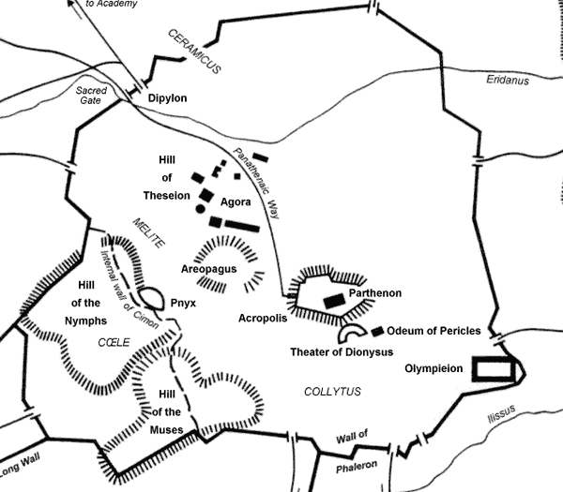

Slide 14
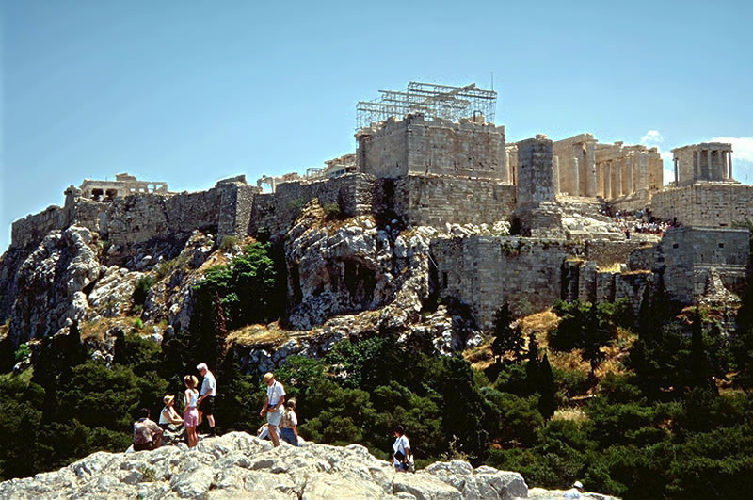
Acropolis as seen from Areopagus, Athens

Slide 15
DramaticŦhematic Planes
“There-and-Then”
mythic
cosmic
“Here-and-Now”
topical
political
Political-Judicial Context
461 Areopagus depoliticized, radical democracy strengthened, Ephialtes murdered
458 Oresteia produced.
Notes:
Succession Myths / “Myths”
Cosmic
Ouranos > Kronos > Zeus
Delphic
Gaia > Themis > Phoebe > Apollo
Political-Judicial
heroic past
vendetta > first law court (Areopagus)
“here-and-now”
political-judicial > judicial Areopagus
461, Ephialtes murdered

Slide 16
Oresteia: Oppositions, Progressions
old
earth
female
violence
strife
self-help revenge
Erinyes (Furies)
new
sky
male
persuasion
harmony
judicial process
Semnai (Revered Ones)
Can we deconstruct these?
Notes:
we can, then, view this not simply as the birth of justice, of political-judicial order, but of patriarchy, too - of the tyranny of the male
thus we face an interpretive dilemma
does the oresteia finally present us with what we have sought all along: dike without hubris, knowledge ushering in prosperity, not destruction?
does the trilogy in its struggle to establish a legitimate order expose the inequalities on which a patriarchal society like this is built?
or does the trilogy in the end subtly critique patriarchy?

Slide 17
Tragic Patterns: Aeschylean Progression
verbal
ambiguous
human
visual
clear
divine
to
Notes:
how realized in LB?
as in the ag, so too in the lb, the finale exhibits the visible outcome of vengeance: bloody bodies wheeled out on the ekkuklema. the riddle of clyt’s dream is resolved, its prophecy fulfilled. but we have yet to bring gods clearly into the picture

Slide 18
Justice on Trial
Eumenides Debate

Slide 19
Procedure
Form groups of 3-5.
Team Clytemnestra (TC) on left, Team Orestes (TO) on right.
Judges, front row center
Discuss, smaller groups. 10 mins.
Arguments phase. Take notes! 20 mins.
TC, then TO.
Rebuttals.
Judges deliberate OUT LOUD. They VOTE.
We reflect on what just happened.
Judges may ask questions of anyone at any time.

