Slide 1

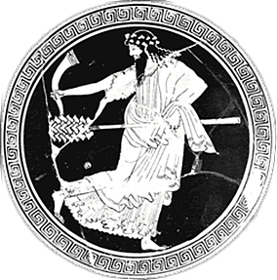
Aristophanes’ Frogs
Drama to the Rescue?
Notes:
can drama – tragedy, specifically, save us? if so, how?
I’d like to start by polling students as to their reactions to the play – extremely different from anything we’ve read so far. this is comedy, not tragedy nor even satyr drama. so,
how are you finding it different from those other genres?
comedy?
satyr drama?
what about the humor?
does it resemble anything from contemporary culture? what?
so I wonder, is it possible to take a play like this seriously? is there something there beyond (to name but a few features) obscenity plus a host of poop, fart, sex, and gender-related jokes?

Slide 2
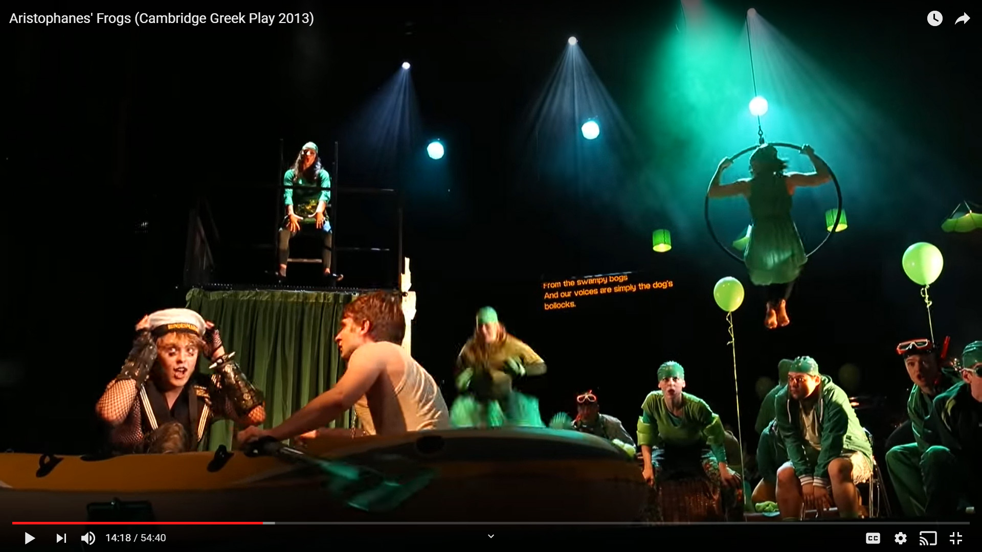
https://www.youtube.com/watch?v=yYYQIn_sC-4&t=613s
Notes:
Question: What, if any, message does this send?
let me introduce the scene
Dionysus and his slave Xanthias are headed for the land of the dead. Dionysus wants to bring Euripides back from the dead to save tragedy and to save the city of Athens.
to get to the land of the dead they need to be ferried by Charon, whose job it is to ferry dead souls across a lake. (well, Dionysus is going to ride in Charon’s boat; Xanthias, a slave with no navy service, will have to walk.)
as Dionysus rows and Charon keeps time, they get into some sort of a singing contest with a group of underworld frogs.
the scene opens with Charon the boatman pulling in to dock his boat and singing a kind of gondolier song. you’ll want to pay attention to the subtitles; they’re speaking ancient greek.

Slide 3
FROGS Brekekekex koax koax!
DIONYSUS Blast you, and your koax too!
Yes, all you are is koax.
FROGS Quite so, you busybody!
For the Muses skillful on the lyre cherish us,
and hornfoot Pan, who plays the tuneful reeds,
and Apollo the Harper delights in us too,
in thanks for the stalks that I grow
in lake water, as girding for his lyre.
Brekekekex koax koax! (Frogs , p. 59)
Notes:
why is this a kind of musical battle, Dionysus versus frogs? does it matter who wins? why?

Slide 4
Prologue: Chorus, to Demeter
“May I utter much that's funny, / and also much that’s serious” (p. 79)
Notes:
“May I utter much that's funny, / and also much that’s serious” (p. 79)
I ask not simply because of the quotation just flashed on screen, but also because of the play’s connection with events and situations current with the time and place of its earliest performances.

Slide 5
From the Ancient Summary
“So much was the play (Aristophanes Frogs) admired on account of its parabasis* that it was produced for a second time.”
* pp. 62 ff., Henderson Frogs translation.
Notes:
arguably, some athenians, enough of them to carry the popular assembly, were so keen on the supposedly serious content of the play that they adopted its political recommendations and voted the play the unique honor of an encore performance.
from Henderson’s introduction to his Focus translation:
“... the ancient Life of Aristophanes, probably also deriving its information from Dicaearchus, informs us that Aristophanes was ‘officially commended and crowned with a wreath of sacred olive, considered equal in honor to a gold crown, for the lines he had spoken in Frogs about the disenfranchised’” (lines 686 ff.).
(the parabasis is that section of the play where the chorus addresses the audience directly.)

Slide 6
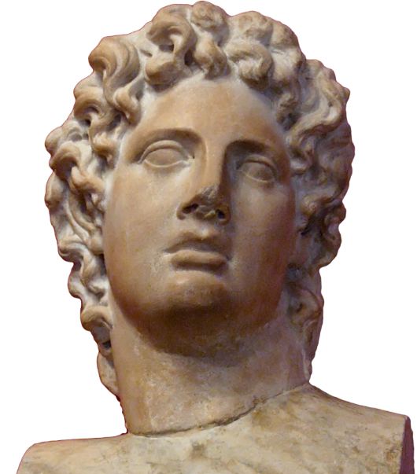
Athens in Jan/Feb 405 BCE
Facing possible defeat, destruction
  Peloponnesian War (Athens/Sparta), 431-404 BCE
Lacking many of its (militarily experienced) elite
  Exiled for attacking democracy
Entertained by its leading comic playwright
  Aristophanes’ Frogs, staged Jan/Feb 405 BCE
Alcibiades
Notes:
the message, in effect, political advice, delivered in that parabasis was that the city, in its hour of dire need, should recall the exiled aristocrats who had been deemed traitors and no goods; only they good save the city.

Slide 7

Can drama save us? Must it? Must we choose between serious and silly, enjoyment and edification?
“For one (which?) I consider a master (or “wise”), the other (which?) I enjoy!” (Dionysus, p. 100)
Notes:
so i guess i’m asking you to think about this:
can drama save us? and is that where the value of really good drama lies: to save us? should we, can we afford to, make time for anything else?
and given that this play, Aristophanes’ frogs, is about tragedy, a genre supposedly more serious than comedy, does this opposition, “wise” literature-theater-art versus “enjoyable” literature-theater-art, actually make sense?

Slide 8
Agenda
Bring It Up-To-Date (debate)
  Aeschylus or Euripides — Whom Do You Prefer Now? (And why?)
Aristophanes’ Frogs
  Overview of Play

Slide 9
Bring It Up-To-Date (debate)
Aeschylus or Euripides — Whom Do You Prefer Now? (And why?)

Slide 10
Aeschylus or Euripides?
Given the way things are now in our 21st-century world (not Aristophanes’ 5th-cent BCE world), do you prefer Aeschylus or Euripides, and why? That could be in terms of entertainment value, how their plays do or don't speak to you, pretty much anything.

Slide 11
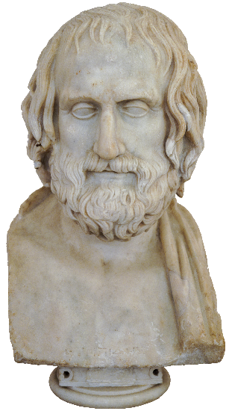
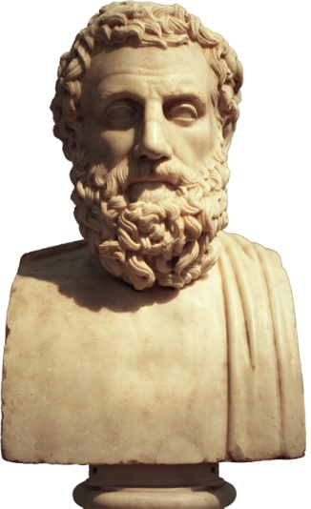
Procedure
1. Form groups, choose recorders-reporters, assign sides of room to teams.
2. Groups prepare arguments (10 mins).
3a. One group on LEFT states case (3 mins).
3b. Individual/individuals on RIGHT respond.
4. Above two steps repeated, sides reversed.
5. Repeat steps 3-4.
6. Reflect.
Euripides
Aeschylus

Slide 12
Aristophanes’ Frogs
Overview of Play

Slide 13
Production, Themes
Production (405 BCE)
  Lenaea (Jan/Feb)
  1st prize
Political Crises
  413 Sicilian Disaster
  411 Oligarchic coup
    Exile of oligarchs
  406 Aegospotamoi
    Trial of naval officers
Poetic Crises
  “Tragic” losses
    456/5 BCE Aeschylus
    406 BCE Euripides
    406 BCE Sophocles
  Dionysus’ “yearning”
Notes:
Historical
Production
405 BCE
Lenaea (Jan/Feb)
lenaea = dio fest. ordinarily 5 comedies, but during war, cut back to 3. no non-citizens permitted.
1st prize, crown, encore
Politics etc.
413 Sicilian disaster
411 exile of oligarchs
arginusae, 406
405
material pressures
military uncertainties
political tension
404
aegos potamoi, 404
final defeat
democracy dissolved
Religious
Dionysian festival
mystery (Eleusinian) evocations
Demeter, Persephone, Iacchos-Dionysos
ritual insult
Chorus of Initiates
us???
Dramatic
Aischylos, Sophokles, Euripides, Agathon dead
Dionysos “yearning”
Athens bereft, desperate

Slide 14
Analysis
Prologue (p. 21)
  Xanthias, Dionysus, Heracles, Corpse, Charon
Choral dialogue, agōn (37)
  Frog Chorus, Dionysus
Scene (39)
  Charon, Dionysus, Xanthias (Empusa)
Parodos (44)
  Lyric, chanting, dialogue. Mystic Chorus of initiates, Dionysus, Xanthias
Scene (49)
  Dionysus, Xanthias, Aeacus, Maid
Parabasis (62)
  Advice to the city
Scene (65)
  Slaves
Choral ode (69)
  Agōn prelude
Agōn (70)
  Trash talk, rituals, annoying tag lines, etc.
  Prologues
  Lyrics
  Weighing of lines
  Policy questions
  Judgment
Exodos (1.5)
  Pluto, Aeschylus, Chorus. Farewell
Notes:
15. scatology. metatheatrical refs. refs to competitors.
25. d longs for eur. all the poets dead and gone...
scene (87)
Dionysus, Xanthias, Aeacus, Maid. Door comedy, drubbing scene, etc.
119. parabasis. advice.
123. coinage metaphor, bring back good citizens and use them for war.
scene (125)
Slaves. (Trouble in Hades)
129. the first we hear of aesch and eur's quarrel. seat for tragedy.
131. eur as poet to the scoundrels below. eur basically as sophist. if eur wins, soph will challenge eur.
choral ode (137)
Tragic parody: consternation over poetic quarrel. (agōn prelude)143. dio refers to the sophismata ("intellectualisms") of evidently both playwrights.
147. eur prays to his novel (sophistic) gods.
AGON: BASIC THEME, SHOW (aesch) VERSUS TELL (eur). that extends to eur’s (supposed) clarity and aesch’s (supposed) riddle-like obscurity. only check out aesch’s last piece of advice, p. 227.
153. eur's describes own stuff. simplified language, clarified with prologues. eur taught athenians "how to talk" - i.e., sophistic ruses. also introduced the everyday into tragedy.
157. critical thinking.
161. aesch's turn. gets eur to state the purpose of poetry: political and social value, improvement. aesch claims eur corrupted athenians. aesch claims he made athenians warlike. NOBLE, INSPIRING EXAMPLES.
165. persians: confirms as a patriotic play. the tragedy in any of this?? poetry here validated for dicdiactic role - just as in eur. only there, eur plays the sophist, here, aesch the traditional educator.
169. aesch alleges that eur's erotic plays corrupted women's morals. "... the poet has the special duty to conceal what's wicked, not stage or teach it." poet = teacheer for adults. poetry as propaganda.
[so eur's problem is he's too real.]
Aeschylus v. Euripides’ prologues
e criticizes a’s prols as redudant
a attckes e’s as somehow amounting to same thing, finishing with a metrical pattern equiv to “lost his little bottle.” i.e., as trivial. (possible dirty joke, too.) (bottle joke, 177)
a’s and e’s lyrics – e recites a’s lyrics inplying inflated, repetitious, inflated language with little meaning. (e as economjical in lang)
weighing of lines: a’s much more weighty. lightweight persuasion v death. a as religiously profound. (compare previous)
219. dio's last test: the best advice thing. alc. eur seems to criticize al, asch seems to advise acceding to a dangerous alc. that's sage (asch) and clear (eur). then silly stuff. then eur recommending a change of the guard. then aesch's last word completely puzzling.

Slide 15
Which is Which? (Euripides, Aeschylus)
“For one (which?) I consider a master (or “wise”), the other (which?) I enjoy!” (Dionysus, p. 100)

