Slide 1
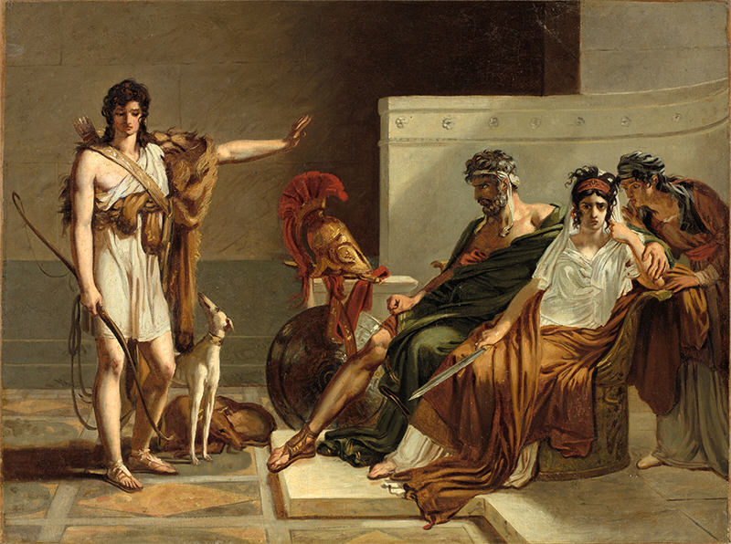
Seneca’s Phaedra, or. . .
“The Explosion of Evil” 1
Pierre-Narcisse Guérin, Phaedra and Hippolytus

Slide 2
Agenda
Recap, Update, Preview
Roman History, Culture, Tragedy
“The Explosion of Evil”
Introduction to Senecan Tragedy

Slide 3
Recap, Update, Preview
Roman History, Culture, Tragedy

Slide 4
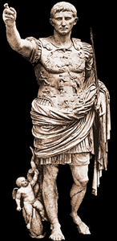
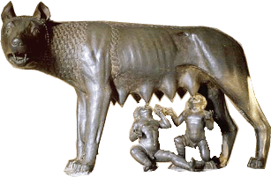
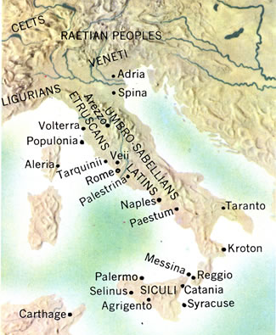
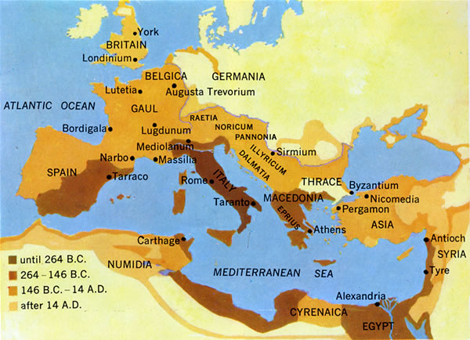
Capitoline Wolf
Augustus
Ancient Italy
Roman Empire

Slide 5
Timeline
753-510 BCE Regal period
Ruled by kings.
510-27 BCE Republic
Mixed constitution: oligarchic, quasi-democratic.
27 BCE-293 CE Principate (Early Empire)
De facto monarchy (imperātor, Caesar, princeps)

Slide 6
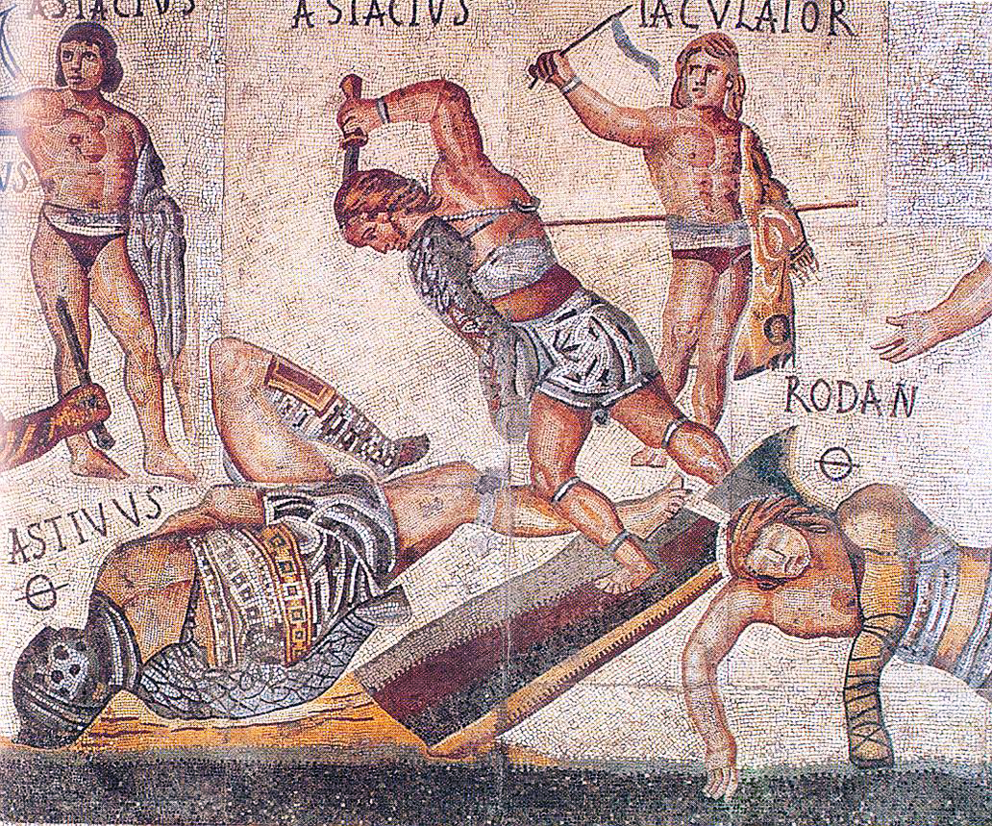
Rome and the grotesque 1
Gladiator mosaic, ca. 320 CE, Borghese Gallery, Rome

Slide 7
Tertullian on Gladiators
“. . . gladiators, most loving of men, to whom men surrender their souls and women their bodies as well, . . .; on one and the same account [people] glorify them and ... degrade and diminish them. . . . The perversity of it! They love whom they lower; they despise whom they approve; the art they glorify, the artist they disgrace.” (De spectaculis 22)
Notes:
something to keep in mind: gladiatorial combat was spectacle, a show. it was a centerpiece of shared attention, repulsive and attractive all at once.
at first, gladiators were condemned criminals and prisoners of war. soon, though, free romans started enlisting to be gladiators, until about half of all gladiators were volunteers. in being a gladiator, honor and prestige was found in debasement. you had to take an oath to be ready to endure every torment. your life was now worth something only because, for you, it was now worthless.
in his letters, Seneca deploys gladiatorial combat not for its cruelty but as a waste of time for the intellectual. elsewhere, he praises the fortitude of gladiators who accept death without blinking.

Slide 8
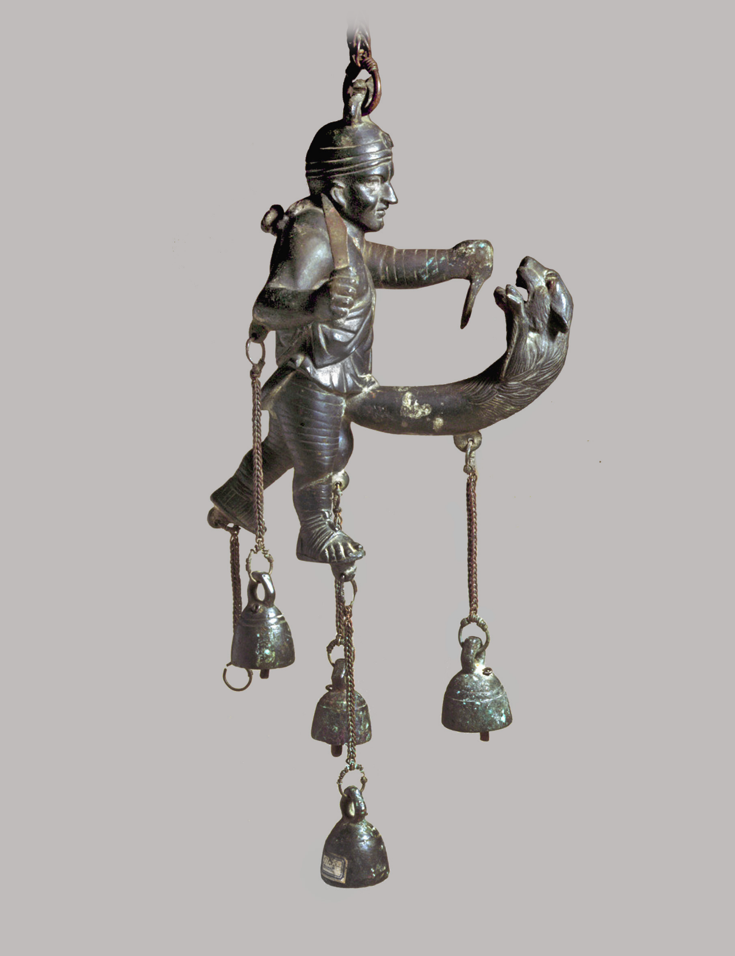
Rome and the grotesque 2
Apotropaic tintinnabulum (fascinum countermeasure), 1st cent. CE. Museo archeologico nazionale di Napoli
Notes:
this is to ward off evil generally and the evil eye specifically. I’ve already mentioned how it worked: it distracts the eye, while its phallic, aggressive character intimidates it.
in terms of imagery, this is a bestiarius, a kind of huntsman gladiator, battling a beast, some sort of lion, in the arena. only the beast is his own lust as embodied in his sexual organ. in popular systems of ancient roman thought, there was a strange kinship between the passions of envy and desire: both gnaw at the emoting subject, who, tormented by them, wastes away.
in Senecan tragedy, we see exploration of the pathology of the passions, especially desire, and especially its power to destroy the emoting subject in just the way that this phallic cat seeks to destroy the bestiaries.

Slide 9
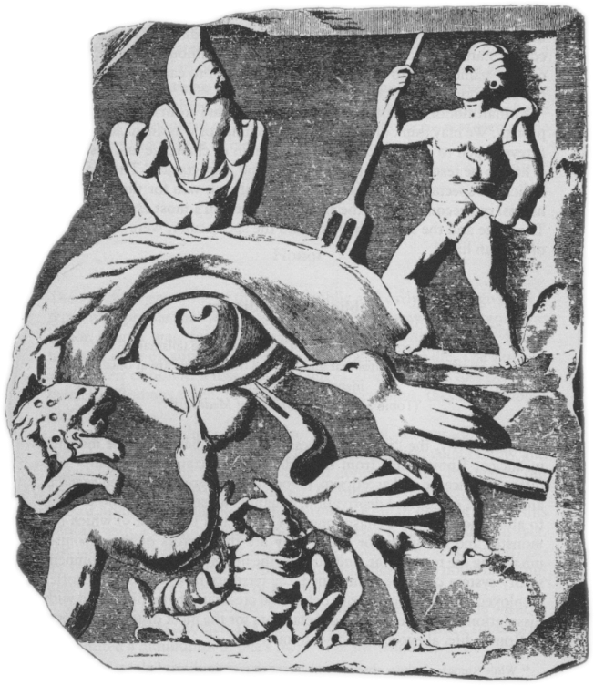
Woburn Marble, 2nd-cent. CE relief

Slide 10
Roman Drama: Fabula. . .
Comedy, fabula...
Tragedy, fabula...
Palliata
himation – i.e., Greek-adapted – comedy
Togata
“toga” – i.e., Italian comedy
Trabeata
upper-class comedy
Mimus
popular farce
Crepidata
“buskin drama” – i.e., tragedy based on Greek myth
Praetexta
“fringed-toga drama” – i.e., Roman history play
Pantomime
narrative dance, chorus accompaniment, mythological plots
ca. 240 BCE-early 100s CE
Notes:
How do the fragments of Latin tragedies compare to extant Greek tragedies in terms of style, structure, and thematic concerns?
(I would like to see a discussion of the differences between Roman tragedy and Greek tragedy, and how one draws influence from the other)
I would like to see where thematic elements of Greek and Roman tragedy differ.
During our discussion I'd like to talk about how the Roman's so heavily adapted from Greek works yet still made it so much their own?

Slide 11
Tragic Playwrights
Republican
Imperial
LIVIUS ANDRONICUS
280/60–200 BCE
Gnaeus NAEVIUS
Late 2nd cent. BCE
Lucius ACCIUS
180–ca. 86 BCE, child of ex-slaves
Lucius Annaeus SENECA
ca. 4 BCE–65 CE
Anonymous author of Octavia (ca. 90 CE)
Notes:
Unlike Greek tragedy which emerged in a highly developed cultural setting, tragedy in Rome appeared at the dawn of Roman literature. In 240 BC the aediles asked Livius [III 1] Andronicus, who came from the Greek-speaking world, probably from Tarentum (Taras [2]), to stage a dramatic play for the ludi Romani ( ludi [II B] and [III G]) (Cassiod. Chronica p. 120 M. on the year. 239 BC: “ludis Romanis primum tragoedia et comoedia”). Thus in Rome, dramatic literature was first 'commissioned' by magistrates. Correspondingly, it had a public, 'political' function. In Rome, the introduction of dramatic plays was primarily an institutional and religious phenomenon [5. 319] and only secondarily a literary phenomenon. Liv. 7,2 (cf. the parallel account in Val. Max. 2,4,4) in a brief excursus on the history of Roman theatre emphasized its administrative and cult aspect [22].
NAEVIUS. “Six titles (Danae, Equos Troianus, Hector proficiscens, Hesiona, Iphigenia, Lycurgus) suggest tragedies of the Attic type. An account of Danae's disgrace (Nonius p. 456. 25, Lindsay) seems to have been set in bacchiac verse rather than in spoken senarii. Naevius also composed original tragedies, one on the story of Romulus the first Roman king, another (the Clastidium) on the defeat of a Gallic army in 222 by M. Claudius Marcellus (1). The latter may have been performed at funeral games for Marcellus in 208 or at the dedication in 205 of the temple of Virtus (see Honos) vowed by the consul before the battle of Clastidium.” (OCD)
ACCIUS. Epic (Annales) and dramatic poet. “The earliest [tragedy], probably the Atreus, was performed in 140 (Cicero Brutus 229). ... The grandeur of Accius' tragic style caused some contemporaries to laugh (Pompon. Hor. Serm. 1. 10. 53). Cicero, however, who was proud to have known him personally, admired his plays almost as highly as he did those of Pacuvius and cited extensive passages in his rhetorical and philosophical dialogues.” (OCD)
PACUVIUS (c. 220-130) stage poet and painter of South Italian birth, nephew and pupil of Quintus Ennius. His family belonged to Brundisium, and he spent his last years in Tarentum.

Slide 12
Brill’s on Roman Tragedy
“The content of Roman tragedy is not ‘tragic.’ ”
Notes:
QUOTES (Brill’s on Roman tragedy):
The content of Roman tragedy is not 'tragic'. In its early form its main purpose was to provide historical arguments. With Pacuvius and Accius tragedy became more literary but continued to focus on the model attribute of virtus (virtue) - either of individual heroes or of the populus Romanus as a whole. Of central concern was not the fate of the individual but rather the advancement of the collective good. Roman heroes do not face tragic decisions between equally important duties since the teleology of Roman society has eliminated such conflicts. [author means a kind of roman version of the end of history; compare Vergil on rome’s mission] Under Nero, tragedy became the genre of the opposition. In their positive aspects Seneca's heroes are Stoic wise men, in their negative aspects monomaniacal criminals. In their own way, both types are autonomous. Entirely self-sufficient, they know neither physical pain nor moral challenges; they are not part of the community. The solution consistently available to them is death [9].

Slide 13
“The Explosion of Evil”
Introduction to Senecan Tragedy

Slide 14
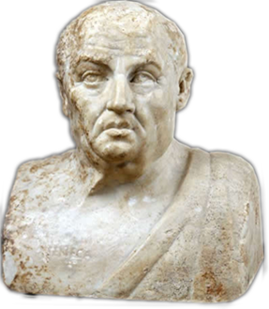
Seneca (10-65 CE)
Historical background
Claudius (r. 41-54)
Nero (r. 54-68)
Biographical notes
Claudius, Agrippina, Nero
Philosophical interests
Stoicism
Epicureanism
Rhetorical dimension
declamation
Notes:
Is there a relationship between the writer's life and the writings themselves? Let me quote C. J. Herington on that very topic as it applies to the extremely complicated and baffling case of Seneca:
What does seem relevant is the clear fact that Seneca himself lived through and witnessed, in his own person or in the persons of those near him, almost every evil and horror that is the theme of his writings, prose or verse. Exile, murder, incest, the threat of poverty and a hideous death and all the savagery of fortune were of the very texture of his career. (In Arion 5 [1966] p. 430)
However remote, bizarre, grotesque, or unnatural we may nowadays find Senecan tragedy, it was certainly "relatable," if to no one else, then at least to Seneca himself.
Historical
Augustus (r. 27 BCE-14 CE)
Tiberius (r. 14-37)
Gaius (r. 37-41)
Claudius (r. 54-68)
Philosophical
Stoicism
Epicureanism
Rhetorical
declamation
Biographical
Spanish birth (ca. 10 BCE)
equestrian class
Roman education
philosophy & rhetoric
Imperial service
Claudius
Agrippina & Nero
Suicide (65 CE)
Writings
prose treatises
“moral epistles”
tragedies. . .

Slide 15
Senecan versus Athenian Tragedy
Athenian
Senecan
Performed
Structure
Episodes, choruses
Action
Offstage violence
Links to
Archaic Greek poetry
Sophistic rhetoric
Performed?
“Closet drama”?
Structure
Acts (5), choruses
Action
EXTREME violence offstage
Links to...
Rhetorical tradition
Philosophical interests
Notes:
Marta Straznicky on closet drama: "part of a larger cultural matrix in which closed spaces, selective interpretive communities, and political dissent are aligned."
* Straznicky, Marta (2004). Privacy, playreading, and women's closet drama, 1500-1700. Cambridge, United Kingdom: Cambridge University Publishing. p. 77
Herington* thinks it is stageable and was performed on dramatic or semi-dramatized form.
* Herington, C. J. “Senecan Tragedy.” Arion 5 (1966): 422–471.

Slide 16
SenTrag: Philosophical Evocations
Stoicism
Epicureanism
“Live according to nature”
NURSE (to Hippolytus): Let nature’s instinct guide your life; be seen / Here in the city; meet your fellow-men. (p. 117)
“Pleasure = freedom from disturbance”
HIPPOLYTUS: So, I think, / Men lived in the olden days, ... They had no gold / To excite their blind desires. (p. 119)

Slide 17
“Senecan Schema” (cf. Herington)
Thematic Structure | Dramatic Structure
CLOUD OF EVIL | ACT 1. Hippolytus’ chaste joy, Phaedra’s love agony.
DEFEAT OF REASON BY PASSION | ACT 1 cont. Phaedra’s and nurse’s debate.
EXPLOSION OF EVIL | ACT 2. Attempted seduction, shocked rejection. Criminal plot – “crime must cover crime” (Nurse, p. 127)
 | ACT 3. Phaedra executes plan.
 | ACT 4. Messenger speech, Hippolytus’ death.
 | ACT 5. Phaedra’s suicide, Theseus’ grief.
Notes:
THE CLOUD OF EVIL, which coincides with a given play's prologue, in which an atmosphere of horror and dread is carefully cultivated.
THE DEFEAT OF REASON BY PASSION, often concentrated in the second act, where in several plays a noble and a lesser character debate - though really, REASON debates PASSION, with victory disastrously won by the latter.
THE EXPLOSION OF EVIL. Self-explanatory, it is, of course, action inevitably resulting from passion's victory over reason. Here, "the shockwave of evil races outwards, prostrating both the wicked and the noble" (Herington 456).
Herington, C. J. “Senecan Tragedy.” Arion 5 (1966): 422–471.

Slide 18
Senecan Rhetoric 1 (Phaedra)
Sententia (pl. sententiae)
Perverse exaggeration
quod non potest vult posse qui nimium potest (Nurse, line 215)
“A man who can do much would like to do / More than he can" (Penguin, p. 106)
“I hate them all; I dread, I shun, I loath them. / I choose – whether by reason, rage, or instinct – I choose to hate them” (Hippolytus, p. 120)
Notes:
from Terms:
Sententia (pl. sententiae)
While the Latin noun sententia can simply mean the "sense" of an utterance, it has a technical meaning pertinent to the study of Roman tragedy. In the poetic and rhetorical stylistics of the imperial period (27 BCE onward), sententia comes to the fore as a term describing a short sentence dense with meaning and often dense, too, with irony. Take, for instance, the famous dictum of Arria, whose husband, Paetus, too cowardly to commit suicide to save his family's fortune, had to be coaxed with the words of his much braver wife, who said, Paete, non dolet, "Paetus, it doesn't hurt" (Pliny Letters 3.16). Of course, she was plunging his sword into her own breast at that moment, so the meaning of her utterance extends well beyond throse three short words: "Paetus, you miserable coward, an affront to your noble ancestors! If you can't find the courage to do the honorable thing, however painful — if your own wife, a mere woman, can, then what are people to think?"
Perverse exaggeration, rhetoric of excess
... taking a sentiment, finding its potential to express something over the top, outrageous, or similar, and then exploiting that potential verbally for all its worth. Take, for instance, a made up, non-Roman example like the following: "STUDENT: Professor Snape, do you really hate students that much? SNAPE: Students? I eat them for lunch – no, I eat them and then spit them out: they disgust me!" Well, no, he doesn't hate students, but you get the point.
Hippolytus’ thing with women:
120 "Stepmothers" — Hippolytus' misogyny and hatred of stepmothers certainly shocks. But maybe it's meant to. This is over-the-top anger and animus; Seneca the Stoic would disapprove. Hippolytus is no hero, but he's also hopelessly naive and tactless. If his aim is, perhaps, to tell the Nurse to bugger off, he could do it a lot more subtly.

Slide 19
Senecan Rhetoric 2
Trope of Decline
Trope of Progress
HIPPOLYTUS: So, I think, / Men lived in the olden days, the men who shared / Their life on earth with gods. They had no gold / To excite their blind desires. (p. 119)
Hippolytus: Bare hands / Were the first weapons; then came stones and clubs. / That was before the slender cornel shaft / With tapered iron point was made, or longsword / Slung from the belt.... (p. 119)

