Slide 1
Introduction to Persuasion in Ancient Greece
Andrew Scholtz, Instructor

Slide 2
Me (Instructor), Persuasion IAG
Andrew Scholtz
ascholtz@binghamton.edu
LT 509
http://bingweb.binghamton.edu/~ascholtz/
Office Hours
R 10-12 in LT 509

Slide 3
Web Access
myCourses
http://mycourses.binghamton.edu/
Bingweb
http://bingweb.binghamton.edu/~clas381a/

Slide 4
First Assignment: Plato Gorgias Pt 1
Read study guide (req'd!)
Read Gorgias sections 447a-481b via web
Do Journal Entry via myCourses site, "Journal"
For more on journal entries, see under Bingweb Syllabus

Slide 5
An Exercise…
Spin Control

Slide 6
Spin
You’re spinning…
Nick’s spinning…
What?
image problems
Challenges?
image
Strategies?
no covering up
re-direction
salvaging
What?
create the perception that cigarettes are safe
shift perc’d intention
that tobacco cares
Challenges?
image
Strategies?
redefining the issue (profits)
pull the other guy down
shift the blame
shock tactics
taking control of the discourse
Notes:
prompt students tosuggest something difficult to persuade people to do. (not sexual, not violent or weird; something more or less believable but also extremely challenging from the persuader’s perspective.)
then solicit and discuss suggestions for successful persuasion. what are the challenges; how to overcome?
next, show clip starting 2:35. before showing, ask them to keep in mind the following questions
what is it that nick is here trying to get people to do or think?
what challenges does he face
how does he ovdercome them?
then ask them is they see anything that looks familiar. that surprises.
then spin control: ethics. second clip… 21:32.

Slide 7
Notes:
pretty cynical, no? the idea of exploiting a kind of cancer mascot that way seems to prove nick’s point. and yet....
can we really afford to ignore spin? does the study of spin — of managing perceptions — have a place in a moral world?
note that, without even answering the question of whether spin has a place, shouldn’t the well-educated individual be educated to recognize, to know when others are trying to manipulate our perceptions?
on the other hand, when we interview for a job, when we put ourselves before a group whose opinions matter to us, what does it say of us that that we don’t care how our we or our views are perceived?

Slide 8
Ancient Counterparts
Captatio benevolentiae
Koinos topos
Rhetorical questioning
Argument by probability
controlling the discourse
Notes:
Captatio benevolentiae (curring goodwill)
“Let me share something with the fine, concerned people in the audience”
Koinos topos (rhetorical commonplace)
“I think that we can all agree that there is nothing more important than America’s children”
Rhetorical questioning
“How on earth would big tobacco profit off of the loss of this young man?”
Provocative questioning/statement (safe? speakers in Pl Gor makes extensive use of)
[same “How on earth would big tobacco profit off of the loss of this young man?”]
Argument by probability (but also provocative)
“If anything, we’d be loosing a customer”
Telling/promising the audience what it wants to hear
in Gorgias and other sources is termed kolakeia
Controlling the discourse

Slide 9
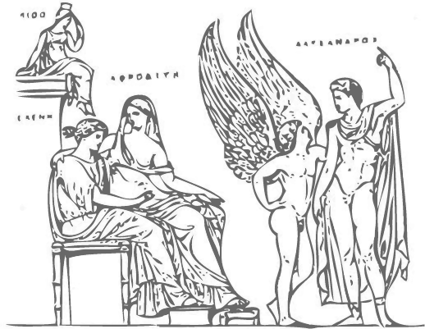
Course Issues
Helen Relief
Notes:
Persuasion (peitho): its…
modalities
venues
applications
power
value
weakness
hazards
analogies, ideologies

Slide 10
Shape of Course
Introduction to peitho
Peitho transformed
Peitho in Action
Peitho in Crisis
A Discipline is Born
Plato Phaedrus
Notes:
basic topics
cultural meaning of persuasion in ancient grc
with special attention to the athenian democacy - role of persuasion therein, its relation to athenian-style democracy as a system
can democracy today shed light on ancient
and vice versa
sequence of units
intro to peitho (abstraction, personification [and thus a divine or magical power])
genesis of peitho in athenian state
as imagined in aesch oresteia
as imagined, and thus insight into its ideological value in, athenian politics, justice
historical overview of the genesis of politics - of the polis - in Greece and thus in the western historical tradition; of democracy at athens, and the role of persuasion therein
the crisis in persuasion, later 400s BCE, and how (or if) resolved
ATHENIAN DEMOCRACY AS A LABORATORY IN PERSUASION
emergence of rhetoric as an intellectual discipline

Slide 11
Course Essentials
Procedures, Access, etc.

Slide 12
Basic Info
CLAS 381A / COLI 380K / PPL 380E / RHET 380P
Andrew Scholtz, instructor
LT50
ascholtz@binghamton.edu
GenEd etc.
“H” (humanities)
“O" (joint)
PPL cognate

Slide 13
Key dates
27-Jan (add/drop)
24-Mar (W, grading option deadline)

Slide 14
Web Access
myCourses
http://mycourses.binghamton.edu/
Bingweb
http://bingweb.binghamton.edu/~clas381a/

Slide 15
Procedures (Syllabus)
Academic honesty
Participation, attendance
Coursework
readings, blogs, discussion
papers, powerpoints
quizzes
(no exams!!)

Slide 16
For Thursday. . .
Plato’s Phaedrus pt. 1

Slide 17
Why love-speeches?
Notes:
Plato's Phaedrus features three speeches on love. Yet Phaedrus isn't about love; it's about rhetoric. So a question for you: Why do you think Socrates uses love speeches to explore rhetoric?
Is it because of something special about love? About rhetoric? Do Plato's own words tell us anything? How do you react?

