Slide 1
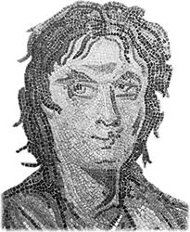
Plutarch’s Life of Alcibiades
Extreme Charisma?

Slide 2
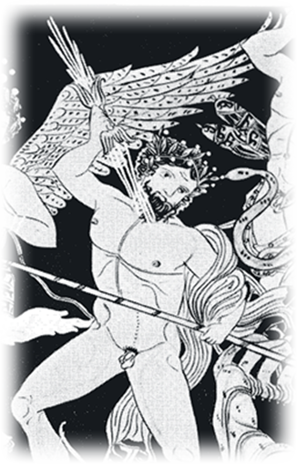
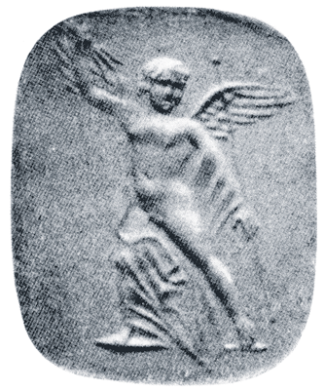
“He had a golden shield made for him, which was emblazoned not with any ancestral device, but with the figure of Eros armed with a thunderbolt.” (Plutarch Alcibiades p. 58)
“The sway which he held over the humbler and poorer classes was so potent that they were filled with an extraordinary passion (an erōs thamastos) for him to rule them as a dictator (a turannos)….” (p. 280)
Eros, Zeus with thunderbolts.
Notes:
what’s with that shield? do you see the shield more as a myth plut uses to characterize al or as a statement al uses to characterize himself?

Slide 3
Agenda
Introduction
Alcibiades’ Life and Times
Oral Report
Plutarch’s Life of Alcibiades
Reading the Body Rhetorical
Alcibiades and Charisma

Slide 4
Introduction
Alcibiades’ Life and Times

Slide 5
Alcibiades’ Life and Times
ca. 450 Born.
431 Peloponnesian War starts.
432-431 Potidaean campaign.
ca. 427 Follower of Cleon.
424 Battle of Delium.
421 Peace with Sparta .
417/6 Melian debate.
416 Olympic victory. Ostracism survived. Sicilian Debate.
415 Mysteries affair. Defection to Sparta.
413 Fortification of Decelea.
413-412 Sicilian disaster. Defection to Persians.
411 Oligarchic coup.
408 Repatriation.
406 Re-exile.
404 Sparta defeats Athens.
404-403 Tyranny of 30. Al murdered.
Notes:
Alcibiades born.
431 War breaks out.
432-431 Potidaean campaign: Socrates saves Alcibiades.
424 Battle of Delium: Alcibiades saves Socrates.
421 Peace with Sparta (“Peace of Nicias”).
416 Annus mirabilis: Olympic victory, ostrakophoria survived, Sicilian Debate. Nearly clinches prostasia tou dēmou.
415 Sicilian expedition; desecration of Herms, Mysteries at Athens; defects to Sparta.
413-412 Sicilian disaster; Al. defects to Persians.
411-410 Al. foments oligarchic revolution and counter-revolution.
408 Repatriated.
406 Re-exiled (defeat at Notium).
404 Sparta defeats Athens.
404-403 30 at Athens; Al. murdered.

Slide 6
Oral Report
Plutarch’s Life of Alcibiades

Slide 7
Reading the Body Rhetorical
Alcibiades and Charisma

Slide 8
Lenses
“Theophrastus noted long ago that the strongest desire of men who have attained to leadership in a popularly governed state is not so much the acquirement of personal wealth as the gradual establishment of their own sovereignty at the expense of popular sovereignty.” (Michels 349)
“The leader (demagogue) rules by virtue of the devotion and trust which his political followers have in him personally” (Weber 268)
“Greek writers about politics all thought that the ‘demagogues’ gained and maintained their authority through substantive promises [i.e., rather than through “emotional appeals”]…. The evidence, as I read it, fully supports that view.” (Finley 98)
Notes:
let’s just review.
charisma. allegiance to inspiring individual, cult of personality. (none of that really applies to athenian demagogues. charismatic domination is “extraordinary,” “revolutionary.”
“Plebiscitary democracy”: the dēmos recognizes, and thus legitimizes, charismatic authority, thereby concealing its authoritarian character. we learn from finley that, for weber, pericles and cleon were charismatocrats.
pure charismatic authority is unstable. the challenge is to maintain it beyond the leadership of any one individual – who’s going to be the next castro, the next hugo chavez?
1114: the leader gains authority “solely by proving his powers in practice.” the perfect charismatic leader = the thief-king.” – maybe a roman caesar, but not an athenian pericles.
Al needs more development with regard to his Weberian-charismatic features. note, e.g., that he had, inter alia, a staff: not exactly that of a Teutonic warlord, but a hetaireia noted by Nicias at the Sicilian debate (thuc bk 6), and perhaps fêted by Al at the mysteries-profanation incident. Indeed, this last suggests Al’s efforts to establish charismatic authority over just that group. However accurate/inaccurate charismatocracy for Athens generally, it works well for a whole range of individual situations. If charismatocracy is inherently revolutionary, transitional, by itself unstable, then it makes eminent good sense to describe Alcibiades’ prostasia as “charismatic.”
Finley argues against Al as exemplary: “What could have been more inconsistent than the success record of Alcibiades?” charismatic leadership by definition unstable, but does a leader who falls short of even achieving a consistent stretch of leadership count? so maybe al was charismatic, but was democracy charismatic under him? but does that mean that charismatic leadership tells us nothing about al or about the democracy he operated under?

Slide 9
Kharis, Charisma, Charm
“Charisma” < kharis
“charm,” “pleasure,” “favor”
Compare
pros kharin legein (Demosthenes)
kharizomai & cognates (Aristophanes Knights)
sexual
political

Slide 10
And Alcibiades?

Slide 11
Kharis
“As for Alcibiades’ beauty, . . . it flowered at each season of his growth in turn, and lent him and extraordinary grace and charm (erasmion kai hēdun). . . . Even his lisp is said to have suited his voice well and to have made his talk persuasive and full of charm (kharis)” (245-246)
Notes:
kharis literally conferred upon al’s speech (1.6, 245).

Slide 12
Erōs: Plutarch’s Life
“He had a golden shield made for him, which was emblazoned not with any ancestral device, but with the figure of Eros armed with a thunderbolt.” (Plutarch Alcibiades p. 58)
“But the weakness which his tempters played upon most of all was his love of distinction (philotimia) and his desire for fame (philodoxia)” (p. 250)
“The hopes he aroused among the Athenians were great enough, but his own were even more ambitious, for while others regarded Sicily as the final objective …, to him it was no more than a springboard” (p. 260)
“The sway which he held over the humbler and poorer classes was so potent that they were filled with an extraordinary passion (eros) for him to rule them as a dictator (turannos)” (p. 280)
Notes:
the aggregate portrait (thuc, plut, others - never mind objective facts for now) strongly suggests an individual motivated by self-interest and able to appeal to self-interest.
kharis coupled with al’s speech - innate, rhetorical charisma? (1.6, 245).
compare
discuss pros kharin legein in relation to charisma.
Athenian orators and writers clearly recognize that Athenian democracy vulnerable to, if not inevitably taken over by, a demagogic, non-substantive, rhetoric-based style of politics
yet in a sense this is endemic to Athenian democracy - in the sense that any rhetor’s policies or leadership can all too easily be spun by an opponent as all words, no action.
so too the enemies of democracy can spin democracy this way - it all depends on how you look at it, what set of interests you are arguing from.
cf. thuc, Sicilian Debate (bk 6). NICIAS: “Do not be sick . . . with yearning (erōs) for what is not here” (116). HISTORIAN’S ANALYSIS: “Now everyone alike fell in love (erōs enepese) with the enterprise” (122).
the power of irrational thinking – eros – in face of rational thought and speech, logos. Nicias’ frank speech not enough to undo the earlier decision. but his second speech arguably intensified the “sick eros” decried by him vis-à-vis expedition.
but the coercive power of charisma also a factor. al subtly sought to counteract nic’s attempt to peel away the older elements. alc seems to treat that as implicitly contrary to a political ethic of consensus – this is, in other words, the rhetoric of consensus as a coercive element. so thucydides on the eros to sail:
This erôs left Athenians feeling empowered and confident, but it also exercised power over them, a power so forceful that nothing Nicias could say would deter support for the invasion. On the contrary, his attempts at reverse psychology only reinforced the city’s resolve (Thucydides 6.24.2). Nor were those opposed to the motion willing to vote their convictions, since to do so would have involved appearing hostile to the city’s interests (kakonous . . . têi polei, 6.24.4; cf. 6.13.1). Thucydides’ point? Among other things, that consensus, when it gains the kind of momentum this “erôs to sail” did, can create a social-discursive atmosphere hostile to the free exchange of ideas, to dialogue. (CD 28)

Slide 13
Savvy Orator?
General assessment:
“Alcibiades possessed in a higher degree than any of his contemporaries the faculty of discerning and grasping what was required of a given situation.” (Plutarch Alcibiades p. 253)
Samos, 411:
“He not only convinced the people and showed them their danger by his speeches in public, but he appealed to them as individuals, using entreaties with some and force with others.” (pp. 272–3)
Notes:
we don’t know that al ever learned a great deal from any teacher – the tradition suggests that he was a very bad student. BUT, xenophon suggests that he and his arch-frenemy, critias, attached themselves to socrates to get from the philosopher what aspiring politicians typically sought from sophists: a knowledge of rhetoric and argumentation. quotes like these, whatever their value as factual evidence may be debateable, do at least suggest an orator who had absorbed the lessons taught in a work like plato’s phaedrus: know your material, know your audience’s mind.

