Slide 1
GRK 101
GRK 101

Slide 2
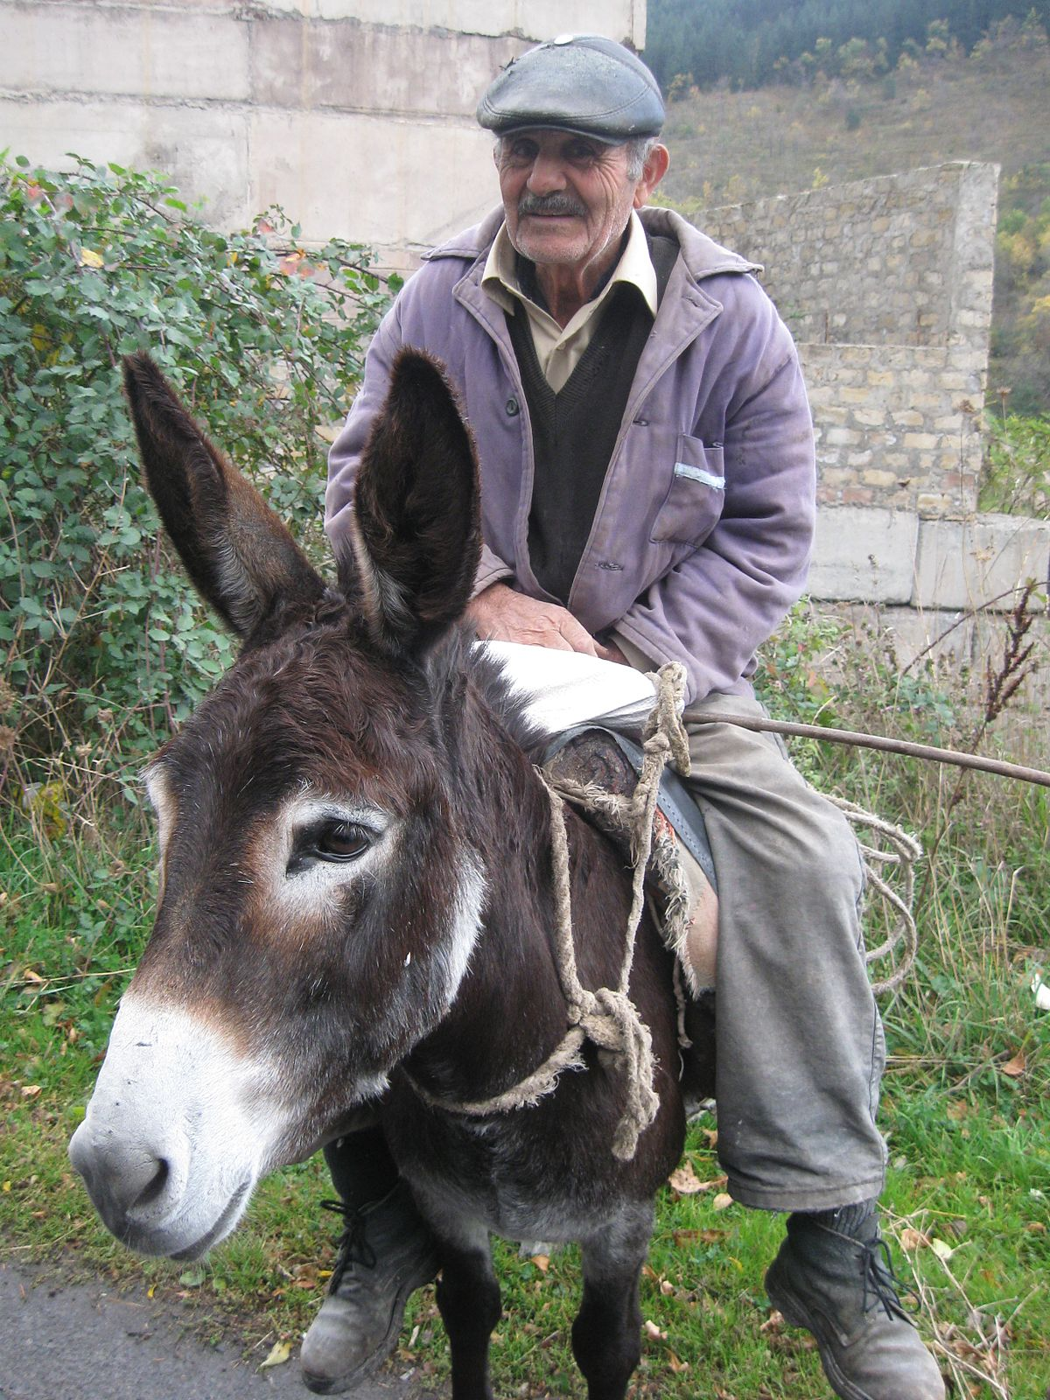
ὁρῶ τὸν πάππον Ἀθήναζε πορευόμενον

Slide 4

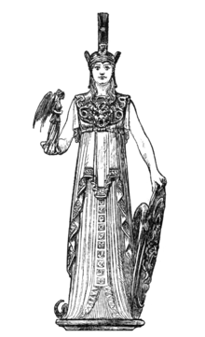
ἑλληνίζωμεν!
ὁράω
ἡ εἰκών, τῆς εἰκόνος
  τὴν εἰκόνα
ἡ Ἀθηνᾶ, τῆς Ἀθηνᾶς
  τὴν Ἀθηνᾶν
ἐνόπλιος, ἐνοπλίου
ἡ Νίκη, τῆς Νίκης
ἡ δεξιά, τῆς δεξιᾶς
φέρω

Slide 5
Generic PTC declension — Act/Mid Present

Slide 6
εἰμί PTC Declension — Act Present

Slide 7
εἰμί PTC Declension — Act Present

Slide 8
omega-verbs. φέρω “carry” — Act Present

Slide 9
omega-verbs. φέρω “carry” — Act Present

Slide 10
α-contr. βοάω “shout” — Act Present

Slide 11
α-contr. βοάω “shout” — Act Present

Slide 12
ε-contracts. πονέω “work” — Act Present

Slide 13
ε-contracts. πονέω “work” — Act Present

Slide 14
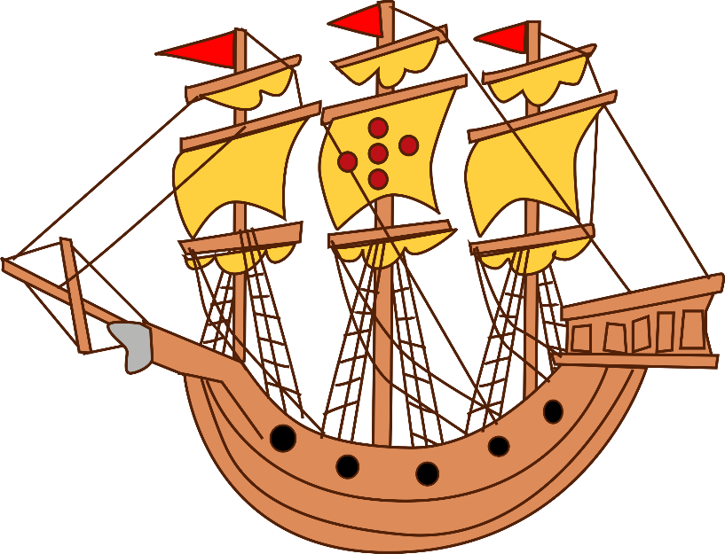
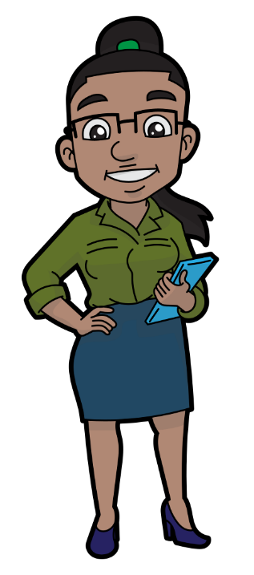
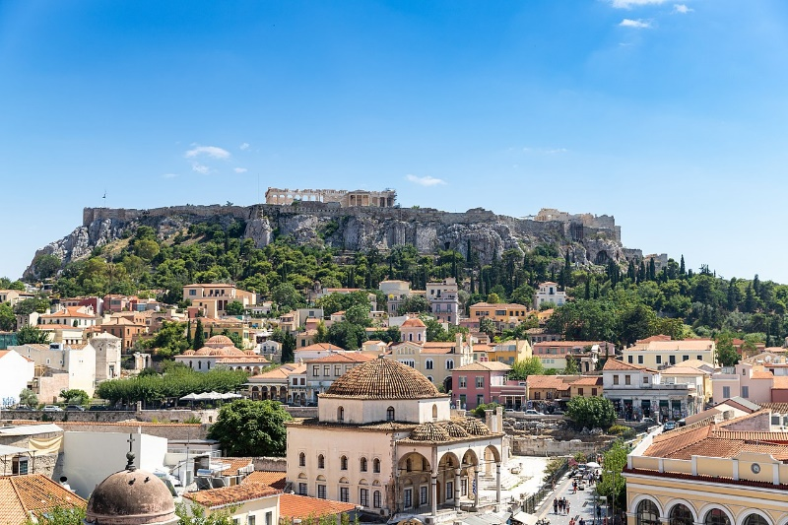
λαλῶμεν ἑλληνιστί
ἡ ναῦς, τῆς νεώς
τὸ ἄστυ, τῆς ἄστεως
ἡ γυνή, τῆς γυναικός

Slide 15


ποῦ ἐστιν ἡ γυνή;
ἐν τῇ νηί ἐστιν.

Slide 16
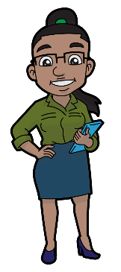
ποῦ ἐστιν ἡ γυνή;
ἐν τῷ ἄστει ἐστίν.

Slide 17
τί ὁρᾷς; (πολύς, πολλή, πολύ)
πολλὰς γυναῖκας ὁρῶ.

Slide 18
τί ὁρᾷς; (πολύς, πολλή, πολύ)
πολλὰ ἄστη ὁρῶ.

Slide 19
πόθεν ἔρχεται ἡ γυνή;
ἐκ τοῦ ἄστεως ἔρχεται.

Slide 20

πόθεν ἔρχεται ἡ γυνή;
ἐκ τῆς νεὼς ἔρχεται.

