Slide 1
grk102
ch11

Slide 2
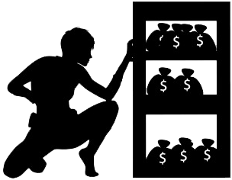
λαλῶμεν ἑλληνιστί!
νῦν δή (“right now”), τίς λαμβάνει τὸ ἀργύριον;
πότερον λαμβάνει αὐτὸ....
ἡ Ὀλίβια, ἢ
ὁ Θωμᾶς, ἢ
ὁ Χρισοφόρος, ἢ
ὁ Ἄγγυς, ἢ
ὁ διδάσκαλος;
τὸ ἀργύριον, τοῦ ἀργυρίου

Slide 3
λαλῶμεν ἑλληνιστί! (cont’d)
χθές (“yesterday”), τίς ἔλαβε τὸ ἀργύριον;
πότερον ἔλαβεν αὐτὸ....
ἡ Ὀλίβια, ἢ
ὁ Θωμᾶς, ἢ
ὁ Χρισοφόρος, ἢ
ὁ Ἄγγυς, ἢ
ὁ διδάσκαλος;
τὸ ἀργύριον, τοῦ ἀργυρίου

Slide 4
λαλῶμεν ἑλληνιστί! (cont’d)
ἆρα χαίρει ὁ / ἡ ____ τὸ ἀργύριον λαβών / λαβοῦσα;
ναί / οὐχί· ____
ἆρα δεῖ τὸν / τὴν ____ τὸ ἀγύριον λαβεῖν;
ναί / οὐχί· ____
τὸ ἀργύριον, τοῦ ἀργυρίου

Slide 5
λαλῶμεν ἑλληνιστί! (cont’d): Principal Parts
λαμβάνω (quizzed)
γίγνομαι (not quizzed)
γίγνομαι
γενήσονται
ἐγενόμην

Slide 6
λαλῶμεν ἑλληνιστί! (cont’d): Principal Parts
λαμβάνω (quizzed)
λαμβάνω
λήψομαι
ἔλαβον
γίγνομαι (not quizzed)
γίγνομαι
γενήσονται
ἐγενόμην

Slide 7
λαλῶμεν ἑλληνιστί! (cont’d): Principal Parts
ἀποθνῄσκω (pres system)
__________ (fut mid)
__________ (aor act/mid)
εἰσάγω (pres system)
__________ (fut act/mid)
__________ (aor act/mid)
λείπω (pres system)
__________ (fut act/mid)
__________ (aor act/mid)
μανθάνω (pres system)
__________ (fut mid)
__________ (aor act/mid)
πάσχω (pres system)
__________ (fut mid)
__________ (aor act/mid)

Slide 8
Aorist λαμβάνω, γίγνομαι
 | “take” | “become”
princ pts | ?? | γίγνομαι, γενήσομαι, ἐγενόμην
 | active 2nd aorist, TOOK etc. | middle 2nd aorist, BECAME etc.
indic. 1st | ?? | ??
2nd | ?? | ??
3rd | ?? | ??
1st | ?? | ??
2nd | ?? | ??
3rd | ?? | ??
imper. sing. | ?? | ??
imper. plur | ?? | ??
inf. | ?? | ??
Ptc | ?? | ??

Slide 9
Aorist λαμβάνω, γίγνομαι
 | “take” | “become”
princ pts | λαμβάνω, λήψομαι, ἔλαβον | γίγνομαι, γενήσομαι, ἐγενόμην
 | active 2nd aorist, TOOK etc. | middle 2nd aorist, BECAME etc.
indic. 1st | ἔλαβ-ον | ἐγεν‑όμην
2nd | ἔλαβ‑ες | ἐγέν‑ου
3rd | ἔλαβ‑ε(ν) | ἐγέν‑ετο
1st | ἐλάβ‑ομεν | ἐγεν‑όμεθα
2nd | ἐλάβ‑ετε | ἐγέν‑εσθε
3rd | ἔλαβ‑ον | ἐγέν‑οντο
imper. sing. | λαβ-έ | γεν‑οῦ
imper. plur | λάβ‑ετε | γέν‑εσθε
inf. | λαβ‑εῖν | γεν‑έσθαι
Ptc | λαβ‑ών, λαβ‑οῦσα, λαβ‑όν (λαβ‑ότντος etc.) | γεν‑όμεν‑ος, -η, -ον

Slide 10
λαλῶμεν ἑλληνιστί! (cont’d)
ΔΙΔΑΣΚΑΛΟΣ τί ἐποίηασας χθές; πότερον...
ἔμαθες, ἢ
ἀνέγνως, ἢ
ἔπαισας ἠλεκρονικῶς;
ΜΑΘΗΤΡΙΣ/ΜΑΘΗΤΗΣ ὦ διδάσκαλε,
ἔμαθον
ἀνέγνων
ἔπαισα ἠλεκρονικῶς

Slide 11
Tense and its Components
Time and Aspect

Slide 12
TENSE
Time
Aspect
When it happens
How it happens

Slide 13
TIME
Present
Past
Future

Slide 14
ASPECT
Imperfective
Aoristic
continuous, repeated, attempted, initiated
simple, completed, undefined

Slide 15
Aorist Tense: Time (varies!)
Indic =
Past
ἔλαβον “I took”
Imperat =
Present
λαβέ “take!”
Inf mostly =
Timeless/quasi-present
λαβεῖν βούλομαι “I want to take”
PTC =
Prior time or timeless
λαβών “having taken” / “taking”

Slide 16
λαλῶμεν ἑλληνιστί! (cont’d)
ΔΙΔΑΣΚΑΛΟΣ τί ἐποίηασας χθές; πότερον...
ἔμαθες, ἢ
ἀνέγνως, ἢ
ἔπαισας ἠλεκρονικῶς;
ΜΑΘΗΤΡΙΣ/ΜΑΘΗΤΗΣ ὦ διδάσκαλε,
ἔμαθον
ἀνέγνων
ἔπαισα ἠλεκτρονικῶς

Slide 17
λαλῶμεν ἑλληνιστί! (cont’d)
αἱρέω (take)
1. αἱρέω (present)
2. ________ (future)
3. ________ (aorist)
ἔρχομαι (go)
1. ἔρχομαι
2. ________
3. ________
λέγω (say)
1. λέγω
2. ________
3. ________
ὁράω (see)
1. ὁράω
2. ________
3. ________
φέρω (bear, carry)
1. φέρω
2. ________
3. ________

Slide 18
Quiz Quotation
Φιλέλλην δὲ γενόμενος ὁ Ἄμασις ἄλλα τε ἐς Ἑλλήνων μετεξετέρους ἀπεδέξατο καὶ δὴ καὶ τοῖσι ἀπικνεομένοισι ἐς Αἴγυπτον ἔδωκε Ναύκρατιν πόλιν ἐνοικῆσαι.

Slide 19
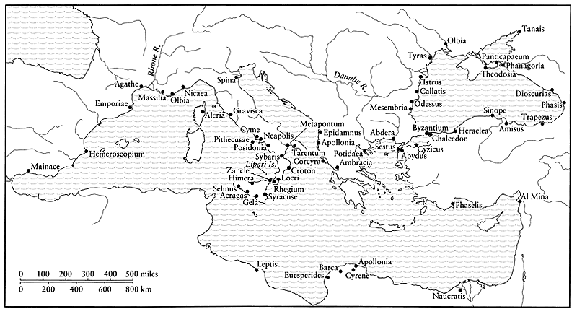

Slide 20
Some vocab. …
apoikia, “colony”
metropolis, “mother city”
emporion, “market”
outside town
overseas trading post
Al Mina
Gravisca (Italy)
Naukratis

Slide 21
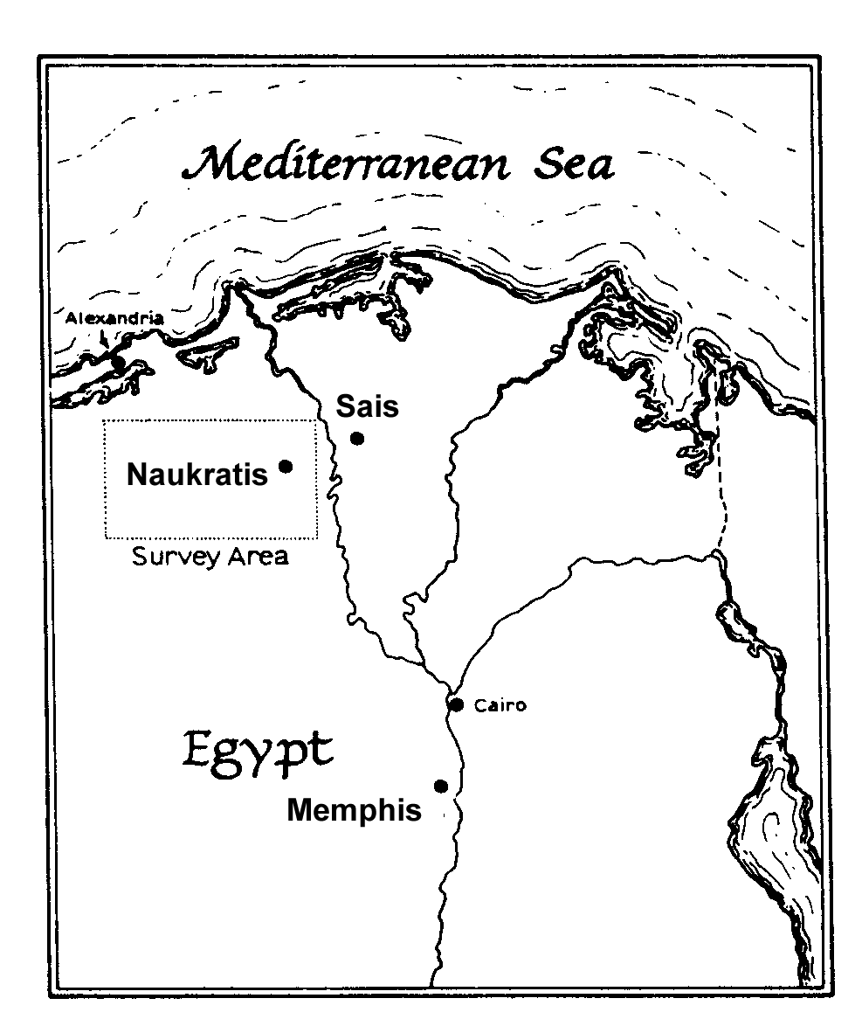
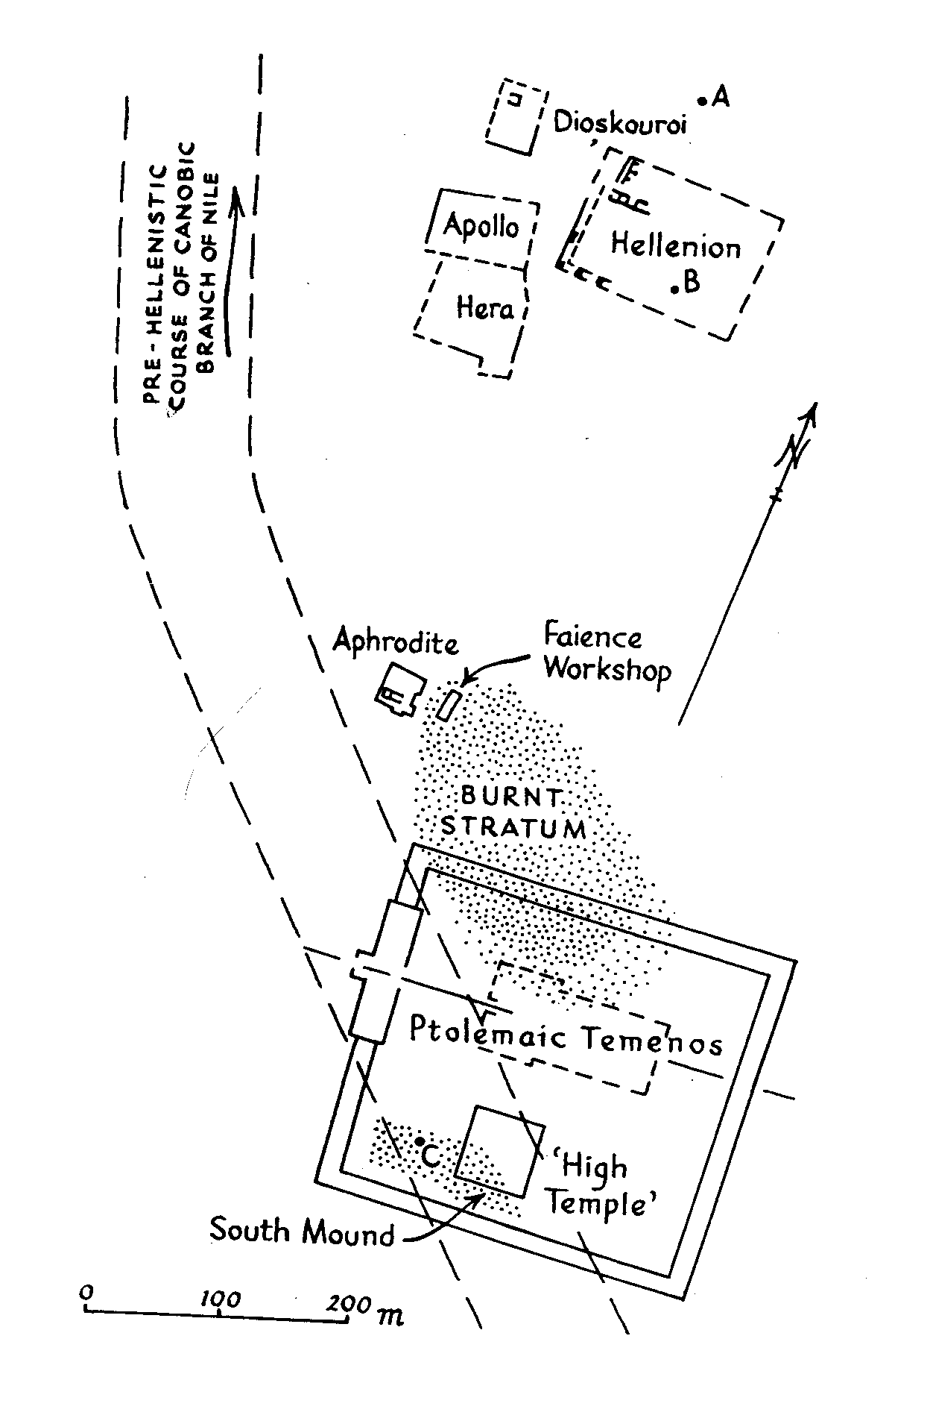
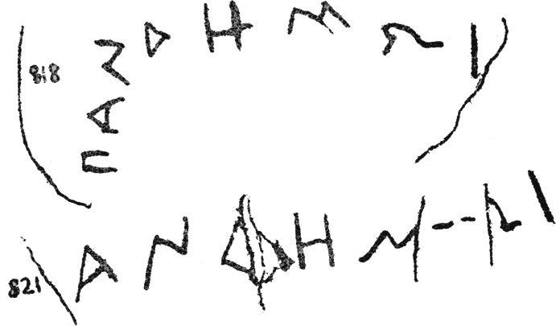
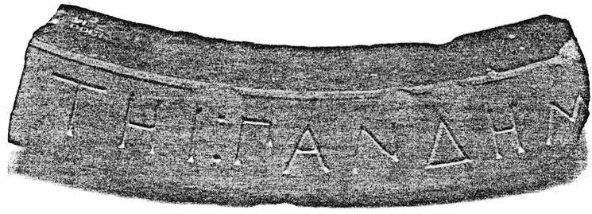
Naukratis, Pandemos Dedications
[ΑΦΡΟΔΙ]ΤΗΙ ΠΑΝΔΗΜΩΙ

Slide 22
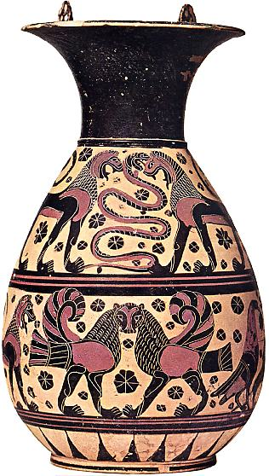
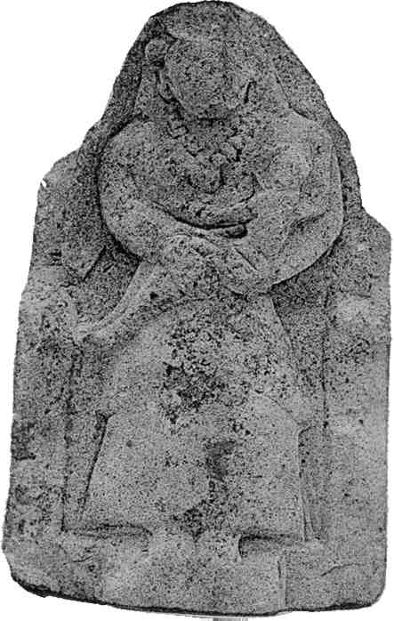
Isis-like figure holding child. Temple of Aphrodite, Naukratis (500s BCE?)
“Orientalizing” Corinthian (not Naukratis) Olpe, ca. 600 BCE

Slide 23
λαλῶμεν ἑλληνιστί. ῥήματα
αἱρέω (take)
_________ (present)
_________ (future)
_________ (aorist)
ἔρχομαι (go)
_________
_________
_________
λέγω (say)
_________
_________
_________
ὁράω (see)
_________
_________
_________
φέρω (bear, carry)
_________
_________
_________
αἱρέω
ὁράω
αἱρήσω
ὄψομαι
εἷλον
εἶδον
ἔρχομαι
φέρω
εἶμι
οἴσω
ἦλθον
ἤνεγκον
λέγω
λέξω
εἶπον

