Slide 1
Chapter 12
grk 102

Slide 2
λαλῶμεν ἑλληνιστί!
ὦ [μαθητρί/μαθητά]· χθές τί ἐποίησας; πότερον...
σφαίρᾳ ἔπαισας, ἢ
ἔγραψάς τι, ἢ
ἠργάσω ἐν πωλητηρίῳ τινι;

Slide 3
ἀγγλιστί | ἑλληνιστί
 | principal parts
 | 1st (pres) | 2nd (fut act/mid) | 3rd (aor act/mid)
 |  |  | 1st aor, indic forms
 |  |  | ἐγώ | σύ | ἡ παῖς | ἡμεῖς | ὑμεῖς | οἱ παῖδες
play | παίζω | παιξοῦμαι | ἔπαισα | ἔπαισας | ἔπαισε(ν) | ἐπαίσαμεν | ἐπαίσατε | ἔπαισαν
write | γράφω | γράψω | ἔγραψα | ἔγραψας | ἔγραψε(ν) | ἐγράψαμεν | ἐγράψατε | ἔγραψαν
work | ἐργάζομαι | ἐργάσομαι | ἠργασάμην | ἠργάσω | ἠργάσατο | ἠργασάμεθα | ἠργάσασθε | ἠργάσαντο
 | aor imperat | aor inf | aor PTC
play | παῖσον, παίσατε | παῖσαι | παίσᾱς, παίσασα, παῖσαν
write | γράψον, γράψατε | γράψαι | γράψᾱς, γράψσασα, γρᾶψαν
work | ἔργασαι, ἐργάσασθε | ἐγάσασθαι | ἐργασάμενος, ἐργασαμένη, ἐργασάμενον

Slide 4
ἐλαύνω, καλέω, μάχομαι, πράττω princ parts
_________ (present system)
_________ (fut act/mid)
_________ (aor act/mid)

Slide 5
ACTIVE | MIDDLE
INDICATIVE
ἔ-λυσ-α | ἐ-λυσ-άμην
ἔ-λυσ-ας | ἐ-λύσ-ω
ἔ-λυσ-ε(ν) | ἐ-λύσ-ατο
ἐ-λύσ-αμεν | ἐ-λυσ-άμεθα
ἐ-λύσ-ατε | ἐ-λύσ-ασθε
ἔ-λυσ-αν | ἐ-λύσ-αντο
IMPERATIVE
λῦσ-ον | λῦσ-αι
λύσ-ατε | λύσ-ασθε
INFINITIVE
λῦσ-αι | λύσ-ασθαι
PARTICIPLE
λύσ-ας, λύσασ-α, λῦσ-αν (λύσαντος, λυσάσης, etc.) | λυσ-άμενος, λυσ-αμένη, λυσ-άμενον

Slide 6
ACTIVE | MIDDLE
INDICATIVE
ἔ-λυσ-α | ἐ-λυσ-άμην
ἔ-λυσ-ας | ἐ-λύσ-ω
ἔ-λυσ-ε(ν) | ἐ-λύσ-ατο
ἐ-λύσ-αμεν | ἐ-λυσ-άμεθα
ἐ-λύσ-ατε | ἐ-λύσ-ασθε
ἔ-λυσ-αν | ἐ-λύσ-αντο
IMPERATIVE
λῦσ-ον | λῦσ-αι
λύσ-ατε | λύσ-ασθε
INFINITIVE
λῦσ-αι | λύσ-ασθαι
PARTICIPLE
λύσ-ας, λύσασ-α, λῦσ-αν (λύσαντος, λυσάσης, etc.) | λυσ-άμενος, λυσ-αμένη, λυσ-άμενον

Slide 7
λαλῶμεν ἑλληνιστί
λύω λύσω ἔλυσα
παῖς, παιδός - ὁ / ἡ
ὁ βοῦς, τοῦ βοός (τοὺς βοῦς)
ἡ μήτηρ, τῆς μητρός

Slide 8
λαλῶμεν ἑλληνιστί
τί ἐποίησας χθές;
ἐ-θεᾱσάμην τὰς τραγῳδίας (θεάομαι)
Παρ-ε-σκεύασα τὸν δεῖπνον (παρασκευάζω)
ἔ-σπευσα οἴκαδε (σπεύδω)

Slide 9
Oral Quiz and Drill
λύω – princ pts
λύω
λύσω
ἔλυσα
λύω – paradigm…
λύω – model sentences
λύω τὸν βοῦν
λύομαι τὸν παῖδα

Slide 10
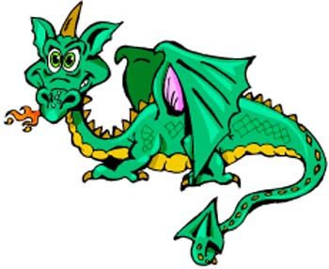
λαλῶμεν ἑλληνιστί. Princ. Parts of...
ἐλαύνω (τὸ αὐτοκίνητον)
_______
_______
_______
καλέω (τὴν φίλην / τὸν φιλόν)
_______
_______
_______
μάχομαι (πρὸς τὸν δρακόντα)
_______
_______
_______
πράττω (εὖ / κακῶς)
_______
_______
_______
τί ἐποίησας χθές;
τί βούλει ποιῆσαι;
τί δεῖ σε ποιῆσαι;
τί ποιήσας/ποιήσασα χαιρεις;

Slide 11
Oral Quiz 2 (beta section, asigmatic aor.). Princ. Parts of...
αἴρω
_______
_______
_______
ἀπο-κτείνω
_______
_______
_______
ἐγείρω
_______
_______
_______
καλέω
_______
_______
_______
κρίνω
_______
_______
_______
μένω
_______
_______
_______

Slide 12
Oral Quiz 2 (beta section, asigmatic aor.). Princ. Parts of...
αἴρω
αἴρω
ἀρῶ (< ἀρέω)
ἦρα (ἀρ-)
ἀπο-κτείνω
ἀπο-κτείνω
ἀπο-κτενῶ (< -κτενέω)
ἀπ-έ-κτεινα
ἐγείρω
ἐγειρω
ἐγερῶ (< ἐγερέω)
ἤγειρα
καλέω
καλέω
καλῶ (< καλέω, < καλέσω)
ἐκάλεσα
κρίνω
κρίνω
κρινῶ (< κρινέω)
ἔκρινα
μένω
μένω
μενῶ (< μενέω, μενέσω)
ἔμεινα

Slide 13
Oral Greek
τί ἐποίησας χθές; ἆρα ...
ἔμεινας οἴκοι; (μένω)
ἀπ-έ-κτεινας τὸν τύραννον; (ἀποκτείνω)
ἤγειρας τοὺς παῖδας (ἐγείρω)

Slide 14
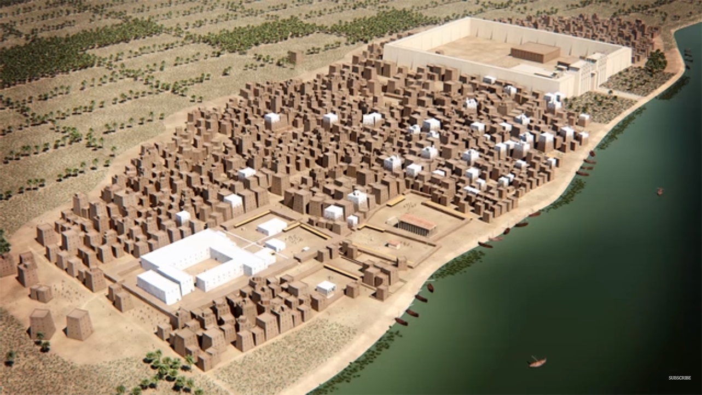

Slide 15
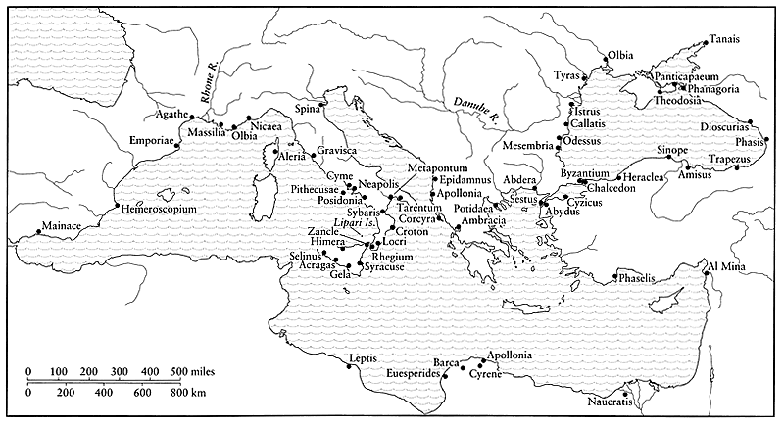

Slide 16
Some vocab. …
apoikia, “colony”
metropolis, “mother city”
emporion, “market”
outside town
overseas trading post
Al Mina
Gravisca (Italy)
Naukratis

Slide 17
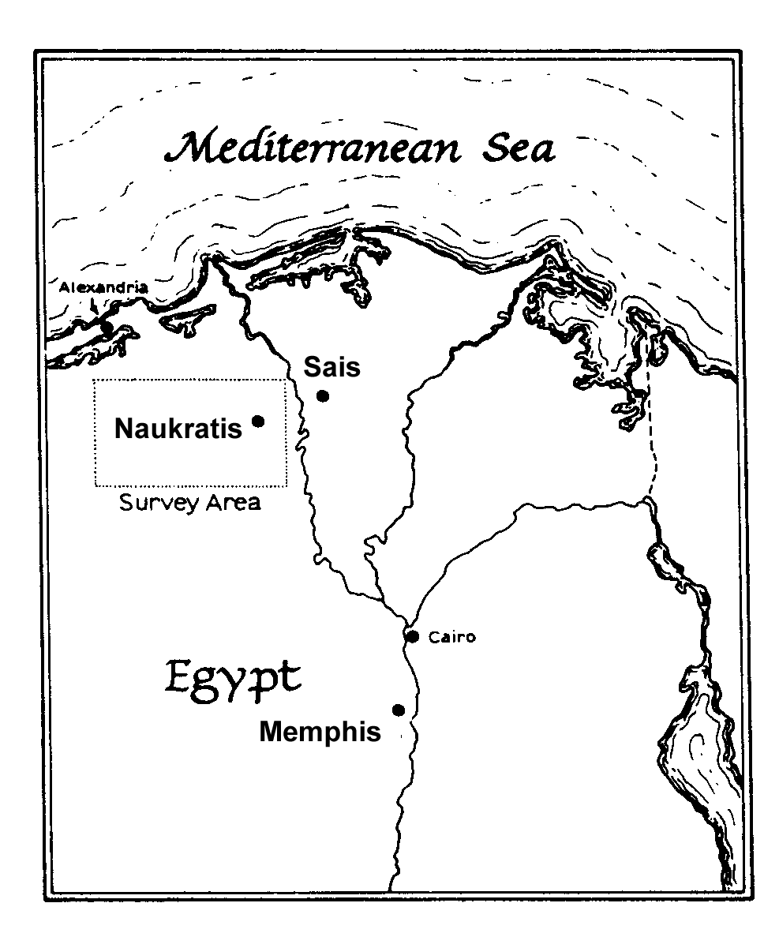
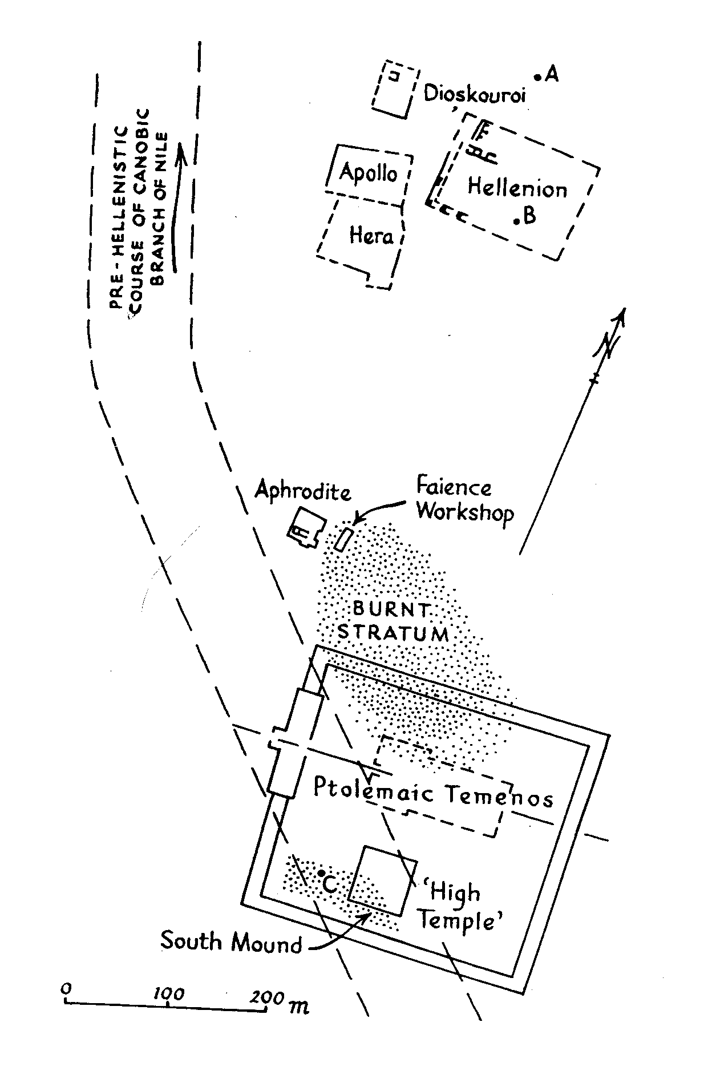
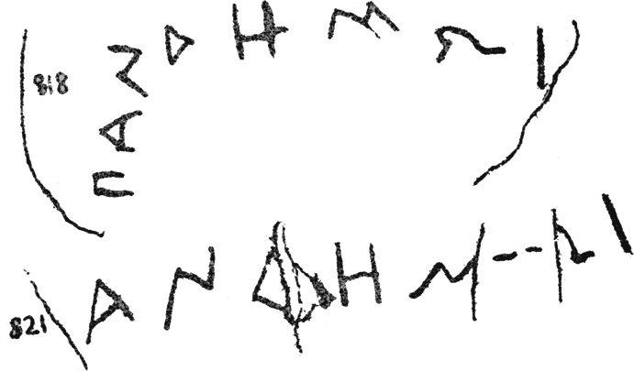
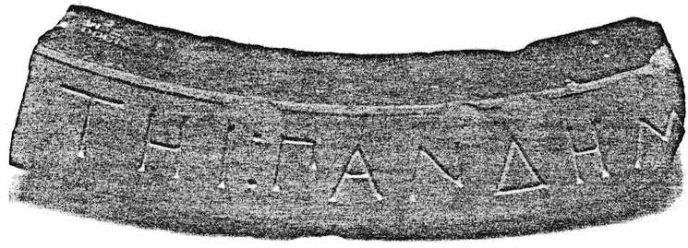
Naukratis, Pandemos Dedications
[ΑΦΡΟΔΙ]ΤΗΙ ΠΑΝΔΗΜΩΙ

Slide 18
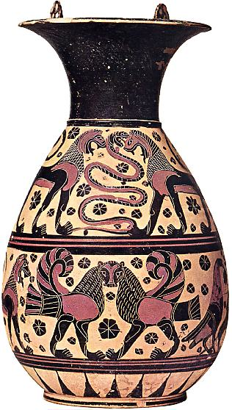
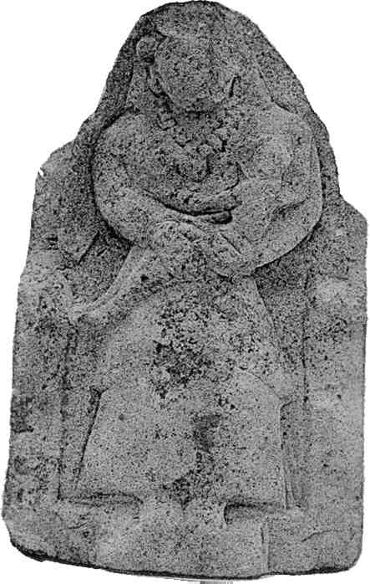
Isis-like figure holding child. Temple of Aphrodite, Naukratis (500s BCE?)
“Orientalizing” Corinthian Olpe, ca. 600 BCE

Slide 19
Bibliography
Boardman, J. 1999
The Greeks Overseas: Their Early Colonies and Trade, ed. 4. London
Scholtz, A. 2002/3
“Aphrodite Pandemos at Naukratis.” Greek, Roman and Byzantine Studies 43:231–242

Slide 20
Midterm Notes
τῶν γὰρ γυναικῶν, αἱ μὲν οἴκοι ἐργαζόμεναι οὐ παύσονται· αἱ δὲ ἐν τῷ ἄστει πρὸς τὰς πύλας σπεύσουσιν.

Slide 21
ACTIVE | MIDDLE
INDICATIVE
ἔ-λυσ-α | ἐ-λυσ-άμην
ἔ-λυσ-ας | ἐ-λύσ-ω
ἔ-λυσ-ε(ν) | ἐ-λύσ-ατο
ἐ-λύσ-αμεν | ἐ-λυσ-άμεθα
ἐ-λύσ-ατε | ἐ-λύσ-ασθε
ἔ-λυσ-αν | ἐ-λύσ-αντο
IMPERATIVE
λῦσ-ον | λῦσ-αι
λύσ-ατε | λύσ-ασθε
INFINITIVE
λῦσ-αι | λύσ-ασθαι
PARTICIPLE
λύσ-ας, λύσασ-α, λῦσ-αν (λύσαντος, λυσάσης, etc.) | λυσ-άμενος, λυσ-αμένη, λυσ-άμενον

Slide 22
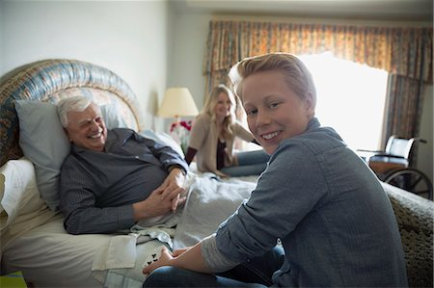
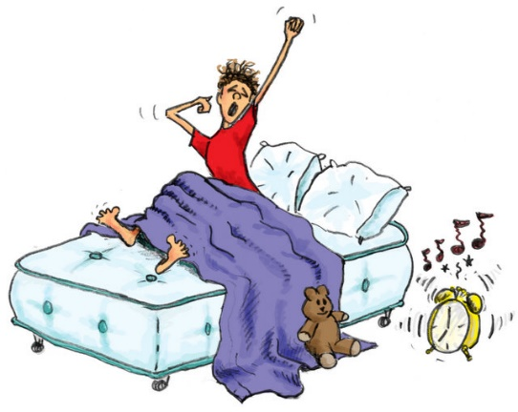
λαλῶμεν ἑλληνιστί. Princ. Parts of...
αἴρω
_______
_______
_______
ἀποκτείνω
_______
_______
_______
ἐγείρω
_______
_______
_______
καλῶ
_______
_______
_______
μένω
_______
_______
_______
ὁ πάππος, τοῦ πάππου
ὁ / ἡ παῖς, τοῦ / τῆς παιδός
τί ἐποίησας χθές;
τί βούλει ποιῆσαι;
τί ποιήσας/ποιήσασα χαιρεις;
ἐν τῇ κλίνῃ
ἐκ τῆς κλίνης

