Slide 1
CH13, Imperfect Tense, Relative Prons.
GRK 102
Notes:
Murder of Agamemnon
Csapo Context of Ancient Drama, plate 2a

Slide 2
Παρατακτικὸς χρόνος
Imperfect Tense

Slide 3
Παρατακτικὸς χρόνος, Stem Formation
Principal parts, λείπω
_______
_______
_______
Imperfect Stem
λείπω
λείψω
ἔλιπον
ἔλειπ-

Slide 4
Παρατακτικὸς χρόνος, Endings (λείπω)
Active
Middle
ἐγὼ
σὺ
ἡ Μυρρίνη
ἡμεῖς
ὑμεῖς
οἱ παῖδες
ἐγὼ
σὺ
ἡ Μυρρίνη
ημεῖς
ὑμεῖς
οἱ παῖδες
ἔλειπον
ἐλειπόμην
ἔλειπες
ἐλείπου
ἔλειπε(ν)
ἐλείπετο
ἐλείπομεν
ἐλειπόμεθα
ἐλείπετε
ἐλείπεσθε
ἔλειπον
ἐλείποντο

Slide 5
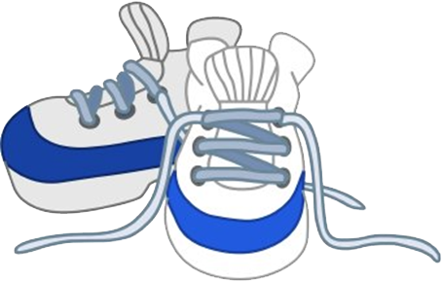
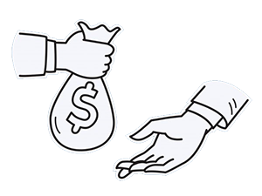
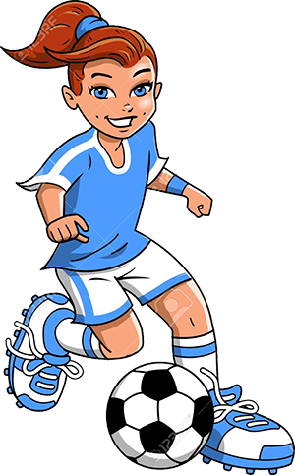
λαλῶμεν ἑλληνιστί· ῥήματα ἐν τῷ παρατακτικῷ
λέξεις (vocabulary)
διάλογος (dialogue)
λύω τὰ ὑποδήματα
λύομαι τοὺς παῖδας
σφαίρᾳ παίζω
χθές, τί ἐποίεις;
ὦ διδάσκαλε, χθὲς _______
παρατακτικὸς χρόνος
“imperfect tense”
ῥήματα ἐν τῷ παρατακτικῷ
“verbs in the imperfect tense”

Slide 6
Aorist, Present, Imperfect — Time and Aspect
Aorist tense
Time?
For indicative moods
Then (past)
Non-indicative moods
Present/concurrent
Prior/earlier
Aspect?
Always aoristic
Present tense
Time?
For indicative moods
Now (present)
Non-indicative moods
Present/concurrent
Aspect?
Always “imperfective”
Imperfect tense (always indic.)
Time?
Then (past)
Aspect?
Always “imperfective”

Slide 7
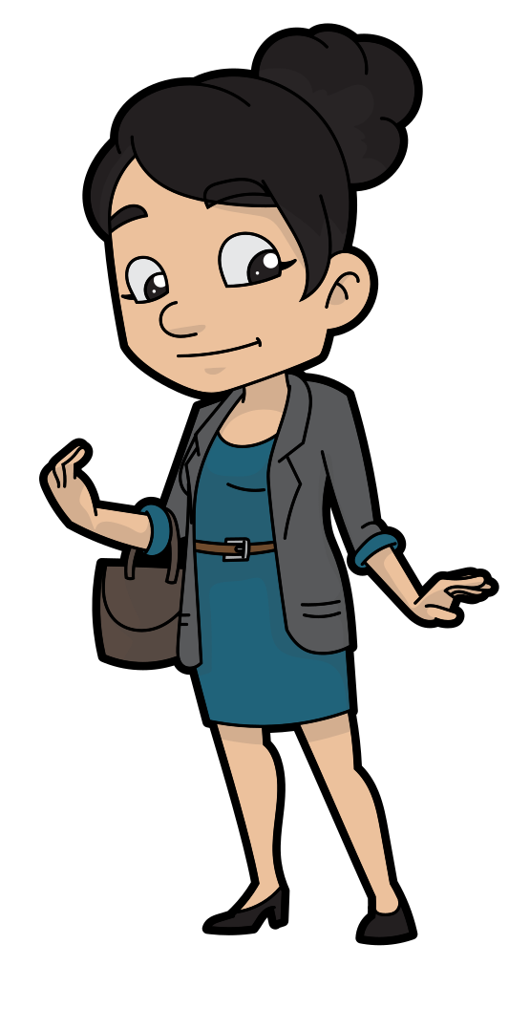
λαλῶμεν ἑλληνιστί· σχετικαὶ ἀντωνυμίαι (rel. pronouns)
τίς ἐστιν αὕτη; (Who is she?)
αὕτη ἐστιν ἡ γυνὴ ἣ τὸν παῖδα ἐλύσατο

Slide 8
λαλῶμεν ἑλληνιστί· σχετικαὶ ἀντωνυμίαι (rel. pronouns)
τίς ἐστιν οὗτος; (Who is he?)
οὗτος ἐστιν ὁ ἀνὴρ _____ τὸν παῖδα ἐλύσατο

Slide 9
λαλῶμεν ἑλληνιστί· σχετικαὶ ἀντωνυμίαι (rel. pronouns)
τίς ἐστιν αὕτη; (Who is she?)
αὕτη ἐστιν ἡ παῖς ___ ὁ ἀνὴρ ἐλύσατο

Slide 10
λαλῶμεν ἑλληνιστί· σχετικαὶ ἀντωνυμίαι (rel. pronouns)
τί ἐστιν τοῦτο; (What is that?)
τοῦτό ἐστι τὸ γένος (family) _______ ἡ γυνὴ ἐλύσατο

Slide 12
λαλῶμεν ἑλληνιστί! — Relative Pronoun
In English??
In Greek??

Slide 13
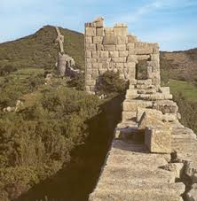
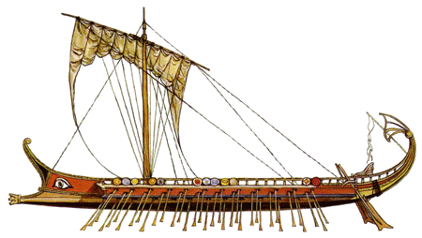
λαλῶμεν ἑλληνιστί!
τριήρης
τεῖχος
ἡ τριήρης
τῆς τριήρους
τῇ τριήρει
τὴν τριήρη
ὦ τριῆρες!
αἱ τριήρεις
τῶν τριήρων
ταῖς τριήρεσι(ν)
τὰς τριήρεις
ὦ τριήρεις
τὸ τεῖχος
τοῦ τείχους
τῷ τείχει
τὸ τεῖχος
ὦ τεῖχος
τὰ τείχη
τῶν τειχῶν
τοἰς τείχεσι(ν)
τὰ τείχη
ὦ τείχη

Slide 14
λαλῶμεν ἑλληνιστί!
τριήρης
τεῖχος
ἆρα ὁρᾷς τὴν τριήρη;
τίνα τριήρη;
τὴν τριήρη ἐν ____ ἐστιν Δικαιόπολις!
ἆρα ὁρᾷς τὸ τεῖχος;
τί τεῖχος;
τὸ τεῖχος ἐν ____ ἐστι Δικαιόπολις!

