Slide 1
GRK 102, CH14
Regular/Irregular Comparison; Interrogatives/Indefinites

Slide 2
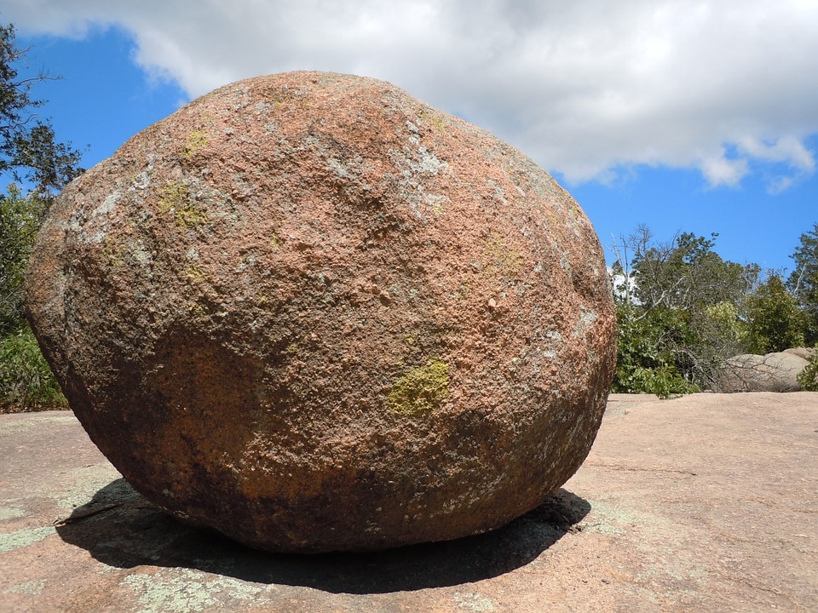
λέξεις
τὸ πτερόν, τοῦ πτεροῦ
ἡ πέτρα, τῆς πέτρας

Slide 3
λαλῶμεν ἑλληνιστί
ἆρα χαλεπόν ἐστιν αἴρειν τὸ πτερόν;
ἆρα χαλεπόν ἐστιν αἴρειν τὴν πέτραν;
τί αὐτῶν ἐστι χαλεπότερον αἴρειν;
πότερον χαλεπότερόν ἐστιν αἴρειν τὸ πτερὸν ἢ τὴν πέτραν;

Slide 4
λαλῶμεν ἑλληνιστί
πῶς χαλεπόν ἐστιν αἴρειν τὸ πτερόν
οὐ μάλα
πολύ
_________???
πῶς χαλεπόν ἐστιν αἴρειν τὴν πέτραν
οὐ μάλα
πολύ
_________???

Slide 5
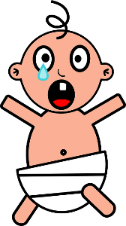
τίς ἐστι μείζων;
τίς ἐστι ______;
μείζων
μέσγιστος
ἐλάττων
ἐλάχιστος, -η
ἀμείνων
ἄριστος, -η
ὁ Φίλιππος
ὁ Πῶλος
ἡ Μέλιττα

Slide 6
πῶς ἔχεις;
πῶς ἔχεις τήμερον;
πῶς εἶχες χθές;
ἆρα εἶχες
καλλίον χθὲς ἢ τήμερον;
καλλίον [τοῦ Μάρκου / ἢ ὁ Μάρκος];
κάλλιστα
ὡς κάλλιστα

Slide 7
Τί πράττεις τήμερον;
Τί εἶχες χθές;
ἆρα εἶχες
ἄμεινον χθὲς ἢ τήμερον;
ἄμεινον ἢ τοῦ _________; (οὐκ οἶδα, ὦ διδάσλαλε!)
ἄριστα
ὡς ἄριστα

Slide 8
A. “regular” comparison (see above)
δεινός, δεινή, δεινόν | δεινό-τερος, -ᾱ, -ον | δεινό-τατος, -η, -ον
φοβερός, -ά, -όν | φοβερ-ώτερος, -ᾱ, -ον | φοβερ-ώτατος, -η, -ον
ψευδής, ψευδές | ψευδέσ-τερος, -ᾱ, -ον | ψευδέσ-τατος, -η, -ον

Slide 9
B. Adj. “irregular” comparison
ἀγαθός, -ή, -όν | ἀμείνων, ἄμεινον (ἀμείνονος, etc.) | ἄριστος, -η, -ον
κακός, -ή, -όν | κακίων, κάκιον | κάκιστος, -η, -ον
καλός, etc. | καλλίων, κάλλιον | κάλλιστος, etc.
μέγας, μεγάλη, μέγα | μείζων, μεῖζον | μέγιστος, etc.
ὀλίγος, etc. | ἐλάττων, ἔλαττον | ὀλίγιστος, etc.
πολύς, πολλή, πολύ | πλείων (πλέων), πλεῖον (πλέον) | πλείστος, etc.
B. Adv. “irregular” comparison (see above)
ἄμεινον | ἄριστα
κάκιον | κάκιστα
πολύ | πλεῖστα
μᾶλλον | μάλιστα

Slide 10
A. “regular” comparison (see above)
φοβερῶς | φοβερ-ώτερον | φοβερ-ώτατα
ψευδῶς | ψευδέστερον | ψευδεστατα
B. “irregular” comparison (see above)
εὖ | ἄμεινον | ἄριστα
κακῶς | κάκιον | κάκιστα
πολύ | πολύ | πλεῖστα
μάλα | μᾶλλον | μάλιστα

Slide 11
“Eye” Verbs
ὁράω, βλέπω, θεάομαι

Slide 12
What’s Wrong with This Picture?
τὰς παῖδας, αἳ τὰς τραγῳδίας ἐν τῷ θεάτρῳ ἐθεῶτο, ἔβλεπες, ἀλλ᾽ αὐτὰς οὐκ εἶδες.
“The boy, who looked the tragedies in the theater, saw her but didn’t watch her.”
“You were looking at the girls who were watching the tragedies in the theater, but you didn’t (actually) see them.”

Slide 13
λαλῶμεν ἑλληνιστί
Δεικτικαὶ ἀντωνυμίαι, “Demonstrative Pronouns/Pronomial Adjectives”

Slide 14
Δεικτικαὶ ἀντωνυμίαι· ἐρωτήματα, ἀποκρίσεις
Τί βιβλίον ἀρέσκει σοι; (Which book pleases [to] you? Which book do you like?)
πότερον ἀρέσκει σοι...
τόδε τὸ βιβλίον, ἠ
τοῦτο τὸ βιβλίον, ἢ
ἐκεῖνο τὸ βιβλίον;
ἐγώ
σύ
λεξικόν
τηλεφωνικὸς κατάλογος
γελοιογραφίαι

Slide 15
THIS (HERE)
 | sing. |  |  | plur.
nom.
gen.
dat.
acc.
THIS/THAT
nom.
gen.
dat.
acc.
THAT
 | sing. |  |  | plur.
nom.
gen.
dat.
acc.

Slide 16
THIS (HERE)
 | sing. |  |  | plur.
nom. | ὅ-δε | ἥ-δε | τό-δε | οἵ-δε | αἵ-δε | τά-δε
gen. | τοῦ-δε | τῆσ-δε | τοῦ-δε | τῶν-δε | τῶν-δε | τῶν-δε
dat. | τῷ‑δε | τῇ‑δε | τῷ‑δε | τοῖσ‑δε | ταῖσ‑δε | τοῖσ‑δε
acc. | τόν-δε | τήν‑δε | τό‑δε | τούσ‑δε | τάσ‑δε | τά‑δε
THIS/THAT
nom. | οὗτος | αὕτη | τοῦτο | οὗτοι | αὗται | ταῦτα
gen. | τούτου | ταύτης | τούτου | τούτων | τούτων | τούτων
dat. | τούτῳ | ταύτῃ | τούτῳ | τούτοις | ταύταις | τούτοις
acc. | τοῦτον | ταύτην | τοῦτο | τούτους | ταύτας | ταῦτα
THAT
 | sing. |  |  | plur.
nom. | ἐκεῖν-ος | ἐκείν-η | ἐκεῖν-ο | ἐκεῖν-οι | ἐκεῖν-αι | ἐκεῖν-α
gen. | ἐκείν-ου | ἐκείν-ης | ἐκείν-ου | ἐκείν-ων | ἐκείν-ων | ἐκείν-ων
dat. | ἐκείν‑ῳ | ἐκείν‑ῃ | ἐκείν‑ῳ | ἐκείν‑οις | ἐκείν‑αις | ἐκείν‑οις
acc. | ἐκεῖν‑ον | ἐκείν‑ην | ἐκεῖν‑ο | ἐκείν‑ους | ἐκείν‑ας | ἐκεῖν‑α

Slide 17
Demonstratives Drill
Demonstratives
Sentences — Use Demonstratives
This (here)
ὅδε etc.
This/that (here/there)
οὗτος etc.
That (there)
ἐκεῖνος etc.
τί ἐστιν τόδε; (answer maps gender)
ἥδε/ὅδε ἐστὶν ἄνθρωπός
Τίνα φιλεῖ ὁ ἀνὴρ;
Τίσιν ὁ λύκος προσχωρεῖ·
κτλ.

Slide 18
Interrogative versus Indefinite
interrogative |  | indefinite (enclitic)
 | who / what? |  | someone (etc.)
 | where? |  | somewhere
 | from where? |  | from somewhere
 | to where? |  | to somewhere
 | when? |  | sometime
 | how? |  | somehow

Slide 19
Interrogative versus Indefinite
interrogative |  | indefinite (enclitic)
τίς / τί; | who / what? | τις / τι | someone (etc.)
ποῦ’ | where? | που | somewhere
πόθεν; | from where? | ποθεν | from somewhere
ποῖ; | to where? | ποι | to somewhere
πότε; | when? | ποτε | sometime
πῶς; | how? | πως | somehow

Slide 20
Demonstratives and Place
Compare place expressions
… with DEMONTRATIVES
(Right) here
ἐνθάδε (at which)
δεῦρο/ἐνθάδε/ἐνταῦθα (to which)
ἐνθένδε/ἐντεῦθεν (from which)
Here/there (where, to which)
ἐνταῦθα
(Over) there
ἐκεῖ (at which)
ἐκεῖσε (to which)
ἐκεῖθεν (from which)
This (right here)
ὅδε
This/that
οὗτος
That (there)
ἐκεῖνος

Slide 21
Position
Demonstrative adjectives (not the pronouns)
Predicate position?
Attributive position?
Predicate
This (here) house? (ὅδε, οἶκος)
ὅδε ὁ οἶκος
ὁ οἶκος ὅδε

