Slide 1
GRK 102
CH15

Slide 2
λαλῶμεν ἑλληνιστί
ἐπὶ τῷ βαίνειν· τοῦ ἀοριστοῦ ἡ κλίσις. Aorist of βαίνω

Slide 3

ΥΜΕΙΣ ΕΠΙ ΤΗΣ ΝΕΩΣ (“you-all on board ship”)
ἡ ναῦς, τῆς νεώς.
εἰςβαινω εἰς τὴν ναῦν, “to board ship”
ὁ λῃστής, τοῦ λῃστοῦ. ἡ λῃστρίς, τῆς λῃστρίδος
οἱ λῃσταί, τῶν λῃστῶν. αἱ λῃστρίδες, τῶν λῃστρίδων

Slide 4
τοῦ βαίνειν βασικά μέρη. βαίνω (“go”), Principle Parts
βαίνω
εἰσ-βαίνω “board (ship, plane, etc.)”
βαίνω.
βήσομαι.
ἔβην.
εἰσ-βαίνω.
εἰσ-βήσομαι.
εἰσ-έβην.

Slide 5


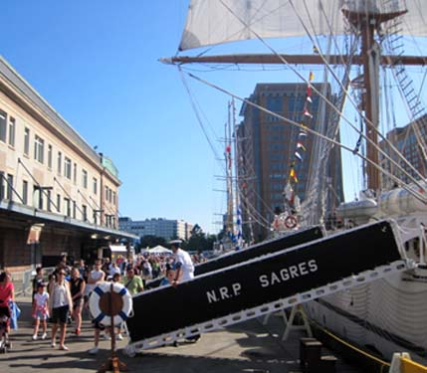

λαλῶμεν ἑλληνιστί
ὦ ______· τί ἐποίεις χθές; πότερον
  ἀνέγνως, ἢ
  τὴν τηλεόρασιν ἐθεῶ, ἢ
  τὴν ναῦν τὴν τῶν λῃστῶν εἰσέβης;
TV

Slide 6
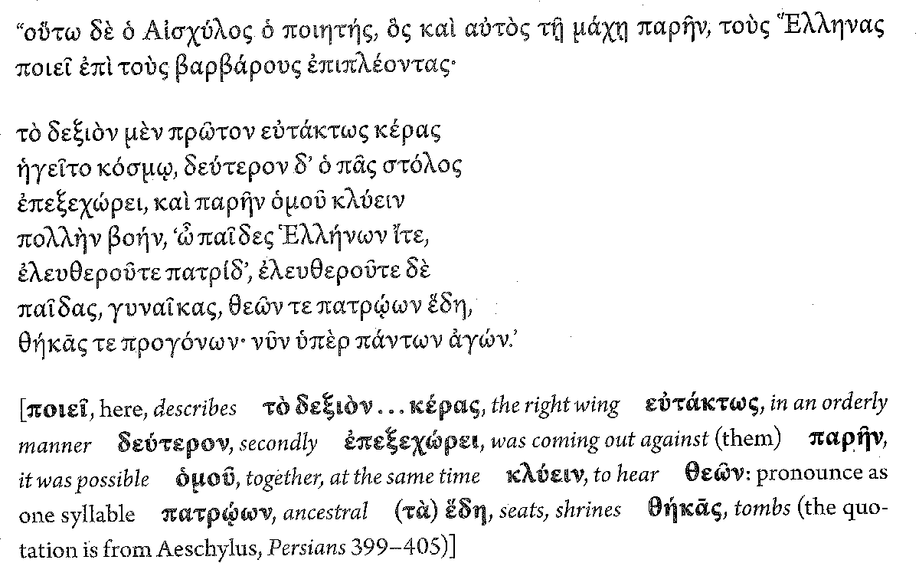
ἐλευθερόω, ἐλευθερώσω, ἠλευθέρωσα

Slide 7
Omicron Contracts (ἐλευθερόω as model)
ἐλευθερόω, _______________, _____________

Slide 8
Omicron Contracts (ἐλευθερόω as model)
ἐλευθερόω, ἐλευθερώσω, ἠλευθέρωσα

Slide 9
Omicron Contracts (ἐλευθερόω as model)
ἐλευθερόω, ἐλευθερώσω, ἠλευθέρωσα

Slide 10
Omicron Contracts (ἐλευθερόω as model)
ἐλευθερόω, ἐλευθερώσω, ἠλευθέρωσα

Slide 11

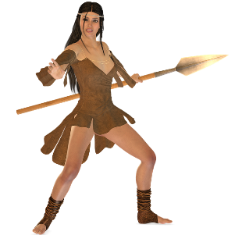


λαλῶμεν ἑλληνιστί — λέξεις
ἐλευθερόω, ἐλευθερώσω, ἠλευθέρωσα
ἡρῴνη, -ης, ἡ
ὁ ἥρως, τοῦ ἥρωος, τῷ ἥρῳ, τὸν ἥρω, οἱ ἥρωες, τῶν ἡρώων, τοῖς ἥρωσι, τοὺς ἥρας
ὁ / ἡ ἐν δεσμοτηρίῳ ἄνθρωπος

