Slide 1
Sparta and Corinth
Civilization, GRK 102

Slide 2
τεθνάμεναι γὰρ καλὸν ἐνὶ προμάχοισι πεσόντα
ἄνδρ᾽ ἀγαθὸν περὶ ἧι πατρίδι μαρνάμενον·

Slide 3
Comments
Sparta
Corinth
Little to say on women either place
Pro
stability
“aggressive military”
“Local autonomy was granted to nearby states”
agōgā
Con
cruelty to infants, to helots
militaristic
controlling aristocracy
imperialist
“continually trying to expand there borders”
Pro
wealth
port, more work
Con
unstable politics, tyranny

Slide 4
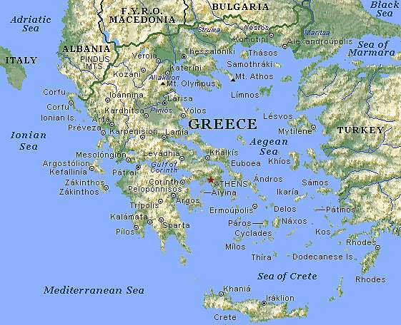
Corinth
Sparta

Slide 5
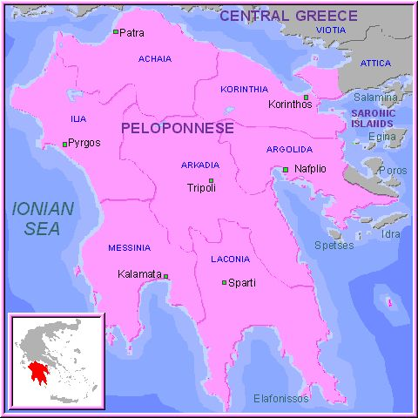

Slide 6
Linguistic, Historical, Cultural Notes
Dialect: Attic
ἡ Μοῦσα
λέγουσι “they say”
Dialect: Doric
standard Doric
ἁ Μοῖσα
λέγοντι
Laconian (Spartan)
ἁ Μῶhα
μυθίδοντι “they say”
Korinthos aphneios
“rich Corinth”
Sparta, Lakedaimon
early archaic period
cultural center
post-Messenian Wars
“Lycurgan constitution”

Slide 7
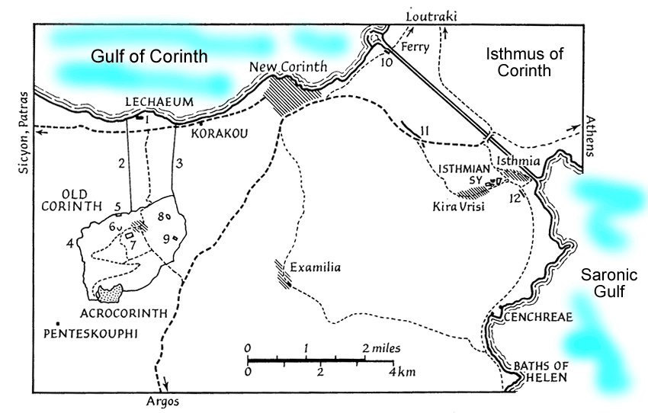
Corinth and the Isthmus

Slide 8
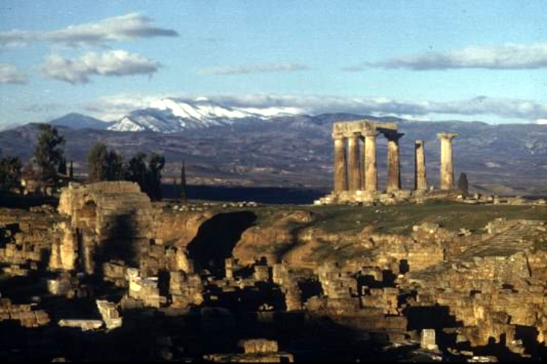
Corinth: Temple of Apollo

Slide 9
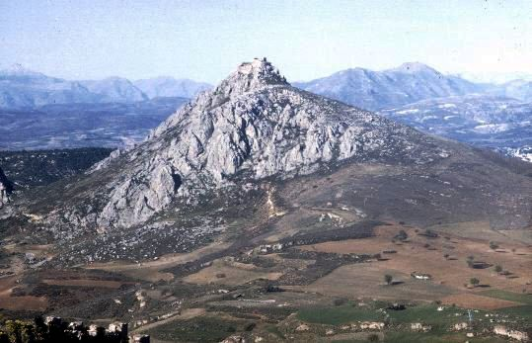
Corinth: Acrocorinth

Slide 10
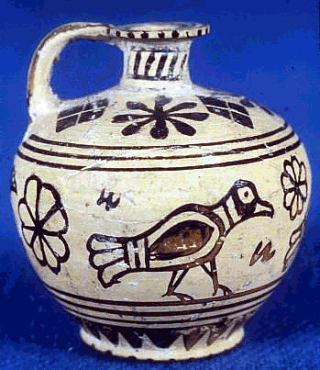
Protocorinthian Aryballos, ca. 720–690 BCE

Slide 11
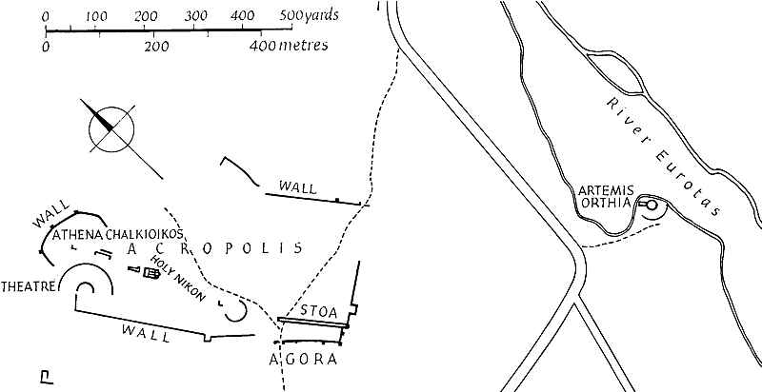
Plan of Ancient Sparta

Slide 12
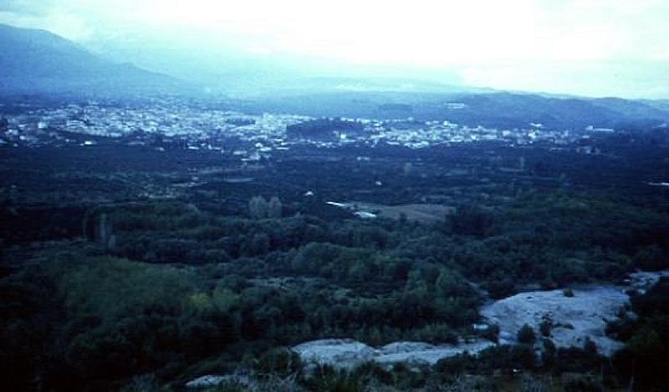
Sparta: View from Meneleum

Slide 13
“Suppose the city of Sparta to be deserted, and nothing left but the temples and ground plan: distant ages would be very unwilling to believe that the power of the Spartans was at all equal to their fame.” Thucydides

