Slide 1
Mycenae and Bronze Age Greece
GRK 102, CH19 Civ

Slide 2
Homer Iliad 2.569, 576-7
Οἳ δὲ Μυκήνας εἶχον ἐϋκτίμενον πτολίεθρον
[ . . . ]
τῶν ἑκατὸν νηῶν ἦρχε κρείων Ἀγαμέμνων
Ἀτρεΐδης·

Slide 3
21-Apr Oral Quiz: ἽΣΤΗΜΙ
Princ Parts
ἵστημι compounds
ἵστημι (ἵσταμαι, trans/intrans mid)
στήσω (trans)
ἔστησα (trans. 1st aor.)
ἔστην (intrans. athem. 2nd aor.)
ἕστηκα (irreg. act. intrans perf)
ἕσταμαι (intrans, rare)
ἐστάθην
+ ἀνά = ?
+ κατά = ?
+ εἰς = ?
etc.
ὁ Περικλῆς
  τοῦ Περικλέους
  τῷ Περικλεῖ
  τὸν Περικλέα

Slide 4
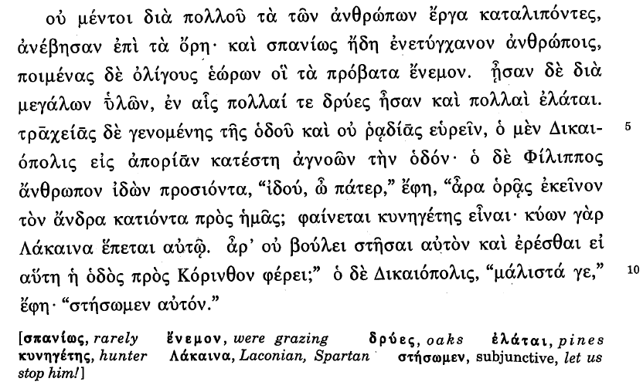

Slide 6
Time Line: Prehistoric Greece
Period | Events
3000-2100 Early Bronze Age | Village organization
2100-1600 Middle Bronze Age | 2100-1900 Arrival of proto-Greeks from Northwest? Anatolia?
1600-1150 Late Bronze Age | 1600 Palace cultures emerge (Mycenae, Tiryns, Pylos, Thebes, etc.) 1500-1450 Mycenaeans occupy Crete 1250-1225 Trojan War (??) 1200-1100 Palace systems collapse
based on Ancient Greece, 1999, Oxford

Slide 7
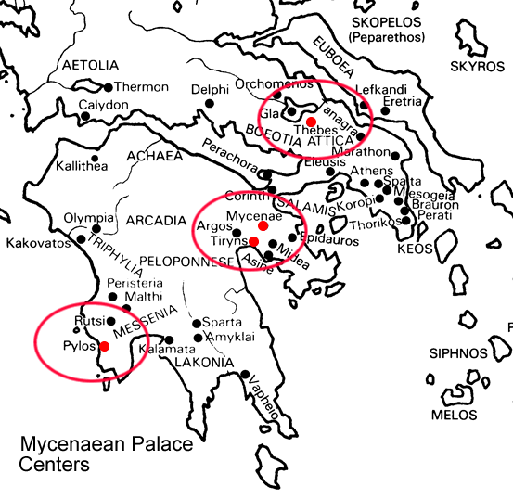

Slide 8
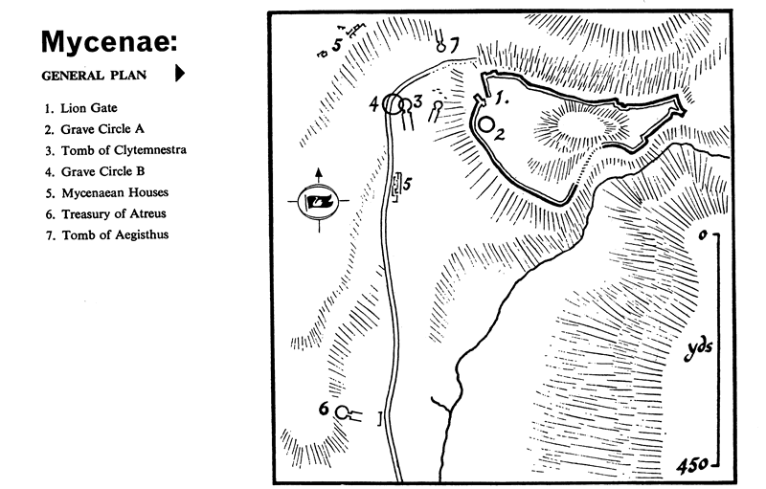

Slide 9
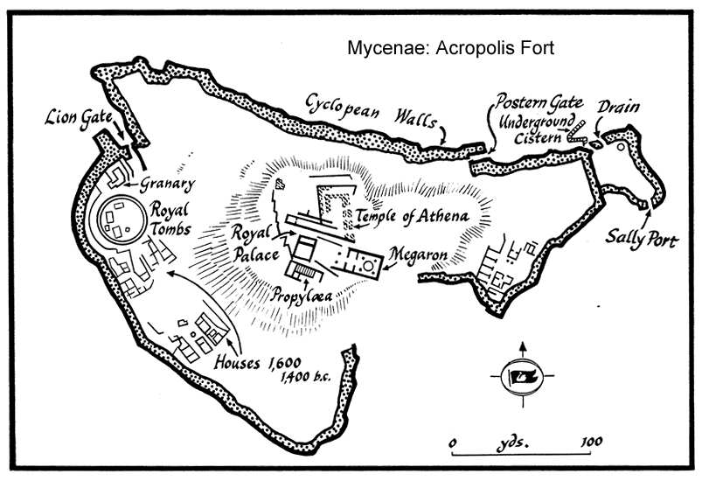

Slide 10
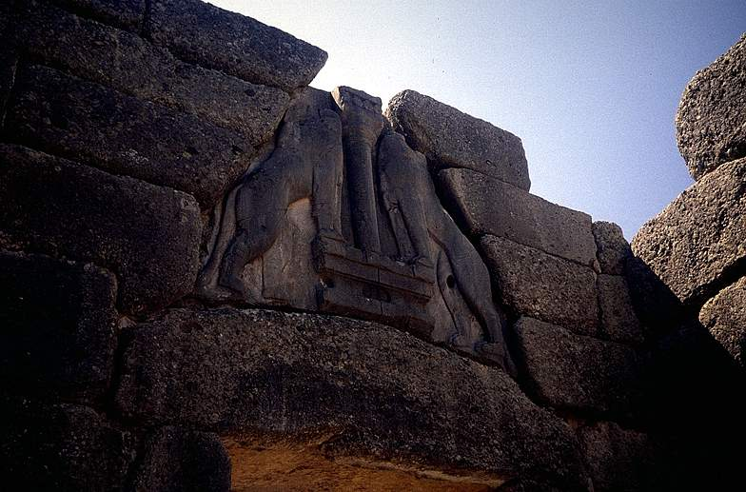
Lion Gate, Mycenae

Slide 11
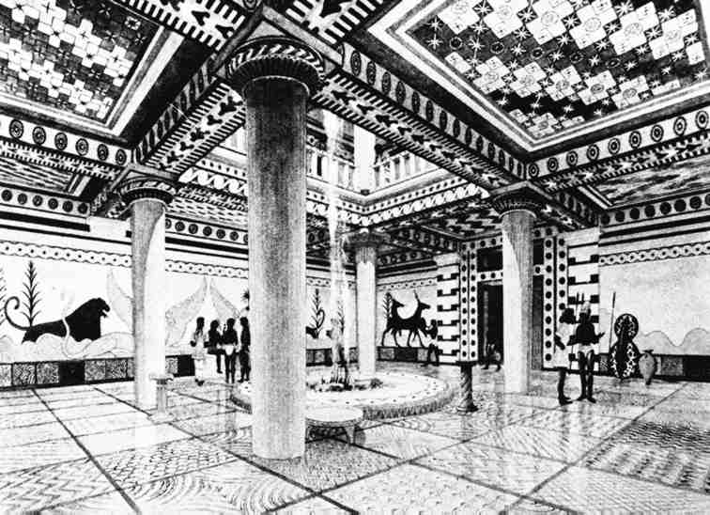
Megaron (great hall), Pylos

Slide 12
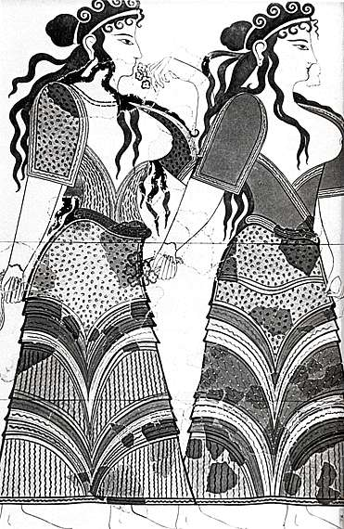
Women (fresco), Pylos, 1200s BCE

Slide 13
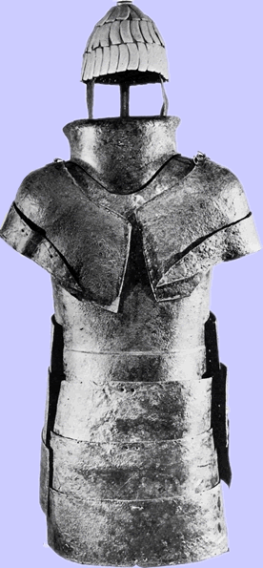
Armor from Dendra (Argolid). Boar’s tusk helmet. Late 1400s BCE

Slide 14
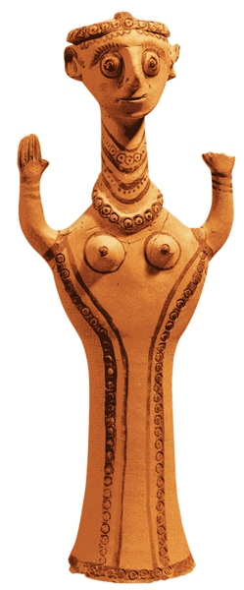
Praying “psi” goddess figurine. Mycenae.

Slide 15
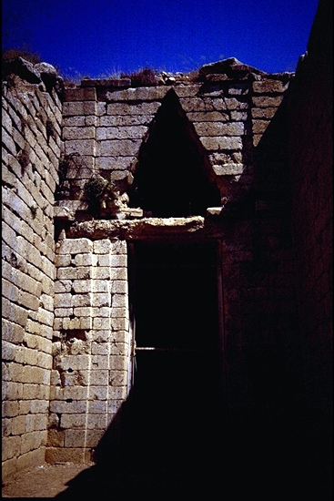
Tholos tomb, Mycenae.

Slide 16
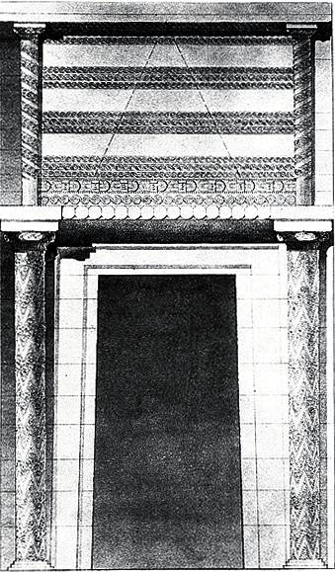
Tholos tomb entrance (reconstructed), Mycenae.

Slide 17
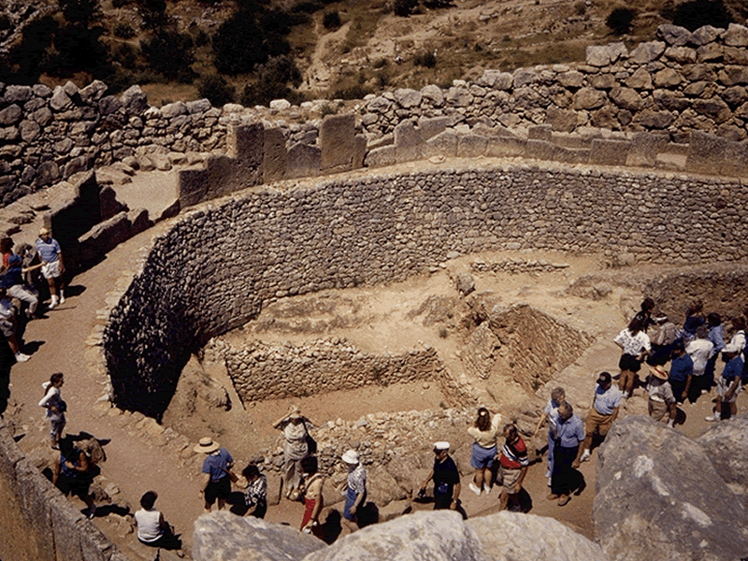

Slide 18
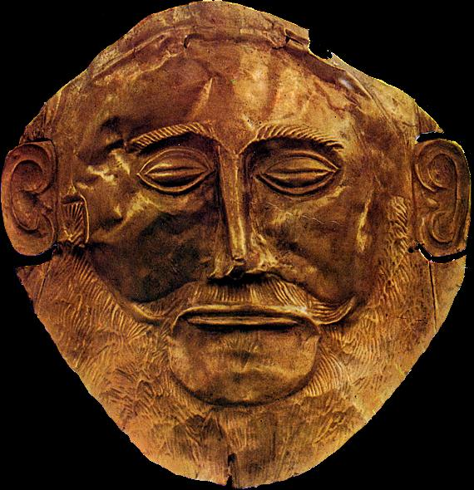
“Mask of Agamemnon,” Mycenae, 1500s BCE

Slide 19
Palace Society: Redistributive Economy
demos (village)
basileus (chieftain)
demos (village)
basileus (chieftain)
palace
wanax (king)
demos (village)
basileus (chieftain)
Produce to palace, where stored; then redistributed back to villages.

Slide 20
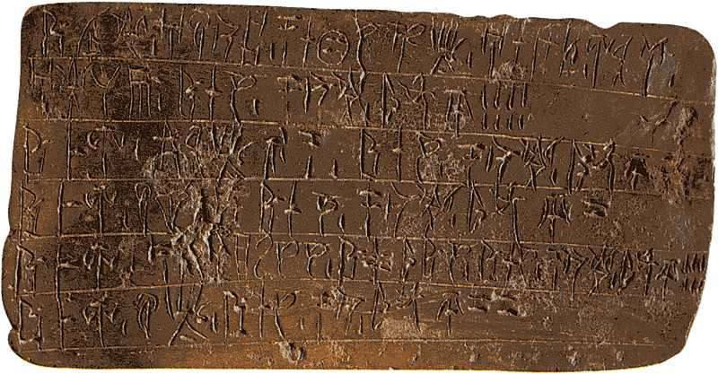
Linear-B clay tablet. Prehistoric Greek writing.

Slide 21
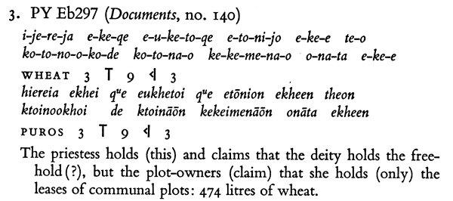
A Linear-B Inscription
ἱέρεια ἔχει ϞϜε εὔχετοί ϞϜε ἐτώνιον ἔχεεν θεὸν
κτοινόοχοι δὲ κτοινάων κεκειμενάων ὀνᾱτὰ ἔχεεν
Note use of ᾱ for η. ϞϜε (kwe) = τε (“and”). -αων = fem. gen. plur. εὔχετοι = εὔχεται (not “prays” but “claims”). κτοινόοχοι = “possession-holding” (as if κτεάνη “possession” + ἔχειν “to have”). ὀνᾱτὰ: ὀνητός later = “useful,” so “that on which ‘use’ is paid.”

Slide 22
Fall of Palace Societies
invasion by …
  Dorians??
  “Sea Peoples” (Mediterranean marauders)?
systems collapse (economic/political)?
combination?

