Slide 1
The Eve of War, 478–431 BCE
GRK 102, 5-Apr 2011

Slide 2
Quotes
ξυνελών τε λέγω τήν τε πᾶσαν πόλιν τῆς Ἑλλάδος παίδευσιν εἶναι
Φιλοκαλοῦμέν τε γὰρ μετ᾽ εὐτελείας καὶ φιλοσοφοῦμεν ἄνευ μαλακίας

Slide 3
New Verbs (learn with other vocab!)
(ἀπο/ἐπι)δείκνῡμι δείξω ἔδειξα δέδειχα δέδειγμαι ἐ-δείχθην
Show, demonstrate, prove
ἐπιδείκνυμαι, middle. Show off.
ζεύγνῡμι ζεύξω ἔζευξα — ἔζευγμαι ἐζεύχθην/ἐζεύγην
Yoke, connect together
ἀν-οίγνῡμι ἀν-οίξω ἀν-έῳξα ἀν-έῳχα ἀν-έῳγμαι ἀν-εῴχθην
Open (a door, etc.)
ῥηγνῡμι ῥήξω ἔρηξα ἔρρηξα ἔρρωγα (intrans. “have broken out”) ἐρράγην
Break

Slide 4
Comment
Athens’ and Sparta’s rocky relationship and manouvering

Slide 5
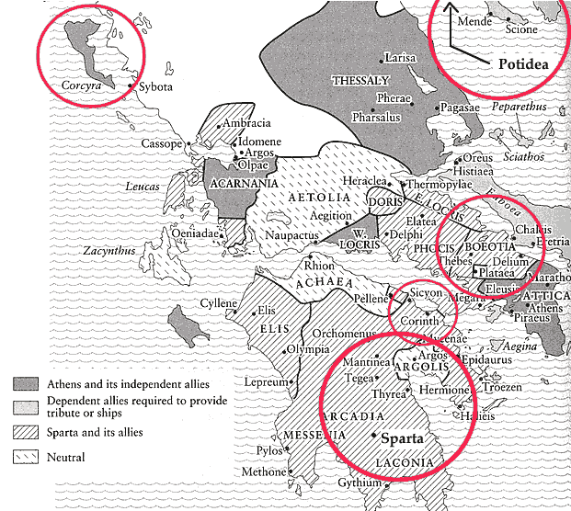

Slide 6
Time Line
Date | Event
480–479 | Defeat of Persians.
478 | Foundation: Delian League
463 | Sparta: Helot rebellion.
460s | Prominence of Cimon, Athens
461– | Pericles’ rise. (Break with Sparta, alliance with Argos.)
460–445 | Athenian land-based aggression: Megara, Boeotia
454 | Delian treasury to Athens
446 | “Thirty Years Peace”: Athens and Sparta
433/2 | Revolts: Corcyra v. Corinth. Potidea v. Athens. Megarian Decree.
431 | Sparta invades Attica

