Slide 1
The Masks of Dionysus
Euripides Bacchae 1

Slide 2

Prelims: On Index Card
Full name
Preferred name
Preferred pronouns
Scholtz, Andrew
“Professor Scholtz”
He, his, etc.

Slide 3
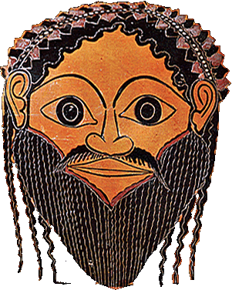
“For whoso leads the revel / He is always Dionysus”
(Euripides’ Bacchae, Chorus, p. 400)
Notes:
“For whoso leads the revel / He is always Dionysus” – what does that mean?
“what does the mask embody or conceal?
is the truly horrific vengeance dio wreaks truly just? or does he present a more unsettling figure - something outside the moral paradigms by which we mortals structure our lives?
and if any of us is leading the revel, a human wearing the mask, aren’t we implicated in that violence? are we Dionysus?

Slide 4
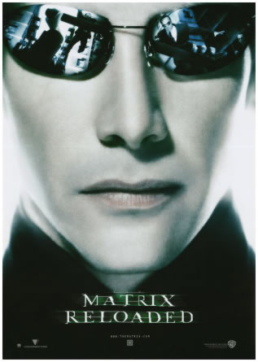
Neo
Matrix Reloaded (2003)
Dionysus/Satyr Mask
(Athenian, 500s BCE)
Notes:
Why are we reading eur’s Bacchae now, at this point in the semester? For in some ways it would make sense to read it together with the other plays by eur that we’ll be reading. it was one of the last he composed, one of the last full Athenian tragedies preserved.
It is because asking what it all has to do with Dionysus may be a way to begin to grasp what ancient Athenian tragedy was.
You know now that tragedy was closely associated with the god, at least in terms of occasions when tragedies were performed and watched.
But does that connection with dio have anything more to say about tragedy than that?
Some have argued no. tragedies may have originated in the tom-foolery of Dionysian worship: masking, partying, phallic processioning. what matters for modern readers are the ideas and their resonance today.
the ideas and their resonance today – that certainly matters. but an appreciation of how Athenian tragedy is not a thing of today, how its “contemporary“ resonances mattered for a bygone time, that can enrich our understanding of it now.
and this play, by forcing us to reflect on how anyone can be the god simply by virtue of the transformation that the mask implies, promises some of the most powerful such enrichment this semester.

Slide 5
Agenda
Recap and Update
  Theory and Practice: Athenian Tragedy
Bacchae: Background
  Drama Dramatized?
Discussion: Tragedy in Performance
  Rock the Palace! (pp. 418 ff.)

Slide 6
Recap and Update
Theory and Practice: Athenian Tragedy
Notes:
ASK YOURSELF: WILL THIS TREATISE HELP YOU IN APPRECIATING/CRITIQUING POETRY? (probably yes.) IN CREATING POETRY? (far more incomplete on that score. differs thus from ari's Rhetoric.) some of it really specifically concerned with critical questions, e.g., which better, epic or tragedy.
AND IF WE CAN VIEW ARISTOTLE’S as a critical-theoretical approach, does ari tell us anything useful about tragedy? what?
ari thus does not impart to readers tekhne (technical skill) as much as try to train them to recognize it, especially in areas that, for aristotle, count.

Slide 7
City Dionysia: Program
Dramatic preliminaries
“Showtime”
Pre-festival
  chorus assignments
Proagōn
“Introduction”
Pompē
Ceremonies
Dithyramb — 10
  Men’s choruses of 50
  Boys’ choruses of 50
Comedies — 5
Tragedy — 3 tetralogies
Notes:
prelims
Assignment of choruses
months earlier, under auspices of the “eponymous archon” for city dionysia (king archon for lenaea), criteria? not known for sure, but clearly not simply quality. past failures could perhaps count against aspiring competitor.
Proagōn (8th elephabolion)
preview of plays, after 440 bce, in pericles’ odeon. playwright, actors, chorus. galanded, no masks or costumes. discussed plays.
“Introduction” processional (on before 9th)
to and from Academy. the icon of dionysus eleutherios, a pole with a mask. for the procession, dressed in costume, garlanded in ivy. carried from temple of d eleuth on n slope to academy. then returned to temple.
10th. Official parade (pompē). citizens, resident foreigners, wine skins and cake baskets carried. finally, men carrying large phalloi – thus a phallic procession. prisons opened, prisoners on bail to attend fest.
the seeming contradiction between leveling and special honors attached to various elements of parade
Preliminary ceremonial
sacrifice of special bull.
theater purified by peristiarchoi using piglet blood
wine libation
public honors to individuals + golden crowns
tribute displayed (until loss of empire)
Poetic/dramatic contests (note that awards were given for first and second place plays. poet and producer (choregos) awarded separate prizes. eventually prizes for actors and pipers. but prizes principally understood as going not to plays but productions. hence criteria for judging neither confined to literary/aesthetic merits of a script, nor really systematized in any way. compare elections for high school office – could have been very much like that. judges chosen, one from each if 10 tribes. there is reason to assume 2 things: (1) that judges considered strongly crowd reaction, and (2) that an element of the judging involved chance.
showtime
At the Dionysia, there were 20 dithyrambs on the first day and five or three comedies on the second day, and the last three days were reserved for tragedies. The tragic poets competed with one tetralogy each. In 5th-cent. Athens, tragedies could only be performed once; an exception was made for Aeschylus' tragedies which were staged again after his death. After 386 it became officially allowed to stage previously performed pieces anew in an agon that was specially created for the purpose (TrGF I DID A 1, 201)."
Dithyrambic choruses (10 + 10)
Comedy (5 plays)
Tragedy (3 tetralogies)
tetralogy = sequence of…
3 tragedies
1 satyr drama
by an individual poet, and presented in a single day
dithyrambic productions by far the most expensive.

Slide 8
Tragic Tetralogy
Four plays, one playwright
Aeschylus’ Oresteia (458 BCE)
Tragedy
Tragedy
Tragedy
Satyr drama
Agamemnon
Libation Bearers
Eumenides
Proteus
Citizen judging
Notes:
csapo 157-160. judging. "one needs to consider the manner in which judging took place and the factors that might influence a judge's decision. above all, one must keep in mind that the perize was not awarded to a play but to a production: though the poet and choregos each won separate prizes, a single decision determined the success of both together."
157 ff. on how of judging. note "degree of public participation and public scrutiny." more like "national elections than ... Nobel Prizes."
efforts to make maximally democratic and minimally corrupt. each of 10 tribes furnish the Athenian council with names. the council approves them. the king archon chooses at random one name from each of ten tribes. for tragedies, perhaps as few as five votes drawn from the jar could determine a sole winner. if a tie, keep drawing until a majority emerges. evidence suggests the non-expert judges responded to audience reactions.
element of sortition and even randomness at the final drawing of votes allowed for Dionysus to enter into the process.
method for determining second and third is harder to conjecture. second and third did not win prizes

Slide 9



And the Winner Is…

Slide 10
Aristotle on Plot (muthos)
Less Good
Better
Episodic
Simple, lacking…
  Reversal (peripeteia) and/or
  Recognition (anagnorisis)
Diffuse
  “Epic” time-span
  Multiple story lines
Logical, plausible
Complex, possessing…
  Reversal (peripeteia) and/or
  Recognition (anagnorisis)
Unified
  24-hour time-span
  Single story line
Notes:
WHAT’S THE VALUE-ADDED OF ARI’S POETICS? WHAT’S THE TAKE-AWAY?
basically, a theory of tragedy that begins help us understand it in relation to its ancient historical development and ancient ways of experiencing it.
but also a theory of it that combines notions of its utility with pleasure3 derived therefrom – indeed, a way of theorizing pleasure as, potentially, at least, pleasurable.
87. how best to go about conceiving a plot.
90. complication, unraveling. complication = plot up to reversal. then unraveling.
reversal should concern "the character between these two extremes [the very noble and the very wicked] - that of a man who is not eminently good and just, yet whose misfortune is brought about not by vice pr depravity, but by some error or frailty [hamartia]." but aristotle means mistake. (76)
79-80. we're seeing recognition not simply of another's identity, but with that, of the moral implications, previously unknown, of a given action as connected to identity. so for instance there is no recognition in antigone, strictly speaking. but there is a point in the play when the delusion falls away from creon and he realizes just what he has been doing: he has been destroying himself, and it is his self-wrought reversal he notices. this dimension of learning in characters and in spectators only lightly touched on in ari, but a central theme of the tragedies themselves. see p. 85.
84. on recognition. relatively unimaginative-artistic: from tokens. (atekhnoterai.) this is about either recognition of, or employment of, tekhne, technical skill.
85. even less artistic, blatant "i am." (i.e., artificial.) ari likes recognition by inference. note that recognition can be of fate etc., not just ID.
86. best: from plot action - e.g., soph's OK.

Slide 11
Production: Personnel
poet | poiētēs, “maker”
producer | khorēgos
director | didaskalos, “teacher”
actors | hupokritai
chorus, “chorus leader” | khoros, koruphaios
piper | aulētēs
All roles, all jobs to men
Notes:
at some point the number of speaking actors (not silent characters or choreuts) fixed at three. persians requires 2. Oresteia, 3.
institution of acting prizes (449) may have fixed the number permanently. (three actor rule often violated in comedy.)
actors can play multiple roles; roles can be shared by diff actors in a play.
the 3 actors get rank names. (prot, deut trit). only the prot paid by state or qualified to win prize.
CHORUS
decline of use of chorus in Athenian drama. choruses continued to be amateur even when the acting was professional. (amateur chorus out by end of 300s.) khoregoi had powers to compel chorus service – was a burden. serving in a chorus could exempt one from military duty; tragic choruses likely made up of young men.
aeschylus seems to have had a chorus of 12; sophocles to have increared number to 15. quasi-military formations used in their movements –this seems to fit other evidence.
victorious khorēgoi won tripods, which would then be dedicated to Dionysus.
“The decree of the deme Aixone honours Auteas son of Autokles and Philoxenides son of Philippos, successful choregoi for their choregia in the local Dionysia, and awards each of them a 100-drachmai gold crown. The stele was to have been set up in the local theatre (lines 11-13 The relief depicts a young satyr carrying an oinochoe toward a seated figure of Dionysos, who holds a kantharos in his right hand. The satyr is depicted as a nude boy with a short tail. The youthful Dionysos sits on a rock, with his left hand raised and holding a sceptre. A long lock of hair hangs down over his left shoulder, and he wears a wreath. Carved in low relief on the architrave above the relief panel are five comic masks.” Carol L. Lawton, Attic Document Reliefs, Art and Politics in Ancient Athens (Selections). http://www.perseus.tufts.edu/hopper/text?doc=Perseus%3Atext%3A1999.04.0005%3Achapter%3D1%3Acatalogue%3DB%3Aentry%3Dcat154

Slide 12
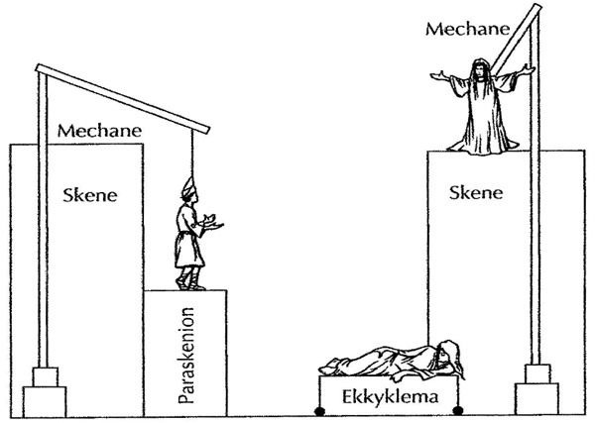
Production: Gear
Masks
Costumes
Music
Props
Scenery
Special effects
  mekhanē
  ekkuklēma

Slide 13
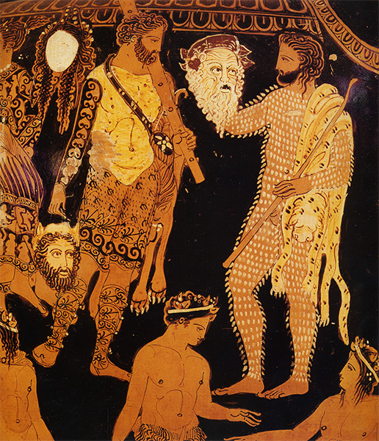
Neo
Matrix Reloaded (2003)
Actor, Papposilenos mask, Pronomos vase
(Athenian, late 400s BCE)
Notes:
dramatic masks: function
visual/auditory projection?
suppression-concealment?
embodiment-externalization?
surface manifestation
are dramatic masks, considering their cultic origins, going then to be way of
making performer more visible?
submerging personality of performer?
John Jones (On Aristotle and Greek Tragedy):
mask, like the face (prosopon) does not conceal, but imitates and externalizes total personality (prosopon) of the character (prosopeion, prosopon)

Slide 14
Bacchae: Background
Drama Dramatized?

Slide 15
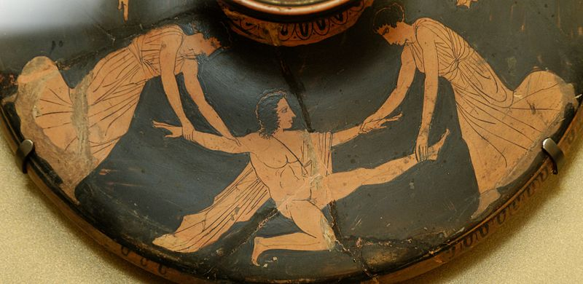
Play Facts, Backstory
Production Date
  ca. 405–400 BCE
Tetralogy
  Iphigenia at Aulis
  Alcmeon
  Bacchae
  satyr play (which?)
Text (issues)
Death of Pentheus, ca. 450-425 BC
Notes:
Production: Dionysia of 405 (postumous).
Text
interpolation
corruption

Slide 16
Characters, Backstory
Notes:
Backstory
Cadmus founds Thebes
Semele scorned
Daughter of Cadmus and Harmonia, spouse of Echion, mother of Pentheus. Her sisters were Autonoë, Ino and Semele
(Αὐτονόη; Autonóē). Daughter of Cadmus and Harmonia, sister of Semele, Agave and Ino ( Leucothea), wife of Aristaeus, mother of Actaeon (Hes. Theog. 977; Apollod. 3,26; 30; Hyg. Fab. 184). In Euripides' Bacchae she leads a thiasos of Theban Maenads (230; 680; Ov. Met. 3,720). Following the death of her son, she goes to Megara; her tomb is mentioned by Pausanias (1,44,5).
(Ἰνώ; Inṓ). Daughter of Cadmus [1] and Harmonia, generally taken to be the second (first: schol. Hom. Il. 7,86 Bekker according to Philostephanus and Eust. ad locum; schol. Lycoph. 22) wife of Athamas in Thebes [2] (the first being Nephele [1]). She is the mother of Learchus and Melicertes. Envy of her stepchildren Phrixus and Helle prompted her to develop a cunning plan. She talked the women of the country into roasting the seed grains, thus causing a severe famine. She bribed the envoys sent by Athamas to Delphi to tell the king that the infertility of the land could only be reversed by offering Phrixus as a sacrifice. After Phrixus and his sister had been carried away by the ram sent by Nephele, Athamas succumbed to madness and, in the mistaken belief that he was out hunting, he killed his eldest son Learchus with arrows. I. fled and flung herself from a cliff into the sea together with her younger son Melicertes. From then on, she was cultically venerated as Leucothea
Pentheus king
Dionysus returns

Slide 17
Dionysus, Dionysianism
Dionysian initiation
Maenads, bakkhoi
Cross-dressing
Mystic knowing
Ritual rebirth
Rapture
  Ekstasis
  Enthousiasmos
Thyrsus
Sparagmos, omophagia
Oresibasia
Notes:
Mystery cults …
of Demeter
e.g., at Eleusis
of Dionysus
… involve
initiatory rite of passage
thematic foci
community
fertility
enlightenment
conquest of death
Bacchae, Initiation (cont.)
Cross-dressing
ritual transvestism as element of mystic, transformative rite of passage
the fluid, redefinition of self
ritual feminization preceding ritual death
p dressed in linen: 821, D to P “then you must put on a linen shift”
linen = bacchic-orphic burial garb
Mystic knowing
Ritual dying, rebirth
LIFE-DEATH-LIFE
maenads, thyrsi, etc.
“. . . and with the fennel, join reverence to riot” (p. 400)
lit. “Sanctify the hubristic (hubristas) fennel rods all around!”
marked oxymoron
holy / hubristic
“weaponized” thyrsi in play
ritual violence both given release and yet needs to be contained
and that foreshadows “terrorist action” of p. 103: “They tore like an invading army into the villages of Hysiae and Erythrae, … and turned them upside down, they snatched up babies out of homes …”
cf. women’s festival of hubristika, at argos: women exercising for a time strange powers and freedoms
HUBRIS AS GOOD!!!
god of paradox and reversal. in the midst of the most dead time of year, celebration of life-renewing license

Slide 18
iō Bakkhe, euoi, euai

Slide 19
Analysis, 1st Half
prologue (starts p. 395)
  Dionysus
parodos (398): “Asian” (modern Turkey) Bacchants. Cult hymn
1st episode (402)
  Tiresias, Cadmus, Pentheus
1st stasimon (412)
  Pentheus’ impiety
2nd episode (414)
  Servant, Pentheus, Dionysus (in disguise)
2nd stasimon (417)
  Thebes’ rejection of Dionysus
Choral dialogue (418): Chorus & D
  Earthquake
Trochaic dialogue, D & Leader (420)
  “messenger” scene
3rd episode (422)
  Short dialogue, D&P
  Messenger scene: hubris in the hills
Notes:
prologue (starts p. 395)
Dionysus. I am changed, a god made man, d’s boundary-crossing aspect. cf. dress-up, geographical-cultural boundary-crossing, etc. he is a foreign god (“I come from Lydia” etc.) coming to conquer Greece. yet he is a native greek. (barbarian-greek divide.)
parodos (398): “Asian” (Anatolian) Bacchants. Cult hymn. celebrates the double birth of god: at thbes, on crete (p. 400, “p chamber of curetes”)
1st episode (402)
Tiresias, Cadmus, Pentheus. note the comedy of c and t, old geezers, done up in Dionysian garb.
tir: humanity has 2 blessings: demeter (earth, food), d (wine). encomium of wine: anodyne, soporific. the wine is d and vice versa. when we drink we are possessed.
286. t defends myth of 2ble birth. a mystic interpretation hinging on pun: meros/homeros. z, harboring d on olympus and thus angering hera, gives to h a piece of sky (aither) as "hostage." but the crowd understands that as meros, "thigh." the myth associates dionysus with the heavenly element, i.e., with zeus. aither is used to make the facsimile of helen, too. note that this interpretation is important: d is the god of facsimile, of the simulacrum. there is, in a sense, no real god there, only air. the process of imitation manifests the god.
1st stasimon (412)
Pentheus’ impiety
2nd episode (414)
Servant, Pentheus, Dionysus (in disguise)
soldier describes the miraculous escape of the Bacchae. note the quasi-sexual appreciation of d’s implicitly effeminate beauty. yet d is the bull god, the roarer, the quintessentially phallic deity. d plays at being an emissary of himself. he is playing someone other than himself, yet in so doing at a deeper level is very much himself. (p casannot see the god though he is looking at him – d is “where I am.) you are d if you are not yourself. this is the essence of Athenian drama.
2nd stasimon (417)
Thebes’ rejection of Dionysus
Choral dialogue (418): Chorus & D
Earthquake. self-freed’s power. adoration of him by bacchants.
Trochaic dialogue, D & Leader (420)
“messenger” scene. d describes his destruction of the palace of pentheus. note that the women, the bacchants of Anatolia, think d is a human worshipper of god. god’s playacting.
3rd episode (422)
Short dialogue, D&P
Messenger scene: hubris in the hills. the foreign women of the chorus are in town. the women of the town have burst free and, led by the royal sisters, wreak hubristic havoc in the countryside. here the fennel rods-thursoi-prove truly hubristic.

Slide 20
Discussion: Tragedy in Performance
Rock the Palace! (pp. 418 ff.)

