Slide 1
The Masks of Dionysus
Euripides Bacchae 2

Slide 2
Agenda
Recap and Update
  Dionysianism cont’d Analysis Part 2, Advice,
Theories of Tragedy
  Aristotle on Bacchae
How to Play?
  Pentheus’ Maenadic Make-Over (pp. 432 ff.)
What Does Bacchae Say About...
  Gender and Ethnicity?

Slide 3
Recap and Update
Dionysianism cont’d Analysis Part 2, Advice,

Slide 4
Dionysus, Dionysianism
Dionysian initiation
Maenads, bakkhoi
Cross-dressing
Mystic knowing
Ritual rebirth
Rapture
Sparagmos, Omophagia
Oresibasia
Thyrsus. . .
Notes:
main point: that much of this figures organically and critically into the action of the play – which could be said to dramatize Dionysian worship.
among the dichotomies of dionysus, perhaps the most important: the god’s ambivalence
ecstatic worship has always exercised a polarizing effect over society
those who sympathize and/or identify
those who reject/feel non-identification
both groups understand the phenomenon of ecstatic worship as a kind of madness that sets one apart
but the latter group regards as dangerous, anti-social delusion
the former, as a higher state of consciousness
similarly, dionysus, the god of the group…
expresses an open-ended sociality: all are welcome
expresses a closed, exclusionary principle: only the privileged few, the members of dionysus’ thiasos, may participate
that, we have seen and shall see, sums up bacchae
the world generally, and thebes in particular, accepts/rejects the god
asia accepts, greece rejects
some thebans accept, others (esp. pentheus) reject and misread
dionysus invites the whole world to join his thiasos
punishes those who exclude him from their social circle
punishes too those who, like pentheus, would seek access to mystic knowledge without proper initiation

Slide 5
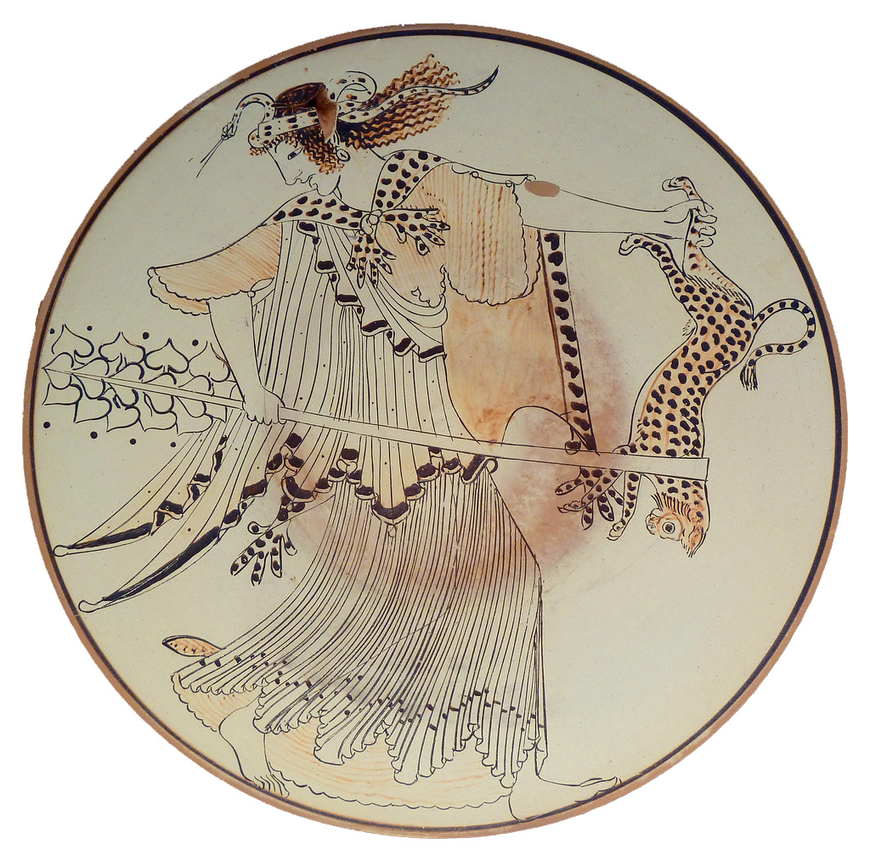
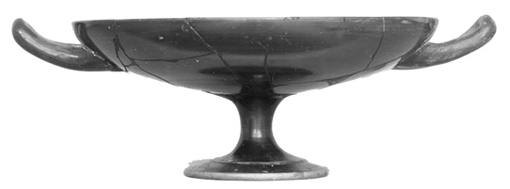
Maenad Kylix (Brygos painter) viewed from top
Different kylix viewed from side
“. . . and with the fennel, join reverence to riot” (p. 400). Lit. “Sanctify the hubristic fennel rods all around!”
Notes:
maenads, thyrsi, etc.
“. . . and with the fennel, join reverence to riot” (p. 400)
lit. “Sanctify the hubristic (hubristas) fennel rods all around!”
greek and trnalsation (parodos, p. 400):
“. . . with the fennel / Join reverence to riot. / Soon the land will dance; For whoso leads the revel / He is always Bacchus….”
ἀμφὶ δὲ νάρθηκας ὑβριστὰς
ὁσιοῦσθ’· αὐτίκα γᾶ πᾶσα χορεύσει--
Βρόμιος ὅστις ἄγῃ θιάσους– (113-115)
marked oxymoron
holy / hubristic
“weaponized” thyrsi in play
ritual violence both given release and yet needs to be contained
and that foreshadows “terrorist action” of p. 103: “They tore like an invading army into the villages of Hysiae and Erythrae, … and turned them upside down, they snatched up babies out of homes …”
cf. women’s festival of hubristika, at argos: women exercising for a time strange powers and freedoms
but is the punishment of p and others over the top? does the play encourage us, the audience of it, to question power, whether that of human sovereigns or of divine sovereigns?
and if the play counterintuitively encourages placing dionysian justice on trial, in effect does it not place tragedy itself, dionysus’ art form, on trial? is tragedy just a form of entertainment, or do eur’s Bacchae and ari’s poetics encourage us, if nothing else, not to take it for granted?

Slide 6
Analysis
prologue (starts p. 395)
  Dionysus
parodos (398): “Asian” (modern Turkey) Bacchants. Cult hymn
1st episode (402)
  Tiresias, Cadmus, Pentheus
1st stasimon (412)
  Pentheus’ impiety
2nd episode (414)
  Servant, Pentheus, Dionysus (in disguise)
2nd stasimon (417)
  Thebes’ rejection of Dionysus
Choral dialogue (418): Chorus & D
  Earthquake
Trochaic dialogue, D & Leader (420)
  “messenger” scene
3rd episode (422)
  Short dialogue, D&P
  Messenger scene: hubris in the hills
Notes:
prologue (starts p. 395)
Dionysus. I am changed, a god made man, d’s boundary-crossing aspect. cf. dress-up, geographical-cultural boundary-crossing, etc. he is a foreign god (“I come from Lydia” etc.) coming to conquer Greece. yet he is a native greek. (barbarian-greek divide.)
parodos (398): “Asian” (Anatolian) Bacchants. Cult hymn. celebrates the double birth of god: at thbes, on crete (p. 400, “p chamber of curetes”)
1st episode (402)
Tiresias, Cadmus, Pentheus. note the comedy of c and t, old geezers, done up in Dionysian garb.
tir: humanity has 2 blessings: demeter (earth, food), d (wine). encomium of wine: anodyne, soporific. the wine is d and vice versa. when we drink we are possessed.
286. t defends myth of 2ble birth. a mystic interpretation hinging on pun: meros/homeros. z, harboring d on olympus and thus angering hera, gives to h a piece of sky (aither) as "hostage." but the crowd understands that as meros, "thigh." the myth associates dionysus with the heavenly element, i.e., with zeus. aither is used to make the facsimile of helen, too. note that this interpretation is important: d is the god of facsimile, of the simulacrum. there is, in a sense, no real god there, only air. the process of imitation manifests the god.
1st stasimon (412)
Pentheus’ impiety
2nd episode (414)
Servant, Pentheus, Dionysus (in disguise)
soldier describes the miraculous escape of the Bacchae. note the quasi-sexual appreciation of d’s implicitly effeminate beauty. yet d is the bull god, the roarer, the quintessentially phallic deity. d plays at being an emissary of himself. he is playing someone other than himself, yet in so doing at a deeper level is very much himself. (p casannot see the god though he is looking at him – d is “where I am.) you are d if you are not yourself. this is the essence of Athenian drama.
2nd stasimon (417)
Thebes’ rejection of Dionysus
Choral dialogue (418): Chorus & D
Earthquake. self-freed’s power. adoration of him by bacchants.
Trochaic dialogue, D & Leader (420)
“messenger” scene. d describes his destruction of the palace of pentheus. note that the women, the bacchants of Anatolia, think d is a human worshipper of god. god’s playacting.
3rd episode (422)
Short dialogue, D&P
Messenger scene: hubris in the hills. the foreign women of the chorus are in town. the women of the town have burst free and, led by the royal sisters, wreak hubristic havoc in the countryside. here the fennel rods-thursoi-prove truly hubristic.

Slide 7
Analysis (con’t)
3rd stasimon (431)
  Hope restored, do not mock the god
4th episode (432)
  D&P. Pentheus’ maenadic make-over
4th stasimon (436)
  Excited song of vengeance
5th episode (438)
  Messenger (servant on death of Pentheus)
5th stasimon (442)
  Short song of triumph
exodos (443)
  Agave’s mad scene
    lyric dialogue
  Cadmus’s return with Pentheus
    recognition, reversal
  Lament for Pentheus
  [“6th choral ode,” added by translator]
  Deus ex machina
Notes:
[first briefly review plot devleopments of second half of play]
4th episode (432)
D&P. Fitting scene
4th episode. ritual feminization preceding p's death. but also representing a stage in p’s “initiation” into the mysteries of dionysus. initiation itself as a kind of ritual death. p sees double. to him d seems a bull. tyrannical-masculine-aggressive p now feminized, effeminate d now hyper-masculinized. p now wants to be publically conducted through thebes. public ritual humiliation.
one is tempted to ask whether that scene serves properly as comedy or tragedy. but the comic element is sort of unmistakeable. yet this is no comic relief with low characters on stage, as in shakespeare, whatever else, this has to be made to fit into the play’s tragic trajectory!
5th episode (438)
Messenger (servant on death of Pentheus)
messenger speech. p's killing by bacchants. p's curiosity. d's miraculous strength as he pulls down tree. d disappears to address thiasos from sky. women go to pelt p etc. (fail), then to uproot tree. p, a "climbing animal," believed will spread secrets. sparagmos and near omophagia, ironically, of agave’s own son.
3rd stasimon (431)
Hope restored, do not mock the god
this choral number offers a point of departure pondering the moral horizon against which the play looks upon the behavior of a p. on the one hand, the obvious: honor the gods if you don’t want to incur their wrath. but wouldn’t p and others have followed that in d’s regard had they just known? maybe it was their arraogance that made them blind, but it’s not at all clear that p and others had more to work from than the claims of Semele.
competition between agave and her sisters for chief honors in the hunt may offer insight. the sisters participate sort of on equal footing with others in their unrestrained celebration of god. but their competition suggests competition within the family for preeminence. just as p suspects the “stranger” competes with him, just as creon and later oed suspect challenges to their power. just as d, also a member of this messed up family, sees p as a impediment to his power at thebes.
so we seem to have something like one of the chief conflicts moving the plot of soph’s ant forward: paternalist power versus the world of women and of the gods. again, a dialectic dramatizing the extremely painful birthpangs of a political and social order retaining patriarchy but subsuming the household and the gods within it. note how acceptance of Dionysus is the acceptance of what is simultaneously domomestic and foreign. through the punishment of p and of ag and family, honoring the gods and attendant benefits will no longer be a mere matter of luck.
exodos (443)
Agave’s mad scene
lyric dialogue
agave’s call to the feast – no entirely explicit, but clearly to feast on Pentheus. (omophagia).
cf.also below
Cadmus’s return with Pentheus. Lament for Pentheus
Cadmus “Murder is what your tragic hands have done. Beautiful the victim cut down by the gods: the sacrificial feast you call me to and Thebes.”
agave comes to her wits, knowledge too late. agave and everyone’s reversal. the kissing scene is also kind of sick
[the chorus p. 452 was made up by the translator]
Deus ex machina
deus ex machina (ex tecto??). (had already begun in lost segments with establishment of cult. translator wrong in rejecting lines. Cadmus and Harmonia to become snakes, to drive chariot to barbarian land. shall lead barbarians in attack on delphi. shall die and be transported to the islands of the blest.
“DIONYSUS: Too late to know me now; you did not when you should.” (knowledge too late)

Slide 8
Theories of Tragedy
Aristotle on Bacchae

Slide 9
concept | Bacchae
ēthos “character” (Pentheus)
hamartia “error”
desis “complication”
lusis “unraveling, solution”
anagnorisis “recognition”
peripeteia “reversal (of fortune)”
katharsis “purification”
learning?
pleasure?
Notes:
ethos “character” (Pentheus)
character traits revealed through speech and action, and thus presumed to motivate same.
arrogant, paranoid. very much like a creon. misogynist? (we’ll have more to say about pentheus next class.)
hamartia “error”
what is pentheus’ tragic mistake? it is surely to have resisted the worship of the god. mistake of agave and her sisters? to accuse Semele of an illicit human union – again, to deny the god.
note how this is hubris—insult—for the god.
desis “complication”. this can include external and internal devleopments.
thus surely the arrival of Dionysus and his new cult – what that means for thebes. but the family is clearly enmeshed in all sorts of dysfunction—anticipates the later line of labdacus (Cadmus => polydorus => labdacus [Chrysippus story] => Laius => Oedipus)
one way – not exactly Aristotle’s – is to view tragic action as less a solution to a desis than an atonement/purification [quasi-aristo] – see next.
lusis “unraveling, solution”
all the action leading to calamities experienced by … more soon.
anagnorisis “recognition”
more soon. but is there non-recognition in the scenes we have read?
peripeteia
“reversal (of fortune)”
more soon
catharsis “purification”
more soon
learning?
more soon
pleasure?
more soon. [what’s fascinating is that the play dramatizes dress-up, impersonation, and spectating – all of which p does. p is tragedy….]

Slide 10
How to Play?
Pentheus’ Maenadic Make-Over (4th episode)
Notes:
pp. 432 ff.
play it for laughs?
problem of transformations – esp pen. credible?
problem of gender issues – are roche’s (not Euripides!) stage directs workable this day and age? (1960s/70s)
Dionysus, is he now evil? is the bull necessary?

Slide 11
“Imbue him with a dizzy fantasy. / Sane, he never will consent / to put a woman’s clothing on.”
(Dionysus to Chorus, p. 430)
Notes:
Issues?
how to play the scene…
comedy? farce?
is pentheus delusional? insane?
why does he see double?

Slide 12
What Does Bacchae Say About...
Gender and Ethnicity?
Notes:
LEADER: [in a cry of triumph]
Lord Bromius, your godhead is made manifest. MESSENGER: What was that?
Woman, do you mean to say my master’s end can give you
joy? LEADER: Oh, let me shout my song in foreign tunes:
a foreigner who need no longer tremble in fear of fetters. MESSENGER: But do you reckon the men of Thebes such cowards
that . . . LEADER: It is not Thebes but Dionysus, son of Zeus, who rules
me.
ETHNICITY
Cadmus is foreign
dio is quasi-foreign
the hubris is distributed
pen’s et al’s “bad” hubris
dio’s and the Bacchae’s “good” hubris?

