Slide 1
From Suffering, Knowledge?
Aeschylus’ Agamemnon, Part 1

Slide 2
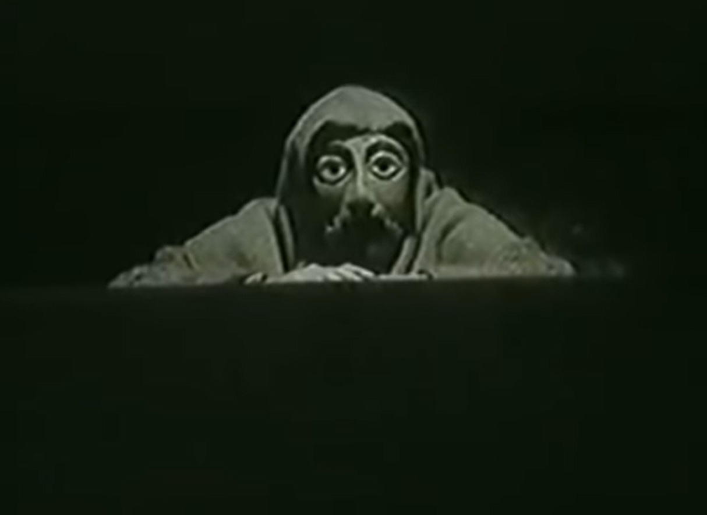
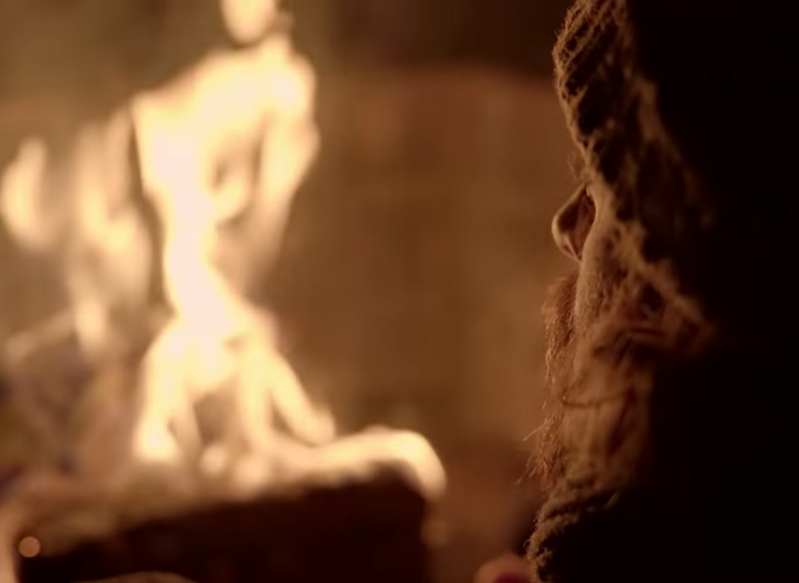
Watchman’s Prologue, Agamemnon
Peter Hall, 1983
BareFacedGreek
Notes:
Watchman’s prologue, which do you prefer, and why?

Slide 3
Agenda
Recap & Update
  Play Intro, Aeschylean Patterns
Why?
  Clytemnestra’s Red Carpet Welcome

Slide 4
Recap & Update
Play Intro, Aeschylean Patterns

Slide 5
Oresteia: Play Facts
Playwright
  Aeschylus 525-456
Plays (458 bce)
  Agamemnon
  Libation Bearers
  Eumenides
  Proteus (lost)

Slide 6
Historical Context: Athens
508 Athenian democracy
479 Persia defeated
461 Constitutional crisis
  Areopagus veto-power rescinded
  Full democracy achieved
Athenian Acropolis
Notes:
we see political themes with a democratic slant poaking their way into the drama at certain points
The people’s voice is heavy with hatred,
now the curses of the people must be paid [the people, understood here as enraged by the deaths of greeks at troy, like a fury. note the greek – emphasizes not just anger but power of the demos, the people]
βαρεῖα δ᾽ ἀστῶν φάτις ξὺν κότῳ·
δημοκράτου δ᾽ ἀρᾶς τίνει χρέος. (456-457)
clyt to ag:
our child is gone, not standing by our side,
the bond of our dearest pledges, mine and yours;
by all rights our child should be here . . .
Orestes. You seem startled.
You needn’t be. Our loyal brother-in-arms
will take good care of him, Strophios the Phocian.
He warned from the start we court two griefs in one.
You risk all on the wars - and what if the people
rise up howling for the king, and anarchy
should dash our plans?
Aeschylus. The Oresteia: Agamemnon; The Libation Bearers; The Eumenides: Agamemnon, The Libation Bearers, The Eumenides (Kindle Locations 2001-2004). Penguin Publishing Group. Kindle Edition.
consider that alongside
Victory, you have sped my way before,
now speed me to the last.
Aeschylus. The Oresteia: Agamemnon; The Libation Bearers; The Eumenides: Agamemnon, The Libation Bearers, The Eumenides (Kindle Locations 1989-1990). Penguin Publishing Group. Kindle Edition.
the context is ag’s fear of subversion at home, of false friends and of elements that need to be rooted out. a king like him cannot rest of his laurels; he must always be winning. put differently, kingship is necessarily unstable

Slide 7
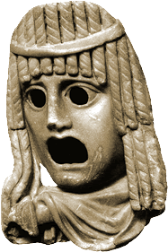
Myth Backstory. . .
Feast of Thyestes (genealogy)
Abduction of Helen (map)
  Sacrifice of Iphigenia
  Sack of Troy
Notes:
a massive pileup of what Aristotle calls hamartia, a sin or error, what archaic greek poetics, what I’m calling the tragic formula, calls hubris and ate, a whole host of crimes narrated as prequel and enacted as plot
Feast of Thyestes
Abduction of Helen
Sacrifice of Iphigenia
Sack of Troy
clyt’s fateful, prophetic words:
And even if the men come back with no offence
to the gods, the avenging dead may never rest -
Oh let no new disaster strike! And here
you have it, what a woman has to say.
oh but they will….

Slide 8
Genealogy
Notes:
Tantalus’ crime
Feast of Thyestes
Sacrifice of Iphigenia

Slide 9
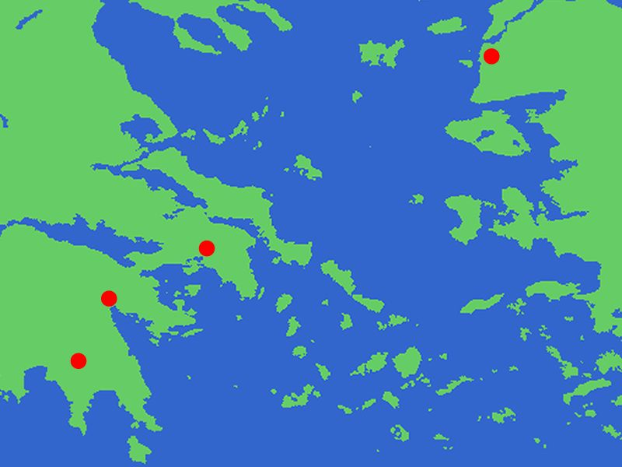
Troy
Greece
Turkey
(Asia Minor)
Delphi
Aulis
Athens
Argos
Sparta

Slide 10
Agamemnon: Analysis
Prologue (pp. Penguin 103 f.)
  Watchman
Parodos (105 ff.)
  Entry march (recited). misgivings: expedition
  Lyric (sung, danced). portent of eagles and hare
1st episode (112 ff.)
  Leader, Clyt. Fire signals
1st stasimon (117 ff.)
  Paris’ crime
2nd episode (121 ff.)
  Herald, Leader, Clyt. Victory. Menelaus lost?
2nd stasimon (129 ff.)
  Helen’s blood wedding
3rd episode (132 ff.)
  Chorus (reciting). Ag., Clyt. Red-carpet welcome
3rd stasimon (141 ff.)
  Foreboding
4th episode (143 ff.)
  Clyt., Leader. Cassandra to enter palace
  Cass., Leader, whole Chorus. Cass.’s visions (spoken, sung)
Choral recitation (158)
  Perils of power
Choral scene (159)
  Leader, whole Chorus, Ag. (offstage)
Exodos (160 ff.)
  Clyt., Leader. Ekkuklēma with corpses
  Clyt., Chorus (lyric dialogue). Recriminations
  Clyt., Aegisthus, Leader (dialogue). Gloating in victory, more recriminations
Notes:
108. artemis as pitying troy. detaining fleet at aulis with contrary winds. "the architect of vengeance" - clyt. the connection: iphi. clyt as "memory womb of child-avenging Fury." then back to eagles. calchas' prophecy of blessings and doom.

Slide 11
Oresteia: Aeschylean Patterns
Aeschylean Epiphany
“Tragic Formula”
verbal
ambiguity
human
visual
clarity
divine
koros (excess, extravagance)
hubris (arrogance, violation)
ate (delusion, ruin)
dike (justice)
to
In the Agamemnon?
Notes:
Patterns, recap. . .
EPIPHANY
How manifested?
in the movement from talking to action
yes, the signals “signal” ag’s immanent return, but the talk isn’t fully believed until he shows up in person
in the consummation of a foreshadowed doom or redemption
in ag’s immanent murder as punishment for iph’s death
in the oresteia more generally, …
in the move from “acts” 1 and 2 to the third to Zeus the Savior
“FORMULA”:
COMMENT: when i say “formula,” i’m misrepresenting a bit. as herington divined, this is a formula operating according to an archaic “logic,” one that is in essence circular. each step is implied in the next, the strict sequentality of it all is no more a reality than is any too neat articulation of the “formula” in any source – indeed, to illustrate it in the agamemnon, where it is prominently on display, one cannot but jump around.
anyway, just to recapitulate, the formula can best be articulated as an archaic, pre-aristotelian version of reversal as in the Poetics, only here imagined as a cosmic principle.
EXEMPLIFIED IN AGAMEMNON:
koros (excess)
CHORUS: “Sprung from the great good fortune in the race | comes bloom on bloom of pain” (p. 131)
hubris (violation), which may precipitate ate or may operate in tandem with it
CHORUS: “But ancient Violence (hubris) longs to breed, | new Violence (hubris) comes when its fatal hour comes” (p. 131)
the sacrifice-murder of iph as crime paying for the destruction of troy
cl’s warning:
Just let no lust, no mad desire seize the armies
to ravish what they must not touch -
overwhelmed by all they’ve won!
Aeschylus. The Oresteia: Agamemnon; The Libation Bearers; The Eumenides: Agamemnon, The Libation Bearers, The Eumenides (Kindle Locations 1766-1767). Penguin Publishing Group. Kindle Edition.
ate (ruin)
CHORUS: “… neither young nor strong could leap the giant dredge-net of slavery, all-embracing ruin (ate)” (p. 117)
the frenzy that besets ag
dike (justice)
“Justice turns the balance scales, / sees that we suffer / and we suffer and we learn” (p. 111)

Slide 12
Tragic Cycle
Crime begets crime
Blood guilt
Tragic knowing
  Pathei mathos
  (“from suffering, knowledge”)
Notes:
109-. hymn to zeus. "he who was once mighty" etc. = ouranos, kronos. zeus thus = "zeuss the victor." but note that it is a victory of son defeating father.
"zeus has led us on to know, the helmsman lays it down as law that we must suffer, suffer into truth." punishment comes from the gods, and in the form of inexorable, fated woe. then returern to the prophecies. then the upshot: iphi must die.
111. what's next? no one knows, but "justice turns the balance scales, sees that we suffer and we learn.“
Patterns, update. . .
at the same time, that ideological structure could see unstable as the pattern we can call the cycle of violence also kicks in - crime begets crime, vendetta justice calls down on itself further vendetta, the sins of the parents are passed down through the family
“A curse burns bright on crime—full blown, the father’s crimes will blossom, burst into the son’s” (378-80)
“… men’s prosperity never will die childless, once full-grown it breeds. Sprung from the great good fortune in the race comes bloom on bloom of pain”
CHORUS:
“A curse burns bright on crime –
full-blown, the father’s crimes will blossom,
burst into the son’s.” (Chorus, lines 378 ff.)
“Ancient violence (hubris) longs to breed, new Violence comes when its fatal hour comes, the demon comes to take her toll–no war, no force, no prayer can hinder the midnight fury stamped with parent fury moving through the house” (755–60)
from suffering knowledge
yet tragedy action also self-justifies: through suffering we gain a higher awareness. the questions is, do tragic characters learn in time to benefit from their misfortune?
Crime begets crime
“the father’s crimes will blossom, / burst into the son’s” (p. 117)
Blood guilt
“womb of guilt, kinsmen / torturing kinsmen, . . . severed heads” (“Feast of Thyestes,” p. 145)
Tragic knowing
Pathei mathos
(“from suffering, knowledge”)
“Zeus has led us on to know, . . . that we must suffer, suffer into truth,” (Chorus, p. 109)
But Justice turns the balance scales,
sees that we suffer
and we suffer and we learn.
Aeschylus. The Oresteia: Agamemnon; The Libation Bearers; The Eumenides: Agamemnon, The Libation Bearers, The Eumenides (Kindle Locations 1714-1715). Penguin Publishing Group. Kindle Edition.
ate-ruin.
p. 117 1st stas “neither young nor strong could leap the giant dredge of slavery, all embracing ruin.”
Persuasion, maddening child of Ruin
overpowers him - Ruin plans it all.
βιᾶται δ᾽ ἁ τάλαινα πειθώ,
προβούλου παῖς ἄφερτος ἄτας. (385-386)
Aeschylus. The Oresteia: Agamemnon; The Libation Bearers; The Eumenides: Agamemnon, The Libation Bearers, The Eumenides (Kindle Location 1784). Penguin Publishing Group. Kindle Edition.
p. 131. 2nd stasimon. cycle of evil, tragic formula.

Slide 13
Aristotelian Elements
Reversal(s)?
  peripeteia
Recognition(s)?
  anagnorisis
Hamartia?
Pity? Fear?

Slide 14
Why?
Clytemnestra’s Red Carpet Welcome

Slide 15
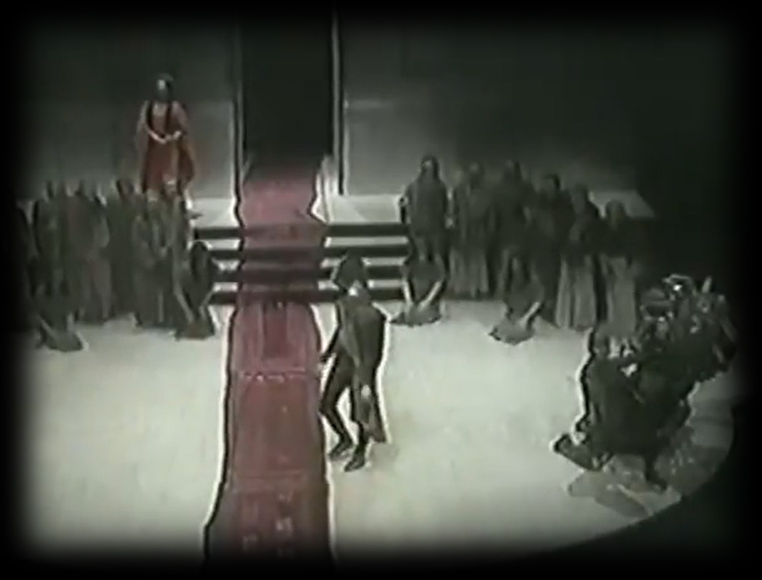
Red-Carpet Welcome
Oresteia Agamemnon part 2. Peter Hall production, 1981. 5" 2' – 11" 42'
https://youtu.be/ldIJVtDG5TM?t=302

Slide 16
Associative Poetics
Lyric exposition: parodos
Linked imagery: fire, blood
Portent: eagles, hare.
Artemis’ anger.
Hymn to Zeus.
Sacrifice of Iphigenia.
Burning of Troy.
Fire signals.
Red carpet.
Murder in the palace.
Notes:
“The gods breathe power through
my song,
my fighting strength, Persuasion” chorus in Agamemnon.
Aeschylus. The Oresteia: Agamemnon; The Libation Bearers; The Eumenides: Agamemnon, The Libation Bearers, The Eumenides (Kindle Location 1667). Penguin Publishing Group. Kindle Edition.
the associative poetics of aesch’s lyric exposition, especially during choruses, are like Cassandra’s powerful yet incoherent prophecies. they stack horror on horror so that sequentially distinct stages in the story collapse onto each other like the platforms of a failed scaffolding. we, like Cassandra, feel crushed, but also see all too clearly how all the horrors connect. endowed now with our own visionary powers, we break free from the logic of ordinary causation. instead, we see how the terror rages “back and back in the future / . . .
Memory womb of Fury child-avenging fury!”
associative poetics: conceptual association by way of a shared feature, motif, image. in these plays, weavings, colors, poured drink offerings, blood – a host of motifs binding the whole oresteia together as a group of plays. chief among these motifs: the color red. as the color of blood and of fire, it is serves as emblematic of the organic connection between tragic events like the feast of thyestes, sack of troy, and murder in agamemnon’s palace. so, too, red, as the color of fire, convey with the fire signals in the opening of agamemnon not just news of troy’s destruction; they emblematically convey curse from troy to argos. the red carpet completes the connection; cassandra’s vision of the bloody, gory feast of thyestes atop the roof of the palace, like a gory, bloody version of panckakes and syrup, allows doom to saturate how we imagine the house of agamemnon. it allows us, the audience, a single stroke to envision doom upon doom crashing down upon the accursed house of agamemnon. but we shall also see this unifying motif of the color red return repurposed yet constant in its resonance in the Eumenides, the final act of this three-tragedy drama.
in a choral passage like the parodos, the imagery commands a chaotic, almost hallucinogenic series of connections, all suggesting that the synaptic firing of the chorus’s imagination has plunged into a mad spiral. we see more of the same in the likewise lyric ravings of cassandra later.
otherwise, sins recapitulate key features of one another:
killing of children – iphi, feast of thyestes
cannibalism: unreferenced tantalus-pelops myth, thyestes
adultery: thyestes with aerope (atreus’ wife), aegisthus with clyt
note how she looks forward to the revenge to come, and prays that it will be a revenge for her too

