Slide 1
From Suffering, Knowledge?
Aeschylus’ Agamemnon Part 2

Slide 2
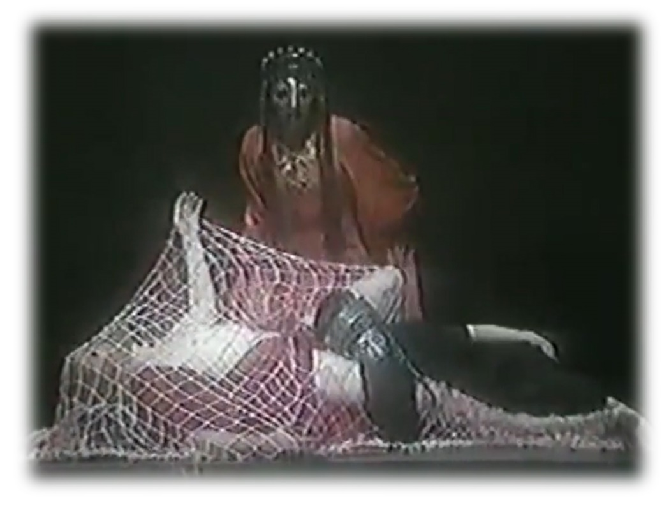
The Big Reveal
How does the Chorus feel?
How does Clytemnestra feel?
How do you feel?
Aeschylus Agamemnon part 2. Peter Hall, 1981
https://youtu.be/ldIJVtDG5TM?t=1764
Notes:
CLYTAEMNESTRA: “Words, endless words I’ve said to serve the moment -
now it makes me proud to tell the truth.”
so says Clytaemnestra, and with the deed she has just done, she fulfills all our worst fears.
so, what is that thing we see rolled out with the bodies of Agamemnon and Cassandra stacked on it?
ekkuklēma
but what about the chorus just prior to the murder? they talk about doing something, but do they in fact do something?
who does do something? who, to use the Greek, drāi? Whom commits a drama, an action?
it is, of course, clyt. and the moment of the palace doors opening, and of the ekkuklēma being wheeled out, with its horrific cargo – that is exactly the moment the audience has so eagerly been waiting for. it is the big reveal. Aristotle very clearly deems staging of secondary importance to words as the machinery of imitation. but in Aeschylean drama, the culmination of the verbal in the visual is what it is all about. and here we have it: clyt’s complete triumph over her child-murdering husband but also over the doubts of the chorus. she stands before us in all her magnificent yet terrible glory. and we can only wonder, where will this all lead to?

Slide 3
Agenda
Recap & Update
  Tragic Patterns, Tragic Themes in Aeschylus’ Agamemnon
Is She Tragic?
  And If So, How? (Cassandra Scene, pp. 143 ff.)

Slide 4
Recap & Update
Tragic Patterns, Tragic Themes in Aeschylus’ Agamemnon

Slide 5
Agamemnon: Analysis
Prologue (pp. Penguin 103 f.)
  Watchman
Parodos (105 ff.)
  Entry march (recited). misgivings: expedition
  Lyric (sung, danced). portent of eagles and hare
1st episode (112 ff.)
  Leader, Clyt. Fire signals
1st stasimon (117 ff.)
  Paris’ crime
2nd episode (121 ff.)
  Herald, Leader, Clyt. Victory. Menelaus lost?
2nd stasimon (129 ff.)
  Helen’s blood wedding
3rd episode (132 ff.)
  Chorus (reciting). Ag., Clyt. Red-carpet welcome
3rd stasimon (141 ff.)
  Foreboding
4th episode (143 ff.)
  Clyt., Leader. Cassandra to enter palace
  Cass., Leader, whole Chorus. Cass.’s visions (spoken, sung)
Choral recitation (158)
  Perils of power
Choral scene (159)
  Leader, whole Chorus, Ag. (offstage)
Exodos (160 ff.)
  Clyt., Leader. Ekkuklēma with corpses
  Clyt., Chorus (lyric dialogue). Recriminations
  Clyt., Aegisthus, Leader (dialogue). Gloating in victory, more recriminations
Notes:
108. artemis as pitying troy. detaining fleet at aulis with contrary winds. "the architect of vengeance" - clyt. the connection: iphi. clyt as "memory womb of child-avenging Fury." then back to eagles. calchas' prophecy of blessings and doom.

Slide 6
Associative Poetics
Lyric exposition: parodos
Linked imagery: fire, blood
Portent: eagles, hare.
Artemis’ anger.
Hymn to Zeus.
Sacrifice of Iphigenia.
Burning of Troy.
Fire signals.
Red carpet.
Murder in the palace.
Notes:
“The gods breathe power through
my song,
my fighting strength, Persuasion” chorus in Agamemnon
the associative poetics of aesch’s lyric exposition, especially during choruses, are like Cassandra’s powerful yet incoherent prophecies. they stack horror on horror so that sequentially distinct stages in the story collapse onto each other like the platforms of a failed scaffolding. we, like Cassandra, feel crushed, but also see all too clearly how all the horrors connect. endowed now with our own visionary powers, we break free from the logic of ordinary causation. instead, we see how the terror rages “back and back in the future / . . .
Memory womb of Fury child-avenging fury!”
associative poetics: conceptual association by way of a shared feature, motif, image. in these plays, weavings, colors, poured drink offerings, blood – a host of motifs binding the whole oresteia together as a group of plays. chief among these motifs: the color red. as the color of blood and of fire, it is serves as emblematic of the organic connection between tragic events like the feast of thyestes, sack of troy, and murder in agamemnon’s palace. so, too, red, as the color of fire, convey with the fire signals in the opening of agamemnon not just news of troy’s destruction; they emblematically convey curse from troy to argos. the red carpet completes the connection; cassandra’s vision of the bloody, gory feast of thyestes atop the roof of the palace, like a gory, bloody version of panckakes and syrup, allows doom to saturate how we imagine the house of agamemnon. it allows us, the audience, a single stroke to envision doom upon doom crashing down upon the accursed house of agamemnon. but we shall also see this unifying motif of the color red return repurposed yet constant in its resonance in the Eumenides, the final act of this three-tragedy drama.
in a choral passage like the parodos, the imagery commands a chaotic, almost hallucinogenic series of connections, all suggesting that the synaptic firing of the chorus’s imagination has plunged into a mad spiral. we see more of the same in the likewise lyric ravings of cassandra later.
otherwise, sins recapitulate key features of one another:
killing of children – iphi, feast of thyestes
cannibalism: unreferenced tantalus-pelops myth, thyestes
adultery: thyestes with aerope (atreus’ wife), aegisthus with clyt
note how she looks forward to the revenge to come, and prays that it will be a revenge for her too

Slide 7
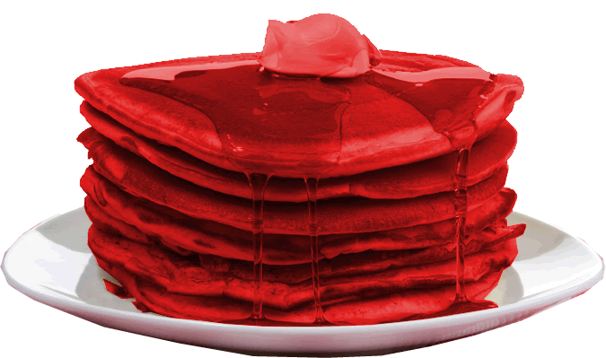
Associative Poetics: Cassandra Scene
Feast of Thyestes
Trojan War
Murder of Agamemnon &
Cassandra
Murder of Clytemnestra
Notes:
PAST PRESENT AND FUTURE collapsed into one, poetry delivered in a prophetic mode…
we see more of the same in the likewise lyric ravings of cassandra later. thus for cassandra, past, present, and future meld together into a single, awful reality. so, too, within the poetic texture of the play as whole, thematic, imagistic, and plot-action echoes, create a web of relationships more complex than simply action causing action – in a sense, poetic worm-holes allowing instant shifts across time and place in the narrative texture. the horror drips through the whole like a bloody stack of pancakes.

Slide 8
Oresteia: Thematic Conflicts
man | v. | woman
civic harmony | v. | civic chaos
(democracy | v. | tyranny)
persuasion | v. | violence
JUSTICE | v. | JUSTICE
Do the binaries really hold up?
Notes:
the plays speak the language of ideological affirmation:
of gender ideologies, political ideologies, and so on.
but the conflicts dramatized in plays necessarily put a whole range of cherished truths on trial:
that the patriarchal suppression of women (par for the course in the world known to our playwright and his audience) is just.
that men’s lust for glory constructive.
that the conflicts that inevitably arise in the social-political order can be neatly resolved through existing institutions, that justice without compromise jives with social or political order, with human happiness. for in a world where crime punishes crime, could justice itself be the problem?

Slide 9
Tragic Patterns
Aristotelian poetics
  Reversal — peripeteia
  Recognition — anagnorisis
  Sin, error — hamartia
  Pity, fear, catharsis
Aeschylean Epiphany
  Verbal, ambiguous, human
  Visual, clear, divine

Slide 10
Tragic Patterns (cont’d)
Tragic “Formula”
  koros (excess, extravagance)
  hubris (arrogance, outrage, insult)
  ate (delusion, ruin)
  dike (justice)
Tragic cycle
  Crime begets crime
Tragic knowing
  Pathei mathos (“from suffering, knowledge”)
Notes:
question: which patterns manifested where, how?
“FORMULA”:
COMMENT: when i say “formula,” i’m misrepresenting a bit. as herington divined, this is a formula operating according to an archaic “logic,” one that is in essence circular. each step is implied in the next, the strict sequentality of it all is no more a reality than is any too neat articulation of the “formula” in any source – indeed, to illustrate it in the agamemnon, where it is prominently on display, one cannot but jump around.
anyway, just to recapitulate, the formula can best be articulated as an archaic, pre-aristotelian version of reversal as in the Poetics, only here imagined as a cosmic principle.

Slide 11
Justice turns the balance scales,
sees that we suffer
and we suffer and we learn. (Chorus p. 111)
... men’s prosperity never will die childless,
once full-grown it breeds.
Sprung from the great good fortune in the race (genos, “family”)
comes bloom on bloom of pain.
· · ·
But ancient Violence (hubris) longs to breed,
new Violence comes when its fatal hour comes. (Chorus p. 131)
Notes:
question: which patterns manifested where, how?

Slide 12
Words, endless words I’ve said to serve the moment —
now it makes me proud to tell the truth. (Clytemnestra, p. 160)
The truth still holds while Zeus still holds the throne:
the one who acts must suffer —
that is law. Who can tear from the veins
the bad seed, the curse? The race (gona, “family”) is welded to its ruin. (Chorus, p. 167)
Notes:
Clytemnestra, p. 160: verbal to visual, ambiguous to clear. human to divine must wait.

Slide 13
But the lust for power never dies -
men cannot have enough.
No one will lift a hand to send it
from his door, to give it warning,
‘Power, never come again!’
Take this man: the gods in glory
gave him Priam’s city to plunder,
brought him home in splendour like a god.
But now if he must pay for the blood
his fathers shed, and die for the deaths
he brought to pass, and bring more death
to avenge his dying, show us one
who boasts himself born free
of the raging angel, once he hears — (Chorus, p. 158)

Slide 14
Is She Tragic?
And If So, How? (Cassandra Scene, pp. 143 ff.)

Slide 15
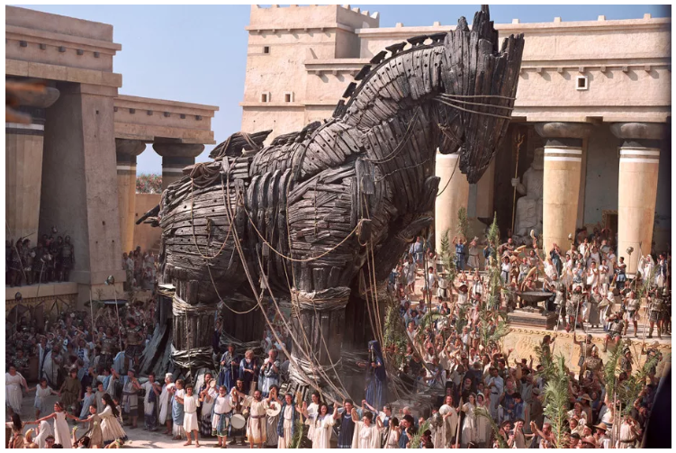
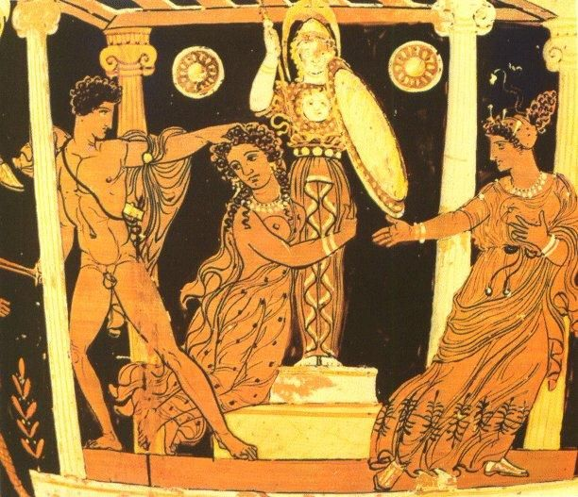
Who Is Cassandra

Slide 16
Cassandra Scene: Summary
Part 1 (pp. 143–149)
Part 2 (pp. 149–158)
Greek incomprehension
  Clytemnestra, Leader, Cassandra
Lyric transport
  Visions, prophecy
  Cassandra, Leader
Speech 1
  Visionary credentials
Speech 2
  Grief & fury
Speech 3
  Humiliation, later calamity
Notes:
Part 1 (pp. 143–149)
Greek incomprehension
Clytemnestra, Leader, Cassandra
Lyric transport
Cassandra, Leader
feast of Thyestes
Aegisthus’ complicity in Agamemnon’s murder
Paris, abduction of Helen
house as place of death, net of death, etc. (net of death = cly herself)
Part 2 (pp. 149–158)
Speech 1
Visionary credentials. (prōtarkhos atē, Thyestes’ adultery with Atreus’ wife, Aerope)
story of the source of her doomed prophecy
Speech 2
Visionary reveal, grief & fury. “Agamemnon, you will see him dead” (p.
Speech 3
Humiliation, coming calamity
cass‘s near-rape by apollo

Slide 17
CLYTEMNESTRA Unless she’s like a swallow, possessed / of her own barbaric song, strange, dark. / I speak directly as I can — she must obey. (p. 143)
CASSANDRA Aieeeeee! Earth — Mother — / Curse of the Earth — Apollo Apollo! (p. 144) (ototototoi popoi dā | ōpollon ōpollon, lines 1072–1073)
CASSANDRA You, you godforsaken — you’d do this? / The lord of your bed, / you bathe him . . . his body glistens, then — / how to tell the climax? — . . . .
LEADER. Still lost. Her riddles, her dark words of god / I’m groping, helpless. (pp. 146–147)
CASSANDRA I yielded / then at the climax I recoiled — I deceived Apollo. (p. 151)
CASSANDRA We will die, / but not without some honour from the gods. / There will come another to avenge us, / born to kill his mother, born / his father’s champion. (p. 155)

