Slide 1
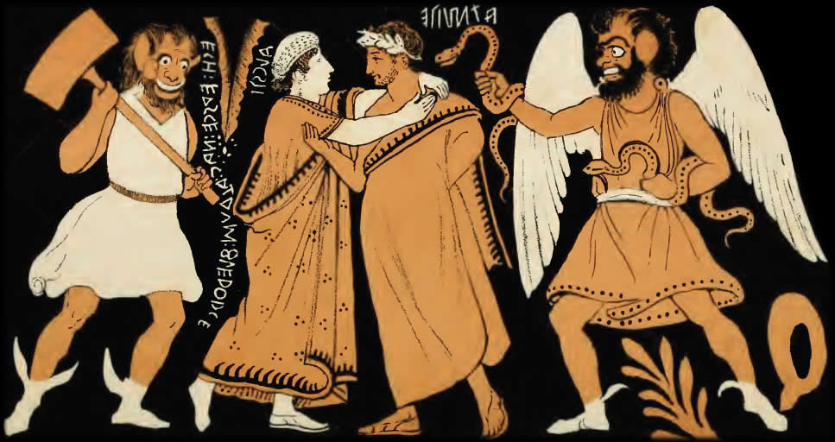
Prosatyric or “Anti-satyric”?
Euripides’ Alcestis
Alcestis and Admetus. Etruscan vase
Notes:
you see on the screen what – purely on a subjective, totally non-scholarly level – looks kind of odd and funny. it’s an Etruscan vase (not Greek) showing Alcestis and Admetus, the loving couple, surrounded by what look like demons of death. one looks like he wants to poison ad with snakes; the other seems intent on bonking poor Alcestis on the head. with their leering expressions, balding heads, and oversize ears, they look like nothing so much as two of the three stooges. or maybe a couple of oddball satyrs. so I have to ask myself if I want more to bite my nails in fear and pity or to laugh out loud.
put differently, I want to know if this vase painting is supposed to be sad or funny. and I have to confess, I kind of feel the same way about the play this vase is, almost certainly, based on - the play we’re reading today, Euripides Alcestis.

Slide 2
“She never can be hurt again.
For her a thousand cares are over — she is sublime.
But I, who have no title to be living
and I have overstepped my mark,
must go on and on — most melancholy — alive.
Too late I learn this now.”
(Admetus to Chorus, Euripides Alcestis, p. 36)
Notes:
case in point. on p. 37, in the 4th episode, Admetus, in a quasi-soliloquy (he’s actually addressing the chorus), bewails his situation as follows:
“She never can be hurt again.
For her a thousand cares are over - she is sublime.
But I, who have no title to be living
and I have overstepped my mark,
must go on and on - most melancholy - alive.
Too late I learn this now.”
he is, of course, talking about his recently deceased wife, Alcestis – her death so he could live. and although he clearly regards her death as tragic, I’m tempted to ask, tragic for whom?
not so much for Alcestis herself (he speaks of her as beyond suffering now: “She never can be hurt again. For her a thousand cares are over”) as much as for himself, and in ways coded, we now know, for tragedy:
“I have overstepped my mark”
too late I learn this now”
but how has Admetus “overstepped the mark”? what has he learned? or has he learned anything? and does all this arouse pity and fear? or, as would seem to be the case for the character of Death in the prologue and for pheres, ad’s dad, but also for the Butler in the drunken Heracles scene, maybe even for Heracles himself (who gently reproves ad in the finale), not to mention for us, the audience (and we’re the ones that count!), maybe it arouses reactions ranging from impatience, outrage, resentment, and ridicule. not very tragic…..
for it is not at all clear that ad has learned anything, as he seems, along with Apollo, his divine pal and advocate, to overstep boundaries of various sorts, and with depressing predictability.
so this play, which we know eur positioned last in its tetralogy, the place ordinarily reserved for satyr drama, again tests the boundaries of greek tragedy:
is its ending happy or is it sad
do the action arouse pity and fear or something else?
is a house undone, and a lesson learned, albeit too late, or are we dealing with something else?
and whether the play is or isn’t tragedy, does its testing the boundaries of the genre tell us anything about the genre itself?
those are the sorts of questions I was hoping we’d be able to explore with eur’s

Slide 3
Agenda
Tragedy in Performance
  Reunion Scene (p. 40 ff., near bottom: HERACLES “You’ve lost a perfect wife, there’s no denying”)
Discussion: Alcestis and Genre
  What Is Alcestis? What Do We Learn?
Introduction to Play
  Tragic Themes, Satyric Treatment?

Slide 4
Tragedy in Performance
Reunion Scene (p. 40 ff., near bottom: HERACLES “You’ve lost a perfect wife, there’s no denying”)
Notes:
how to read the seeming over-dramatization of alc’s death? her seeming passive-aggressive behavior?
should or should we not say that alc torments her children with the prospect of her immanent death. note that alc has a vested interested in this death: it’s her ticket to undying glory.
compare how the sense of loss works out in tw. there’s maybe something a bit over-the-top there, too, about the sense of loss – but the tw tal-ast-andr scene does easily lend itself to being played for laughs.
ad bans all celebration – a ban he himself shall break. a hypocrite in the full sense of the term, an insincere actor. extravagant claims about rescuing her – foreshadowing herc. yet the seeming over-dramatization of the promise – “children, have you heard?” (16).

Slide 5
Discussion: Alcestis and Genre
What Is Alcestis? What Do We Learn?

Slide 6
Ancient Commentary
“The drama is rather of the satyr-play variety, because its reversal leads to joy and pleasure, contrary to tragic genre. Inadmissible as examples of tragic poetry are both the Orestes [of Euripides] and the Alcestis, as they start from misfortune and finish joyously, with the characters well off – a plot pattern holding rather more to comedy.”

Slide 7
Discussion: Possible Points…
Happy tragedy?
  Is that a happy ending?
  Is happy tragedy even possible?
Genre parody?
  Paratragic
And if Alcestis…
  is/isn’t tragedy
… what is tragedy?
Notes:
Tragic?
Lamentation
“I have overstepped my mark, ... Too late I learn this now” (Admetus, p. 36)
Satyric?
Butler on Heracles (p. 30)
“He grabs the loving cup with ivy round it / and swills it down neat like so much grape juice”
Heracles to Butler (p. 31)
“Have a drink”
“… pay homage to … Aphrodite”
“… take a swig with me”

Slide 8
Introduction to Play
Tragic Themes, Satyric Treatment?

Slide 9
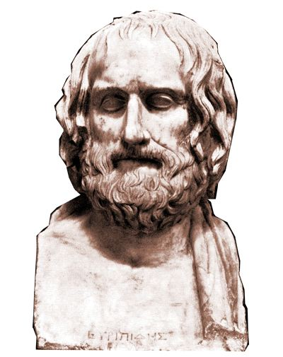
Production Facts
Euripides
Alcestis
480s-406 BCE
First competes, 455
438 BCE
1st preserved play
2nd to Sophocles
Tetralogy
  Cretan Women
  Alcmaeon in Psophis
  Telephus
  Alcestis
Notes:
438 BCE
Athens not yet embroiled in war!
1st preserved play of his
first competes 455, age c. 40
production notice …
“satyr-drama-like”
plot holding rather “to comedy”
perhaps not so well known …
treated earlier (c. 490 BCE, +/- 20 years) by Phrynichus
little more known than that
but figures importantly in the background to the eum, where the furies clearly carry a grudge against apollo for interfering in the affairs of the deities associated with earth, death, punishment.

Slide 10
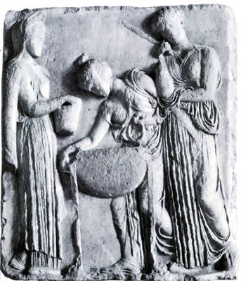
Mythological Background
Asclepius, Apollo
Apollo, Admetus
Alcestis, Pelias, Medea
Heracles & Cerberus
Pelias takes a bath. . .
Notes:
PROLOGUE: the quasi-agon of apollo and death place the play’s conflicts in the context of virtually the same cosmic conflicts as emerge in aesch’s eum.
noticeable is apollo’s role as a kind of divine exemplar of anti-sociality. mythical background not irrelevant:
hinted at but not mentioned here is the reason for apollo’s having to serve admetus as a kind of servant. apollo’s son, the physician asclepius, had been infringing on the territory of death by bringing the dead back to life. (p. 8, ref to ascl as only god capable of reviving her soul) apollo, in anger, then kills the cyclopses as providers of the lethal thunderbolt (never mind that the cyclopses in at least some sources are gods and immortal.) apollo, for that crime, forced into servitude to admetus, who takes that rather as an opportunity to exhibit his extraordinary hospitality. apollo, pleased, tricks the fates into providing admetus with a one-time pass on avoiding a fated death, provided he can find someone to take his place. our play mentions the “trick” apollo plays on the fates; in aesch’s eum, we hear that apollo had got the fates drunk!!
but alcestis too could be said to have a hand in a potentially transgressive act of rejuvenation if not revival. acc to various sources, the caucasian witch medea persuaded the daughters of pelias that, by following a certain magic recipe, they could restore their father to youth - recall that one of pelias’ daughters is alcestis.
well, just as medea had planned, it doesn’t work, and alcestis and her sisters kill their dad. which isn’t to say that act represents hamartia for which alc must pay. but that this play of eur’s is completely suffused with themes of hubristic trespass: ad’s (and, in effect, herc’s) upon proper observance of mourning, and that of a whole bunch of characters – not least, the god apollo – upon proper observance of the boundaries between life and death, of youth and old age.
so students who point out that the alcestis can’t work exactly as a tragedy are right. still, the play, if nothing else – and especially considering its ending – leaves us scratching our heads whether the cosmos has been back in balance by play’s end, or is just as dysfunctional as it was when it started.
Athens: Agora Altar of Pity relief-Medea and daughters of Pelias Date c.410 B.C. Location Athens (Greece)
marble copy, Rome, Lateran
Athens (Greece)--Agora--Altar of Pity
Greek--5th C. B.C
Medea (Greek mythology) ARTstor CollectionARTstor Slide Gallery

Slide 11
Alcestis: Analysis
Prologue (p. 1 ff., Signet ed.)
  Apollo, death. (Quasi-agōn)
Parodos (6)
  Elders of Pherae. (Alcestis: best of women)
Episode 1 (8)
  Maidservant, Leader
Stasimon 1 (11)
  “Gods: “help!”
Episode 2 (12)
  lyric duet, dialogue: Alcestis, Admetus (grief, fidelity)
  lyric duet: Admetus, Eumelus
  spoken: Admetus solo
Stasimon 2 (19)
  best of women. . .
Episode 3 (20)
  Heracles, leader, Admetus. (Lodging, deception, desis-lusis)
Stasimon 3 (23)
  Admetus’ hospitality
Episode 4 (25)
  Admetus, Leader, Pheres. (Agōn)
Short choral interlude (29)
Episode 5 (29)
  Butler, Heracles. (Carousing, 1st recognition)
Stasimon 4 (37)
  Power of fate
Exodos
  Admetus, Heracles, silent Alcestis (2nd recognition, 2nd desis/lusis)
Notes:
in terms of plot, very conventional eur – a rather UN-conventional poet.
PROLOGUE: backstory, thematic context.
the play’s prologue, with its dramatization of a clash between gods (and therefore clearly alluding to aesch’s eum), prompts the question: is there hamartia here, and if so, what is it? does apollo err by infringing on death’s territory? (apollo has a history of this, precisely what led to the punishment that itself led to ap’s meeting ad.) is it hamartia when ad canvasses for a stand-in death-victim, or when alc extracts from the promise, in return for her life, he must pledge himself not simply to eternal widower-hood, but celibacy too (not sharing his bed with anyone)?
in effect, AGON! between death and apollo. (apollo as trickster god – cf. Eumenides) death rightly suspects apollo. apollo says he has his reasons. what are they? apollo adduces some really pitiful arguments to “bribe” death to spare alc. (the beautiful funeral if she’s carried off old.) apollo takes death’s demurrals as sophistry – an interest of eur’s. apollo utters a thinly veiled oracle predicting the saving of alc by heracles.
PARODOS. the frequently encountered chorus of elderly – and more or less bewildered – men. (is this the day al is to die?)
1ST EPISODE. more later when we do the performance. how to read the seeming over-dramatization of alc’s death? her seeming passive-aggressive behavior? (alc’s farewells – even to her bed. what’s that with obsessive focus on the bed, i.e., on her marriage?)
STASIMON 1. prayer to apollo. chorus insane with sense of loss, almost suicidal.
EPISODE 2. more later, but again, tragedy or paratragedy of alc’s death….
ad declares a full year of mourning.
EPISODE 3. her, ad. ad’s equivocal, nebulous talk. asked a straightforward question, he speaks in enigmatic ambiguities – he trying to say things that maintain the appearance of saying something without actually saying anything. ad the host is trumping ad the husband. in the process, he plays false to both sides of his social self.
STASIMON 3. ostensibly, praise of ad’s hospitality and of ap’s serenely bucolic music. but the irony: implications of both (ad’s hospitality, ap’s association with carefree serenity) source of tension. “for the gentle-born cannot err but in generous wise. all wisdom resides in the noble. it sets me to thinking. deep in my soul a faith abides that the referent man will always fare well” (chorus, 24). that gives utterance to the sorts of platitudes that many on the last exam assumed are the “lessons” of tragedy. but uncritical buy-in to those sentiments must ignore a great deal else contracting that in the play.
EPISODE 4. pheres-ad agon. whatever you think of the back-and-forth (and neither side looks good here), upshot: the deal with death is tearing the family apart – by athenian standards, ad’s disrespect to his father is appalling, however contemptible the father’s relief is (the “what else are wives for?” thing). and the theme of families torn apart very much is close to the heart of tragedy. plus, father shows up son’s cowardice.
EPISODE 5. heracles satyr?? bit of cyclops?
arias and duets. ample kommos.
formal agon: long speeches, stichomythia.
choruses: not simply ornamental, but resonate with action, project an emotional response to it. do not advance plot. but ad unambiguously makes a deal with alc.
exodos. in effect, heracles’ DEM. but does herac actually solve – or create – problems? note the cascading consequences of inept yielding to passion, inclination. if not tragic cycle, still, some sort of cycle.
mirroring, reversal
rejection and welcome
rejection of Pheres
welcome of Heracles
mourning and rejoicing
by Admetus
death and resurrection …
of Alcestis
double …
deception (Ad dec’d H, H deceives Ad)
anagnorisis (recognition, H of the situation in which he finds himself, Ad that it’s his wife)
peripateia (reversal, of H and AL/AD – but al’s death not a reversal, rather is exdpected)
… of
Heracles
Admetus
the untragic action reveals flawed ethos of Admetus. he commits hamartia: whether in entertaining heracl or in breaking his promise to al. but Alcestis exaggerated
note also element of koros: excessive grief of adm (Heracles: "Bear up! Don't overdo your grief,“ p. 40), excessive meddling of alc (? do not remarry, “. . . remember always what you owe to me; / something I can never ask you to repay,” p. 14).
dike: I know most of you want to see the ending as happy, but could we also see this spectral alcestis as a kind of human Fury, an albatross bound to remind him every chance she gets of his failure to keep two of his promises? (ad: "Really her, / not some hallucination from the shades?" ad: "Are you sure she's not some ghost rising from the shades the shades?" herac: "That would make your guest a spirit-raiser,“ p. 42.)
MORE GENERALLY, on the tragic/un-tragic features of play,…
ate? leader on p. 15: “all this he’ll do – or else be raving mad.” leader on page 23, when ad asks that her be hospitably received: “what are you doing, admetus? overwhelmed by catastrophe, and you think of entertaining? are you out of your senses?”
koros? recognition? reversal? not as clear cut as in aesch., but this is a king who in a sense has it all – and wants to keep it that way. just as soon as he consents to his wife’s proxy death, he experiences reversals (the compromising promises he’s forced to make). but when his wife returns, he arguably experiences reversal. but it is reversal with pity and fear? KOROS. not what’s usually meant by the word, but note the servant’s “he’s just too considerate, too hospitable” (31).

Slide 12
Themes: Gender, Heroism
Alcestis
Compare
“Alcestis / who seems to me and all of us / best of wives a man could get” (Chorus, 7)
“The noblest consort under the sun!” (Leader, p. 9)
“Your death bequeaths | A theme for songs | For us, and lays for endless singers” (Chorus, p. 19)
Achilles as “Best of the Greeks” (Homer Iliad 2.411)
Achilles’ “undying glory” (Homer Iliad 9.411)
Pericles to Athenian women
  “Great will be your glory in not falling short of your natural character; and greatest will be hers who is least talked of among the men whether for good or for bad” (Thucydides 2.45)
Notes:
Alcestis’ as best of women. Achilles in the iliad is best of thr greeks for his warrior prowess and courage. Alcestis in this play is best of women for her self-abnegation, by dying for her husband. so in IA, iph similarly heroic for allowing self to be destroyed: one woman’s life is worth many men’s lives. only here we may see something like a send up ofg that idea: ad comes across as distinctly unheroic.
7. "Alcestis / who seems to me and all of us / best of wives a man could get." (83-85 Ἄλκηστις, ἐμοὶ πᾶσί τ᾽ ἀρίστη | δόξασα γυνὴ | πόσιν εἰς αὑτῆς γεγενῆσθαι.) [note resonance with thuc fo, homeric "best of the achaeans." her best-ness is in self-negation.]
9. leader: "The noblest consort under the sun!“
but that necessarily involves pure SELF-NEGATION – yet again, glorious action in an outwardly directed direction is denied a woman. (cf. the lordly clyt, cf. also the proactive medea and her concern for her dignity.)
do we see see koros from alc vis-à-vis glory and mourning – a sort of passive-aggressive alc??
at the same time, alc’s sacrifice comes at a steep price: ad’s liberty after her death.
note that chorus leader ominously-ironically foreshadows ad’s faithlessness when says “all this he’ll do – or else be raving mad” (15).
leader on page 23, when ad asks that her be hospitably received: “what are doing, admetus? overwhelmed by catastrophe, and you think of entertaining? are you out of your senses?” this is the tragic setup, you might say – the playwright sets the trap, just as Dionysus does in the Bacchae, where he serves as orchestrator of tragic action.

