Slide 1

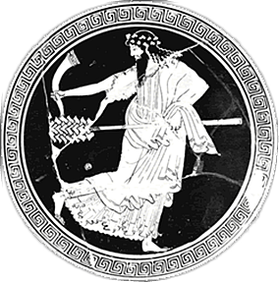
Aristophanes’ Frogs
Drama to the Rescue?
Notes:
can drama – tragedy, specifically, save us? if so, how?
I’d like to start by polling students as to their reactions to the play – extremely different from anything we’ve read so far. this is comedy, not tragedy nor even satyr drama. so,
how are you finding it different from those other genres?
comedy?
satyr drama?
what about the humor?
what’s it resemble from contemporary culture?....
so I wonder, is it possible to take a play like this seriously? is there something there beyond poop, fart, and sex jokes?

Slide 2
Prologue: Chorus, to Demeter
“May I utter much that's funny, / and also much that’s serious” (p. 79)
Notes:
I ask not simply because of the quotation flashed on screen earlier, but also because of the play’s connection with events and situations current with the time and place of its earliest performances.

Slide 3
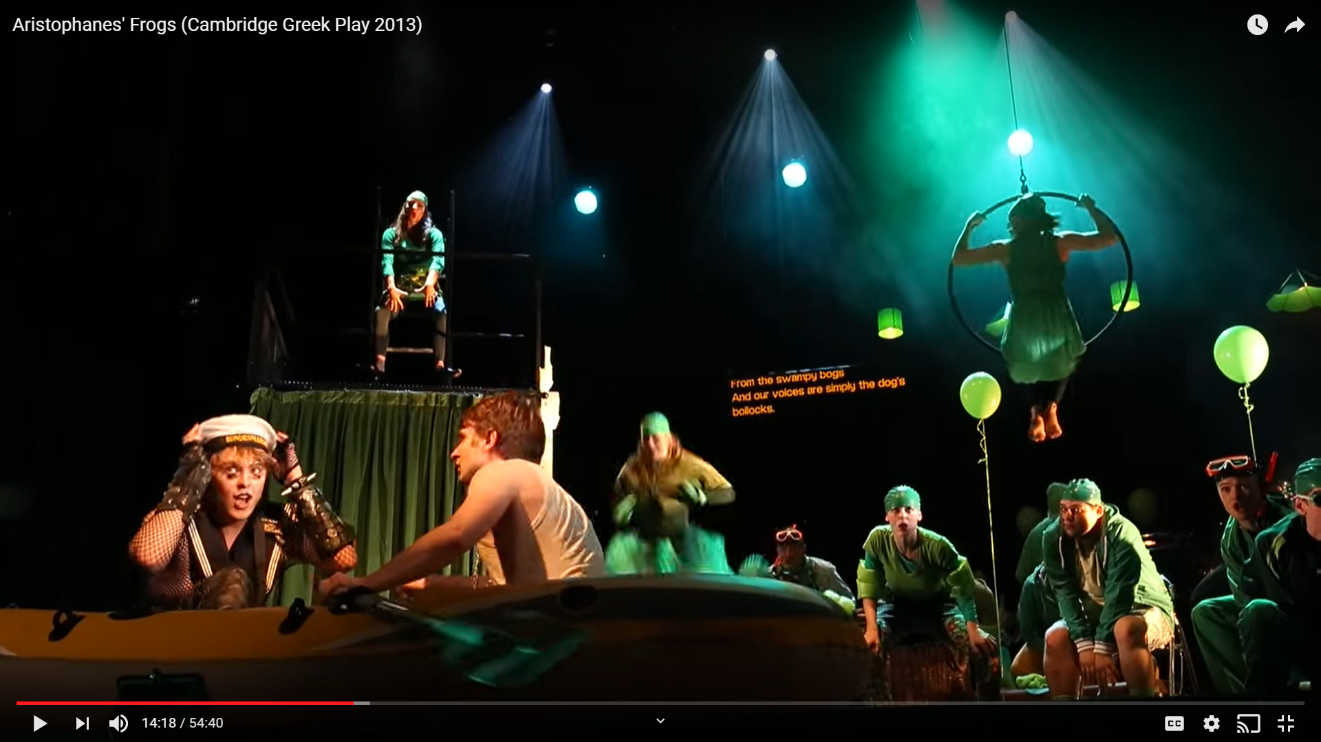
https://youtu.be/yYYQIn_sC-4?t=618

Slide 4
FROGS Brekekekex koax koax!
DIONYSUS Blast you, and your koax too!
Yes, all you are is koax.
FROGS Quite so, you busybody!
For the Muses skillful on the lyre cherish us,
and hornfoot Pan, who plays the tuneful reeds,
and Apollo the Harper delights in us too,
in thanks for the stalks that I grow
in lake water, as girding for his lyre.
Brekekekex koax koax! (Frogs , p. 59)
Notes:
ask students to write down one reason why it’s (possibly) silly, one why (possibly) serious. is it possible for the silliness to contribute to a serious point?
53. the frog chorus. d as resentful of the whole thing. objects to the "koax" that's all the frogs are. frogs protest that gods fond of them. frog song as anus song. d might be saying that the song is devoid of substance. he is seeking in poetry something substantial. the chant turns out to be good for little more than competitive shouting. thus symbolizes a kind of disunity.
why bring great tragedy back to Athens?
the frog chorus could be read as rejection of not vulgar or puerile humor itself as worthless discourse, but of comedy that offers nothing more – no more than croaking of frogs
compare references to gratuitously vulgar humor in play’s beginning (though that seemingly a common motif)
in fact, the play is a sustained argument for the importance of tragedy in Athenian life
p. 161. aesch cross-examines eur. (elenchus) gets eur to say that poets should be admired for "skill and good counsel, and because we make people better members of their communities." acc to aesch, eur has corrupted, aeschylus, ennobled athenians. aesch inspired military virtue. note citation of persians. attacks immorality of eur's characters. (what about aesch's immoral characters? - "and no one can find a lustful woman in anything I ever composed.") poets are teachers to adults. must supress the immoral exemplum. treatment of royalty as if common. overturned manly training, proper deference to authority
Dionysus quizzes Aeschylus and Euripides about
what to do to win the war
what to do about Dionysus
but the play itself has already answered both
in the section marked katabasis, it recommends that exiled aristocrats capable of quality leadership be brought back
that arguably will have been a reference to, among others, Alcibiades, who in 405 will have been in self imposed exile as result of a setback he wasn’t responsible for (notium, 407, Arginusae and trial of generals, 406)
p. 219. the will-take-the-one-with-the-better-advice-back thing. opinions on alc. eur and aesch express the same opinion basically on al. eur clearly, the other "sagely" (but obscurely). similar on other question
SO WHOSE VISION OF TRAGEDY WINS, Asch’s or Eur’s?
arguments of two sides very similar: both assume that tragedy should benefit the city, should inculcate desirable behaviors. (161. aesch cross-examines eur. [elenchus] gets eur to say that poets should be admired for "skill and good counsel, and because we make people better members of their communities.")
but differ as to how:
EUR by teaching critical thinking through exemplary clarity of language (eur – “That's how I encouraged these people to think, by putting rationality and critical thinking into my art, …” [175]; eur taken to be willing to exhibit sub-ideal characters, situations, etc.)
AESCH by inculcating traditional values - acc to aesch, eur has corrupted aeschylus-ennobled athenians. aesch inspired military virtue. note citation of persians. attacks immorality of eur's characters. (what about aesch's immoral characters? - "and no one can find a lustful woman in anything I ever composed.") poets are teachers to adults. must suppress the innmoral exemplum. treatment of royalty as if common. overturned manly training, proper deference to authority.
EUR clear expression.
AESCH weighty expression.
D’s judgment: 217. d on the 2 poets. "One I consider a master, the other I enjoy.” 1413 τὸν μὲν γὰρ ἡγοῦμαι σοφόν, τῷ δ᾽ ἥδομαι.
validity of political advice? but how do they really differ? only as to style of presentation. note, at any rate, assumption that tragedy should by implication engage issues of the day.

Slide 5
Modern Tragedy. . .
“Deep relations” between history and literature
Modern tragedy as “crossroads”
  Experience
  Literary/dramatic works
  Theory
Problem of lived versus literary tragedy
Notes:
so here, then, is my point. in 405 bce, the year of the initial production of frogs, a play that is about – in a word – tragedy, Athens was undergoing tragedies (in the non-literary sense of the word) of its own
the loss of its greatest tragedians
the loss of its empire and of its leading position in the greek world
so we come back, then, not just to our opening quotation (chorus: “May I utter much that's funny, / and also much that’s serious,” p. 79) but to the leading concerns of the Williams reading, especially the relationship between tragedy and real life
for Williams, the proposition that tragedy can – and should – respond to the crises and preoccupations of real human beings
for Aristophanes in his frogs, the proposition, if we can take it seriously, that tragedy has something crucial to offer the city in its crisis
basic idea, "central argument": the deep relations between the actual forms of our history and the tragic forms within which these are perceived, articulated, and reshaped" (208).
13. on the book as crossroads between experience, literature, academic theoretical debates. w's own personal experience tragedies and its connection to tragedies of his age.
14. the "powerful presence" of surviving tragic lit. the problem of connecting experiential tragedy with lit tragedy and esp with theories thereof. tragedy, experiential or lit
15. examination of the tradition will shed light on the problem of relating fictive to lived tragedy.

Slide 6
Questions…
Is Frogs (partly) serious?
What does Frogs seem to say tragedy has to offer?
What can that tell us about tragedy itself?
  In its ancient, Athenian context
  In general
Notes:
so we are going to explore the following questions today:
is there, in fact, a serious component to frogs?
if so, what, if anything, does that seem to have to do with whatever the play seems to say about what tragedy had to offer an Athens in crisis
and what, if anything, can that tell us about tragic genre itself

Slide 7
Agenda
Aristophanes’ Frogs
  Introduction to Play
Debate
  Aeschylus or Euripides — Whom Do You Prefer? (And why?)

Slide 8
Aristophanes’ Frogs
Introduction to Play

Slide 9
Production, Themes
Production (405 BCE)
  Lenaea (Jan/Feb)
  1st prize
Political Crises
  413 Sicilian Disaster
  411 Oligarchic coup
    exile of oligarchs
  406 Aegospotamoi
Poetic Crises
  “Tragic” losses
    456/5 BCE Aeschylus
    406 BCE Euripides
    406 BCE Sophocles
  Dionysus’ “yearning”
Notes:
Historical
Production
405 BCE
Lenaea (Jan/Feb)
lenaea = dio fest. ordinarily 5 comedies, but during war, cut back to 3. no non-citizens permitted.
1st prize, crown, encore
Politics etc.
413 Sicilian disaster
411 exile of oligarchs
arginusae, 406
405
material pressures
military uncertainties
political tension
404
aegos potamoi, 404
final defeat
democracy dissolved
Religious
Dionysian festival
mystery (Eleusinian) evocations
Demeter, Persephone, Iacchos-Dionysos
ritual insult
Chorus of Initiates
us???
Dramatic
Aischylos, Sophokles, Euripides, Agathon dead
Dionysos “yearning”
Athens bereft, desperate

Slide 10
Analysis
Prologue
  Xanthias, Dionysus, Heracles, Corpse, Charon
Choral dialogue, agōn
  Frog Chorus, Dionysus
Scene
  Charon, Dionysus, Xanthias (Empusa)
Parodos
  Lyric, chanting, dialogue. Mystic Chorus of initiates, Dionysus, Xanthias
Scene
  Dionysus, Xanthias, Aeacus, Maid
Parabasis
  advice to the city
Scene
  Slaves
Choral ode
  Agōn prelude
Agōn
  Opening arguments (147)
  Prologues (177)
  Lyrics (197)
  Weighing of lines (209)
  Leadership (219)
Exodos
  Pluto, Aeschylus, Chorus. Farewell
Notes:
15. scatology. metatheatrical refs. refs to competitors.
25. d longs for eur. all the poets dead and gone...
scene (87)
Dionysus, Xanthias, Aeacus, Maid. Door comedy, drubbing scene, etc.
119. parabasis. advice.
123. coinage metaphor, bring back good citizens and use them for war.
scene (125)
Slaves. (Trouble in Hades)
129. the first we hear of aesch and eur's quarrel. seat for tragedy.
131. eur as poet to the scoundrels below. eur basically as sophist. if eur wins, soph will challenge eur.
choral ode (137)
Tragic parody: consternation over poetic quarrel. (agōn prelude)143. dio refers to the sophismata ("intellectualisms") of evidently both playwrights.
147. eur prays to his novel (sophistic) gods.
AGON: BASIC THEME, SHOW (aesch) VERSUS TELL (eur). that extends to eur’s (supposed) clarity and aesch’s (supposed) riddle-like obscurity. only check out aesch’s last piece of advice, p. 227.
153. eur's describes own stuff. simplified language, clarified with prologues. eur taught athenians "how to talk" - i.e., sophistic ruses. also introduced the everyday into tragedy.
157. critical thinking.
161. aesch's turn. gets eur to state the purpose of poetry: political and social value, improvement. aesch claims eur corrupted athenians. aesch claims he made athenians warlike. NOBLE, INSPIRING EXAMPLES.
165. persians: confirms as a patriotic play. the tragedy in any of this?? poetry here validated for dicdiactic role - just as in eur. only there, eur plays the sophist, here, aesch the traditional educator.
169. aesch alleges that eur's erotic plays corrupted women's morals. "... the poet has the special duty to conceal what's wicked, not stage or teach it." poet = teacheer for adults. poetry as propaganda.
[so eur's problem is he's too real.]
Aeschylus v. Euripides’ prologues
e criticizes a’s prols as redudant
a attckes e’s as somehow amounting to same thing, finishing with a metrical pattern equiv to “lost his little bottle.” i.e., as trivial. (possible dirty joke, too.) (bottle joke, 177)
a’s and e’s lyrics – e recites a’s lyrics inplying inflated, repetitious, inflated language with little meaning. (e as economjical in lang)
weighing of lines: a’s much more weighty. lightweight persuasion v death. a as religiously profound. (compare previous)
219. dio's last test: the best advice thing. alc. eur seems to criticize al, asch seems to advise acceeding to a dangerous alc. that's sage (asch) and clear (eur). then silly stuff. then eur recommending a change of the guard. then aesch's last word completely puzzling.

Slide 11
Debate
Aeschylus or Euripides — Whom Do You Prefer? (And why?)

Slide 12
Aeschylus or Euripides?
Given the way things are now, do you prefer Aeschylus or Euripides? That could be in terms of entertainment value, how their plays do or don't speak to you, pretty much anything.

Slide 13
Procedure
(10 mins?) Each group chooses secretary, discusses how best to:
  Argue for their preferred dramatist
  Argue against the other one
  Secretary records main points in chat (hit enter when done)
  Judges discuss amongst selves how they see the case
(2 mins each) Each group summarizes main point(s).
(10 mins?) Judges interrogate groups.
Judges deliberate, vote, announce verdict.
Everybody votes in an anonymous poll.

