Slide 1

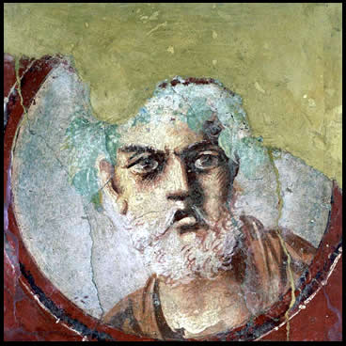
Introduction to
Roman Tragedy

Slide 2
Agenda
Discussion…
  The content of Roman tragedy is not “tragic”?
City and Empire
  The Briefest of Surveys of the Roman World
Roman Theater, Roman Drama
  Continuities, Developments
Republican Tragedy, Choice Quotes
  Your impressions....

Slide 3
Discussion…
The content of Roman tragedy is not “tragic”?

Slide 4
Brill’s on Roman Tragedy
“The content of Roman tragedy is not ‘tragic.’ ”
Notes:
QUOTES (Brill’s on Roman tragedy):
Unlike Greek tragedy which emerged in a highly developed cultural setting, tragedy in Rome came at the beginning of literature. In 240 BC the aediles asked Livius [III 1] Andronicus, who came from the Greek-speaking world, probably from Tarentum (Taras [2]), to stage a dramatic play for the ludi Romani ( ludi [II B] and [III G]) (Cassiod. Chronica p. 120 M. on the year. 239 BC: “ludis Romanis primum tragoedia et comoedia”). Thus in Rome, dramatic literature was first 'commissioned' by magistrates. Correspondingly, it had a public, 'political' function. In Rome, the introduction of dramatic plays was primarily an institutional and religious phenomenon [5. 319] and only secondarily a literary phenomenon. Liv. 7,2 (cf. the parallel account in Val. Max. 2,4,4) in a brief excursus on the history of Roman theatre emphasized its administrative and cult aspect [22].
The content of Roman tragedy is not 'tragic'. In its early form its main purpose was to provide historical arguments. With Pacuvius and Accius tragedy became more literary but continued to focus on the model attribute of virtus (virtue) - either of individual heroes or of the populus Romanus as a whole. Of central concern was not the fate of the individual but rather the advancement of the collective good. Roman heroes do not face tragic decisions between equally important duties since the teleology of Roman society has eliminated such conflicts. [author means a kind of roman version of the end of history; compare Vergil on rome’s mission] Under Nero, tragedy became the genre of the opposition. In their positive aspects Seneca's heroes are Stoic wise men, in their negative aspects monomaniacal criminals. In their own way, both types are autonomous. Entirely self-sufficient, they know neither physical pain nor moral challenges; they are not part of the community. The solution consistently available to them is death [9].

Slide 5
Discussion: How?
I will form (randomized) breakout rooms.
In each of your groups, you choose a typist-scribe.
10 minutes. Discuss what, according to Brill's, is untragic about Roman tragedy. Underlying assumptions? Implications
  Everyone discuss (I’ll be checking in)
  Scribe. In chat box, type...
    First names of group members
    Chief points (not detailed record!) of discussion
    Share that via chat
“The content of Roman tragedy is not ‘tragic.’ ”
Notes:
The content of Roman tragedy is not 'tragic'. In its early form its main purpose was to provide historical arguments. With Pacuvius and Accius tragedy became more literary but continued to focus on the model attribute of virtus (virtue) - either of individual heroes or of the populus Romanus as a whole. Of central concern was not the fate of the individual but rather the advancement of the collective good. Roman heroes do not face tragic decisions between equally important duties since the teleology of Roman society has eliminated such conflicts. Under Nero, tragedy became the genre of the opposition. In their positive aspects Seneca's heroes are Stoic wise men, in their negative aspects monomaniacal criminals. In their own way, both types are autonomous. Entirely self-sufficient, they know neither physical pain nor moral challenges; they are not part of the community. The solution consistently available to them is death [9]. (Brill’s New Pauly)

Slide 6
City and Empire
The Briefest of Surveys of the Roman World

Slide 7
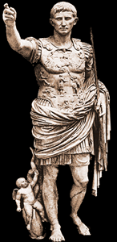
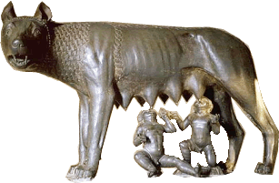
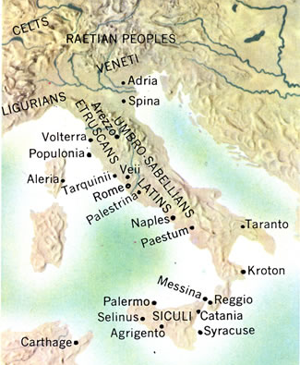
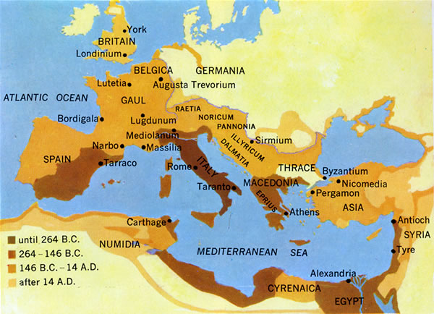
Capitoline Wolf
Augustus
Ancient Italy
Roman Empire

Slide 8
Timeline
753-510 BCE Regal period
Ruled by kings.
510-27 BCE Republic
Mixed constitution: oligarchic, quasi-democratic.
27 BCE-293 CE Principate (Early Empire)
De facto monarchy (imperātor, Caesar, princeps)

Slide 9
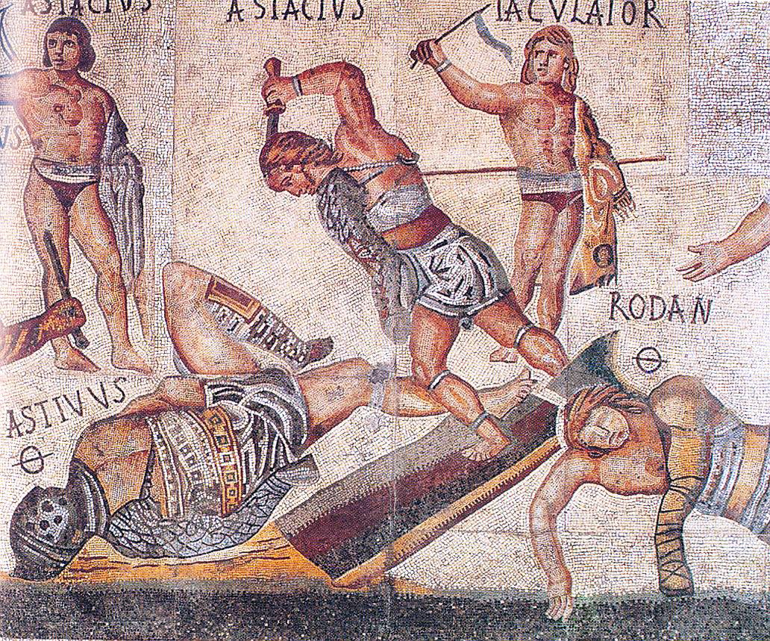
Rome and the grotesque
(Gladiator mosaic, ca. 320 CE, Borghese Gallery, Rome)

Slide 10
Roman Theater, Roman Drama
Continuities, Developments

Slide 11
From Horace’s Letter to Augustus
“Captive Greece took its wild conqueror captive, and civilized the savage land of the Latins.” (p. 276)
Graecia capta ferum uictorem cepit et artes
intulit agresti Latio. (Epistles 2.156–7)
mos maiorum
“way of the ancestors”
Notes:
this famous passage from the roman poet in a way sums up the issue we’ll be dealing with during this next phase of the semester. on the one hand, tragedy was a greek thing. its stories and style derived in large measure from greek antecedents. yet to explain roman tragedy as basically a reflection of some sort of mania on the part of romans for greek culture is to miss the point. for one thing, the romans were at pains to represent their own culture as something distinct from greek culture, which they tended to regard as decadent in comparison too their own – or rather, to the roots of their culture, as it was commonplace at rome that the ancestors possessed a morality superior to that of later generations of romans. the technical term for that is mos maiorum, the “ways of the ancestors.
so does roman tragedy, given all its greek elements, reflect a specifically roman character at all? and if so, how? that’s what we’re going to start considering round about now…

Slide 12
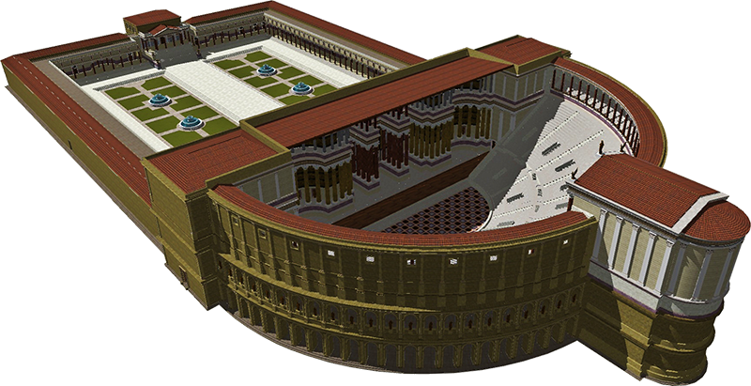
Theater of Pompey, Rome (55 BCE). Reconstruction (Wikipedia)

Slide 13
Roman Drama: Fabula. . .
Comedy, fabula...
Tragedy, fabula...
Palliata
  himation – i.e., Greek – comedy
Togata
  “toga” – i.e., Italian comedy
Trabeata
  upper-class comedy
Mimus
  popular farce
Crepidata
  “buskin drama” – i.e., tragedy based on Greek myth
Praetexta
  “fringed-toga drama” – i.e., Roman history play
Pantomime
  narrative dance, chorus accompaniment, mythological plots
ca. 240 BCE-early 100s CE

Slide 14
Tragic Playwrights
Republican
Imperial
LIVIUS ANDRONICUS
  280/60–200 BCE
Gnaeus NAEVIUS
  Late 2nd cent. BCE
Lucius ACCIUS
  180–ca. 86 BCE, child of ex-slaves
Lucius Annaeus SENECA
  ca. 4 BCE–65 CE
Notes:
NAEVIUS. “Six titles (Danae, Equos Troianus, Hector proficiscens, Hesiona, Iphigenia, Lycurgus) suggest tragedies of the Attic type. An account of Danae's disgrace (Nonius p. 456. 25, Lindsay) seems to have been set in bacchiac verse rather than in spoken senarii. Naevius also composed original tragedies, one on the story of Romulus the first Roman king, another (the Clastidium) on the defeat of a Gallic army in 222 by M. Claudius Marcellus (1). The latter may have been performed at funeral games for Marcellus in 208 or at the dedication in 205 of the temple of Virtus (see Honos) vowed by the consul before the battle of Clastidium.” (OCD)
ACCIUS. Epic (Annales) and dramatic poet. “The earliest [tragedy], probably the Atreus, was performed in 140 (Cicero Brutus 229). ... The grandeur of Accius' tragic style caused some contemporaries to laugh (Pompon. Hor. Serm. 1. 10. 53). Cicero, however, who was proud to have known him personally, admired his plays almost as highly as he did those of Pacuvius and cited extensive passages in his rhetorical and philosophical dialogues.” (OCD)
PACUVIUS (c. 220-130) stage poet and painter of South Italian birth, nephew and pupil of Quintus Ennius. His family belonged to Brundisium, and he spent his last years in Tarentum.

Slide 15
Republican Tragedy, Choice Quotes
Your impressions....

Slide 16
Republican Tragedy, Choice Quotes
Listen to the Latin and to the translation. For each, record your impressions in the chat box.

Slide 17
Crepidata…
... maior mihi moles, maius miscendumst malum / qui illius acerbum cor contundam et comprimam
“Again Thyestes comes, / At Atreus to grabble, now again / Approaches me to rouse me from my calm. / More moil for me! A bigger bane to brew, / That I may crush and crunch his grievous soul!”
  Atreus, in Accius’ Atreus frr. 163-166
oderint dum metuant
“Let them hate, so long as they fear”
  Atreus, in Accius’ Atreus fr. 168)
Notes:
note the passages from accius’ atreus – the feast-of-thyestes story. e.g., p. 383: “again thyestes comes.”
also the sententia: “let them hate so long as they fear,” a neat summation of what tyranny is about – accius was renowned in antiquity for his eloquence (disertissimus poeta, cic. sest. 122).

Slide 18
Praetextae…
“Back to his native land, happy in life never dying”
  Naevius Clastidium, performed 195 BCE?
“It was thus most favorably foretold that the Roman state would be supreme”
  Seer to Tarquin, Accius Brutus fr. 38
“Tullius [early Roman king], who for the citizens had made freedom firm”
  Accius Brutus fr. 40)
Notes:
“Back to his native land, happy in life never dying”
Naevius Clastidium (performed 195 BCE?)
Naevius (ca. 265-190 BCE). a single line from a lost play, the Clastidium (performed 195 BCE?), which described the victory in single combat of the Consul (high Roman official) Marcus Claudius Marcellus over the Gallic chieftain, Viridomarus, in 222 BCE. In reward, Marcellus received the spolia opima.
accius’ brutus is believed to have celebrated the family brutus, descended from the play’s protagonist, the republic’s founder.

