Slide 1
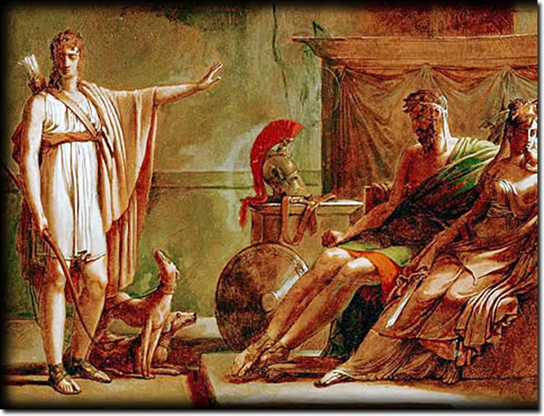
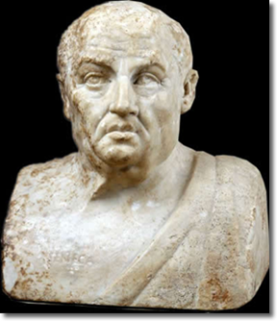
Seneca’s
Phaedra, or. . .
“The Explosion
of Evil” 1
Notes:
Creator Pierre Guérin (1774-1833) Title Phaedra and Hippolytus, oil sketch Work Type painting Date before 1802 Material oil, pen and ink, and pencil on paper mounted on canvas Measurements 33 x 46 cm Description RF 1982-13 The finished picture was completed in 1802 and is also in the Louvre (inv. 5182) Repository Musée du Louvre, Paris, France ARTstor Collection Art, Archaeology and Architecture (Erich Lessing Culture and Fine Arts Archives) ID Number 40-11-21/16
Culture Roman Title Double Herm: Socrates and Seneca
Socrates, front view Work Type portrait sculpture Date Roman copy of around 50-60CE of a Greek work made in the first half of the 3rd century BCE Style Period Imperial Description With this double herm a wealthy Roman had decorated his garden thereby stressing his own erudition.
Inscription: Seneca (in Latin letters) and Sokrates (in Greek letters)
Treatment: Very well preserved with the following parts restored in modern times: of Socrates tip of nose and part of moustache; of Seneca nose, left eyebrow and part of temple, part of left eye and eye lid as well as corner and part of cheekbone.
Photographer: Ingrid Geske Repository Staatliche Museen zu Berlin--Preussischer Kulturbesitz. Antikensammlung
http://www.smb.museum/smb/home/index.php?lang=de
Provenance: The double herm was found in 1813 on the ground of Villa Mattei at Rome and acquired in 1878. Accession Number Sk 391 Related Item Bibliography: 27. Studio-Ausstellung Berlin: Römische Porträts, exhibition catalogue Berlin (1981) p. 10-12 nr. 9 (H. Heres); Die Antikensammlung im Pergamonmuseum und in Charlottenburg (1992) p. 215-216 nr. 105 (with further bibliographical references); Lisippo, l'arte e la fortuna, exhibition catalogue Rome (1995) p. 330 nr. 6.6.5 (M. G. Picozzi); H. Born/K. Stemmer, Damnatio memoriae, Sammlung Axel Guttmann Band 5 (1996) p. 98. 105 fig. 93. ARTstor Collection Classical Sculptures (Berlin State Museums) Source Image and original data provided by Staatliche Museen zu Berlin, Stiftung Preussischer Kulturbesitz

Slide 2
Agenda
Recap and Update
  Introduction to Roman Tragedy
Republican Tragedy (ca. 240–27 bce)
  Choice Quotes, Your Impressions....
Introduction to Seneca
  “The Explosion of Evil”

Slide 3
Recap and Update
Introduction to Roman Tragedy

Slide 4
Brill’s on Roman Tragedy
“The content of Roman tragedy is not ‘tragic.’ ”
Notes:
QUOTES (Brill’s on Roman tragedy):
The content of Roman tragedy is not 'tragic'. In its early form its main purpose was to provide historical arguments. With Pacuvius and Accius tragedy became more literary but continued to focus on the model attribute of virtus (virtue) - either of individual heroes or of the populus Romanus as a whole. Of central concern was not the fate of the individual but rather the advancement of the collective good. Roman heroes do not face tragic decisions between equally important duties since the teleology of Roman society has eliminated such conflicts. [author means a kind of roman version of the end of history; compare Vergil on rome’s mission] Under Nero, tragedy became the genre of the opposition. In their positive aspects Seneca's heroes are Stoic wise men, in their negative aspects monomaniacal criminals. In their own way, both types are autonomous. Entirely self-sufficient, they know neither physical pain nor moral challenges; they are not part of the community. The solution consistently available to them is death [9].

Slide 5
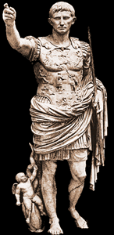
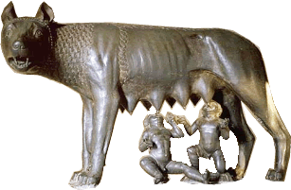
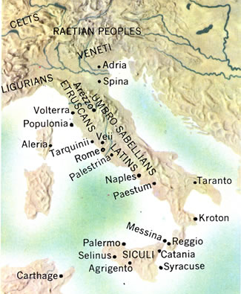
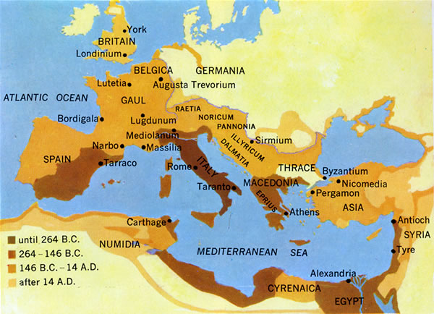
Capitoline Wolf
Augustus
Ancient Italy
Roman Empire

Slide 6
Timeline
753-510 BCE Regal period
Ruled by kings.
510-27 BCE Republic
Mixed constitution: oligarchic, quasi-democratic.
27 BCE-293 CE Principate (Early Empire)
De facto monarchy (imperātor, Caesar, princeps)

Slide 7
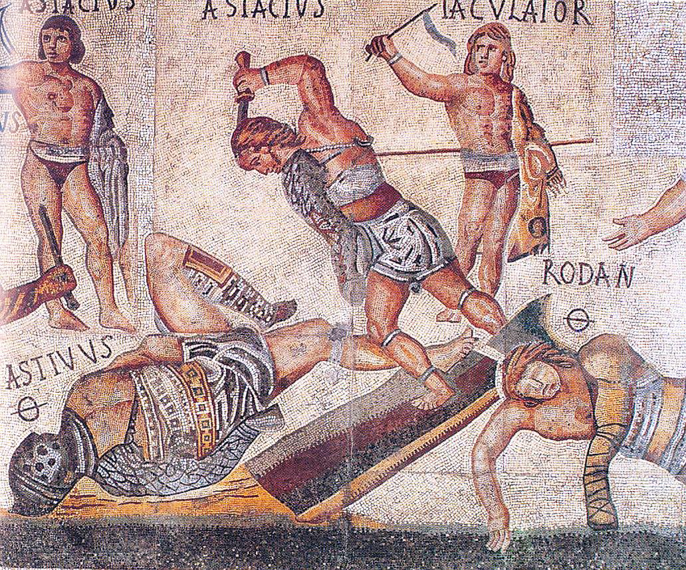
Rome and the grotesque
(Gladiator mosaic, ca. 320 CE, Borghese Gallery, Rome)

Slide 8
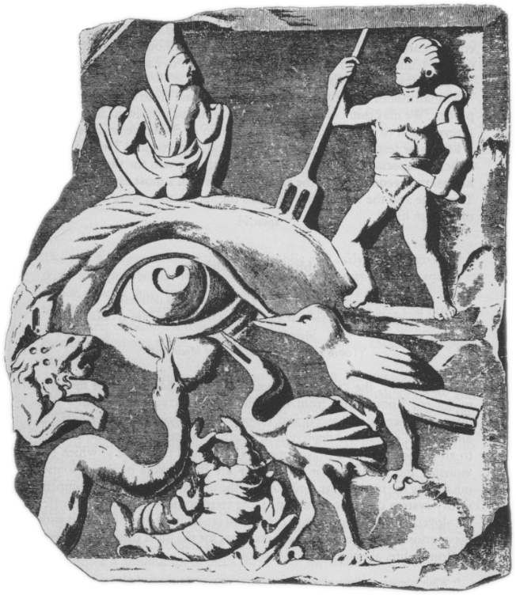
Woburn Marble, 2nd-cent. CE relief

Slide 9
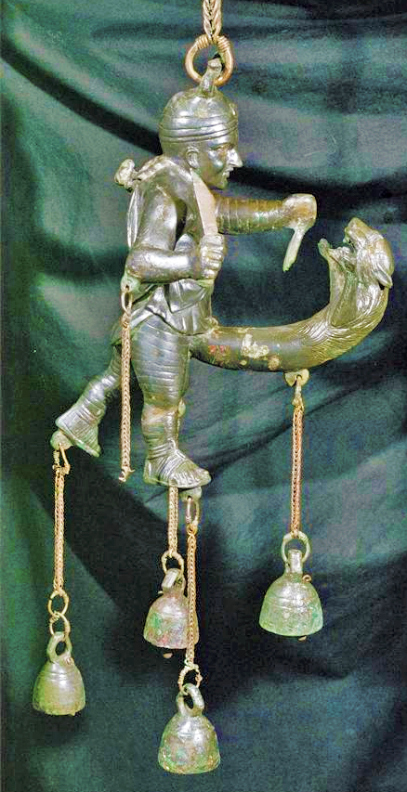
1st-cent. CE tintinnabulum. Naples Archaeological Museum

Slide 10
“Captive Greece took its wild conqueror captive, and civilized the savage land of the Latins.” (p. 276)
Graecia capta ferum uictorem cepit et artes
intulit agresti Latio. (Horace Epistles 2.156–7)
mos maiorum
“way of the ancestors”
Notes:
this famous passage from the roman poet in a way sums up the issue we’ll be dealing with during this next phase of the semester. on the one hand, tragedy was a greek thing. its stories and style derived in large measure from greek antecedents. yet to explain roman tragedy as basically a reflection of some sort of mania on the part of romans for greek culture is to miss the point. for one thing, the romans were at pains to represent their own culture as something distinct from greek culture, which they tended to regard as decadent in comparison too their own – or rather, to the roots of their culture, as it was commonplace at rome that the ancestors possessed a morality superior to that of later generations of romans. the technical term for that is mos maiorum, the “ways of the ancestors.
so does roman tragedy, given all its greek elements, reflect a specifically roman character at all? and if so, how? that’s what we’re going to start considering round about now…

Slide 11
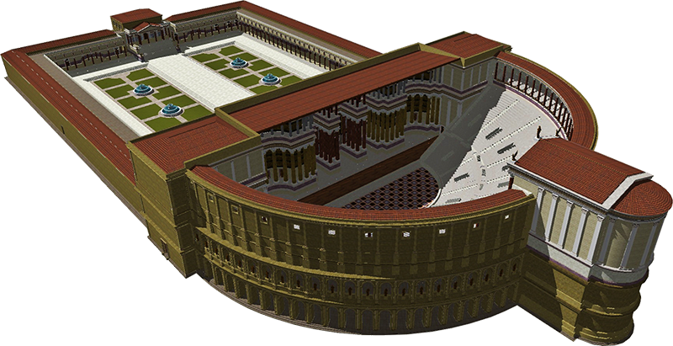
Theater of Pompey, Rome (55 BCE). Reconstruction (Wikipedia)

Slide 12
Roman Drama: Fabula. . .
Comedy, fabula...
Tragedy, fabula...
Palliata
  himation – i.e., Greek – comedy
Togata
  “toga” – i.e., Italian comedy
Trabeata
  upper-class comedy
Mimus
  popular farce
Crepidata
  “buskin drama” – i.e., tragedy based on Greek myth
Praetexta
  “fringed-toga drama” – i.e., Roman history play
Pantomime
  narrative dance, chorus accompaniment, mythological plots
ca. 240 BCE-early 100s CE

Slide 13
Tragic Playwrights
Republican
Imperial
LIVIUS ANDRONICUS
  280/60–200 BCE
Gnaeus NAEVIUS
  Late 2nd cent. BCE
Lucius ACCIUS
  180–ca. 86 BCE, child of ex-slaves
Lucius Annaeus SENECA
  ca. 4 BCE–65 CE
“Unlike Greek tragedy which emerged in a highly developed cultural setting, tragedy in Rome came at the beginning of literature” (Brill’s New Pauly)
?
Notes:
Unlike Greek tragedy which emerged in a highly developed cultural setting, tragedy in Rome came at the beginning of literature. In 240 BC the aediles asked Livius [III 1] Andronicus, who came from the Greek-speaking world, probably from Tarentum (Taras [2]), to stage a dramatic play for the ludi Romani ( ludi [II B] and [III G]) (Cassiod. Chronica p. 120 M. on the year. 239 BC: “ludis Romanis primum tragoedia et comoedia”). Thus in Rome, dramatic literature was first 'commissioned' by magistrates. Correspondingly, it had a public, 'political' function. In Rome, the introduction of dramatic plays was primarily an institutional and religious phenomenon [5. 319] and only secondarily a literary phenomenon. Liv. 7,2 (cf. the parallel account in Val. Max. 2,4,4) in a brief excursus on the history of Roman theatre emphasized its administrative and cult aspect [22].
NAEVIUS. “Six titles (Danae, Equos Troianus, Hector proficiscens, Hesiona, Iphigenia, Lycurgus) suggest tragedies of the Attic type. An account of Danae's disgrace (Nonius p. 456. 25, Lindsay) seems to have been set in bacchiac verse rather than in spoken senarii. Naevius also composed original tragedies, one on the story of Romulus the first Roman king, another (the Clastidium) on the defeat of a Gallic army in 222 by M. Claudius Marcellus (1). The latter may have been performed at funeral games for Marcellus in 208 or at the dedication in 205 of the temple of Virtus (see Honos) vowed by the consul before the battle of Clastidium.” (OCD)
ACCIUS. Epic (Annales) and dramatic poet. “The earliest [tragedy], probably the Atreus, was performed in 140 (Cicero Brutus 229). ... The grandeur of Accius' tragic style caused some contemporaries to laugh (Pompon. Hor. Serm. 1. 10. 53). Cicero, however, who was proud to have known him personally, admired his plays almost as highly as he did those of Pacuvius and cited extensive passages in his rhetorical and philosophical dialogues.” (OCD)
PACUVIUS (c. 220-130) stage poet and painter of South Italian birth, nephew and pupil of Quintus Ennius. His family belonged to Brundisium, and he spent his last years in Tarentum.

Slide 14
Republican Tragedy (ca. 240–27 bce)
Choice Quotes, Your Impressions....
Notes:
Listen to the Latin and to the translation
For each, record your impressions in the chat box
When you do, remember that everyone will see them...

Slide 15
Crepidata…
... maior mihi moles, maius miscendumst malum / qui illius acerbum cor contundam et comprimam
“Again Thyestes comes, / At Atreus to grabble, now again / Approaches me to rouse me from my calm. / More moil for me! A bigger bane to brew, / That I may crush and crunch his grievous soul!”
  Atreus, in Accius’ Atreus frr. 163-166
oderint dum metuant
“Let them hate, so long as they fear”
  Atreus, in Accius’ Atreus fr. 168)
Notes:
note the passages from accius’ atreus – the feast-of-thyestes story. e.g., p. 383: “again thyestes comes.”
also the sententia: “let them hate so long as they fear,” a neat summation of what tyranny is about – accius was renowned in antiquity for his eloquence (disertissimus poeta, cic. sest. 122).

Slide 16
Praetextae…
“Back to his native land, happy in life never dying”
  Naevius Clastidium, performed 195 BCE?
“It was thus most favorably foretold that the Roman state would be supreme”
  Seer to Tarquin, Accius Brutus fr. 38
“Tullius [early Roman king], who for the citizens had made freedom firm”
  Accius Brutus fr. 40)
Notes:
“Back to his native land, happy in life never dying”
Naevius Clastidium (performed 195 BCE?)
Naevius (ca. 265-190 BCE). a single line from a lost play, the Clastidium (performed 195 BCE?), which described the victory in single combat of the Consul (high Roman official) Marcus Claudius Marcellus over the Gallic chieftain, Viridomarus, in 222 BCE. In reward, Marcellus received the spolia opima.
accius’ brutus is believed to have celebrated the family brutus, descended from the play’s protagonist, the republic’s founder.

Slide 17
Introduction to Seneca
“The Explosion of Evil”

Slide 18
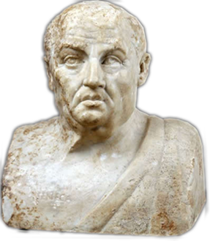
Seneca (10-65 CE)
Historical background
  Claudius (r. 41-54)
  Nero (r. 54-68)
Biographical notes
  Claudius, Agrippina, Nero
Philosophical interests
  Stoicism
  Epicureanism
Rhetorical dimension
  declamation
Notes:
Is there a relationship between the writer's life and the writings themselves? Let me quote C. J. Herington on that very topic as it applies to the extremely complicated and baffling case of Seneca:
What does seem relevant is the clear fact that Seneca himself lived through and witnessed, in his own person or in the persons of those near him, almost every evil and horror that is the theme of his writings, prose or verse. Exile, murder, incest, the threat of poverty and a hideous death and all the savagery of fortune were of the very texture of his career. (In Arion 5 [1966] p. 430)
However remote, bizarre, grotesque, or unnatural we may nowadays find Senecan tragedy, it was certainly "relatable," if to no one else, then at least to Seneca himself.
Historical
Augustus (r. 27 BCE-14 CE)
Tiberius (r. 14-37)
Gaius (r. 37-41)
Claudius (r. 54-68)
Philosophical
Stoicism
Epicureanism
Rhetorical
declamation
Biographical
Spanish birth (ca. 10 BCE)
equestrian class
Roman education
philosophy & rhetoric
Imperial service
Claudius
Agrippina & Nero
Suicide (65 CE)
Writings
prose treatises
“moral epistles”
tragedies. . .

Slide 19
Senecan versus Athenian Tragedy
Athenian
Senecan
Performed
Structure
  Episodes, choruses
Action
  Offstage violence
Links to
  Archaic Greek poetry
  Sophistic rhetoric
Performed?
  “Closet drama”?
Structure
  Acts (5), choruses
Action
  EXTREME violence offstage
Links to
  Roman rhetorical tradition
  Roman philosophical interests
Notes:
Marta Straznicky on closet drama: "part of a larger cultural matrix in which closed spaces, selective interpretive communities, and political dissent are aligned."
* Straznicky, Marta (2004). Privacy, playreading, and women's closet drama, 1500-1700. Cambridge, United Kingdom: Cambridge University Publishing. p. 77
Herington* thinks it is stageable and was performed on dramatic or semi-dramatized form.
* Herington, C. J. “Senecan Tragedy.” Arion 5 (1966): 422–471.

Slide 20
Senecan Rhetoric (Phaedra)
Sententia (pl. sententiae)
Perverse exaggeration
quod non potest vult posse qui nimium potest (Nurse, line 215)
“A man who can do much would like to do / More than he can" (Penguin, p. 106)
“I hate them all; I dread, I shun, I loath them. / I choose – whether by reason, rage, or instinct – I choose to hate them” (Hippolytus, p. 120)
Notes:
from Terms:
Sententia (pl. sententiae)
While the Latin noun sententia can simply mean the "sense" of an utterance, it has a technical meaning pertinent to the study of Roman tragedy. In the poetic and rhetorical stylistics of the imperial period (27 BCE onward), sententia comes to the fore as a term describing a short sentence dense with meaning and often dense, too, with irony. Take, for instance, the famous dictum of Arria, whose husband, Paetus, too cowardly to commit suicide to save his family's fortune, had to be coaxed with the words of his much braver wife, who said, Paete, non dolet, "Paetus, it doesn't hurt" (Pliny Letters 3.16). Of course, she was plunging his sword into her own breast at that moment, so the meaning of her utterance extends well beyond throse three short words: "Paetus, you miserable coward, an affront to your noble ancestors! If you can't find the courage to do the honorable thing, however painful — if your own wife, a mere woman, can, then what are people to think?"
Perverse exaggeration, rhetoric of excess
... taking a sentiment, finding its potential to express something over the top, outrageous, or similar, and then exploiting that potential verbally for all its worth. Take, for instance, a made up, non-Roman example like the following: "STUDENT: Professor Snape, do you really hate students that much? SNAPE: Students? I eat them for lunch!" Well, no, he doesn't, but you get the point.

Slide 21
“Senecan Formula” (cf. Herington)
Thematic Structure | Dramatic Structure
CLOUD OF EVIL | ACT 1. Hippolytus’ chaste joy, Phaedra’s love agony.
DEFEAT OF REASON BY PASSION | ACT 1 cont. Phaedra’s and nurse’s debate.
EXPLOSION OF EVIL | ACT 2. Attempted seduction, shocked rejection. Criminal plot – “crime must cover crime” (Nurse, p. 127)
 | ACT 3. Phaedra executes plan.
 | ACT 4. Messenger speech, Hippolytus’ death.
 | ACT 5. Phaedra’s suicide, Theseus’ grief.
Notes:
THE CLOUD OF EVIL, which coincides with a given play's prologue, in which an atmosphere of horror and dread is carefully cultivated.
THE DEFEAT OF REASON BY PASSION, often concentrated in the second act, where in several plays a noble and a lesser character debate - though really, REASON debates PASSION, with victory disastrously won by the latter.
THE EXPLOSION OF EVIL. Self-explanatory, it is, of course, action inevitably resulting from passion's victory over reason. Here, "the shockwave of evil races outwards, prostrating both the wicked and the noble" (Herington 456).
Herington, C. J. “Senecan Tragedy.” Arion 5 (1966): 422–471.

