Slide 1
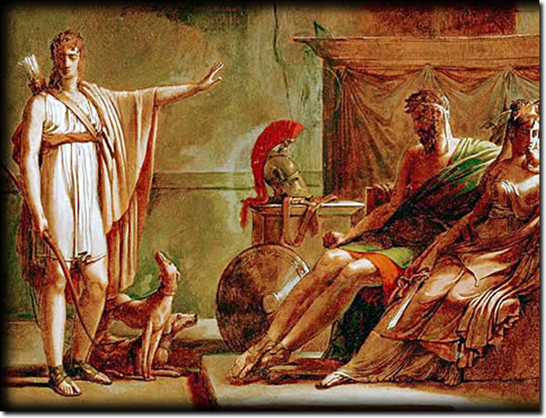
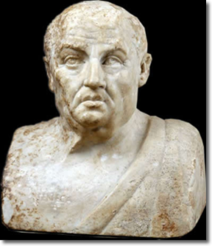
Seneca’s
Phaedra, or. . .
“The Explosion
of Evil” 2
Notes:
Creator Pierre Guérin (1774-1833) Title Phaedra and Hippolytus, oil sketch Work Type painting Date before 1802 Material oil, pen and ink, and pencil on paper mounted on canvas Measurements 33 x 46 cm Description RF 1982-13 The finished picture was completed in 1802 and is also in the Louvre (inv. 5182) Repository Musée du Louvre, Paris, France ARTstor Collection Art, Archaeology and Architecture (Erich Lessing Culture and Fine Arts Archives) ID Number 40-11-21/16
Culture Roman Title Double Herm: Socrates and Seneca
Socrates, front view Work Type portrait sculpture Date Roman copy of around 50-60CE of a Greek work made in the first half of the 3rd century BCE Style Period Imperial Description With this double herm a wealthy Roman had decorated his garden thereby stressing his own erudition.
Inscription: Seneca (in Latin letters) and Sokrates (in Greek letters)
Treatment: Very well preserved with the following parts restored in modern times: of Socrates tip of nose and part of moustache; of Seneca nose, left eyebrow and part of temple, part of left eye and eye lid as well as corner and part of cheekbone.
Photographer: Ingrid Geske Repository Staatliche Museen zu Berlin--Preussischer Kulturbesitz. Antikensammlung
http://www.smb.museum/smb/home/index.php?lang=de
Provenance: The double herm was found in 1813 on the ground of Villa Mattei at Rome and acquired in 1878. Accession Number Sk 391 Related Item Bibliography: 27. Studio-Ausstellung Berlin: Römische Porträts, exhibition catalogue Berlin (1981) p. 10-12 nr. 9 (H. Heres); Die Antikensammlung im Pergamonmuseum und in Charlottenburg (1992) p. 215-216 nr. 105 (with further bibliographical references); Lisippo, l'arte e la fortuna, exhibition catalogue Rome (1995) p. 330 nr. 6.6.5 (M. G. Picozzi); H. Born/K. Stemmer, Damnatio memoriae, Sammlung Axel Guttmann Band 5 (1996) p. 98. 105 fig. 93. ARTstor Collection Classical Sculptures (Berlin State Museums) Source Image and original data provided by Staatliche Museen zu Berlin, Stiftung Preussischer Kulturbesitz

Slide 2
Roman Tragedy?
Sophocles OAC
Seneca Phaedra
“Not to be born is best when all is reckoned in, but once a man has seen the light the next best thing, by far, is to go back back where he came from, quickly as he can.”
(Chorus, p. 358)
“Wilful sin is a worse evil than unnatural passion; that comes by fate, but sin comes from our nature. ... To choose the good is the first rule of life, and not to falter on the way; next best is to have shame and know where sin must stop.” (Nurse, p. 104)
“Good nurse. Unreason drives me into evil. ... Reason? What good can reason do? Unreason reigns supreme, a potent god commands my heart, the invincible winged god, who rules all earth....” (Phaedra, p. 105)
“The content of Roman tragedy is not ‘tragic.’ ”

Slide 3
Agenda
Introduction to Senecan Tragedy
  “The Explosion of Evil,” Phaedra
Tragedy in Performance
  How to handle the rhetoric?

Slide 4
Introduction to Senecan Tragedy
“The Explosion of Evil,” Phaedra

Slide 5
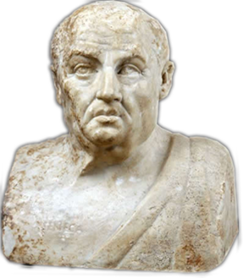
Seneca (10-65 CE)
Historical background
  Claudius (r. 41-54)
  Nero (r. 54-68)
Biographical notes
  Claudius, Agrippina, Nero
Philosophical, rhetorical, literary interests
  Stoicism
  Epicureanism
  Declamation
  Tragedy (Phaedra early 50s CE, reign of Claudius?)
Notes:
Is there a relationship between the writer's life and the writings themselves? Let me quote C. J. Herington on that very topic as it applies to the extremely complicated and baffling case of Seneca:
What does seem relevant is the clear fact that Seneca himself lived through and witnessed, in his own person or in the persons of those near him, almost every evil and horror that is the theme of his writings, prose or verse. Exile, murder, incest, the threat of poverty and a hideous death and all the savagery of fortune were of the very texture of his career. (In Arion 5 [1966] p. 430)
However remote, bizarre, grotesque, or unnatural we may nowadays find Senecan tragedy, it was certainly "relatable," if to no one else, then at least to Seneca himself.
Historical
Augustus (r. 27 BCE-14 CE)
Tiberius (r. 14-37)
Gaius (r. 37-41)
Claudius (r. 54-68)
Philosophical
Stoicism
Epicureanism
Rhetorical
declamation
Biographical
Spanish birth (ca. 10 BCE)
equestrian class
Roman education
philosophy & rhetoric
Imperial service
Claudius
Agrippina & Nero
Suicide (65 CE)
Writings
prose treatises
“moral epistles”
tragedies. . .

Slide 6
Horace on Drama
“Let a play which would be inquired after, and though seen, represented anew, be neither shorter nor longer than the fifth act. Neither let a god interfere, unless a difficulty worthy of a god’s unraveling should happen; nor let a fourth person be officious to speak.” (Ars poetica)

Slide 7
Senecan versus Athenian Tragedy
Athenian
Senecan
Performed
Structure
  Episodes, choruses
Action
  Offstage violence
Links to
  Archaic Greek poetry
  Sophistic rhetoric
Performed?
  “Closet drama”?
Structure
  Acts (5), choruses
Action
  EXTREME violence (on-, offstage)
Links to
  Roman rhetorical tradition
  Roman philosophical interests
Notes:
Marta Straznicky on closet drama: "part of a larger cultural matrix in which closed spaces, selective interpretive communities, and political dissent are aligned."
* Straznicky, Marta (2004). Privacy, playreading, and women's closet drama, 1500-1700. Cambridge, United Kingdom: Cambridge University Publishing. p. 77
Herington* thinks it is stageable and was performed on dramatic or semi-dramatized form.
* Herington, C. J. “Senecan Tragedy.” Arion 5 (1966): 422–471.

Slide 8
Seneca’s Phaedra, Backstory
Euripides’ Hippolytus plays
  Divine prologue, dea ex machina (#2)
Lecherous stepmother
  Potiphar’s wife (Gen. 39:5-20), Bellerophon & Sthenoboea, etc.
Theseus’ wives, adventures
  Antiope (Amazon)
  Phaedra (Cretan princess)
  Journey to Underworld

Slide 9
“Senecan Formula” (cf. Herington)
Thematic Structure | Dramatic Structure
CLOUD OF EVIL | ACT 1. Hippolytus’ chaste joy, Phaedra’s love agony.
DEFEAT OF REASON BY PASSION | ACT 1 cont. Phaedra’s and nurse’s debate.
EXPLOSION OF EVIL | ACT 2. Attempted seduction, shocked rejection. Criminal plot – “crime must cover crime” (Nurse, p. 127)
 | ACT 3. Phaedra executes plan.
 | ACT 4. Messenger speech, Hippolytus’ death.
 | ACT 5. Phaedra’s suicide, Theseus’ grief.
Notes:
THE CLOUD OF EVIL, which coincides with a given play's prologue, in which an atmosphere of horror and dread is carefully cultivated.
THE DEFEAT OF REASON BY PASSION, often concentrated in the second act, where in several plays a noble and a lesser character debate - though really, REASON debates PASSION, with victory disastrously won by the latter.
THE EXPLOSION OF EVIL. Self-explanatory, it is, of course, action inevitably resulting from passion's victory over reason. Here, "the shockwave of evil races outwards, prostrating both the wicked and the noble" (Herington 456).
Herington, C. J. “Senecan Tragedy.” Arion 5 (1966): 422–471.

Slide 10
Senecan Rhetoric (Phaedra)
Sententia (pl. sententiae)
Perverse exaggeration
quod non potest vult posse qui nimium potest (Nurse, line 215)
“A man who can do much would like to do more than he can” (Nurse, p. 106)
“I hate them all; I dread, I shun, I loath them. I choose – whether by reason, rage, or instinct – I choose to hate them” (Hippolytus, p. 120)
Notes:
from Terms:
Sententia (pl. sententiae)
While the Latin noun sententia can simply mean the "sense" of an utterance, it has a technical meaning pertinent to the study of Roman tragedy. In the poetic and rhetorical stylistics of the imperial period (27 BCE onward), sententia comes to the fore as a term describing a short sentence dense with meaning and often dense, too, with irony. Take, for instance, the famous dictum of Arria, whose husband, Paetus, too cowardly to commit suicide to save his family's fortune, had to be coaxed with the words of his much braver wife, who said, Paete, non dolet, "Paetus, it doesn't hurt" (Pliny Letters 3.16). Of course, she was plunging his sword into her own breast at that moment, so the meaning of her utterance extends well beyond throse three short words: "Paetus, you miserable coward, an affront to your noble ancestors! If you can't find the courage to do the honorable thing, however painful — if your own wife, a mere woman, can, then what are people to think?"
Perverse exaggeration, rhetoric of excess
... taking a sentiment, finding its potential to express something over the top, outrageous, or similar, and then exploiting that potential verbally for all its worth. Take, for instance, a made up, non-Roman example like the following: "STUDENT: Professor Snape, do you really hate students that much? SNAPE: Students? I eat them for lunch!" Well, no, he doesn't, but you get the point.

Slide 11
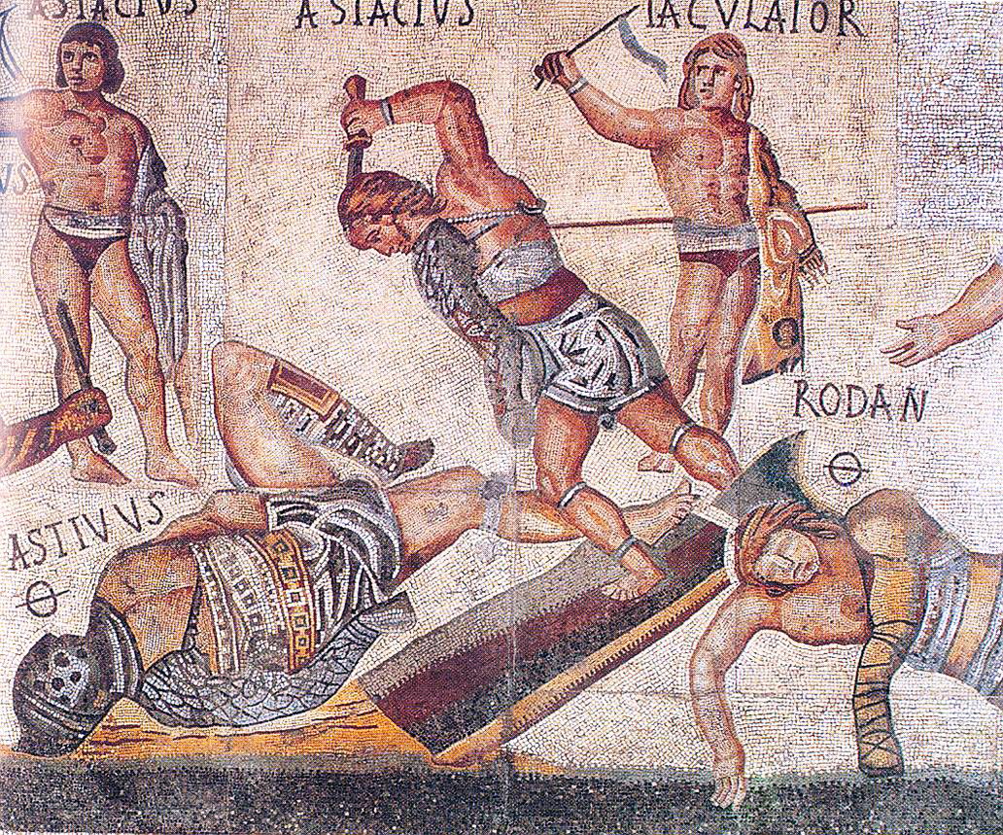
Rome and the grotesque
(Gladiator mosaic, ca. 320 CE, Borghese Gallery, Rome)

Slide 12
Comparison: Hippolytus’ Crash
Euripides Hippolytus
Seneca Phaedra
“The unfortunate youth, inextricably entangled in the reins, was dragged along — his dear head battered against the rocks and his body shredded.” (Roche)
“The speeding wheels trundled the dying body until it caught upon a half-burnt tree-stump, sharp as a stake, which pierced the groin and held him transfixed....” (Messenger, p. 142)

Slide 13
Tragedy in Performance
How to handle the rhetoric?
“Mad for your love. Once more, contemptuous man, I stoop to kiss the ground before your feet....” (Phaedra, p. 126)

