Slide 1
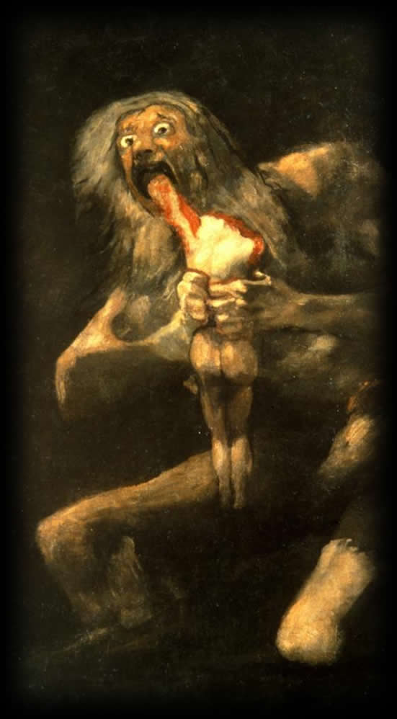
Seneca’s
Thyestes
Tragic Exploration or Lurid Fascination?
Saturn Devouring his Children, Goya

Slide 2
https://youtu.be/a3aFv8IQb4s?t=551
Notes:
let’s start with a clip:
https://youtu.be/a3aFv8IQb4s?t=551

Slide 3
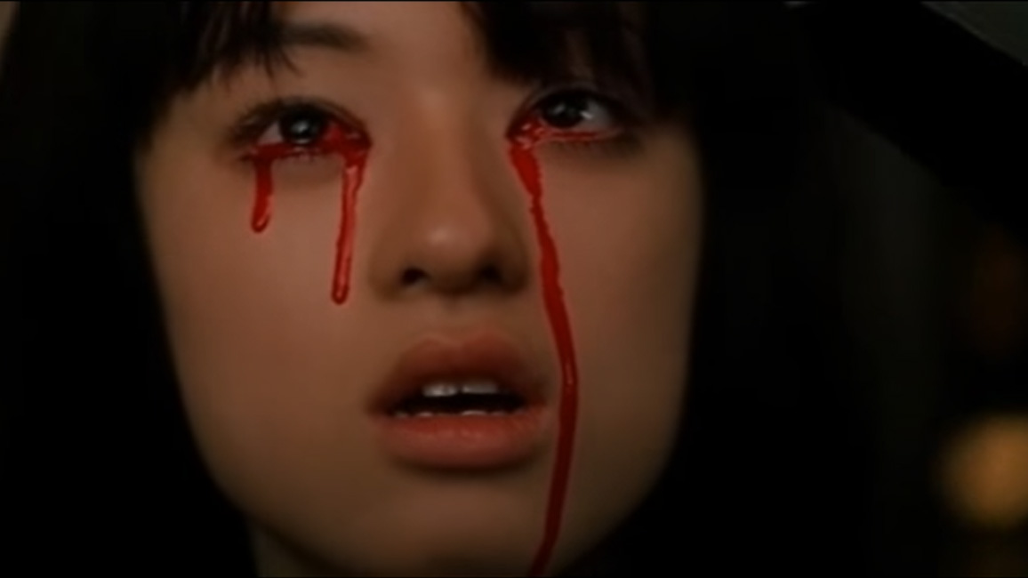
How to relate to the violence in Kill Bill? As
Funny?
Sad?
Esquisite?
Repulsive?
Notes:
how to respond to the violence, to the excess? does it celebrate violence? is it pornographic? is it cartoonish? and if it is, how we take seriously the theme of revenge in the movie? Does this then become more a satire? for if we can’t somehow let ourselves into the violence, if we cannot step outside it, how can we take it seriously? how are we not somehow complicit in it?

Slide 4
“The most unpleasantly sanguinary [of Senecan tragedies] is the Thyestes, a subject which, so far as we know, was not attempted by a Greek dramatist" (xxiii-iv). That is simply un true. Eight Greek dramatists, including Sophocles, Euripides and Agathon, wrote tragedies entitled Thyestes; although all are now lost and the fragments of them, as so often, are scanty, at least the Sophoclean Second Thyestes (and possibly, also, his Atreus) almost certainly dealt with the cannibalistic dinner.” (C.J. Herington Senecan Tragedy Arion 1966 p. 428)
Notes:
what does that have to do with Seneca’s Thyestes? let me quote John Herington’s masterful and memorable article in which the author comments on TS Eliot’s own essay on Senecan tragedy:
“The most unpleasantly sanguinary [of Senecan tragedies] is the Thyestes, a subject which, so far as we know, was not attempted by a Greek dramatist" (xxiii-iv). That is simply un true. Eight Greek dramatists, including Sophocles, Euripides and Agathon, wrote tragedies entitled Thyestes; although all are now lost and the fragments of them, as so often, are scanty, at least the Sophoclean Second Thyestes (and possibly, also, his Atreus) al most certainly dealt with the cannibalistic dinner.”
Here, I’m less interested in Herington’s spot-on correction than in the assumption underpinning Eliot’s comments, namely, that a play like Seneca’s Thyestes is a beast of altogether different species from any play by sophocles, aeschylus, or Euripides. that the violence in a play like Seneca’s Thyestes, a blood-soaked spectacle worthy of the roman amphitheater, is too grotesque to be understood as having very much to do with the masterpieces of Athenian tragedy......

Slide 5
“The most unpleasantly sanguinary [of Senecan tragedies] is the Thyestes, a subject which, so far as we know, was not attempted by a Greek dramatist" (xxiii-iv). That is simply un true. Eight Greek dramatists, including Sophocles, Euripides and Agathon, wrote tragedies entitled Thyestes; although all are now lost and the fragments of them, as so often, are scanty, at least the Sophoclean Second Thyestes (and possibly, also, his Atreus) almost certainly dealt with the cannibalistic dinner.” (C.J. Herington Senecan Tragedy Arion 1966 p. 428)
“The content of Roman tragedy is not ‘tragic.’ ” (Brill’s New Pauly)
Notes:
— that we very well might not regard it as tragedy at all!

Slide 6
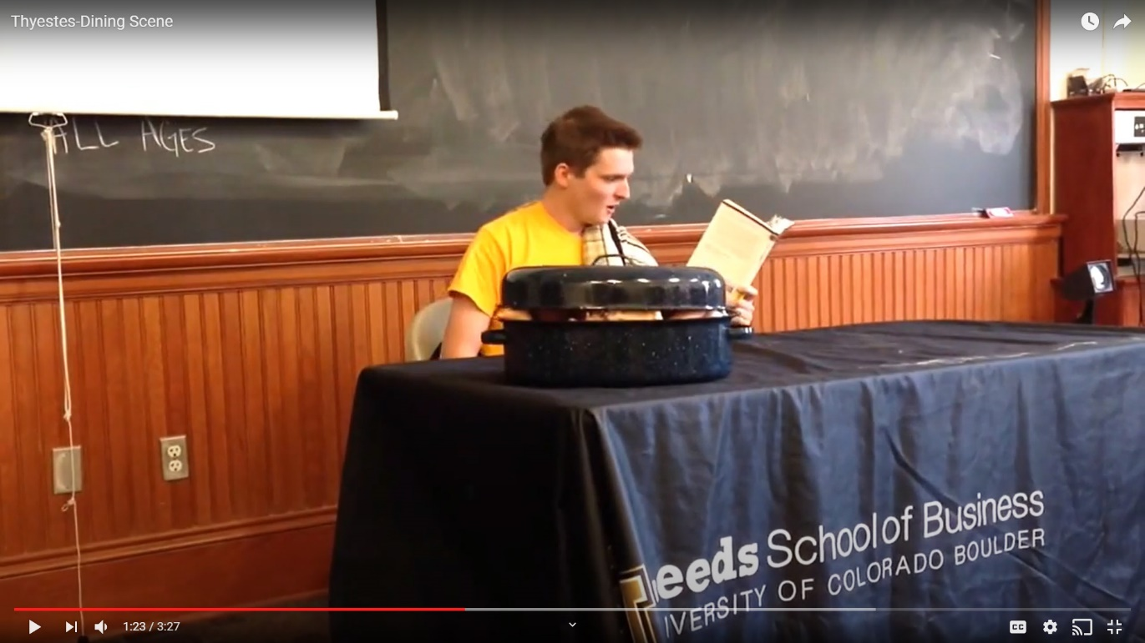
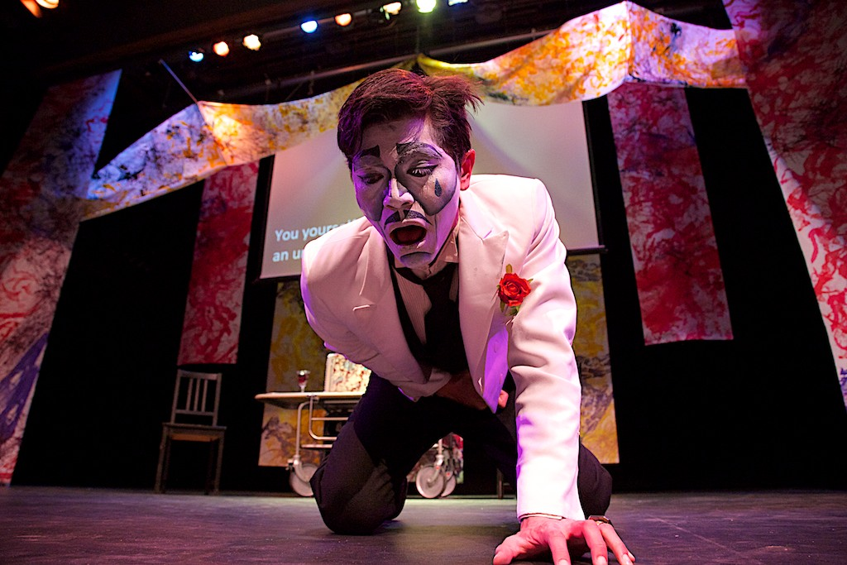
“This monstrous (but tragic?) banquet”
University of Colorado @ Boulder?
https://youtu.be/Q9ljSXHPiQo?t=83
Barnard production, 2013
https://youtu.be/QxoFwDpkg10?t=4242
Notes:
“This monstrous (but tragic??) banquet!” pp. 87-90
from Didaskalia 10 (2013) 2, Timothy Hanford review:
“How could one perform such a horrific ‘freak show’ onstage for a 21st century audience? This production made the bold choice of employing a circus metaphor for much of the play, in which Atreus was intriguingly portrayed as ‘ringmaster’ (and old-time magician) for the ensuing drama. This metaphor strongly activated the sense of horrific exhibitionism present in Seneca’s tragedy, particularly in the last two acts.” but is that tragedy?

Slide 7
ATREUS: Brother, we two must celebrate together
This memorable day, which will confirm
My kingdom and assure my confidence
In everlasting peace.
THYESTES: I have dined well;
And you have wined me well. Only one thing
Can add a culmination to my pleasure —
That I should share my pleasure with my sons.
ATREUS: Consider them already with you here
In your embrace. They are, and will be, with you
For evermore. (Seneca Thyestes p. 87)

Slide 8
Recap and Update
Senecan Tragedy, Seneca’s Thyestes

Slide 9
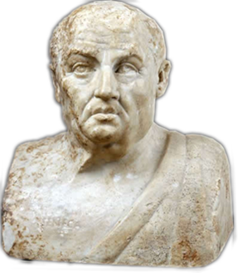
Seneca (10-65 CE)
Historical background
  Claudius (r. 41-54)
  Nero (r. 54-68)
Biographical notes
  Claudius, Agrippina, Nero
Philosophical, rhetorical, literary interests
  Stoicism
  Epicureanism
  Declamation
  Tragedy (Thyestes 60s CE, reign of Nero?)
Notes:
Seneca and the relationship of his plays to historical context:
Is there a relationship between the writer's life and the writings themselves? Let me quote C. J. Herington on that very topic as it applies to the extremely complicated and baffling case of Seneca:
What does seem relevant is the clear fact that Seneca himself lived through and witnessed, in his own person or in the persons of those near him, almost every evil and horror that is the theme of his writings, prose or verse. Exile, murder, incest, the threat of poverty and a hideous death and all the savagery of fortune were of the very texture of his career. (In Arion 5 [1966] p. 430)
However remote, bizarre, grotesque, or unnatural we may nowadays find Senecan tragedy, it was certainly "relatable," if to no one else, then at least to Seneca himself.
Dingel in Brill’s New Pauly writes, “It has proved impossible as yet to give a philosophical interpretation of the tragedies of Seneca….”
Herington, by contrast, disagrees: “An essential preliminary to the understanding of Seneca is the realization that, however eclectic he is, he is still Stoic enough by habit to draw little or no distinction between spiritual, moral and material realities.” (Herington p. 434)
Herington is right. These plays aren’t themselves philosophical essays, but Stoic and other philosophical ideas permeate them,

Slide 10
“And are we chosen out of all earth’s children to perish in the last catastrophe of a disjointed universe? Are we to see the world’s end come? A cruel fate brought us to birth, if we have lived to lose the sun, or if our sins have driven him away. But we must not complain, nor fear; too fond of life is he who would not die when all the world dies with him.” (Chorus p. 83)
Notes:
note that chorus doesn't really yet know what's up – they think it's end of the world. (thus a kind of metaphor) but this also recalls the stoic idea of the empyrosis, the great conflagration that ends a given cosmic order to pave the way for the next.
the retreat of the sun turned into questions whether the universe has simply gone haywire. fear that the world will descend back into primordial chaos - the stoic empyrosis sort of becomes a Götterdämerung. the constellations will fall into the sea.
how does this matter?
Dingel in Brill’s New Pauly writes, “It has proved impossible as yet to give a philosophical interpretation of the tragedies of Seneca….”
Herington, by contrast, disagrees: “An essential preliminary to the understanding of Seneca is the realization that, however eclectic he is, he is still Stoic enough by habit to draw little or no distinction between spiritual, moral and material realities.” (Herington p. 434)
Herington also writes:: "There is no difference for Seneca - and this a point which should interest readers of his tragedy Thyestes - between physical or moral light or darkness. . ." (in Arion 5 [1966] p. 433). Put differently, the pathetic fallacy is, in a sense, for Seneca no fallacy at all, it expresses deep truths about the interconnectedness of the physical and the spiritual. Metaphor and simile disappear; the spiritual bleakness of evil becomes the moral equivalent of a starless, moonless gloom.

Slide 11
House of Tantalus
Tantalus Senior
Pelops
Atreus
Thyestes
Agamem-non
Menelaus
Tantalus Junior
Plisthenes
[third son]
Notes:
in a sense, the myth itself asks if it itself is performable. if the gods too horrified to allow the sun to illuminate the spectacle, what does that say about its viewability by a human audience? of course, the messenger speech and the following recognition and reversal don’t actually allow us to see the horrors involved, but the telling in the mess speech, and then in the telling display of emotion in last act, are lurid enough. and then there’s atreus himself, a nightmare of total surrender to violent and angry impulses.
TANTALUS’ CRIME
related crime of procne, philomela, tereus
tantalus’: his example seeds the crime of a succeeding generation. t’s sinful repast as conducive to greater hunger, not to satisfaction. as for atreus, he evidently doesn’t feast on nephews, but he in a sense feats on the misery he inflicts on brother. his vengeance goes well beyond vengeance.
PEOLOPS’ CRIME
I.E., TRAGIC CYCLE

Slide 12
Thyestes: Plot and Theme
(“Senecan Formula”)
Thematic Structure | Dramatic Structure
CLOUD OF EVIL | ACT 1. Fury incites Tantalus’ ghost. Choral ode. Prayer against tragic cycle.
DEFEAT OF REASON BY PASSION | ACT 2. Atreus and Minister. Debate, portrait in tyranny.
 | ACT 3. Thyestes and sons. Retirement v. return.
EXPLOSION OF EVIL | ACT 3 cont. Atreus & Thyestes – “reconciliation.”
 | ACT 4. Messenger. Sacrifice, locus horridus.
 | ACT 5. Atreus, Thyestes. Recognition & reversal.
Notes:
46. fury seeks tantalus to spur family on to further crime as its own punishment. note the seeming simultaneity of chance and fate as operative in the fortunes of characters. note how strife here extending horizontally, i.e., between contemporaries (brother and brother) is turned into a curse by being made to extend vertically, in effect pitting father against son along a chronological axis. The result is to let loose the forces of disorder, which Roman writers often identify with chance (fors) and the human passions. In various ways, this resembles the tragic cycle as in Aeschylean drama, only it goes well beyond it. This can, in other words, be viewed as exemplifying the Roman penchant for extremes. Indeed, malaise and catastrophe penetrate to all places and times; the cosmos is saturated with human disaster.
53. ACT 2. atreus, minister. atreus a portrait in roman tyranny and exaggerated anger. it seems wrong-headed to speak of atreus’ madness as a roman kind of ate. he willfully commits evil, desires it like a “hungry tiger” (messenger, p. 76). atr's overstated desire for brother's death; the overdetermined plotting. vengeance as competitive retaliation.
54. minister: "Men compelled by fear / to praise, may be by fear compelled to hate." (accius: "let them hate so long as they fear.")
56. atr's "sanctity begone!“
ROMANIZING OF THE GREEK MYTH. the palace is not simply a goofy haunted house. it is emblematic of tyranny, arguably, with a roman twist. so it looms over argos-mycenae (seneca uses both names to refer to one and the same setting of the play.) but its structure is that of a roman domus, a roman house: public rooms in front, private apartments in back, and a kind of peristyle or park emblamatic of suffering and terror as the tools of tyrannical domination. I’m thinking of that weird open-air space where atreus personally murders the children as an offering to the gods of death and destruction, sponsors of his power.
so for all the seemingly gratuitously gory rhetoric, the play’s treatment of political themes undeniably carries with it topical resonances – the abuses of absolute power - frequently encountered in literature of the that time and place: mid first cent. bce.
so do we want to cover our eyes? or do we perhaps want to gaze all the more closely through our minds eye? that, arguably, would represent a roman impulse as presented in a number of sources – the fascination with the curious and with the monstrous.
the lurid fascination of violence – we know that in the roman arena, public executions could feature lurid dramatizations of storied killings and deaths. (Catullus’s mime the Laureolus, in which the escape, capture and crucifixion of the real-life robber Laureolus was performed as the mythical punishment of the titan prometheus [Mart. spect. 7]. Brills)

Slide 13
Rhetoric
Perverse exaggeration
Sententia
“The fire seems loath to touch the roasting flesh. . . . The liver on the spits was heard to squeal” (Messenger, p. 79)
“Men compelled by fear / to praise, may be by fear compelled to hate” (Minister to Atreus, p. 54)
Compare
“Let them hate so long as they fear” (Ōdērint dum metuant, Atreus in Accius’ Atreus)
Notes:
Prominent in Roman rhetoric and poetics is a certain penchant for what I'll call "perverse exaggeration," for stating something at the limit of the plausible or tolerable and then ostentatiously surpassing that limit. So, for instance, Atreus doesn't just exult in a crime so abhorrent that the gods refuse to let the sun's rays reveal to them the extent of the horror. Atreus absolutely wishes he could force the gods to watch!

