Slide 1
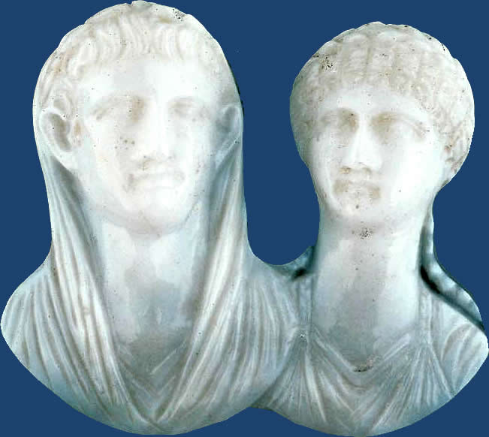
Pseudo-
Seneca’s
Octavia, or. . .
“Tragedy Is US”?. . .
Cameo with busts of Nero and Octavia, 1st cent. CE
Notes:
Title Cameo with busts of Nero and Octavia Work Type Costume and Jewelry Date 1st century A.D. Material Sardonyx Measurements Length x width: 4.8 x 4.3 cm (1 7/8 x 1 11/16 in.) Style Period Imperial, Julio-Claudian Period Description Full View Repository Museum of Fine Arts, Boston
Boston, Massachusetts, USA
Henry Lillie Pierce Fund
98.754
http://www.mfa.org/

Slide 2
Agenda
Discussion
  Is Octavia Tragedy?
Introduction to Play
  Pseudo-Seneca Octavia
Genre, Rhetoric, Theme
  Seneca, Pseudo-Seneca. . .

Slide 3
Discussion
Is Octavia Tragedy?

Slide 4
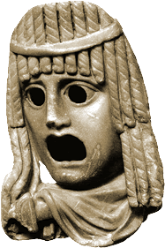
Is Octavia Tragedy?
Why/Why not tragic?
How like/unlike. . .
  Athenian tragedy?
  Tragedy by the real Seneca?
Notes:
a number of comments are talking about koros hubris ate dike catharsis etc. etc. is this greek tragedy? or are we saying that the features of grk tragedy apply to all tragedy? Shakespeare included?
how about we agree it’s tragedy like – but is that the same as saying it’s tragedy?
AS IN SENECAN TRAGEDIES, the moral cynicism is prominent - contrast soph and aesch (and even eur) trag, where the tragic action aims at, or somehow fits into a pattern of, rebalancing the disequilibrium created by human hubris.
in Phaedra, in thyestes, in the pseudo-Senecan Octavia, the horror seems to be one of inescapable corruption. Seneca the philosopher in the Octavia seems to offer the only solution: the stoic that the empyrosis, the cosmic conflagration, incinerate the universe and therefore allow for a new creation and a new age of innocence.
if it’s tragedy (and I think it is) it is incomplete tragedy. the completion of the tragedy must always lie in an ever waited for future.
or, can a play be so cynical it isn’t tragedy any more?.....
student: "the audience is meant to pity Rome rather than Octavia"

Slide 5
Trope of Decline as a Roman Tragedy
“Is all this glory doomed to age with time
and perish in blind chaos? Then must come
Once more upon the world a day of death,
When skies must fall and our unworthy race
Be blotted out, until a brighter dawn
Bring in a new and better generation
Like that which walked upon a younger world
When Saturn was ruler of the sky.” (p. 272)
Notes:
272. the stoic empyrosis. then a return to golden age. recall of sequence of the ages leading to roman era, a period marred by PASSION.
imperial catastrophe as cosmic correction.
roman history as a roman tragedy

Slide 6
“Our Women” as Tragic?
  Good women as “fungible” women
  Independent women as “bad” women
  Octavia, Agrippina, Poppaea as
    Exemplary?
    Deviant?
Rome’s tragedy as lapse in patriarchy?
Notes:
HISTORICAL EXEMPLA, Virginia, Lucretia, Tullia
They did well When they avenged the dying soul Of a pure maiden whom her father slew To save her from base servitude, To rob vile lust of its unlawful triumph.1 And, sad Lucretia, for thy sake Grim war began, when thou wast wronged By a base tyrant’s lust, and died By thine own hand. The price was paid Not by Tarquinius alone For his foul deed, but by his wife2 Tullia, who mutilated Her own dead father’s limbs Under her flying chariot wheels, Inhuman daughter, and refused his aged corpse The rite of funeral fire.
Seneca. Four Tragedies and Octavia (Classics) (pp. 268-269). Penguin Books Ltd. Kindle Edition.

Slide 7
Introduction to Play
Pseudo-Seneca Octavia

Slide 8
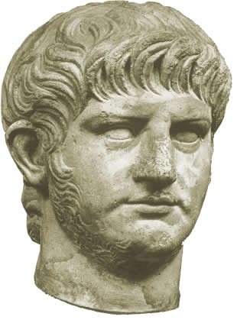
Play Facts
Author (anon.)
Genre (praetexta)
Composition date, context
  Flavian emperors, 69–96 CE
Setting (Rome, 62 CE)
Characters
Nero, ca. 55 CE
Notes:
Author
anonymous, knew his seneca. but pro-claudian tone doesn’t fit with what we know of genuine seneca.
Genre
praetexta – but with strong element of myth and resonance with Senecan tragedy, e.g., Heracles Furens, Phaedra, Thyestes
Composition date, context
Flavians
Setting
Rome, palace of Caesars, three days in 62
Characters
Octavia, whose words counted as over-passionate by more-or-less clueless (as per usual in roman tragedy) nurse.
Nurse
Nero
Seneca
Agrippina’s ghost
Poppaea
Poppaea’s nurse
Prefect
Chorus

Slide 9
Octavia: Characters
Messalina
Claudius
Agrippina
Gnaeus Domitius Ahenobarbus
adoption
Rufrius Crispinus
Brittanicus
Octavia
Nero
Poppaea Sabina
Seneca (minister, philosopher)
Octavia’s nurse
Prefect
Poppaea
Poppaea’s nurse
messenger
Chorus
Notes:
note that OCTAVIA and NERO are distant cousins, both being descended from JULIA ATIA, the mother of AUGUSTUS.
BRILL’S OCTAVIA. Daughter of the emperor Claudius [III 1] and Messalina [2] and sister of Britannicus, born around 40 AD. She was betrothed at the age of two to L. Iunius [II 36] Silanus Torquatus (Tac. Ann. 12,3,2; Suet. Claud. 27,2; Cass. Dio 60,5,7). On Agrippina’s [3] initiative O. was betrothed to Nero in 49 AD (Tac. Ann. 12,9,1). In order for the betrothal to be legally binding she had to be adopted beforehand by another gens, as Nero, whom she married in 53 AD, was her adoptive brother (Tac. Ann. 12,58,1; Suet. Nero 7,2). However, he soon preferred Claudia [II 4] Acte and Poppaea Sabina to her. Under the pretext of infertility and adultery with the slave Eucaerus (Tac. Ann. 14,60) Nero disowned her and banished her to Campania in spite of public protests (Tac. Ann. 14,60f.; Suet. Nero 35). Later Nero accused her of adultery with Anicetus [1] and of having an abortion (Tac. Ann. 14,63; cf. [1. 62; 94]); he banished her to Pandateria, where he had her murdered on 9 June 62 (Tac. Ann. 14,64; Suet. Nero 35; Jos. Ant. Iud. 20,153). Compare also the tragic drama O. [4] attributed to Seneca [2. 21331].
Crispinus. That's Poppaea's first husband, Rufrius Crispinus, whom Poppaea divorced to marry Otho, the future emperor, in 58. But in the same year, she entered into a love affair with Nero and married him. Poppaea died pregnant in 65. (The story that she died from Nero's kicking her in the stomach is probably a fabrication.)

Slide 10
Genre, Rhetoric, Theme
Seneca, Pseudo-Seneca. . .

Slide 11
Octavia: “Senecan Formula”?
Thematic Structure | Dramatic Structure
CLOUD OF EVIL | SCENE 1, day 1. Octavia, Nurse, Chorus. (Octavia’s plight, what to do.)
DEFEAT OF REASON BY PASSION | SCENE 2. Seneca, Nero, Prefect, Chorus. (Seneca remonstrates with Nero.)
EXPLOSION OF EVIL | SCENE 3, day 2. Agrippina’s Ghost, Octavia, Chorus. (Restless dead, indignant living.)
 | SCENE 4, day 3. Poppaea, Nurse, Chorus. (Poppaea’s dream.)
 | SCENE 5. Messenger, Chorus. (Angry mob. Chorus: Love v. arms.)
 | SCENE 6. Nero, Prefect. (The tyrant rages.)
 | SCENE 7. Chorus, Octavia. (Fickle mob, Octavia’s lament.)
Notes:
AS IN SENECAN TRAGEDIES, the moral cynicism is prominent - contrast soph and aesch (and even eur) trag, where the tragic action aims at, or somehow fits into a pattern of, rebalancing the disequilibrium created by human hubris. THINK ABOUT THAT AS YOU THINK ABOUT THE RELATIONSHIP BETWEEN ROMAN AND OTHER TRAGEDY READ FOR THIS CLASS. . .
257. oct., nurse. roman hist and grk myth combined in all that imagery. oct is narrating her "oft told" (??) travails to nurse. THAT RATHER MYTHOLOGIZES HER STORY, OR AT LEAST ENTERS IT INTO THE KIND OF PUBLIC DOMAIN THAT WE TEND TO ASSOCIATE WITH MYTH- AND HISTORY-BASED DRAMA. but apostrophizes mother, messalina. the "vile stepmother's rule" thing. (agrippina.) she oct's "fury."
258. n's panegyric to the dynasty of claudius. THAT APPEARS PARTISAN. but note who speaks: the nurse.
260. death could end oct's misery, but fears violent death. sees brit in her sleep.
284. poppaea's nurse and poppaea. poppaea's night of nighmares. nurse provides unalarming interpretation - a foolish one. read backwards as "be afraid, be very afraid." tragic thing, these dreams. CF. ATOSSA IN PERSIANS, OR CLYT IN LIBATION BEARERS.
271. scene. seneca, nero, prefect. seneca misses the years of carefree study on corsica.
271 ff. SENECA’S philosophical monologue. 272. the stoic empyrosis. then a return to golden age. recall of sequence of the ages leading to roman era, a period marred by PASSION.
274. justice and the tyrant: "let him be just who has no need to fear." (note that creon in antigone claimed to be just.) this seneca-nero scene recaps the herington deliberation thing. seneca boosts clemency. de clementia. nero insistent on FEAR.
275. nero alleges that oct plotting against him. 276. nero alleges that senate plots against him.
262. Poppaea demands the head of oct. silanus' suicide.
263. the flight of "pure fidelity."
[prev. section shows the usual inferior trying to dissuade a superior. oct's passion will then be her RIGHTEOUS anger, but also her cynical resignation. nurse hopelessly naive.]
264. relationship between brit as cupid and nero's inconstant cupid?? comparison: oct = juno, nero = jup.
266. pathetic fallacy: cosmos is sick. (motifs familair from seneca.). NOTE IMPLICATIONS HERE AND IN CHORUS IN THYESTES THAT WHAT IS BEING STAGED HOLDS SOME SORT OF COSMIC IMPORT. THAT SUGGESTS PARALLELS WITH EUMENIDES, BUT IT ALSO SUGGESTS MORE FOR A HISTORY PLAY: THAT THE COSMIC PROCESS IS, S0MEHOW, ABOUT “US” – THAT “OUR ROMAN ORDER” IS THE SUBJECT OF THE UNIVERSAL TRAGEDY, a self-referential and tragic spin on the trope of decline as a kind of pathetic fallacy.
267. chorus 1. the new wife and threat to family-political order. "we" are to blame. (??) exempla from roman history - including lucr. 269. the old republican family acts compared to recent evils. the trope of decline. narration of killing of agrippina.
278. popp more beautiful than juno or venus.
280. agrippina's ghost enters. explains how nero sought damnatio memoriae against her; narrates death. Claudius demands from Aagrippina the lifed of Nero. foretells Nero's violent death.
282. octavia on the wedding of poppaea.
283. chorus.
287. chorus on jup's paramours, will take up with poppaea.
288. messenger and chorus. the angry mob. note the symbolic dismemberment of p's statue. chorus: the war god cannot defeat love.
289. nero comes in. his over-the-top tyrannical anger.
290. prefect. reports quelling of mob. but nero wants more.
292. the chorus sees resonance with the gracchi, cornelia, etc.
293. Octavia being dragged off.

Slide 12
Praetexta in crepidata shoes?

Slide 13
(1) No other fate can equal mine,
No other suffering compare,
Not though I should remember thine,
Ill-starred Electra; thy despair
For father slain was not forbidden;
Thou hadst a brother, whom thy care
And trustful love had saved and hidden,
To avenge the crime. (2) I do not dare
To mourn two parents lost, nor pray
For brother dead; in whom the fair
Hope I might have of brighter day,
And comfort in my sorrow, were. (Octavia, p. 259)

Slide 14
Praetexta in crepidata Shoes?
Electra ≈
Orestes ≈
Agamemnon ≈
Octavia
Britannicus
Claudius
“No other fate can equal mine, … not though I should remember thine, Electra …” (Octavia, p. 259)
Notes:
How does/doesn’t the allusion make sense?

Slide 15
Praetexta in crepidata Shoes?
Octavia ≈
“Augustus”-Nero ≈
Juno/Hera
Jupiter/Zeus
“… shall our Augustus banish from her ancestral house / His sister wife?” (Chorus, p. 268)

Slide 16
SENECA | PS-SENECA
SENTENTIA
quod non potest vult posse qui nimium potest (Nurse, Thyestes 215). “A man who can do much would like to do / More than he can.” (Penguin p. 106) | odio pari | ardet maritus, mutua flagrant face (Nurse, lines 49-50). “She loathes and shuns; he burns with equal fire of venomous hatred” (Penguin p. 259)
PERVERSE EXAGGERATION
“I walk among the stars! Above the world / My proud head reaches up to heaven’s height” (Atreus, Thyestes p. 84) | “. . . the forum / Stank with putrid gore / that dripped from rotting faces” (Nero on past civil war, p. 277)
THE TYRANT’S CREED, THE TYRANT’S DILEMMA
“Let them hate so long as they fear” (Atreus in Accius Atreus) “Men compelled by fear / to praise, may be by fear compelled to hate” (Minister in Seneca Thyestes) “Let him be just who has no need to fear” (Nero in Octavia)

Slide 17
Trope of Decline & mos maiorum
(“Tragedy Is Us,” Seneca, p. 268, 273)
“… our forefathers knew true Roman virtue”
...
“Now upon our heads
The gathered weight of centuries of sin
Falls like a breaking flood. We are crushed down
Under our own intolerable age
When crime is king, impiety let loose,
And lawless love gives reign to Lechery.”
Notes:
272. the stoic empyrosis. then a return to golden age. recall of sequence of the ages leading to roman era, a period marred by PASSION.

