Slide 1
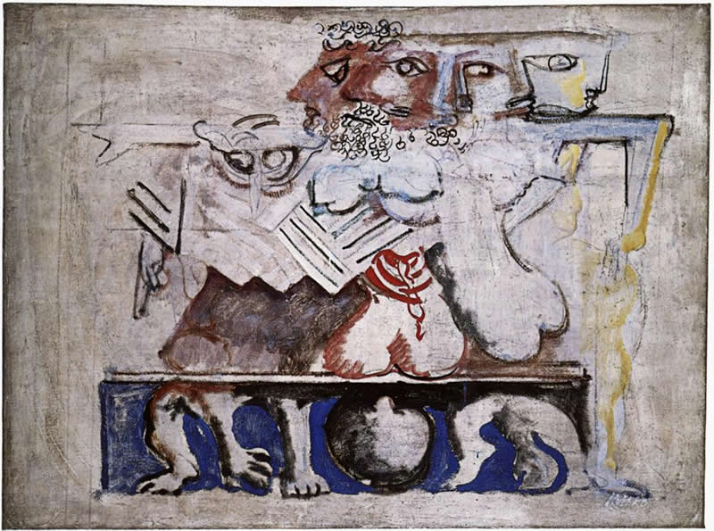
Anouilh’s Antigone
Tragedy Trashed or Translated?
Mark Rothko, “Antigone”

Slide 2
Is this what tragedy is?
(pp. 101–102)
https://www.youtube.com/watch?v=7w-1GZTk6f4&feature=youtu.be&t=1970

Slide 3
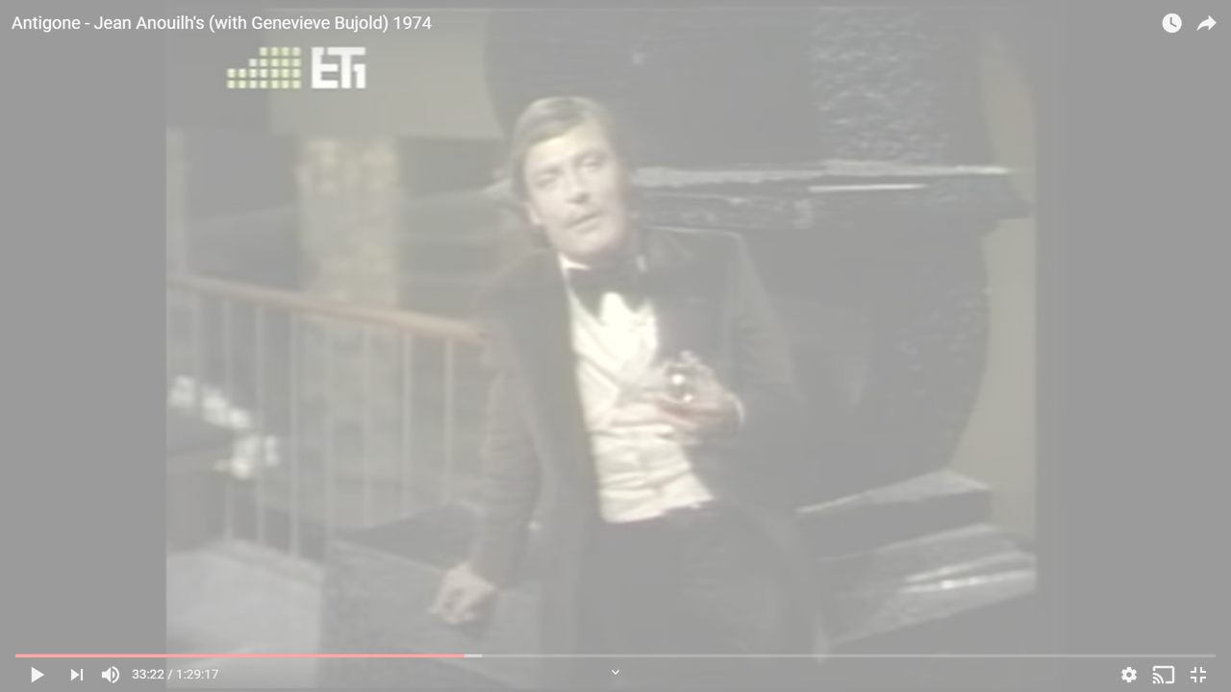
“Drama” v. Tragedy
“In a drama, with its traitors, its desperate villains, its innocent victims, avengers, devoted followers and glimmers of hope, death becomes something terrible, a kind of accident.”
“In drama you struggle, because you hope you’re going to survive. It’s utilitarian – sordid. But tragedy is gratuitous. Pointless, irremediable. Fit for a king!” (Chorus, 102)
Notes:
What do you think the Chorus means by that? Do you agree? Disagree? Judging by dramas read during both halves of the semester (please discuss at least two from each half), how does this quote validate or challenge your definition of tragedy? How do you respond?
[final discussion plus exam question]
[note that this is implicitly tragedy. this is a theory of tragedy. "That's the convenient thing about tragedy - you can start if off with the flick of a finger: a glance at a girl going past with uplifted arms in the street [?? nazi arrests??]; a sudden hunger for fame when you wake up one day - as if it were something to eat; asking yourself one question too many one evening. ... Death, treachery, despair - all there ready and waiting...." then the "clockwork." invenitability, but fate and suffering? is this all relateable? or is it trivial?]
in French, the word drame can = “tragedy.”
“Dans le drame, avec ces traîtres, avec ces méchants acharnés, cette innocence persécutée, ces vengeurs, ces terreneuve, ces lueurs despoir, cela devient épouvantable de mourir, comme un accident.“
“Dans le drame, on se débat parce quon espère en sortir. Cest ignoble, cest utilitaire. Là, cest gratuit. Cest pour les rois."

Slide 4
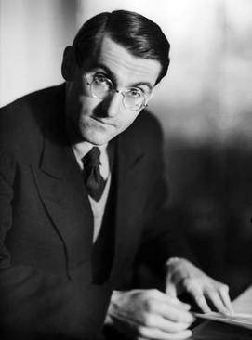
Playwright, Composition, Setting
Jean Anouilh, 1910–1987
Antigone, 1943
“Set without historical or geographical implications” (p. 79)

Slide 5
Characters
Prologue
Chorus
Creon
Antigone
Ismene
Haemon
Nurse
Messenger
Guards
Notes:
CHARACTERS
we see similarities to soph’s ant, but always departures.
ant here seeks not simply to do right by slain bro, but to break away from childhood – she is also deeply jealous of her sister’s looks and popularity.
this last seems a modern feature, but it curiously recalls aspects of euipidean tragedy – its “modernism.”
likewise the nurse – a recurrent figure in euripides (and encountered in seneca and ps-sen).
so too creon. though he’s still paranoid, in his clash with ant, doesn’t present that state-v-family, divine-law-v-human-law dialectic, nor is he really a “classic” grk or roman tyrant – but rather a functionary, at times pititful, at times sinister – seeking to keep the state and his own family from falling apart completely, whether under the pressure of seemingly principled action as in ant’s case, or under that of selfish action, as we’re surprised to see applies to both poly and to eteo. a very 20th cent creon. (anc grk creon was concerned with maintaining his honor and masculinity.) note the political necessity of leaving the body out to rot. note too twisting of the arm thing. implies a kind of twisted character in creon - he's more a gestapo figure than a grand tyrant.

Slide 6
Structure – “scene one”
Prologue (pp. 79 ff.)
Antigone &. . . (82)
Creon &. . . (97)
Chorus (101)
Debates, recognitions, reversals (102)
Antigone’s choice (128)
Dénouement (134)
Notes:
STRUCTURE
in terms of plot, it departs in key ways from soph, and seems in doing so to echo, if anyone, eur:
oed as present in thebes up to about the point of the war
jocasta is still alive
79. stage directions. note attempt to remove time-place situatedness. attempt to create sense of ordinary family. prologue speaks as if not there - or as if others not.
79. Prologue - note movement toward impersonalization of this function, like that of chorus. complete breaking of the dramatic illusion - metatheatrical theater. becoming antigone and living out a preexisting myth. she plays her part b/c of her name. the increasing isolation of the character is the character. a thing between ism and haem. antig overly thoughtful, ism and haem not very.
81. backstory. this is a eur prologue.
101. there is an important chorus – a reflection on the character of tragedy (in part, our focus today).
102. a striking debate scene – very much like an ancient agon – in which creon tries to persuade ant to give up her intransigence. but it also contains certain reversals and quasi-recognitions
creon reveals something of his own mindset and motivations
note as well cr’s attack on the “pride” (hubris?) of the oedipus family – their seemingly exhibitionistic tragicizing.
108. cr assumes ant thinks she'll get away with it. cr: "The pride of Oedipus. You're its living image." hubris theme.
creon reveals the true character of the brothers – selfish and ambitious, mirrors of each other and in death, almost indistinguishable.
ant’s shift from defiance of an unjust order to her disgust with creon’s cynicism ("Nothing is true but what is never said" [121, creon to ant.]) and willingness to compromise.

Slide 7
Thematic Oppositions
Frivolity
Fate
Pragmatism
“Drama”
Purpose
Free will
Individualism
“Tragedy”
versus

Slide 8
Context
Historical
Intellectual
Nazi occupation
  Creon = reluctant commandant?
  Antigone = resistance?
Modernist search for meaning
Existentialism
  Individuality
    Responsibility for actions
    Definition by actions
  Absurdity
    Humans give meaning to world
  Facticity
  Authenticity
  Despair
“Set without historical or geographical indications”
(p. 79)
Notes:
Composed, produced under Nazi (1943)
Creon = occupation?
Antigone = resistance?
Modernist search for meaning
Existentialism
Individuality
Responsibility for actions
Definition by actions
Absurdity
Humans give meaning to world
we give meaning, otherwise world is meaningless and unfair
Facticity
We are our past evolving into our future
Authenticity
Self-fashioning
Despair
Loss of hope that comes from loss of the constituents of identity
does Antigone seek death as a heroic affirmation or as an escape from the humdrum?

Slide 9
Anouilh’s & Sophocles
Ship of state
Existential despair
Sophocles Oedipus the King
  “Our city … our ship pitches wildly” (Priest to Oedipus, p. 160)
Anouilh Antigone
  “Try to understand for a minute, you little fool! … Someone has to steer the ship. … The crew won’t obey” (Creon to Antigone, p. 115)
Sophocles Oedipus at Colonus
  “Not to be born is best” (Chorus, p. 358)
Anouilh Antigone
  Creon: “Are you looking forward to growing up?" Page: “Oh, yes!” Creon: “You're mad, boy! It'd be best never to grow up, either” (p. 136)
Notes:
“Not to be born is best
when all is reckoned in, but once a man has seen the light
the next best thing, by far, is to go back
back where he came from, quickly as he can.”
(Chorus, Sophocles Oedipus at Colonus, p. 358)

