Slide 1
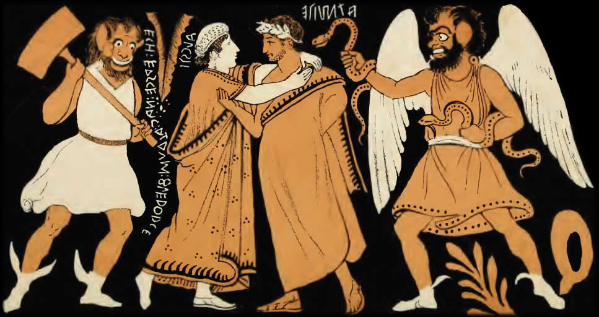
Euripides’ Alcestis
Social Script or Ideological Critique?
Alcestis and Admetus. Etruscan vase
Notes:
Chorus: “Let her be sure, at least, that there dies / the noblest woman underneath the sun, by far”
Maid: “Noblest? Of course the noblest, who will argue that? / What shall be the wife who surpasses here? And how could any woman show that she loves her husband more / than herself better than by consent to die for him?” (pp. 15–16)
Alcestis 150–155
{Χο.} ἴστω νυν εὐκλεής γε κατθανουμένη
γυνή τ᾽ ἀρίστη τῶν ὑφ᾽ ἡλίωι μακρῶι.
{Θε.} πῶς δ᾽ οὐκ ἀρίστη; τίς δ᾽ ἐναντιώσεται;
τί χρὴ λέγεσθαι τὴν ὑπερβεβλημένην
γυναῖκα; πῶς δ᾽ ἂν μᾶλλον ἐνδείξαιτό τις
πόσιν προτιμῶσ᾽ ἢ θέλουσ᾽ ὑπερθανεῖν;
seemingly repeated almost endlessly are statements to the effect that al is “noblest/best of women.” so alcestis is in fact being spoken of a great deal here, and in ways that remind one of the fame that achilles famously wins in the iliad: that of being “best of men.” now, think about it: fame and renown rely on what? speech: “buzz” declaring one famous/renowned/glorious. and in fact, the chorus here alludes to precisely that when they say that she is noblest. for the greek word “noblest” translates in part eukleēs, “being spoken of well,” “celebrated.” the chorus is praising alc for being praised, celebrating al for being celebrated – celebrating, in other words, the speech acts celebrating al’s greatness.
so we have a bunch of speech acts enacting al’s distinction, but is there a script? and if, according to pericles (as thuc purports to quote him, “the highest praise you can win is to be spoken of by men as little as possible”), “the highest praise you can win is to be spoken of by men as little as possible,” is that script being followed?

Slide 2
Agenda
Discussion: “Best of Women”
  Scripted Femininity?
Euripides’ Alcestis
  Social Script or Ideological Critique?

Slide 3
Discussion: “Best of Women”
Scripted Femininity?

Slide 4
Chorus:
“… she who in my mind appears / noble beyond / all women beside in a wife’s duty” (10).
“… the noblest woman underneath the sun, by far” (15).
“… the bravest wife …” (19).
“Now let ... Death ... | know that you are the bravest of wives, by far” (24).
“best of all women” (45)
Pheres:
“I say people ought to marry / like this. Otherwise, better not to marry at all” (32)
Pericles:
“… the highest praise you can win is to be spoken of by men as little as possible …” (Thucydides quoted Paul-Zinserling p. 22)
Notes:
Journal Entries
Can we say that Alcestis — or another character of your choice — is "being" gender (fulfilling a gender she/he was born into) or performing it? Do characters perform against gender? Does the play seem to offer more evidence supporting Butler's ideas or does it seem to challenge them? Explain. . . .
al’s actions speak to her nobility just as the chorus’ words literally enact it. but is all that according to script? and what is the script we’re talking about?
we’re first going to chart out the script itself, using not simply eur’s al, but other works read for this course. we’ll then determine if and how that script is performed.
32 f. ad/pher debate. ad's words question the validity of the kinship structure - whether it has followed the script. thus al becomes all ad's kin all at once. in effect, ad and ph quarrel over what that script is. (ph calls the script "greek," p. 34.)
45. chorus: al "best of all women" again. (γενναιοτάταν πασᾶν). continuous reinstantiation of al's status through the funeral inscription being read by wayfarers. her virtual deification.

Slide 5
Discussion
Script?
It’s performance?
family first
  needs of family before own
  she’d rather have her children have a father than a mother
strength, nobility, bravery – not that
passivity – yes
care-taker, mother, wife
  Eumelus’ speech
passivity
  let’s stuff happen, doesn’t fight
paradox of being spoken of…
  it may be a kind of joke????
mixed points on her providing for her family
gender reversals
  male mourning
  courageous woman
dying for = feminine
way she dealt with it masculine
  assertiveness

Slide 6
Euripides’ Alcestis
Social Script or Ideological Critique?

Slide 7
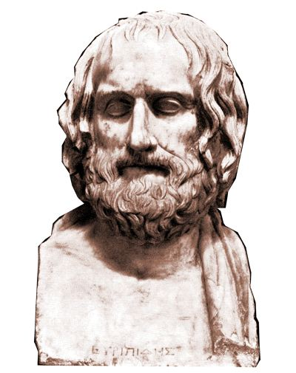
Production Facts
438 BCE
1st preserved play
2nd to Sophocles
Notes:
438 BCE
Athens not yet embroiled in war!
1st preserved play of his
first competes 455, age c. 40
production notice …
“satyr-drama-like”
plot holding rather “to comedy”
perhaps not so well known …
treated earlier (c. 490 BCE, +/- 20 years) by Phrynichus
little more known than that
but figures importantly in the background to the eum, where the furies clearly carry a grudge against apollo for interfering in the affairs of the deities associated with earth, death, punishment.

Slide 8
Alcestis: Analysis
Prologue
  Apollo, death (debate)
Chorus entry
  Alcestis: best of women
Scene
  Maidservant, Chorus
Chorus
  “Gods: “help!”
Scene
  Alcestis, Admetus, Eumelus. Grief, oath
Chorus
  Best of women. . .
Scene
  Heracles, Admetus
Chorus
  Admetus’ hospitality
Scene
  Admetus, Pheres (debate)
Chorus
Scene
  Servant, Heracles
Chorus
  Power of fate
Finale
  Happy ending?
Notes:
the apollo/death debate seems strangely to parallel the heracles/admetus wrangle over ad’s hospitality, ad’s and ph’s over dying, servant and herc’s over partying/mourning, ad’s and herc’s over alc. it’s a wrangle in all cases over proper boundaries, spheres, belonging. apollo shows himself downright arrogant toward death in former’s interfering with latter. herc appal’s servant with his over-the-top carousing during a time of mourning. (herc even seems to want to rape the servant: "Then, beyond all gods, pay your attentions to / the Cyprian, man's sweetest“ (38), τίμα δὲ καὶ τὴν πλεῖστον ἡδίστην θεῶν | Κύπριν βροτοῖσιν· εὐμενὴς γὰρ ἡ θεός (790-791).
xenophon’s ischomachus would probably tell us that the house is in disarray, but so it would seem is the larger universe in which it is located.

Slide 9
Antinomies in Euripides’ Alcestis
male | ~ | female
sociality | ~ | isolation
belonging | ~ | alienation
Admetus’ hospitality | ~ | Alcestis’ glory
life | ~ | death
revelry | ~ | mourning
dominant | ~ | submissive
fame | ~ | silence
Notes:
two things about these antinomies: they illustrate the failure of compartmentalization, of preventing interference between spheres.
at the same time, they don’t fully make sense. so for instance, alcestis is mourned by the house to distraction. she is its emotional core. yet ad to justify herc’s acepting his hospitality, represents al as a foreigner. yes, rather disingenuously, but not entirely falsely: in athenian marriage, the wife was never fully part of the household and could be “recalled” by the husband.
the most significant inconsistency: al’s fame/silence.

Slide 10
Does Euripides’ Alcestis “think” inside/outside the ideological “box”?
Notes:
hence a question: does the play validate the ideological horizons operative within it? interrogate them? does it enunciate or challenge the scripts it arguably dramatizes? does it think within or outside the box boxing its characters in? is alcestis more like butler’s or like hegel’s antigone?

