Slide 1
Sophocles’ Antigone 1
“I am no man”
Notes:
past thought has tried to find something timeless and universal in the antigone (play) and ant (character): in hegel, an expression of the passage from kinship relations to a civilized, political order; in lacan, an expression of pure, boundary bashing feminine desire; often, a model for feminist resistance and revolution.
though those interpretations are often self-consciously forward thinking, they may still approach antigone reductively. what, then, does the play say about gender, possibly about sexuality?
the play at various points and in various ways shows human desire breaking boundaries and overcoming limitations, both in an affirmative way but also in problematic ways – the chorus on
so the question becomes: how is antigone female/feminine, how are her desires such, if they are such, in play. (we have the rest of this class and much of the next to explore more fully.)

Slide 2
Agenda
Problems (cont’d) …
Gender, Sexuality, Values, Ideology
Shape of Course
  Where, When, What, How
Sophocles’ Antigone
  Background, Approaches, Issues
Discussion
  Gender, Values, Power

Slide 3
Problems (cont’d) …
Gender, Sexuality, Values, Ideology

Slide 4

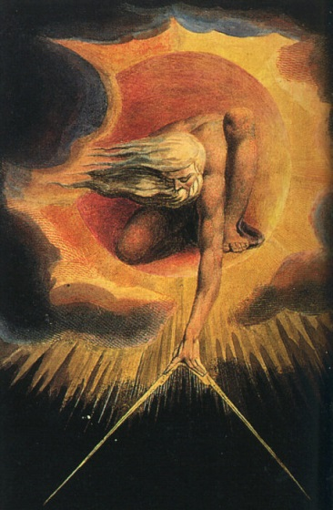

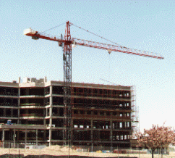
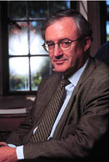

Issues / Thinkers
Butler
Foucault
Essentialism
Constructionism
Finnis
Nussbaum
Notes:
how relevant for tody??
the study of ancient sexuality helps us gain perspective on issues animating the (still simmering) culture wars
a world that is neither wholly alien nor familiar, but one that forces us to confront questions of universality and particularism where our morals and cultural practices are concerned

Slide 5
Shape of Course
Where, When, What, How

Slide 6
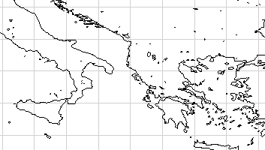
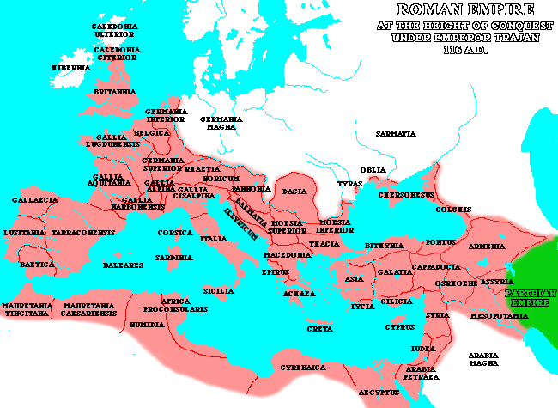
Greek World
Italy
Rome
Athens
Mediterranean Sea
Roman Empire ca. 116 CE

Slide 7
When…
Trojan War ca. 1,200 BCE
Rome founded 753 BCE
Athenian democracy 400s–300s B.C.
1,000 BCE
Roman Republic, Empire
510 BCE–CE 476
1,000 CE
Greece, 550: BCE–CE 200
Periods covered in course
Rome, 200 BCE–125 CE

Slide 8
What (cont.)
Greece v. Rome
Modernity v. antiquity
CONTINUITY V. SINGULARITY

Slide 9
How? Through Critical…
Reading
Thinking
Writing
  Papers
  Journals

Slide 10
Sophocles’ Antigone
Background, Approaches, Issues

Slide 11
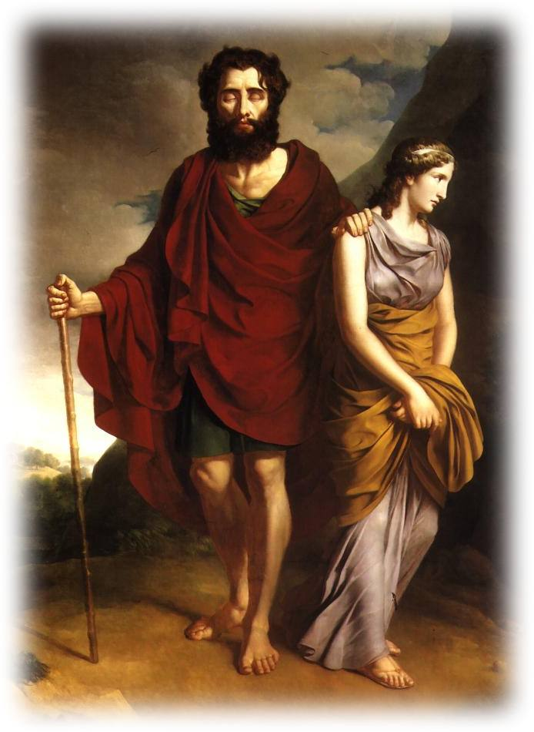
Background
Playwright and play
House of Labdacus
  genealogy…
Oedipus and aftermath…
  Oedipus the King (after 429)
  Oedipus at Colonus (ca. 406)
  Antigone (442/1)
Oedipus and Antigone
Notes:
Playwright and play
House of Labdacus
genealogy…
Laius, Oed’s father, associated with the first homoerotic abduction in myth tradition. (earliest in eur’s play chrysippus.) in eur’s phoenissae, the sphinx is to punish thebes for laius’ transgression. difficult to relate to the sophoclean handling, but suggests an overall sexual dimension to the usual set of transgressions afflicting royal houses in grk tragedy. (aesch’s 7 mentions laius’ transgression but no more.)
Oedipus and aftermath…
Oedipus the King
oed’s discovery of his parentage uncovers his incest and leads to his blinding and expulsion, and the death of his mother
Oedipus at Colonus
oed learns of the quarrelling of his sons, whom he characterizes as effeminate egyptians, and curses, thus nailing the last nail in the coffin of his abortive dynasty, a marriage productive of offspring but in the long run destructive of the lineage.
Antigone
after a terrible, fratricidal war (pitting bro v bro), creon, now ruler of thebes (after death of eteocles and rival bro, poly), decrees poly the traitor’s body must be left unburied and therefore dishonored. decrees punsihment v those who would defy. sister ismene obeys, but not ant.
ant was to marry haemon, creon’s son, but the discovery of ant’s role nixes that. creon decrees that ant be consigned to a “living tomb,” a walled up cave. haemon goes to join ant only to find her having hung self. news of h’s prompts mother eury’s suicide, creon’s grief and regret.
the main interpretive challenge becomes how to read ant’s definance: legit? illegit? revolutionary? conservative? gendered? political? positive? (liberating…) negative? (morbid and self-defeating…)

Slide 12
Myth Background: House of Labdacus
Labdacus
Menoeceus
Laius
Jocasta
Creon
Eurydice
Oedipus
Jocasta
Polynices
Eteocles
Antigone
Ismene
Haemon
Megareus
Notes:
important point: that this is family drama, the drama of a house
indeed, it is the drama of a house’s fall – itself a tragic theme
so we tend to think of the “tragic” as bad fortune, disaster, etc.
but the disasters and reversals of staged tragedy in classical Athens by and large counts as something healthful – misfortune through which individuals and groups atone for a family history of transgression, and a means through which the community is purified, is freed of the “bad karma” these royal transgressions entail

Slide 13
Ideological Oppositions
ANTIGONE
thesis
female
private
inside
oikos (family, household, kinship)
lamentation
divine law
CREON
antithesis
male
public
outside
polis (politics, city)
retribution
human law

Slide 14
Issues
Play as evidence
  (historically situated?)
  (ahistorical-universal?)
For …
  sexuality
  gender
Notes:
we can very ask if this play – one that, if nothing else, features and explores gender and power in a big way – presents us with a familiar or an unfamiliar world
if familiar, then that could suggest the universality of gender categories in the play,…
if unfamiliar, then that complicates questions
if gender is located only/mostly in the biology we are given or develop into through physiological processes, then question already answered and we can go home.
but even if a certain biology is always there, can it be seen differently in different circumstances?
can that seeing, in other words, be contingent on social / political / other circumstances?
and can ways of thinking / speaking / acting also be contingent on the cultural situatedness of our biological “given”?
does biology negate culture?
and what, if anything, can a work like antigone tell us?

Slide 15
Approaches
Hegelian dialectic
  thesis, antithesis → synthesis
Lacanian psychoanalysis
  pure desire
  heroic transgression
Judith Butler
  next week…
Notes:
Hegelian dialectic
thesis, antithesis => synthesis
privileges gender and the political, ignores the sexual.
here ant and cr stand for represent extreme ideological positions, each in a sense oppositionally generating the other. but they are necessary each to the other to enable their survival in the world. their respective extremisms will be necessary to “cancel” (aufhebung) the destructive extremism of the other and “lift” the other “out” of the crisis each places the other in.
(the two characters aren’t bad; each is too “good,” too pure, for the world. thus each side is both right and wrong: valid in being true to principle, but their one-sidedness not viable and thus unjust.)
it therefore seems to assigned balanced roles to gender in social reality, but it also suggests that a gendered reality is not viable in social reality, which will be always more complex – an interestingly nuanced take.
Lacanian psychoanalysis
pure desire
heroic transgression
BUTLER ON LACAN ON ANT. acc to l, ant doesn't love bro qua individual, but as ideal of bro - symbolic level negating the actual. love a symbolic bro. lacanians abstract kinship as something linguistic-symbolic, not organic. lacanians focus on the process of maturation as symbolic castration, submission to symbolic order.
lacan seems to have read the play as an essay in a pure, unrestrained, and transgressive desire on ant’s part – feminine desire as excess, causing her to ignore social dictates – she is apolis, without city or society.
Judith Butler
next time…

Slide 16
Discussion
Gender, Values, Power

Slide 17
Discussion Focus
Clashing moral imperatives?
Power struggle?
Castration anxiety?
Other?
“I am no man and she the man instead
if she can have this conquest without pain” (Creon, p. 175).
Notes:
“This girl was expert in her insolence (hubris)
when she broke bounds beyond established law.
Once she had done it, insolence the second,
to boast her doing and to laugh in it.
I am no man and she the man instead
if she can have this conquest without pain” (Creon, p. 175).
“Then go down there, if you must love, and love / the dead. No woman rules me while I live.” (Creon p. 177)
I asked you in your journals to comment on heroism/villainy (good guys versus baddies) and gender-associations. I’ll now rephrase that in more theoretical terms. Do we begin to gain a sense here (i.e., in the reading you’ve so far done in the play) of socially validated notions of gender and power? is it as simple as masculine-good, feminine-bad? If a hero is one whose deeds are valued socially, can, within the ideological horizons of this play, a women be a hero? (be a powerful force for good in society?) or is power masculine, and anything else a kind of ideological noise?

