Slide 1
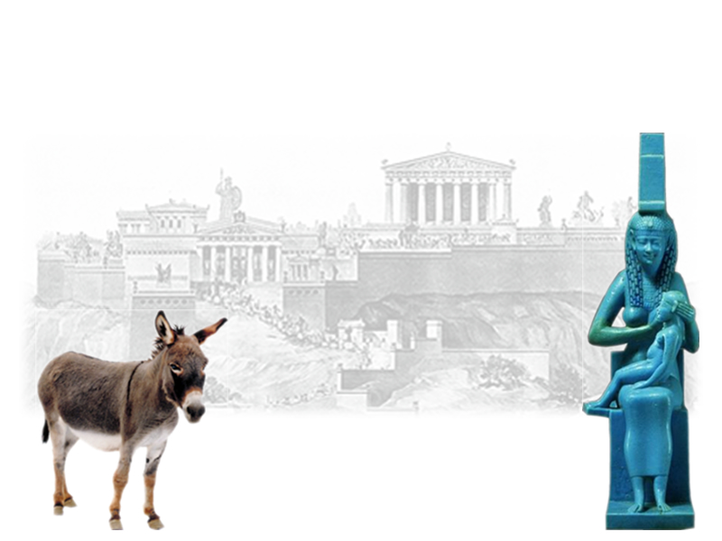
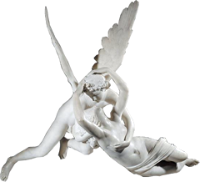
Apuleius’ Golden Ass
Desire and its Discontents 3
Notes:
let’s just assume, for the sake of argument, that the GA doesn’t relate to either N or F. What would we want to see absent from the GA for that to be the case? or, if it were to relate to them, how should it? and is that the case with the work?

Slide 2
Agenda
Sexual Universality?
  The Priests of the Syrian Goddess
Recap and Update
  A Reprobate Redeemed
Gender in Apuleius
  Tradition and Normativity? Diversity and Empathy?

Slide 3
Sexual Universality?
The Priests of the Syrian Goddess

Slide 4
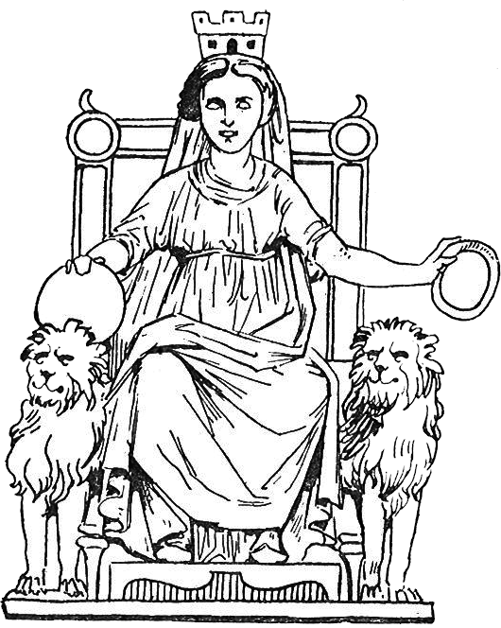
Are They “Gay”? (What is Salient?)
“… he [Philebus] was a real old queen (cinaedum)” (pp. 141)
“ ‘Look, girls (puellae), at the pretty slave [Lucius] I’ve bought.’ [… the others] saying that this wasn’t a servant ... but a husband (non enim seruum, sed maritum) for himself ” (p. 143)
“… these effeminates (semiviris illis)...” (p. 144)
Dea Syria
Notes:
this certainly looks like sexual intolerance, but is this what finnis is talking about? is what is salient that they have sex with men?...

Slide 5
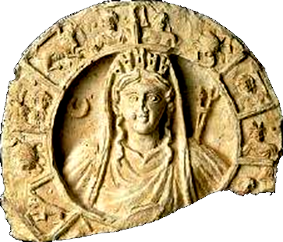
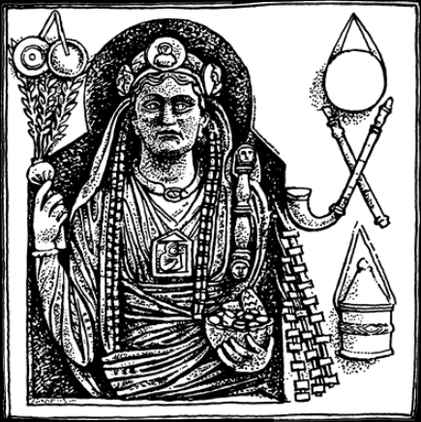
Galli (priests of Dea Syria)
Mendicant
Eunuch
Transvestite
Atargatis (Syrian Goddess)
Gallus

Slide 6
Discussion

Slide 7
Recap and Update
A Reprobate Redeemed

Slide 8
Story Arc
Lucius curiosus (bks 1–3)
  wants to see magic Meroe
  watches, turns into an ass
Lucius asinus (bks 3–10)
  abusive treatment, fortune comes to the fore
Lucius initiatus (bk 11)
  ??
Notes:
Lucius initiatus (bk 11)
Isis et Sarapis
Rome
law-practice
203-4. priest's speech - L's delivery, unaided by learning, birth, etc., from "tempests" of blind fortune to a beneficent "seeing" fortune (i.e., Isis).
206. L will have to dedicate self to celibacy. (???)
209. the reader's curiosity over initiatiatory details, L's discretion: Quaeras forsitan satis anxie, studiose lector, quid deinde dictum, quid factum; dicerem, si dicere liceret, cognosceres, si liceret audire. Sed parem noxam contraherent et aures et lingua, <ista impiae loquacitatis>, illae temerariae curiositatis (11.23). religious initiation as a model for a kind of licit learning and instruction. note parallels with C&Ps tale ending.

Slide 9
Narrative-Thematic Arcs
restoration,
conversion
reunion,
reconciliation,
apotheosis
temptation,
transformation
Psyche
marriage,
temptation
Psyche
trials, slavery
Lucius
Slavery, sexual performance, humiliation
Notes:
how is this a replay of the symposium?
how is it not?

Slide 10
Pleasure Arc
more pleasure
“Give me your ear, reader, you will enjoy yourself (laetaberis)” (p. 7)
“… and when her time came there was born to them a daughter, whom we call Pleasure (Voluptatem).” (p. 106)
“… you lowered yourself to servile pleasures (serviles voluptates) and reaped a bitter reward for your ill-starred curiosity (curiositatis inprosperae)” (p. 203)
“I entered joyfully (gaudens obibam) on my duties as a member of this ancient college, founded in the time of Sulla”
Notes:
“but in spite of it all, fortune, in her blindness, all the while that she was torturing and cruelly imperiling you, has by the very exercise of her unforseeing malignity, brought you to this state of holy felicity. now let her go, let her vent her made rage elsewhere….
note that initiation will require that lucius live a chaste life of abstinence. (206. quod enim sedulo percontaueram difficile religionis obsequium et castimoniorum abstinentiam satis arduam cautoque circumspectu uitam, quae multis casibus subiacet, esse muniendam, 11.19)

Slide 11
Foucault on Pleasure in Seneca
“… gaudium or laetitia is a state that is neither accompanied nor followed by any form of disturbance in the body or mind. … [Voluptas] denotes ... violent, uncertain, conditional pleasure....”
(Foucault History vol. 3 pp. 66–67)

Slide 12
Gender in Apuleius
Tradition and Normativity? Diversity and Empathy?
Notes:
finnis and nussbaum are mostly concerned with the implications of the sexual-ethical tradition for homerotic sex, but does gender relate to this? how?

Slide 13
Gender in Apuleius
Men
Women

Slide 14
Finnis v. Nussbaum
Finnis
Nussbaum
“… thoughts which have historically been implicit in the judgments of many non-philosophical people, and which have been held to justify the laws adopted in many nations and states” before and after the advent of Christianity (1063).
Greek texts “force us to confront the fact that much of what we consider necessary and natural in our own practices is actually local and nonuniversal” (1518–19), whence empathy for difference

Slide 15
Discussion

