Slide 1
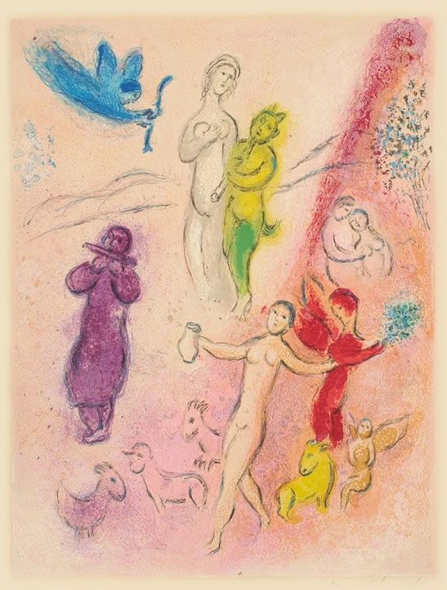
Sexual-Gender (Dis)-Symmetry?
Daphnis & Chloe 2
Daphnis & Chloe, Marc Chagall

Slide 2
Agenda
Finnis Is Right — Right?
  Critical Thinking for the Twenty-First Century
Longus’ Daphnis & Chloe
  Recap & Update
Sexual Symmetry?
  Late Antique Erōs and David Konstan’s Sexual Symmetry

Slide 3
Finnis Is Right — Right?
Critical Thinking for the Twenty-First Century

Slide 4
Finnis’ “Little Noticed Fact”
“… Socrates, Plato and Aristotle regarded homosexual conduct as intrinsically shameful, immoral, and indeed depraved or depraving.”
“Plato … in his Symposium … made very clear that all forms of sexual conduct outside heterosexual marriage are shameful, wrongful and harmful.” (p. 1057)

Slide 5
Finnis v. Nussbaum
Finnis
Nussbaum
“… thoughts which have historically been implicit in the judgments of many non-philosophical people, and which have been held to justify the laws adopted in many nations and states” before and after the advent of Christianity (1063).
Greek texts “force us to confront the fact that much of what we consider necessary and natural in our own practices is actually local and nonuniversal” (1518–19), whence empathy for difference
Notes:
is it one focused on a procreative sex as a biological realization of the goods of affection? if so, then maybe the clearly non-intellectual thoughts of d &c (and we read a lot of them!) reflect “thoughts which have historically been implicit in the judgments of many non-philosophical people,” and have in some cases “been held to justify the laws adopted in many nations and states” before and after the advent of Christianity.”
or is it a script favorable to the formation of patrilineal inheritance, and thus protective above all of elite wealth? if so, that may well “force us to confront the fact that much of what we consider necessary and natural in our own practices is actually local and nonuniversal.” so, …

Slide 6
Bibliography
Sexuality
  Foucault History Vol.3
  Hallett, Skinner, eds. Roman Sexualities
  Konstan Sexual Symmetry
  Williams Roman Homosexuality
Gender
  Hallett “Women in the Ancient Roman World”
Fascination, curiosity
  Barton Sorrows of the Ancient Romans
Marriage + legislation
  Treggiari Roman Marriage
  McGinn Prostitution etc.
Art
  Clarke Art in the Lives of Ordinary Romans
  ---. “Look Who’s Laughing at Sex”
  ---. Looking at Lovemaking
  ---. “Representations of the Cinaedus in Roman Art”
  Grant, Mulas Eros in Pompeii

Slide 7
Longus’ Daphnis & Chloe
Recap & Update

Slide 8
D&C: Analysis
PROLOGUE
  nature / art
  creative erōs
    madness / sanity
BOOK 1
  birth, rearing, education in nature
    Eros – who’s that?
    wolf-trap, D objectified
    Dorcon “wolf”
  D/C switch clothes
  Pirates: C rescues D
BOOK 2
  vintage fest, Chloe oggled
  Philetas
    education in eros
    homoerotic attraction
    age issues
    eros illness, cure
BOOK 2 (cont.)
  Methymnian louts
    Daphnis “tried”
    war, C abducted, country v. town
BOOK 3
  winter separation
    D’s “more ingenuity than a girl”
  Lycaenion courts D
  echo: D understands, C doesn’t
  C’s/D’s marriage to – others?
  D’s windfall
BOOK 4
  Lampis courts C
  Gnathon courts D
  Lampis kidnaps C
  parentage revealed, wedding approved
Notes:
Daphnis:
A herder; his name is a conventional herder's name in bucolic poetry. ("And to ensure that the child's name should sound adequately pastoral ....") Reared by
Lamon and Myrtale
Chloe:
Also a herder. Her name means "green young shoot" or "foliage." Reared by
Dryas and Nape
Dorcon:
In Greek, "Roe-Deer," called dorkon/dorkas, a species so-called from its large eyes (from the verb dedorkenai, "to gaze"). Our Dorcon is another herder, and, for a while, a rival to Daphnis. His name represents him as getting an eyeful of Chloe, i.e., as a kind of embodiment of the desiring gaze.
Philetas:
An older herder, he has the same name as the Philetas who was teacher to Theocritus, the bucolic poet. Our Philetas also teaches, in a sense, our lovers — how?
Lycaenion:
A woman from town, wife to the rather old, but evidently free, Chromis. Her name means "Little She-Wolf" — significant, perhaps, in some way? (See terms.)
Lampis:
Another herder, and another rival to Daphnis. How does he figure into things?
Astylus:"Urbane," "City Slicker," son of Daphnis' master,
Dionysophanes,
who is married to
Cleariste
Gnathon:
"Ravenous Mouth," Astylus' sidekick (the Greek word for "sidekick" is parasitos, and yes, he is rather parasitic) — how does he figure vis-à-vis Daphnis?

Slide 9
Sexual Symmetry?
Late Antique Erōs and David Konstan’s Sexual Symmetry

Slide 10

Delos rhyton, 2nd cent. BCE
(Hellenistic)
Notes:
Modern readers of the ancient novels, be they men or women, students or professors, can consider themselves fortunate, for the pleasure they take in those novels will be doubled by David Konstan's Sexual Symmetry, which shows that the love relationship at their centers consists of a pairing of equal partners utterly unique in ancient literary constructions of eros and foreign to most modern ones as well. It is a gloriously humane and healthy version of love K. describes: "Here, the body is not a threat or the source of sin. Rather, it is the natural locus of desire, in men and women alike. Fidelity is not won at the expense of passion, but is its complement, whenever the attraction is mutual, between equals, and uncoerced." The phrase "between equals" here sounds the keynote of Sexual Symmetry, which begins by showing that in the five extant Greek novels the heterosexual passion of the protagonists holds to an equilibrium in which male and female lovers experience matching emotions and neither attains power over the other. Homosexual liaisons, by contrast, are marginalized in the novels when they involve an eromenos and an erastes, i.e., a power-imbalanced love-pair; and the predations of lustful tyrants and bandit chiefs serve likewise as negative models, showing how eros grows cold when it is predicated on domination. The analysis of the literary construction of love, based in part (as K. asserts) on Michel Foucault's more socially-oriented analysis in the History of Sexuality, will be welcome to fans of Foucault and of the increasingly prevalent use of power paradigms in analyzing human relationships; those for whom the aforementioned are anathema had best forego this book.
Romm in: http://bmcr.brynmawr.edu/1994/94.05.15.html

Slide 11
D&C: Analysis
PROLOGUE
  nature / art
  creative erōs
    madness / sanity
BOOK 1
  birth, rearing, education in nature
    Eros – who’s that?
    wolf-trap, D objectified
    Dorcon “wolf”
  D/C switch clothes
  Pirates: C rescues D
BOOK 2
  vintage fest, Chloe oggled
  Philetas
    education in eros
    homoerotic attraction
    age issues
    eros illness, cure
BOOK 2 (cont.)
  Methymnian louts
    Daphnis “tried”
    war, C abducted, country v. town
BOOK 3
  winter separation
    D’s “more ingenuity than a girl”
  Lycaenion courts D
  echo: D understands, C doesn’t
  C’s/D’s marriage to – others?
  D’s windfall
BOOK 4
  Lampis courts C
  Gnathon courts D
  Lampis kidnaps C
  parentage revealed, wedding approved
Notes:
Daphnis:
A herder; his name is a conventional herder's name in bucolic poetry. ("And to ensure that the child's name should sound adequately pastoral ....") Reared by
Lamon and Myrtale
Chloe:
Also a herder. Her name means "green young shoot" or "foliage." Reared by
Dryas and Nape
Dorcon:
In Greek, "Roe-Deer," called dorkon/dorkas, a species so-called from its large eyes (from the verb dedorkenai, "to gaze"). Our Dorcon is another herder, and, for a while, a rival to Daphnis. His name represents him as getting an eyeful of Chloe, i.e., as a kind of embodiment of the desiring gaze.
Philetas:
An older herder, he has the same name as the Philetas who was teacher to Theocritus, the bucolic poet. Our Philetas also teaches, in a sense, our lovers — how?
Lycaenion:
A woman from town, wife to the rather old, but evidently free, Chromis. Her name means "Little She-Wolf" — significant, perhaps, in some way? (See terms.)
Lampis:
Another herder, and another rival to Daphnis. How does he figure into things?
Astylus:"Urbane," "City Slicker," son of Daphnis' master,
Dionysophanes,
who is married to
Cleariste
Gnathon:
"Ravenous Mouth," Astylus' sidekick (the Greek word for "sidekick" is parasitos, and yes, he is rather parasitic) — how does he figure vis-à-vis Daphnis?

