Slide 1
Evans v. Romer
Why Read Plato?...
Notes:
They attended the Dean's translation class, and when one of the men was forging quietly ahead Mr. Cornwallis observed in a flat toneless voice: "Omit: a reference to the unspeakable vice of the Greeks." Durham observed afterwards that he ought to lose his fellowship for such hypocrisy.
Maurice laughed.
"I regard it as a point of pure scholarship. The Greeks, or most of them, were that way inclined, and to omit it is to omit the mainstay of Athenian society."
"Is that so?"
"You've read the Symposium?"
Maurice had not, and did not add that he had explored Martial. [*1516]
"It's all in there - not meat for babes, of course, but you ought to read it. Read it this vac."
... He hadn't known it could be mentioned, and when Durham did so in the middle of the sunlit court a breath of liberty touched him. ^{n1}

Slide 2
“The less that lawyers know about a subject, the less that judges will know; and the less that judges know, the more likely they are to vote their prejudices.”
(Nussbaum p. 3 quoting Posner)
Notes:
why should clive dunham read Plato’s Symposium on his next vacation?
why should we?
“In 1990, a conservative American judge, a Reagan appointee to the United States Court of Appeals for the Seventh Circuit, fulfilled Clive Durham's assignment, reading the Symposium for the first time in order to "plug one of many embarrassing gaps in [his] education." ^{n2} In his 1992 book Sex and Reason, Richard Posner describes the impact of this experience:
I knew it was about love, but that was all I knew. I was surprised to discover that it was a defense, and as one can imagine a highly interesting and articulate one, of homosexual love. It had never occurred to me that the greatest figure in the history of philosophy, or for that matter any other respectable figure in the history of thought, had attempted such a thing. It dawned on me that the discussion of the topic in the opinions in Bowers v. Hardwick ... was superficial ... ^{n3}
Discussing those opinions later in his book, Posner argues that they betray both a lack of historical knowledge and a lack of "empathy" for the situation of the homosexual, the two being closely connected: "The less that lawyers know about a subject, the less that judges will know; and the less that judges know, the more likely they are to vote their prejudices.”

Slide 3
Agenda
Sex and the State
  Evans v. Romer: Case and Case-Law
Finnis versus Nussbaum
  Dissonant Harmony?
Adventures in Critical Thinking
  The Arguments: Your Impressions

Slide 4
Sex and the State
Evans v. Romer: Case and Case-Law

Slide 5

Bowers v. Hardwick (1986)
Supreme Court Case
Sodomy law upheld
“To hold that the act of homosexual sodomy is somehow protected as a fundamental right would be to cast aside millennia of moral teaching” (Chief Justice Warren Burger)
Notes:
Supreme Court Case
Georgia Sodomy law upheld
CHIEF JUSTICE BURGER, concurring:
"I join the Court's opinion, but I write separately to underscore my view that, in constitutional terms, there is no such thing as a fundamental right to commit homosexual sodomy. ... To hold that the act of homosexual sodomy is somehow protected as a fundamental right would be to cast aside millennia of moral teaching.“
i.e., moral-value systems handed down in a society should be determinants in what is legal/illegal.

Slide 6
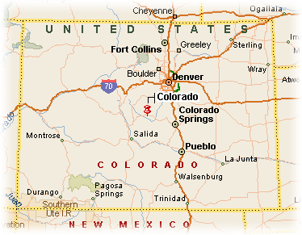
Colorado Amendment 2 (1992)
Outlawing…
  pro-gay/bi legislation
Denying…
  sexual minority rights recognition
Notes:
Nov. 3, 1992: Amendment 2 passes
by state referendum
text on p. 1519, Nussbaum
adopt or enforce any statute, regulation, ordinance or policy whereby homosexual, lesbian or bisexual orientation, con-duct, practices or relationships shall constitute or otherwise be the basis of or entitle any person or class of persons to have or claim any minority status, quota preferences, protected status or claim of discrimination.
Because Aspen, Boulder, and Denver had in fact passed civil rights ordinances aimed at protecting lesbians and gays from discrimina [*1520] tion, the Amendment nullified those ordinances.
response to proposed pro-gay legislation
would ban passage, enforcement of such laws
protection of racial minorities OK, but not sexual
state has interest in promoting certain family values
(cf. democratic Athens)

Slide 7
Challenge: Evans v. Romer
Plaintiffs
  Richard G. Evans
  John Miller
  Priscilla Inkpen
  et al.
Defendants
  Gov. Roy Romer
  state of Colo.
  state attorney general
Notes:
History (cont.)
Evans on referendum
“It was as if 800,000 people had said, ‘You’re not equal to us’ ”
Kevin Tebedo, executive director of Colorado for Family values in Colo. Springs:
“That is typical of a homosexual male. They take all this personally”
Back-and-forth …
narrowly drawn?
compelling need?
scholarly involvement
finnis and nussbuam
judge bayless’s legal-moral criteria seem to challenge those (quoting nussbaum) “Judge Bayless borrowed from Chief Justice Earl Warren: the trial of Amendment 2, he said, would take place in the light of "evolving standards of decency that mark the progress of a maturing society." n357 [*1600] [quoting chief justice earl warren, Trop v Dulles, 1957, “the evolving standards of decency that mark the progress of a maturing society,” denationalization as punishment barred by 8th amenedment]
State SC rules (12/14/1993) Colorado Amendment 2 unconstitutional
“bars [gays et al.] from having an effective voice in government affairs, insofar as those persons deem it beneficial to seek legislation that would protect them from discrimination based on their sexual orientation” [that assumes that ability to enact special protections of minority rights needed as well in the case of sexual minorities]

Slide 8
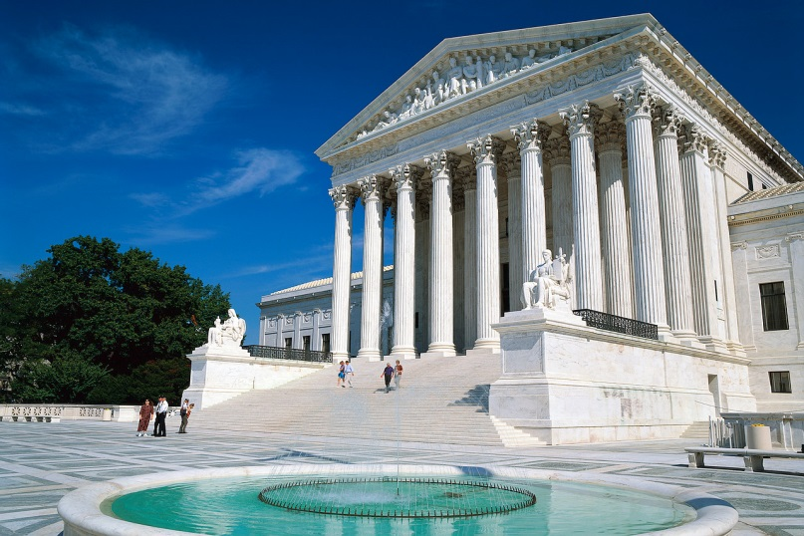
Federal Appeal…
Struck down (5/21/1996)
  14th amendment (equal protection)
Scalia dissent…
  Amendment 2 as “modest attempt ... to preserve traditional sexual mores against the efforts of a politically powerful minority”
Notes:
May 21, 1996
US Supreme Court appeal
amendment 2 struck down in 6-3 decision
Because Amendment 2 …
violates 14th amendment: no person shall be denied equal protection under the laws
imposes broad disability on a single group: homosexuals

Slide 9


Aftermath…
Lawrence v. Texas (2003)
  Overturns Bowers v. Hardwick
Same-sex marriage
  Legalized
    Massachusetts
    Connecticut
    California
  Outlawed
    Arizona
    California (Proposition 8, 2008)
Notes:
Lawrence v. Texas (2003)
Overturns Bowers v. Hardwick
Historical considerations also figure in Justice Kennedy's opinion written in Lawrence case - including direct critique of historical argument from Bowers case:
(quoting the decision) “[T]he fact that the governing majority in a State has traditionally viewed a particular practice as immoral is not a sufficient reason for upholding a law prohibiting the practice . . . .”
Note the following argument, drawn from scholarship clearly influenced by Foucault:
"The absence of legal prohibitions focusing on homosexual conduct may be explained in part by noting that according to some scholars the concept of the homosexual as a distinct category of person did not emerge until the late 19th century." What emerges here is that historical, intellectual-historical, and similar considerations, while not necessarily decisive, still matter here and need to be addressed. So the question becomes, in a way, do we want the "experts" judging this stuff by themselves, or do we want to pitch in ourselves? do we passively allow our justices and legislators to interpret tradition for us, or do we get that education judge posner talks about, and try to make up our own minds?
Same-sex marriage
in the meantime, there have been efforts to establish as legitimate gay marriage, and efforts to block those efforts
Outlawed
Arizona
Legalized
Massachusetts
Connecticut
California
the most famous of the latter: cal. prop 8 (2008) – state constitutional amendment
note the cal attourny general’s remarks on which: “Proposition 8 must be invalidated because the amendment process cannot be used to extinguish fundamental constitutional rights without compelling justification,” Mr. Brown said in a statement.”
nyt points out “Opponents have argued that the proposition fundamentally altered the state Constitution by taking away the right to marry from same-sex couples, who had been free to do so since May, when the California Supreme Court legalized such marriages. Proposition 8 overturned that decision by defining marriage in California as between only men and women”
ken starr leads the case in behalf of the amendment: “The language, policy, history and intent of Proposition 8 do not permit recognition of some same-sex marriages but not others,” read the brief, which was also written by the prominent conservative lawyer Kenneth W. Starr. “None are valid or recognized in California”

Slide 10
Finnis versus Nussbaum
Dissonant Harmony?

Slide 11
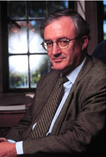

Authors and Aims
Finnis, “Law, Morality, and ‘Sexual Orientation’ ”
  Notre Dame Law Review 69.5 (1994) 1049–76
Nussbaum, “Platonic Love and Colorado Law: The Relevance of Ancient Greek Norms to Modern Sexual Controversies”
  Virginia Law Review 80.7 (1994) 1515–1652
Notes:
F&N not brought in to pontificate on sexual morality. nor do they, however much it may sound as if they do. rather, what they were called in to do, AND WHAT THEY IN FACT DID, was to comment on the larger context of society's and the state's interest in promoting this or that vision of sexual morality.

Slide 12
What say they/you?...
Finnis
Nussbaum
Traditional morality standard
  as per Burger
Parallel
  Standard Modern (European) Position
Moral argument
  Homoerotic sex as actualizing no good
Textual-historical validation
Evolving standards perspective
  as per Warren
Ancient texts as
  Thought experiments in diversity
  Interrogations of assumptions
Notes:
Finnis: 2 main arguments
legal argument
“standard modern [European] position” a valid parallel
14. smep assigns primary role in inculcating sexual morality to parents, but involves state as well. state "secondary" to parents in shaping morality of young; does not supplant them. does not place state in loco parentis vav consenting adults. but does take responsibility for the public realm. [state thus maintains a voice in perpetuating a sexual morality.]
moral argument
crucially, f’s arguments involve a notion of biological union possible only in the case of heteroerotic sex, and a teleology possible only in the case of what we’d refer to as traditional marriage.
catholic natural law standard of sexual morality privileges reason over authority
homosexuals think they are actualizing a bonding of affection
as in marriage
no such bonding
“want of a common good,”
except in genital bonding for procreative (heterosexual) purposes
as in marriage
homosexual “bonding” equals
masturbation
exploitation
F IS NOT SAYING THAT MARRIAGE IS THERE TO SERVE AS MEANS TO REPLENISH SOCIETY but rather that procreation gives marriage its meaning and value (the technical philosophical term would be the telos or end of marriage)
instructor’s observations:
quasi-essentialist features: thus it is morality itself that is transhistorical etc. (and that’s the main point), not just behavior as a psycho-biological phenomenon. hence the inevitable conclusion: homoerotic conduct either is treatable or else isn't doesn't offer a sufficiently well-defined category as to merit legal consideration. in effect, finnis' argument is more with boswell or hubbard than with halperin.
but there is essentialism: “14. "... the state has by no means renounced its legitimate concern with public morality and the education of children and young people towards truly worthwhile and against alluring but bad forms of conduct and life. Nor have such states renounced the judgment that a life involving homosexual conduct is bad even for anyone unfortunate enough to have innate or quasi-innate homosexual inclinations.“
it’s view of the role government seems to conflate essentialist and quasi-constructonist positions: “15-16. criticism of gay rights movements. "gay rights" def'd by author as "the phrase ambiguously assimilates two things which the standard modern position carefully distinguishes: (I) a psychological or psychosomatic disposition inwardly orienting one towards homosexual activity; (II) the deliberate decision so to orient one's public behavior as to express or manifest one's active interest in and endorsement of homosexual conduct and/or forms of life which presumptively involve such conduct"; " 'gay rights' movements interpret the phrase as extending full legal protection to public activities intended specifically to promote, procure and facilitate homosexual conduct.“
hence, while it is unjust to apply parental-style discrimination v. consenting adults, special legislation to outlaw sexual discrimination inappropriate remedy, and prejudicial to rights of religious groups etc.
it is also striking that literary interpretation, ordinarily, a slippery thing, has suddenly to become a matter of incontrovertible clarity.
argument from authority
1. instrinsic good of heteroerotic marriage, its incompatibility with all extramarital sex.
2. homoerotic acts, as "radically and peculiarly non-marital," do not accord with 1.
3. "Furthermore, according to Plato, if not Aristotle, homosexual acts have a special | similarity to solitary masturbation, and both types of radically non-marital act are manifestly unworthy of the human being and immoral."
17 ff. introduces argument from authority from greek philosophy v. homoerotic activity: "Let me begin by noticing a too little noticed fact. All three of the greatest Greek philosophers, Socrates, Plato and Aristotle, regarded homosexual conduct as intrinsically shameful, immoral, and indeed depraved or depraving. That is to say, all three rejected the linchpin of modern 'gay' ideology and lifestyle." cites dover for socrates as a "platonic" lover where pederasty concerned.
argues that ancient authorities regarded homoerotic sex as para phusin and as tolmema.
pp. 1063 ff. sect. V.
comes close to admitting a trans-cultural, transhistorical validity not to sexual categories but to sexual morality. that's foundationalism. introduces recent "natural law" theory ("Germain Grisez and others"). f doesn't just appeal to intellectual authorities; he states that this "articulates thoughts which have historically been implicit in the judgments of many non-philosophical people, and which have been held to justify the laws adopted in many nations and states both before and after the period when Christian beliefs as such were politically and socially dominant."
Nussbaum: Thesis Statement (pp. 1518–9). surprisingly butlerian in its ethical import:
Ancient sources to be used NOT as authorities,
but to …
1) force one to realize "much of what we consider necessary and universal in our own practices is actually local and nonuniversal"
2) help to question "empirical claims"
3) arguments VAV "human goods" of sexual relationships
4) the ancient texts promote empathy for homoerotic relationships
to counter prejudice
to promote empathy for “alternative” sexualities
"Through this text and many others [aristoph in pl’s symp], I suggested that a study of history reveals a wide variety of judgments and reasoned arguments about same-sex acts and attachments, obliging us to examine our own judgments and arguments in this area and the extent to which they are based on reason.“
cf.: 1597 ff. addresses value of philosophy, answers finnis. with f, grks force us to see difference. "As Michel Foucault wrote in the introduction to his study of Greek sexuality, the Greeks 'free [our] thought from what it silently thinks, and so enable it to think differently.' "
1543. foucauldian aspect to n: "the picture shows us a culture in which the sexual appetite is not found per se problematic or shameful. Here I agree with both Kenneth Dover and Michel Foucault: there is a great distance, both in the general culture and in the philosophers, from the Christian problematizing of sex.“
much of n is an attempt to dismantle f’s reading of his authorities.
1568. result? "What we have, then, is a commonplace of the culture, given new Platonic sharpness: a stern criticism of the hedonist, who in all his sexual acts behaves like an animal, indifferent to the soul. The departure from standard cultural norms consists in understanding child-begetting itself as a merely animal act, but this is to be explained by Plato's tendency to equate human nature with intellectual form-seeing nature. None of this implies that all homosexual copulation is "contrary to nature" in some normative sense; indeed, that suggestion would be hard to square with Plato's treatment of the intercourse of the second-best couples."
commonalities
both seem to echo the basically aristotelian idea (one evidently that makes contact with certain more or less conventional ideas in pausan in pl symp, xenophom, stoics) that the end of pederasty is an abiding philia to outlast eros. hence, by extension, consent, affection and mutuality as criterion of a model sort of eros.
1518. n interestingly makes a finnis-like (via symposium-aristophanes) argument: "the activity of sexual intercourse as a joyful attempt to be restored to the lost unity of their original natures. This is so no less for the same-sex than for the opposite-sex couples: in all cases, lovemaking expresses a deep inner need coming from nature, and in all cases the couples, so uniting, have the potential to make a valuable civic contribution." similar, but how diff??

Slide 13
Adventures in Critical Thinking
The Arguments: Your Impressions
Notes:
What about the argument that because we can't know antiquity "exactly," we can't know it. But can we know ANYTHING exactly? Science may be the art of seeking ever more exacting knowledge of something/anything, but only the theoretical sciences (math, logic) could ever hope to claim to be exact - and even that's debatable. So, for instance, physicians, on the basis often of highly INEXACT knowledge of the character or causes of a patient's symptoms, have to form diagnoses and prescribe treatment
What, then, of the study of antiquity? Can it ever hope to hold relevance if we'll never gain "exact" knowledge of it? If our science has flown right past and over the heads of the ancients? Nussbaum, for one, is clearly quite leery of ARGUMENTS FROM AUTHORTY based on authorities as unreliable as Plato et al. But is hers an argument from authority? However flawed her translation of tolmema (a minor point, see papers topic....), is her sense that things were somehow different way back when wrong simply because of our imperfect evidence? She may have got here Greeks wrong, but not because antiquity, because not knowable perfectly, is unknowable

Slide 14
The Arguments: Your Impressions
Notes:
e.g., what about gender evidence? the two papers deal almost exclusively in matters of sexuality. but how might gender matter here?
note, e.g., n’s rebuttal of f regarding his arguments that ancient authorities held up ideal not just of hetero- marriage, but of sexual and other mutuality in marriage. n 1554-1555. the point about asymmetry in later marriage a good one. "By contrast, a woman in an orgasmically unfulfilling marriage typically cannot look ahead to a time when she will find prompt and enduring satisfaction.” does, for instance, the position of women in the societies contextualizing, say, some of the more intellectualist of the sources we’ll be reading change our own evaluation of same in relation to the rec’d western ethical tradition? what about literary/non-intellectual sources?
how do they nuance or modify how we evaluate intellectual sources? romans in relation to greeks?

