Slide 1
Michel Foucault’s History of Sexuality II
Identity Power?

Slide 2
Thought Experiment
Classical Athenian (500-300 BCE) Facebook Signup

Slide 3
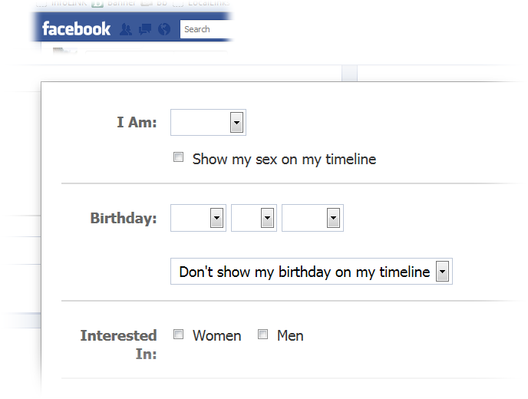

Slide 4
Your Comments
lot’s of terminology
  suggestive of different ways of viewing
masc/feminine roles maybe not so different today
constructed sexuality
  they had something like sexuality
passive/active problematized in gender situations
  dangers of feminization

Slide 5
Recap and Update
Butler → Foucault

Slide 6
Butler / Foucault (compare/contrast)
Butler
Foucault?...
Performed gender/sexuality
Normativity/deviance
Quotes…
  “social deformation … as a consequence of her act”
  “when the limits to representation and representability are exposed”
Performed gender/sexuality
  [comment here]
Normativity/deviance
  [comment here]
Notes:
74 ff. starts outlining new principles for kinship organization, points to existing structures as models. "consensual" rather than blood-ties. that leads to reformulation of sexual normativity. the quarrel between psychoanalysis and what it attacks as "utopian" queer theory. again, the perverse as the necessary structural foil to the norm, pace the psychoanalysts, not a generous gesture toward perversion.
76. ant isn't gay, but she doesn't subscribe to straight straitjacket - she doesn't stay alive for haemon to marry. then there is her "wavering gender." her tomb "stands for the very destruction of marriage."
80 ff. b is talking about the "shadowy realm" of the un- or half-recognized, the de-humanized - the melancholy of being denied legitimacy for what one is. this is "social death."

Slide 7
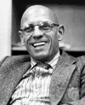
Michel Foucault (1926-1984)
Power
Knowledge
Discursive formations
Notes:
Michel Foucault (1926-1984) was a French thinker concerned primarily with the operations of power in society — not power as a property of political structures, nor the power of rulers, generals, etc., but power as expressed in social institutions like the medical professions or the penal system. How, he wanted to know, do they exercise a certain hold over the popular mind? What is the source of their authority?
Foucault understood power in relation to discursive formations, forms of knowledge (psychiatry, for instance) that are not so much controlled by individuals or groups, but themselves control and seek to expand their power by creating objects to regulate. So, for instance, the category "homosexual" arises only relatively lately (i.e., in the modern period) to offer the medical profession an object of knowledge and an arena within which to leverage the power inherent in knowledge. For Foucault, knowledge is power in a very real way.

Slide 8
History of Sexuality (1976-1984)
An Introduction
  “Repressive Hypothesis”
  “Perverse Implantation”
The Use of Pleasure
  “Genealogy”
The Care of the Self
  Late-antique “mistrust of pleasures…”
Notes:
1. An Introduction
“Repressive Hypothesis”
doubts more generally, and with specific reference to sex, whether power exercised to limit freedom in western society; suggests theory exploring western society as repressive of sexual freedom actually complicit in power structures it attempts to analyze – sexual freedom/perversion actually product of growth of certain analytic-scientific disciplines in modern era
“Perverse Implantation”
“A proliferation of sexualities through the extension of power [the authority of the medical/psychiatric professions etc.]; an optimization of the power to which each of these local sexualities gave a surface of intervention” (p. 48) – “nonconjugal, nonmonogamous sexualities” established to regulate, police, treat
discourse (scientific etc.) “channels” power toward unique behaviors; their categorization represents knowledge-power in action
2. The Use of Pleasure
anc grc-rm: sexual morality less a matter of codes and definitions than of ethics and practices. hence principal difference with the western middle ages.
focus esp on quantitative and qualitative-aesthetic, not a code of with whom etc. hence parallel of sex and food ethics, esp as regards moderation/excess.
seems to take medical-philosophical writers as playing a role parallel to 19th-20th-cent. psychiatry as exercizing power. at the same time, in v. 2 the dominant counterpoint is with christian (western) middle ages.
“genealogy” - sexual categories a tough nut for f. hence undertakes a "genealogy," a history not of conceptions of desire, but of how reflection on desire played into conceptions of the "who i am." how people interpreted (hermeneutics) their and others' desire, how western humanity through ages understood itself as subject of and to desire. how, in other words, through history of west, does the individual understand self as a subject? the study of a "hermeneutics of the self" in antiquity. part of "games of truth." ("games of truth" more or less answers to "socially coonstructed reality.")
social aim: "to learn to what extent the effort to think one's own history can free thought from what it silently thinks, and so enable it to think differently." to allow us to reflect on own assumptions and their causes [compare butler]
2 generalized questions: (1) why sexuality widely problematized? (2) what link to ethics (the "arts of existence")?
3. The Care of the Self
“A mistrust of pleasures…”

Slide 9
Analysis
Dietetics
  Issues of the body
Economics
  Issues of Marriage
Erotics
  Issues of sex
Philosophy
  Issues of truth

Slide 10
Part 1. “Moral Problematization of Pleasures”
Aphrodisia (sex)
Chrēsis (use)
Enkrateia (“self-control”)
  v. akrateia (“incontinence”)
“Freedom and Truth”
  Epithumia
  Sophrosunē
Notes:
Aphrodisia
aphrodisia = physical sexual pleasure, a type liable to akolasia, “immoderation.”
grks concerned with the cycle desire-act-pleasure. not which of those (not medieval moralists), but the how, how much, etc. of them.
variable 1. moderation/excess, the main quantitative measures.
the necessity to procreate created conditions for excess and for reversal of the soul-body hierarchy. stasiastic potential of sex. issue is how to make proper use of pleasure without yielding to excess.
variable 2: role/polarity. (passive/active, male/female, feminine/masculine, subject/object, agent/patient). hence a morality of role-consistency.
Chrēsis
sexual morality here as "conditions and modalities" of use of pleasures, not which pleasures to use.
good pleasures respond to a sense of need: hunger, lust, etc. stimulation not in response to a felt appetite is deviant. should be right time: of life, of day, of year. use to be coordinated with status. this esp. crucial for a public life.
Enkrateia
especially the struggle to gain mastery over the self. note that this implies life as an eternal struggle with natural urges. constant practice (askēsis) of self-control essential.
“Freedom and Truth” (sophrosunē)
here f understands sophrosunē in a somewhat unconvevtional fashion: as freedom in sense of non-slavery to urges.

Slide 11
(Sexual Ethics 1) Dynamics
desire
acts
pleasure
aphrodisia
Notes:
38. grks had no detailed catalogue of what constitutes aphrodisia, nor what lies hidden behind it. generally not inclined to explicit description; contrast medieval and modern prescriptive texts. not concerned with the profound depths or nature of sex.
stasiastic-hyperbolic tendency of human appetites, sexual especially.
challenge: control, not denial.
41 for sexual acts, "their dynamics was much more important than their morphology [the forms they took]." act is pleasurable, pleasure is desirable. potential vicious cycle.

Slide 12
“Sexual-Social Isomorphism”
male | ~ | female
masculine | ~ | feminine
penetrator | ~ | penetrated
active | ~ | passive
dominant | ~ | submissive
senior (in status) | ~ | junior
moderate (sophron) | ~ | immoderate
free | ~ | slave
aka “asymmetry hypothesis”

