Slide 1
“She Entered into Rivalry”
Women’s Lives and Voices in Ancient Greece

Slide 2
Two Quotes…
“I blame clear-voiced Myrtis because — though a woman — she entered into rivalry with Pindar”
(Corinna, Lefkowitz p. 5)
“… the highest praise you can win is to be spoken of by men as little as possible …”
(Thucydides quoted Paul-Zinserling p. 22)
Notes:
i’d like to recall for you the first of the 3 theory readings we did” judith butler’s antigone’s claim. cutr back to its basics, the book is about the meaning of antigone’s actions and the actions performed by her words: how that enacts a non-normative symbolic system of gender and kinship.
so I present you here with two quotes from today’s readings, in a way, quotes evoke butler’s ideas in intriguing ways. on the one hand, we have the woman poet corinna apparently blaming the woman poet Myrtis for engaging in rivalry with the male poet pindar. on the other hand, we have the 400s bce athenian historian thuc composing a speech for the great athenian politician pericles. after praising the city and its warriors, he tells the women to seek their best praise in avoiding being spoken of all. and although we have virtually no context for the first quote, it seems nearly assured that myrtis is doing something a woman shouldn’t.
each quote, in other words, is a speech act performing gender in butlerian ways, with the first more even than the second enacting a gender-defining “thou shalt not” in relation to a man.
but what about the poem (now lost, if it ever existed) that myrtis wrote? in challenging pindar, does it appropriate male gender in gender-transgressive ways? or in ostensibly posing a challenge to the male poet’s art – and thereby effectively defying the athenian stateman’s injunction – does it stake out a non-normative women’s gender identity.

Slide 3
Agenda
Writer’s Corner
  Expository Prose, Essay Structure
Women’s Lives
  Athens and Elsewhere
Women’s Voices
  Sappho et al.
Notes:
that is, in a sense, the question that we’ll pursue today, namely, that of what the norms were for women and how they could be validated or transgressed in the words and deeds of women – that in a class that opening up our study of women in the ancient greek world.

Slide 4
Writer’s Corner
Expository Prose, Essay Structure

Slide 5

Expository Essays
https://owl.english.purdue.edu/owl/resource/685/02/

Slide 6
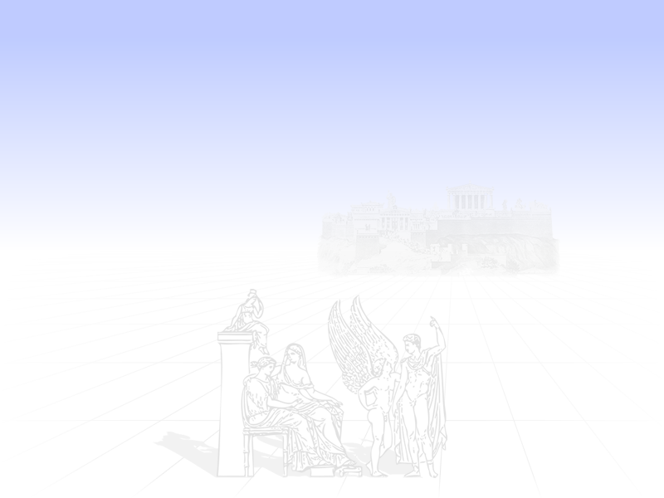
Essay Structure
Beginning
(introduction – say what you’re going to say)
Middle
(main body – say it)
End
(conclusion – say what you’ve said)

Slide 7
Corinna Essay - Introduction
I’m going to address the C quote. I shall analyze this quote in relation to butler’s ideas of the gender performative
does at least this quote seem to support the idea?
it does
by comparing b with zyx etc etc
“I blame clear-voiced Myrtis because — though a woman — she entered into rivalry with Pindar”

Slide 8
Women’s Lives
Athens and Elsewhere

Slide 9
Biblio Note
Blundell, Sue. Women in Ancient Greece. Cambridge, Mass.: Harvard University Press, 1995.
---. Women in Classical Athens. London: Bristol Classical Press, 1998.
Cohen, David. Law, Sexuality and Society: The Enforcement of Morals in Classical Athens. Cambridge and New York: Cambridge University Press, 1991.

Slide 10
Historical Review
ca. 800-500 | Archaic period Aristocratic culture, politics
500-322 | Classical Period Democracy at Athens
322-39 | Hellenistic Period Great kingdoms

Slide 11
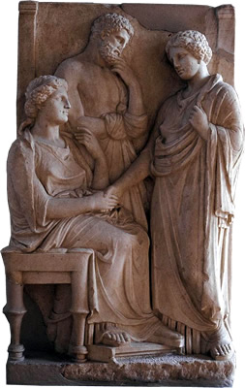
Athenian Women: Status
Political
  politis
  metoikos, xene
Legal (kurieia)
Social
  eleuthera
  doule
  hetaira
  porne

Slide 12
Free Citizen Woman
Domestic (oikos)
  gamos
    enguesis
    ekdosis
  sunoikismos
  epiklēros
  Sequestration?
Public (religious)
  Thesmophoria
  Dionysia
Notes:
NOTES WIVES ETC.
woman helped perpetuate the oikos by producing male issue and, in a pinch, by providing means whereby property could still remain within the family.
Guardianship
kurios and oikos
kurios, legal guardian
oikos
house/home
family, including property transmitted to successive generations through legitimate issue
court representation
not legally competent
Property
ownership permitted
but barred from transaction beyond a medimnos of grain (a few days supply for family)
i.e., from major property transfer
dowry
officially, the woman’s and her birth family’s
but managed - and perhaps invested - by husband
possibility of investment potentially an attraction for prospective bridegrooms
capital reverts on dissolution of mariage, else 18% per annum interest
i.e., a way for birth family to maintain some control of woman
inheritance
male issue favored over female
fathers without sons could transmit property via daughters (epikleros “[woman] with property”)
adoptive son would have to marry daughter to guarantee property remained in family
a father could call upon daughter to divorce husband to become an epikleros to be married to uncle or cousin
ankhisteia: Isaeus 7.20 “Thus the law gives the sister and the sister's son an equal share of their father's and their brother's estate; but when a first cousin, or any other kinsman in a remoter degree, dies, it no longer grants such equality, but gives the male relatives the right of succession as next-of-kin in preference to the female. (ἀλλὰ προτέροις τοῖς ἄρρεσι τῶν θηλειῶν τὴν ἀγχιστείαν πεποίηκε.) For it declares that ‘the males and the issue of the males, who are descended from the same stock, shall be preferred, even though their relationship to the deceased is more remote.’ The wife of Pronapes, therefore, had no right to claim a share at all, and Thrasybulus ought to have claimed the whole if he regarded my adoption as invalid.”
invalidation of will in event of coercion or incapacity, including if influenced by woman’s persuasiveness (dem. 46.14; 6.10; hyp. 17 Loeb; aristot. ath. pol. 35)
cf. neaera pp. 172-173 (phrastor-phano incident): refers to or at least evokes much of above vav woman’s role as caregiver, channel for inheritance, defruader

Slide 13
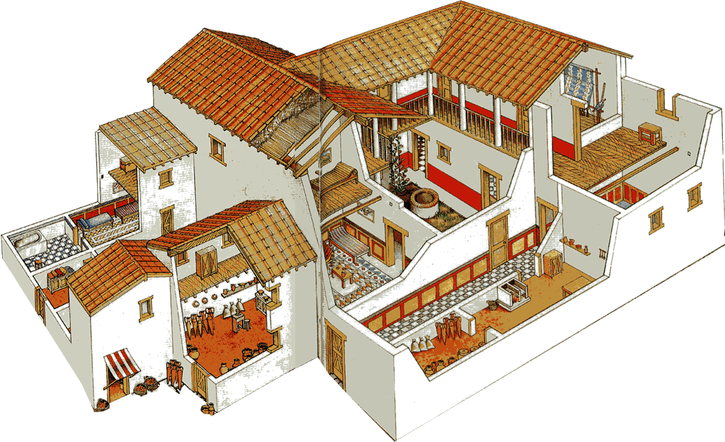
andrōn
(men’s “rumpus room”)
Greek House (oikia), Olynthus, 4th cent. BCE (reconstruction)

Slide 14
Women’s Voices
Sappho et al.

Slide 15
Your Impressions?

Slide 16
Butler or Foucault?
The man seems to me strong as a god, the man who sits across from you and listens to your sweet talk nearby
and your lovely laughter — which, when I hear it, strikes fear in the heart in my breast. For whenever I glance at you, it seems that I can say nothing at all
but my tongue is broken in silence, and that instant a light fire rushes beneath my skin, I can no longer see anything in my eyes and my ears are thundering,
and cold sweat pours down me, and shuddering grasps me all over, and I am greener than grass, and I seem to myself to be little short of death
But all is endurable, since even a poor man ... (Sappho fr. 31)

Slide 17
“Sexual-Social Isomorphism”
male | ~ | female
masculine | ~ | feminine
penetrator | ~ | penetrated
active | ~ | passive
dominant | ~ | submissive
senior (in status) | ~ | junior (in status)
moderate (sōphrōn) | ~ | immoderate (akolastos)
free | ~ | slave
aka “asymmetry hypothesis”
Notes:
this schema continues what f sees as a basically struggle-based model, this time, other-directed. in the case of semi-institutionalized peerasty, the struggle, the element of inequality, potentially harmful to the socially subordinate side, especially in the case of free-citizen youths in pederasty.

Slide 18
Butler on Social Construction
“To publish one’s act in language is in some sense the completion of the act” (Butler AC)
"... gender [but maybe sexuality too?] is an act which has been rehearsed, much as a script … requires individual actors” (“Performative Acts,” in Performing Feminisms 1990)
http://www.cla.purdue.edu/english/theory/genderandsex/modules/butlerperformativity.html
Notes:
"Within speech act theory, a performative is that discursive practice that enacts or produces that which it names" (Bodies that matter 13)
"... gender is an act which has been rehearsed, much as a script survives the particular actors who make use of it, but which requires individual actors in order to be actualized and reproduced as reality once again" ("Performative Acts," Performing Feminisms 1990)

Slide 19
Discussion
Butler?
Foucault?

