Slide 1
Ancient Gender and Sexuality
Andrew Scholtz, Fall 2013

Slide 2
Agenda
Next Class …
  Sophocles’ Antigone – Antigone’s heroism? Creon’s villainy?
Problems …
  Gender, Sexuality, Values, Ideology
Shape of Course
  Where, When, What, How

Slide 3
Next Class …
Sophocles’ Antigone – Antigone’s heroism? Creon’s villainy?

Slide 4
Problems …
Gender, Sexuality, Values, Ideology

Slide 5
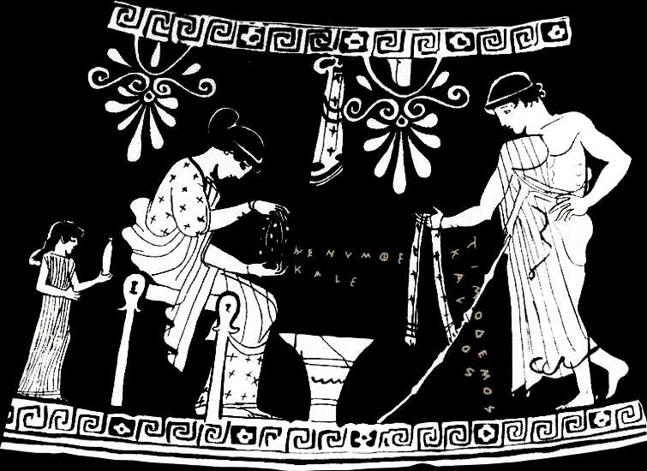
hē numphē kalē, “The bride is beautiful.”
Timodēmos kalos, “Timodemos is handsome.”
Notes:
WHAT DO YOU SEE? WHAT DOES IT SEEM TO SAY?
Scene from alabastron (small scented-oil jar, like what small girl holds), Athenian, ca. 465 BCE. Woman plaiting a wedding/courtship wreath. Youth offering fringed scarf. Woman’s inscription: hē numphē kalē, “The bride is beautiful.” Youth’s: Timodēmos kalos, “Timodemos is handsome.” I.e., kalos-inscriptions meaning “So-and-so is sexually desirable,” or “I love so-and-so.” Girl, probably a slave, brings oil likely to be used here when bride and groom consummate marriage. Sort of, then, propaganda-“pornography” promoting citizen marriage using imagery of (pederastic?) courtship.

Slide 6
“But in Athens, gentlemen, we have a far more admirable code .... Take for instance our maxim that it is better to love openly than in secret, especially when the object of one’s passion is eminent in nobility and virtue ....”
(Plato Symposium 182d–e – speaker’s talking about men loving boys)
Notes:
WHAT DO YOU SEE? WHAT DOES IT SEEM TO SAY?

Slide 7
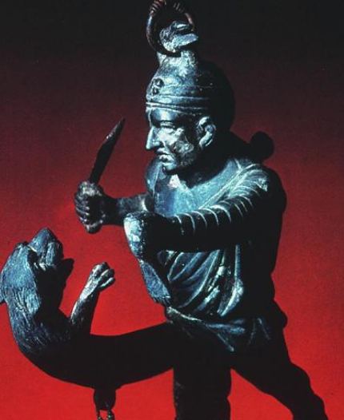
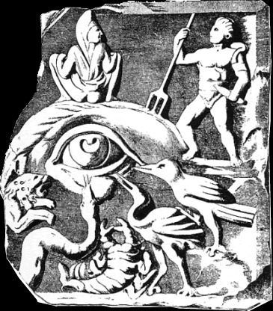
A gladiator fights his own phallus.
(1st-cent. CE Wind-chime from Pompeii)
“Woburn Marble” — an eye on the evil eye
(ca. 200 CE)
Notes:
WHAT DO YOU SEE? WHAT DOES IT SEEM TO SAY?
roman fascination with
the monstrous
the grotesque
the extreme
the gladiator

Slide 8
Class Reflections: What to Ask, How to Answer
Notes:
I’d like us to reflect a little on the experience of viewing and processing the images we’ve just seen. What kinds of questions do the images prompt? How to go about answering those questions? What, in other words, do we want to know, and do we go about knowing it?

Slide 9
… Mr. Cornwallis observed in a flat toneless voice: “Omit: a reference to the unspeakable vice of the Greeks.” Durham observed afterwards that he ought to lose his fellowship for such hypocrisy.
Maurice laughed.
“I regard it as a point of pure scholarship. The Greeks, or most of them, were that way inclined, and to omit it is to omit the mainstay of Athenian society.”
Forster Maurice
Notes:
how once approached – but what (if anything) wrong with the student’s more “enlightened” approach?
They attended the Dean’s translation class, and when one of the men was forging quietly ahead Mr. Cornwallis observed in a flat toneless voice: “Omit: a reference to the unspeakable vice of the Greeks.” Durham observed afterwards that he ought to lose his fellowship for such hypocrisy.
Maurice laughed.
“I regard it as a point of pure scholarship. The Greeks, or most of them, were that way inclined, and to omit it is to omit the mainstay of Athenian society.”
“Is that so?”
“You’ve read the Symposium?”
Maurice had not, and did not add that he had explored Martial.
“It’s all in there—not meat for babes, of course, but you ought to read it. Read it this vac.”
He hadn’t known it could be mentioned, and when Durham did so in the middle of the sunlit court a breath of liberty touched him.
(E. M. Forster Maurice. 1981. p. 51. see in Nussbaum essay)
“The Greeks, or most of them, were that way inclined, and to omit it is to omit the mainstay of Athenian society”
That’s actually debatable—that most Greeks were “that way inclined.”

Slide 10
Discussion
What to ask?
How to answer?
How openly displayed were homosexual relationships?
Will killing the animal hurt the gladiator?
How is womanhood defined in the pottery illustration?
How were gender and sexuality thought of in that society?
I.e., in Symposium.
No, because an intense internal struggle sex drive. Or not…
Relational identities, issues of status.
Attitudes. How societies view others.

Slide 11
Approaches…
Biological
Historicist
Subjective
  “Means to me…”
Ideological
  Means what to whom?
Notes:
OED: A systematic scheme of ideas, usually relating to politics, economics, or society and forming the basis of action or policy; a set of beliefs governing conduct. Also: the forming or holding of such a scheme of ideas.
TERMS: ideology. As a term, "ideology" is often used simply to denigrate — as subjective, as self-centered, as manipulative — systems of thought with which one disagrees. In other views, ideology is the individual's self-image in relation to her or his social/political existence. Ideology legitimizes and orders that which seems vulnerable to contradiction and chaos. Thus the work that ideology is meant to do can betray the misgivings ideology masks.

Slide 12
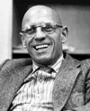
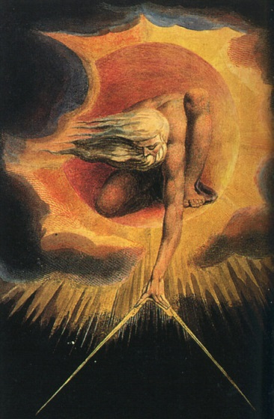

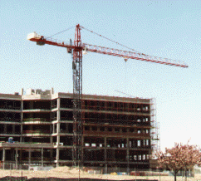
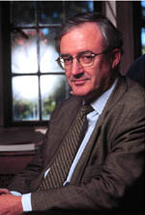

Issues / Thinkers
Butler
Foucault
Essentialism
Constructionism
Finnis
Nussbaum
Notes:
how relevant for tody??
the study of ancient sexuality helps us gain perspective on issues animating the (still simmering) culture wars
a world that is neither wholly alien nor familiar, but one that forces us to confront questions of universality and particularism where our morals and cultural practices are concerned

Slide 13
Shape of Course
Where, When, What, How

Slide 14
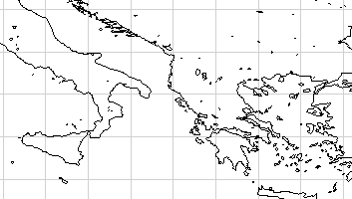
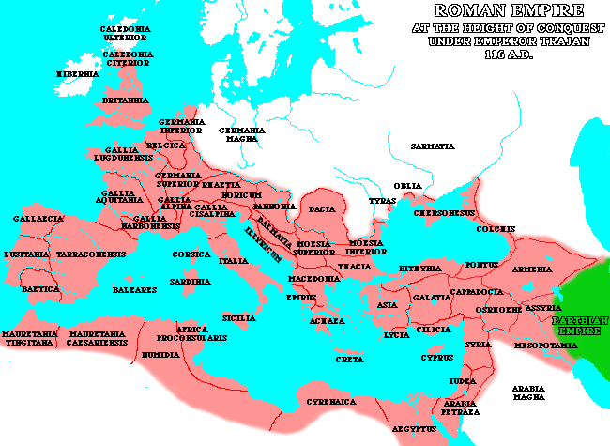
Greek World
Italy
Rome
Athens
Mediterranean Sea
Roman Empire ca. 116 CE

Slide 15
When…
Trojan War ca. 1,200 BCE
Rome founded 753 BCE
Athenian democracy 400s–300s B.C.
1,000 B.C.
Roman Republic, Empire
510 BCE–CE 475
1,000 A.D.
Greece, 550: BCE–CE 200
Periods covered in course
Rome, 200 BCE–125 CE

Slide 16
What (cont.)
Greece v. Rome
Modernity v. antiquity
CONTINUITY V. SINGULARITY

Slide 17
How? Through Critical…
Reading
Thinking
Writing
  Papers
  Journals

