Slide 1
Portrait of a City
Ps-Demosthenes Against Neaera, Art 1

Slide 2
Agenda
Academic Honesty
Ps-Demosthenes’ Against Neaera
  Charges, Ideologies, Rhetoric, Realities
Greek Artistic Evidence
  Where, When, What
Image and Ideology
  What Do You See?

Slide 3
Ps-Demosthenes’ Against Neaera
Charges, Ideologies, Rhetoric, Realities

Slide 4
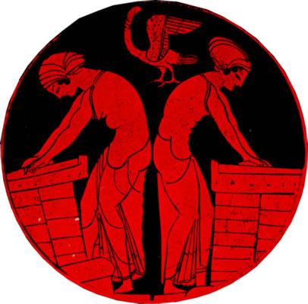
Charges, Ideologies, Rhetoric
Fraudulent…
  citizen-marriage
  citizen-offspring
Impiety
Cheapened enfranchisement
Jury shaming
Bread-making, phallus-bird, c. 500 BCE. Athenian
Notes:
NOTES WIVES ETC.
women helped perpetuate the oikos by producing male issue and, in a pinch, by providing means whereby property could still remain within the family.
hence the stated rationale for this case prosecuted by theomnestus and apollodorus: st has passed off a foreign-born non-citizen ex-slave former prostitute as legit wife and mother of his children
PENALTIES: for st = 1000 dr fine, possible disfranchisement of kids, humiliation; enslavement and confiscation for foreigners posing as citizen spouses.
13. the charges enumerated - made to suggest coalescence of public and private interests.
living with for woman as wife.
introduced children not his as his and as deserving citizenship.
has married off prostitute's daughters as if own.
impiety of the king-archon business.
72 ff. the marrying to Theogenes, the basileus-elect, thing. religion and national identity get into it. 74 ff. historical background to kingship. 79 ff. Areopagus punishes Theogenes for passing off wife as legit
undermined the integrity of the enfranchisement process.
jury appeals (Jury “shaming”)
110 ff. the shaming vis-a`-vis jurors coming home and being quizzed by women on trial. honorable women rightly outraged; women of "less sense" encouraged to license. a general OK for such behavior as n illustrates. the laws providing dowries for the impecunious baffled; poor girls will be forced into prostitution. a vote to protect "your women."
113. law that girl with 1/2 decent looks can get a state-sponsored dowry. acquit, and poor citizen girls will all have to become prostitutes. you're protecting your women here!

Slide 5
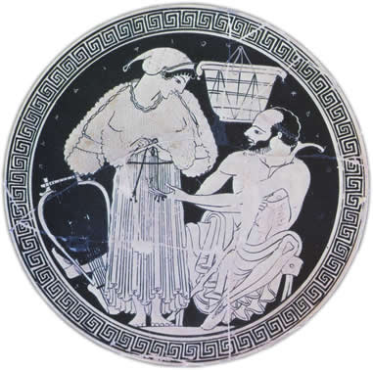
Realities: Prostitutes, Concubines
Hetaira (plur. hetairai)
  expense
  relationship
Porne (plur. pornai)
  publicity
  commodification
Pallake (plur. pallakai)
  “kept” slave woman
Old man & hetaira. Athenian, c.500-490
(Inscription reads Panaitios kalos, “Panaetius” [man’s name] is beautiful.”)
Notes:
ARTstor info:
Creator Onesimos, ca. 500-475 B.C Title Kylix: Hetaira & Old Man Date c.500-490 Location Attike (Greece) Description From Attica; found at Vulci Subject Attike (Greece)
Vase Paintings--Greek: Archaic--520-480 B.C
kylikes Collection The Image Gallery Source Data from: University of California, San Diego
PROSTITUTES, CONCUBINES
Hetaira (plur. hetairai)
expense
relationship
29 ff. Timanoridas and Eucrates seem to have shared her and have bought her for themselves. When they get married, out of apparent affection they want to see her freed and well set up, not "under the thumb of a brothel keeper." She is to buy her freedom for less than they'd orginally paid for it. N consults ex-lovers for the cash. But these men seem to want her out of the way, as if maybe married life could get complicated with an ex-kept woman around. al this confirms n's slave background.
30. owners about to marry seek to procure her freedom. seem to want to enable her to set up as independent hetaira.
say one drach = ca. 50$$. tim and eucr paid 30 minas, @ 100 drs per mn, = 3,000 drs. 150,000$$ is that possible?? she seems to be borrowing money for her freedom from a syndicate led by phrynion, who then seems to treat her as more or less his own. the offer of freedom, it seems to turn out, is meant to get out of corinth once tim and eucr got married. (????)
Porne (plur. pornai)
publicity
commodification
Palake
“kept” slave woman
ath. law homicide (dem 23.53): “If a man kill another unintentionally in an athletic contest, or overcoming him in a fight on the highway, or unwittingly in battle, or in intercourse with his wife, or mother, or sister, or daughter, or concubine kept for procreation of legitimate children, he shall not go into exile as a manslayer on that account.”

Slide 6
Will the Real Neaera Stand Up?
“We [Athenian men] have prostitutes for the sake of pleasure, concubines for meeting our bodily needs day-to-day, but wives for having legitimate children”
(Against Neaera p. 191)

Slide 7
Do They “Jive”?
“We [Athenian men] have prostitutes (hetairai) for the sake of pleasure, concubines (pallakai) for meeting our bodily needs day-to-day, but wives (gunaikes) for having legitimate children” (Against Neaera p. 191)
“This Candaules, then, fell in love with (erasthe) his own wife, so much so that he believed her to be by far the most beautiful woman in the world; and believing this, he praised her beauty beyond measure to Gyges son of Dascylus” (Herodotus 1.8)
“Niceratus too, so I am told, is in love with (erai) his wife and finds his love reciprocated (she anterai him)” (Xenophon Symposium 8.3)
Notes:
26. neaera's career in corinth. she at first evidently operating simewhere between hetaira and slave-porne.
29 ff. Timanoridas and Eucrates seem to have shared her and have bought her for themselves. When they get married, out of apparent affection they want to see her freed and well set up, not "under the thumb of a brothel keeper." She is to buy her freedom for less than they'd orginally paid for it. N consults ex-lovers for the cash. But these men seem to want her out of the way, as if maybe married life could get complicated with an ex-kept woman around. al this confirms n's slave background.
30. owners about to marry seek to procure her freedom. seem to want to enable her to set up as independent hetaira.
say one drach = ca. 50$$. tim and eucr paid 30 minas, @ 100 drs per mn, = 3,000 drs. 150,000$$ is that possible?? she seems to be borrowing money for her freedom from a syndicate led by phrynion, who then seems to treat her as more or less his own. the offer of freedom, it seems to turn out, is meant to get out of corinth once tim and eucr got married. (????)
33. Phrynion and his partying with her. The public spectacle he made treated as disgraceful. goes to the issue of her ill repute.
35. N, unhappy w/ Phr., decamps to Megara.
37. Stephanus enters the scene. makes st. her prostates. n is described now as st's hetaira.
38. st. promises to essentially pass her kids as his own and make the boys legitimate phratry members.
39. st. will essentially pimp n, but also works as sycophant - his own ill repute. (speech as exercise in character assassination.)
45 ff. the "wronged" Phrynion obtains an arbitration. basically, a compromise. n to return goods but keep freedom; st and phr must share the woman. (note general absence of respectable women from dinner parties.)
49 ff. affair of marrying off Stybele-Phano to Phrastor, the "respectable workman." Phrastor divorces and refuses to return dowery. st forced to abandon resitution suit b/c of citizenship-marriage law under which phr had initiated an action.
52. phrastor sues steph for fraudulent betrothal of for woman as if athenian. serious consequences. that's a countersuit for st's dike sitou. the parties come to terms.
55. testimony that n is foreign. at same time, seems to (despite author?) illustrate affective connection between n-ph and phr. push coming to shove on the issue of the adoption of phano's child.
64 ff. st's and n's trick on epaenetus. lure him to country, where they accuse him of adultery with n's daughter (it's phano). leads to ep's suing st on false arrest. ep will claim it was all a matter of porneia.
72 ff. the marrying to Theogenes, the basileus-elect, thing. religion and national identity get into it.
107 ff. n's publicity in connection with her ill repute. (peporneumenen)
108. "making her living from 3 holes"!
110 ff. the shaming vis-a`-vis jurors coming home and being quizzed by women on trial. honorable women rightly outraged; women of "less sense" encouraged to license. a general OK for such behavior as n illustrates. the laws providing doweries for the impecunious baffled; poor girls will be forced into prostitution. a vote to protect "your women."
113. law that girl with 1/2 decent looks can get a state-sponsored dowery. acquit, and poor citizen girls will all have to become prostitutes. you're protecting your women here!

Slide 8
Greek Artistic Evidence
Where, When, What

Slide 9
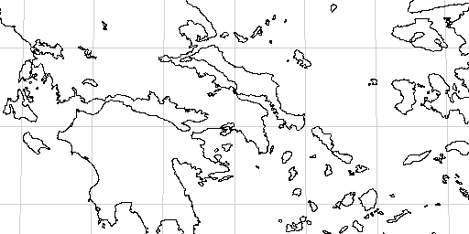
Where…
mostly Athens
Northern Greece
Aegean Sea
Peloponnese

Slide 10
When? (all dates BCE)
Peisistratean tyranny, 561-510
Persian Wars, 490-479
Peloponnesian War, 431-404
death of Alexander, 323
Pericles’ leadership, 460-429
600
500
400
300
Tyrannicides, 510
Cleisthenic democracy, 508
archaic period, 776-475
classical period, 475-322
Hellenistic period, 323-31
Notes:
movement from archaic oligarchy to classical democracy

Slide 11
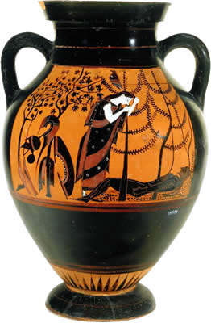
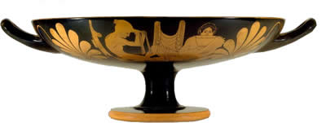
Vase Painting: Style, Chronology
Attic Black Figure
  ca. 600-530
Attic Red Figure
  530-300s
Attic BF amphora c. 530, Eos mourning Memnon
Attic Red Figure Kylix (drinking cup), ca. 500
Notes:
ARTstor
Creator Attributed to Painter of the Vatican Mourner Culture Greek Title Attic Black-figure Amphora with Eos Mourning Her Dead Son Memnon (?) and the Recovery of Helen Work Type pottery Date c. 530 BCE Material terracotta Measurements H: 44cm Style Period Archaic Description Eos Mourning Her Dead Son Memnon (?) Repository Museo Gregoriano Etrusco, Vatican City, Inv. no. 16571 Collection The Image Gallery Source Image and original data provided by SCALA, Florence/ART RESOURCE, N.Y.
http://www.artres.com/c/htm/Home.aspx
ARTstor
Creator Attributed to the, Ashby Painter Culture Greek, Attic Title Kylix, type B
Terracotta kylix (drinking cup) Date ca. 500 B.C. Material Terracotta Measurements Overall: 5 x 16 in. (12.7 x 40.6cm) diameter 12 7/8in. (32.7cm) Repository The Metropolitan Museum of Art
Purchase, Amalia Lacroze de Fortabat Gift and The Bothmer Purchase Fund, 1993
1993.11.5
http://www.metmuseum.org Collection The Image Gallery ID Number TMSCLUSTER02\TMSSQL02.gr:16675 Source Data From: The Metropolitan Museum of Art Rights This image was provided by The Metropolitan Museum of Art. Contact information: Image Library, The Metropolitan Museum of Art, 1000 Fifth Avenue, New York, NY 10028, (212) 396-5050 (fax).
Image © The Metropolitan Museum of Art
This image is available for uses permitted under the ARTstor Terms and Conditions of Use, such as teaching and study, as well as for scholarly publications, through the Images for Academic Publishing (IAP) initiative. If you are seeking to use this image for scholarly publication, you should click on the IAP icon below the thumbnail image. Download Size 1024,1024

Slide 12
Image and Ideology
What Do You See?

Slide 13
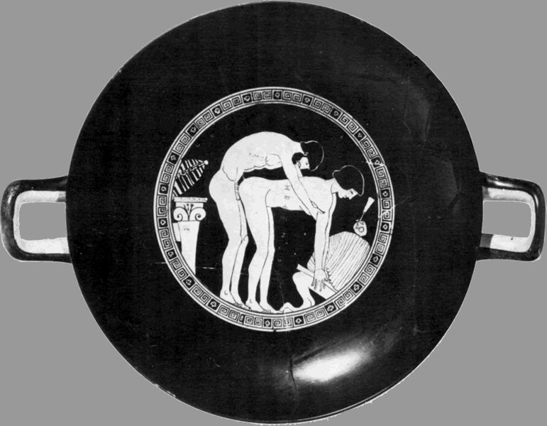
Inside of Attic Red Figure drinking cup (kylix): man/woman sexual congress.
(Man says, “Keep quiet!” or “Keep still!”)

Slide 14
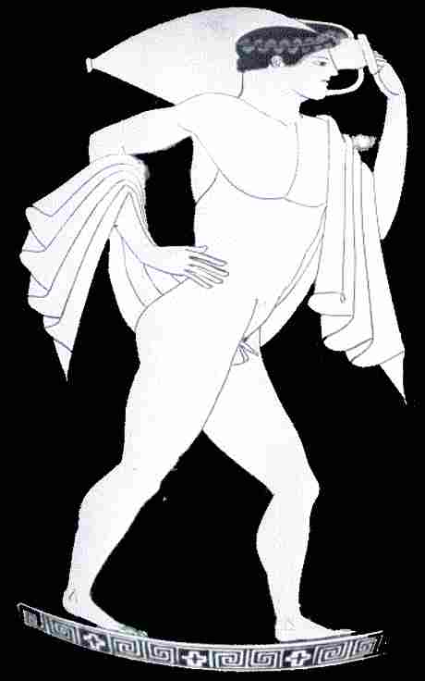

Slide 15
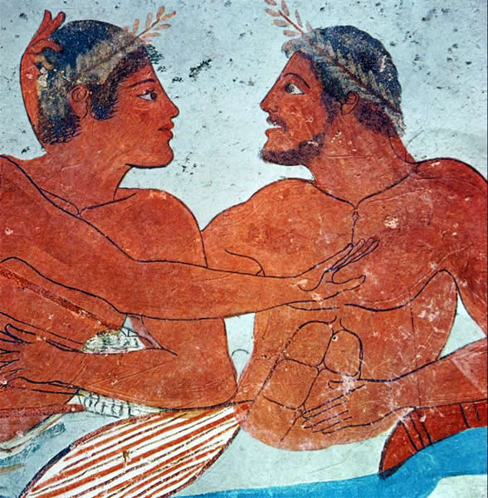

Demure rejection (?),
Paestum, Italy
Notes:
212. pseudo-demosthenes erotic essay "revolves around ... twofold superiority" over self and others.
Title Tomba del Tuffatore: North Slab: symposium scene: det.: courting couple
Tomb of the Diver Date c.480 B.C Material travertine, fresco Repository Museo archeologico nazionale (Paestum, Italy) Subject Paestum (Extinct city)
Painting--Greek: Transitional--480-450 B.C Collection The Image Gallery Source Data from: University of California, San Diego Download Size 1024,1024

Slide 16
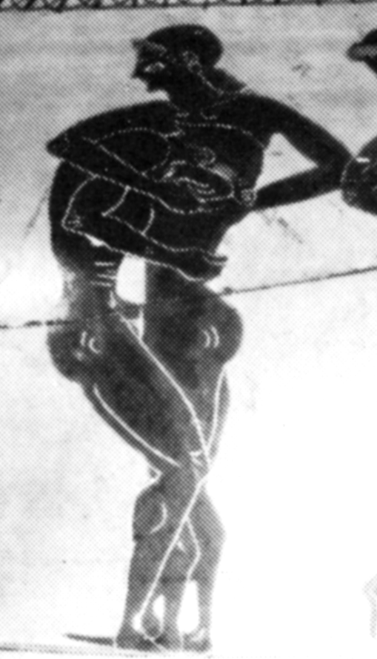
Intercrural intercourse
(archaic Attic BF vase)
Notes:
208 pseudo-demosthenes erotic essay vague of good/bad sexual actions. what leads to shame? what not?? note the reticence of text, reluctance to name. f: main thing, again, not evolved prescriptive codes, but a cultivated sense of occasion and context. the implied agon between boy and suitors - an agaon the boy must always win.
220 notes the contradiction inherent in acceptance of male homoerticism and view of sexual intercourse as all asymmetrical - the problems for the freeborn citizen male. but implies that tim actually liked the passive role.
221. "the antinomy of the boy" - the OK-ness of pederastic courtship, but non-OK-ness of passive role for future citizen male adult. necessity for boy to detach his subjectivity from the encounter.

Slide 17
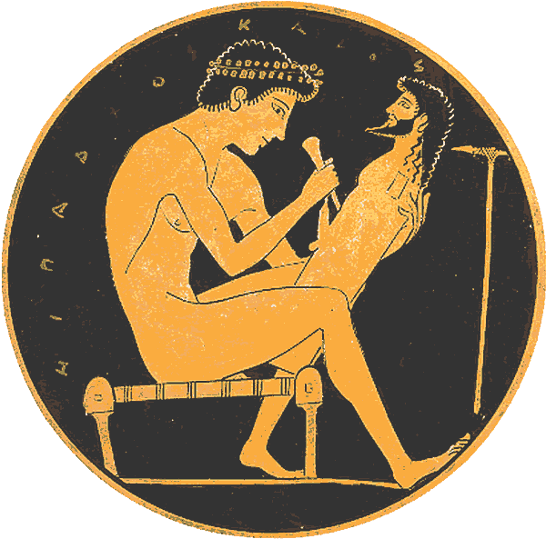
HIPPARKHOS KALOS, “Hipparchus is handsome”
Inside of drinking cup by Epictetus, ca. 510-500 BCE

Slide 18
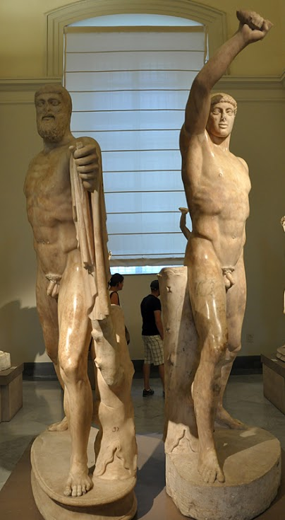
poem
Aristogeiton
Harmodius
“Tyrant-Slayers”

Slide 19
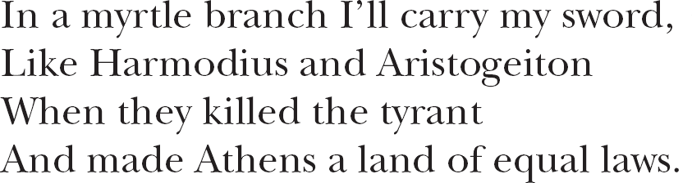
Athenian drinking song, ca. 500 BCE (??). From Hubbard Homosexuality in Greece and Rome, p. 54 #1.89.

Slide 20
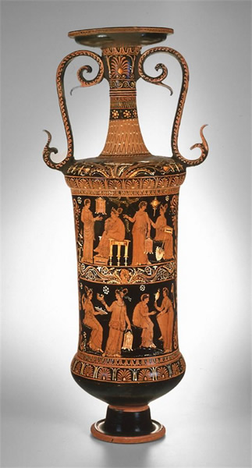
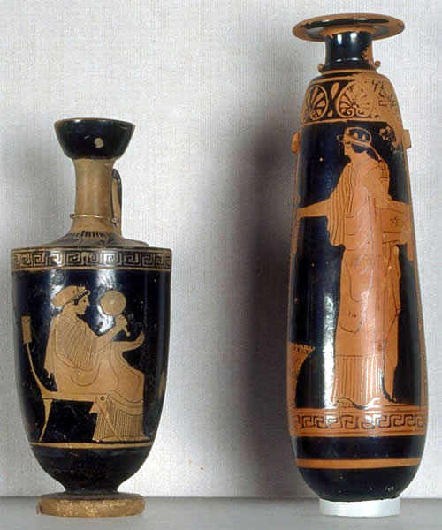
Attic Red Figure alabastra (perfume vases)
ca. 460
Loutrophoros (ritual bathing vase)
Italian Greek, 300s
Notes:
artstor
Creator Aischines Painter, European; Southern European; Greek Title Red-Figure Alabastron Work Type Decorative Arts and Utilitarian Objects
Ceramic
Jar Date circa 460 BC Material Terracotta Measurements 8 1/2 x 2 1/2 (21.6 x 6.4 cm) Repository Fine Arts Museums of San Francisco
San Francisco, California, USA
Gift of the Queen of Greece through Alma de Bretteville Spreckels
1925.346.2
http://www.thinker.org/ Collection The Image Gallery
Formerly in The AMICO Library ID Number FASF.115990 Source Data From: Fine Arts Museums of San Francisco Rights This image was provided by Fine Arts Museums of San Francisco. Contact information: Sue Grinols, Director of Photo Services & Imaging, Fine Arts Museums of San Francisco, 50 Hagiwara Tea Garden Drive, Golden Gate Park, San Francisco, CA 94118-4501, (415) 750-3602 (ph), (415) 750-7686 (fax), sgrinols@famsf.org.
artstor
Creator Greek
The Varrese Painter
Italian; act. 2nd quarter 4th cen. B.C. Europe, Italy Title Loutrophoros (Funerary Vessel)
Funerary Vessel Work Type Decorative Arts and Utilitarian Objects
Vessel Date Late Classical Period, c. 365 B.C. Material Earthenware, red-figure technique Measurements H.: 88 cm (34-3/4 in.) Description Europe, Italy, Puglia (region)
Loutrophoroi were used for ritual cleaning in the ceremonies that preceded a marriage or in funerary rites of the unmarried. This example, perforated through the bottom, served the latter function. On the shoulder, female heads, richly bedecked, appear in agitated floral settings; handles have a serpentine, dynamic shape; vertical zones of palmettes separate the scenes on front and back. At the front, scenes show moments of preparation for a marriage. The bride's entourage displays the needed paraphernalia: mirrors, a fan, jewelry, garlands, oil, and the mystical cistas (boxes or caskets with ritual implements). At the back, other female figures carrying gifts visit a tomb.
back view Repository The Art Institute of Chicago, Katherine K. Adler Fund
Chicago, Illinois, USA
1984.9
http://www.artic.edu/aic/ Collection The Image Gallery
Formerly in The AMICO Library ID Number AIC_.1984.9 Source Data From: The Art Institute of Chicago Rights Photography © The Art Institute of Chicago

Slide 21
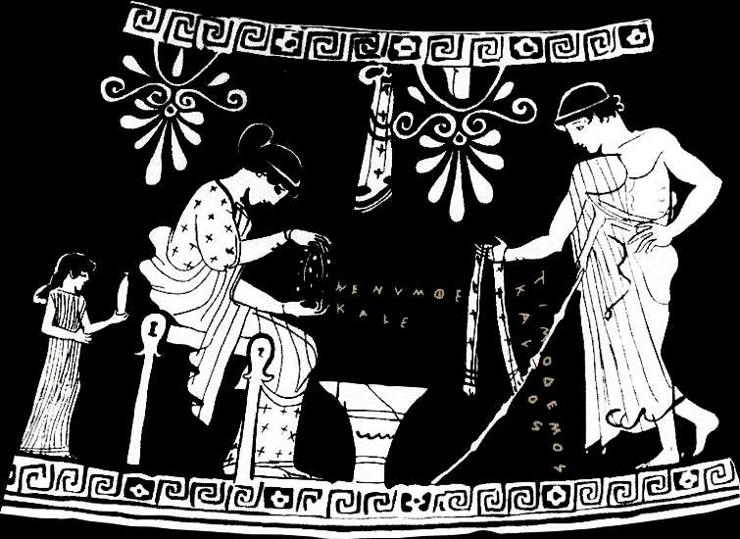
hē numphē kalē, “The bride is beautiful.”
Timodēmos kalos, “Timodemos is handsome.”
Attic Red Figure alabastron
Notes:
Scene from alabastron (small scented-oil jar, like what small girl holds), Athenian, ca. 465 BCE. Woman plaiting a wedding/courtship wreath. Youth offering fringed scarf. Woman’s inscription: hē numphē kalē, “The bride is beautiful.” Youth’s: Timodēmos kalos, “Timodemos is handsome.” I.e., kalos-inscriptions meaning “So-and-so is sexually desirable,” or “I love so-and-so.” Girl, probably a slave, brings oil likely to be used here when bride and groom consummate marriage. Sort of, then, propaganda-“pornography” promoting citizen marriage using imagery of (pederastic?) courtship.
“The emotions that sustain the city”
3. broader context: "the emotions that sustain the city ... including those related to sexuality and gender." (i.e., procreative eros???) "social patterns were manifested and maintained" in the production of cultural artifacts, including, performances, texts, and objects etc. vase painting as vector of, and factor affecting, sex/gender values. "vase painting as a medium of social communication."
Democratic transformation
male egocentric eros
matrimonial eros
3. thesis: "Over the course of two centuries, vase paintings moved from a strictly male-oriented, egocetric eroticism to one that was emotionally based, aimed in good part at a feminine audience that had previously been neglected." [i.e., that the vases were propaganda of a sort, and reflected a shift in the direction of encouraging procreative eros with a view to producing legitimate children.]
6-7. 2nd thesis statement. "The follow- | ing discussion will show how the popular, mass-produced genre (daily life) scenes on Athenian pottery of the sixth and fifth centuries B.C. help the people (dêmos) of Athens acquire the sense of corporate identity that made possible the radical democracy of the fifth century." disclaimers as to appearance of inappropriate ideological bias. simply claims of effiency on what i'd term the level of propaganda.
“Feedback response” model
3-4. the "feedback response" model as, e.g., applied to the romance novel. for ancient athens, we don't have proper audience reception data; hence we should see change in themes as change in audience expectations
evidence, argumentation
8-9. probable explanation of fall-off in scenes: change in athenian tastes and political norms. ealier vases stress release from restraint - dionysian themes. "male emotional self-expression (orgê) of various forms." relative absence of affection or even pleasure in comparison to hostility, anger. by a certain point, emergance of "male dominance and female submission." lack of female perspective.
26. 450s-430s => eros "invades" matrimonial scenes to make explicit the element of desire between man and woman. sutton's idea being that these scenes are, in a sense, meant to encourage athenian women to embrace the role as wives.
26. 450s-430s => eros "invades" (figuratively as well as thematically) matrimonial scenes to make explicit the element of desire between man and woman. sutton's idea being that these scenes are, in a sense, meant to encourage athenian women to embrace the role as wives. (but why athenian brides as the targeted audience?? shouldn't it be men??)

Slide 22
Sutton, Robert F. “Pornography and Persuasion on Attic Pottery.” Pornography and Representation in Greece and Rome. Ed. Amy Richlin. New York: Oxford University Press, 1992. 3–35.

