Slide 1
Pederasty Plus…
Sexuality, Ethnicity, Masculinity

Slide 2
Agenda
Adventures in Critical Thinking
  What Does Halperin Say?
Recap and Update
  Definitions, Theories, Practices
Pederasty
  Concepts and Terms
Choose Your Lenses
  Butler or Foucault?

Slide 3
Adventures in Critical Thinking
What Does Halperin Say?

Slide 4
What Does Halperin Say?
constructionism v. essentialism
essentialism is…
  sexuality is inherent in biological structure
  essentialists: sexuality is unchanging
constructionism is sexual categories as…
  environmentally conditioned
    social-cultural environment
    not constantly changing
Notes:
let me play devil's advocate.... SHOULD we expect ancient texts to validate the idea of biological sexuality? isn't that the job of modern science? what of the possibility that they're both right? (but they can’t both be completely in agreeent. if sexual-prederence typing is itself a built-in behavior, it should show up all over….)
but is the term “homosexual” about facts/acts or about preferences/desires? (in actual usage, it can be about both, sometimes one, sometimes, the other – often both simultaneously.)
what do you think of h's claim that if sex prefs really do have a biological cause and matter that much, then he (h) is wrong? isn't that going out on a limb?

Slide 5
The “Debate”
Essentialism
Constructionsim
Sexual categories as
  Preference-focused
  Culturally-historically constant
  Biologically determined
  Cognitively significant
Sexual categories as
  Variably focused
  Culturally-historically situated
  Socially conditioned
  Subjectively significant
David Halperin. “‘Homosexuality’: A Cultural Construct (An Exchange with Richard Schneider).” In One Hundred Years of Homosexuality (1990).

Slide 6
Recap and Update
Definitions, Theories, Practices

Slide 7
Definitions: What is…?
gender (OED on…)
sexuality (OED on…)
physical sex that a person identifies with
  subjectivity v social perception
sex v gender
  sex = biological category
  gender = social roles/associations
preference in ones taste for their desires
the essence of acknowledgement of oneself as possessing sexual desires
  left out preference
definition based on acts

Slide 8
OED on Gender
“Psychol. and Sociol. (orig. U.S.). The state of being male or female as expressed by social or cultural distinctions and differences, rather than biological ones; the collective attributes or traits associated with a particular sex, or determined as a result of one's sex. Also: a (male or female) group characterized in this way.” (OED 3.b.)

Slide 9
OED on Sexuality
“Sexual nature, instinct, or feelings; the possession or expression of these.” (2.)
“A person's sexual identity in relation to the gender to which he or she is typically attracted; the fact of being heterosexual, homosexual, or bisexual; sexual orientation.” (5.)

Slide 10
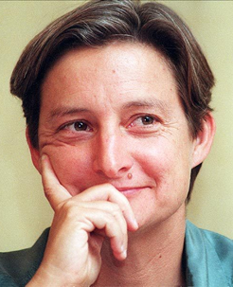
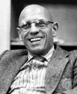
Butler / Foucault (compare/contrast)
Butler
Foucault
Performed gender/sexuality
Normativity challenged
  by deviance…
Gender/sex performance art
Normativity navigated
  by “free” actors…

Slide 11
Foucault Part 1: “Moral Problematization”
Aphrodisia (sexual pleasure)
Use (chrēsis) criteria
Natural
Need-fulfilling
Excess-vulnerable
Moderation v. excess
  enkrateia v. akrateia
  sophrosunē v. akolasia
Role criteria, timeliness (kairos)
Notes:
Aphrodisia (sexual pleasure, sex itself)
their use suggests the struggle for self-mastery, but also the effort to cultivate a higher-order beautful self-presentation.
appetites based on natural needs (epithumiai)
therefore subject to potential, but natural, excess overshooting need
therefore requiring artificial regulation where economic conditions favor
Chrēsis (“use” criteria)
moderation/excess criteria
enkrateia “self-control” / akrateia “incontinence”
sophrosunē “moderation” / akolsia “immoderation”
= an “orderliness and mostery” over need
“bad” use shooting beyond, or ignoring, need.
bad use exemplifying perverse stimulation in the absence of need
good use exhibiting victory in the struggle with self
good use employing prudence and good judgment (sophrosunē) – a beautiful self-presentation.
role criteria, timeliness
social status. seemingly few actual sex laws in classical athens, but among them, solon’s law forbidding slaves to seek pederastic liasons.
age differential criteria

Slide 12
“Sexual-Social Isomorphism”
male | ~ | female
masculine | ~ | feminine
penetrator | ~ | penetrated
active | ~ | passive
dominant | ~ | submissive
senior (in status) | ~ | junior (in status)
moderate (sōphrōn) | ~ | immoderate (akolastos)
free | ~ | slave
aka “asymmetry hypothesis”
Notes:
this schema continues what f sees as a basically struggle-based model, this time, other-directed. in the case of semi-institutionalized peerasty, the struggle, the element of inequality, potentially harmful to the socially subordinate side, especially in the case of free-citizen youths in pederasty.

Slide 13
Pederasty
Concepts and Terms

Slide 14
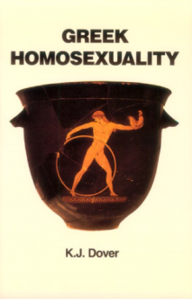
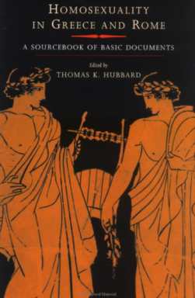
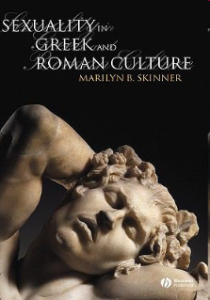
Vocabulary of Pederasty…
affect
eros
eunoia
philia
kharis
actors
erastes
eromenos
  paidika
  kalos k’agathos
  kinaidos
    euruproktos
    katapugon
values
sophrosune v. akolasia
enkrateia v. akrasia
andreia v. malakia
Notes:
eros. take the antigone. there the deviance and possible incestuous character of ant’s lust receives support from the author’s use of the noun eros and the verb eran. acc to ismene, antigone “lusts” (erais - doesn’t just “want”) to carry out impossible things. the chorus says that it is eros that has created the violent state of disorder in the oed family (clearly reference to the current state of affairs), and comments on the insanity of wanting to defy creon as literally (almost sexually) “lusting” after death. add to that ant’s treatment of her doom as a marriage with death, and her clearly powerful urge to lie next to her brother in death, not to mention issues of past family history, and butler’s somewhat controversial claim becomes at least plausible. ant doesn’t say “I want to have sex with poly,” but the text subtly implants in us the suspicion that she might – even if in her head that’s not how she sees it.
HS2 64-5. sophrosune (moderation) and its opposite akolasia (indiscipline) contrasted with enkrateia (continence) and its opposite, akrasia (incontinence, inability to control self). the virtue of the enkrates in proportion to strength of desires. sophrosune as the goal of enkrateia.

Slide 15
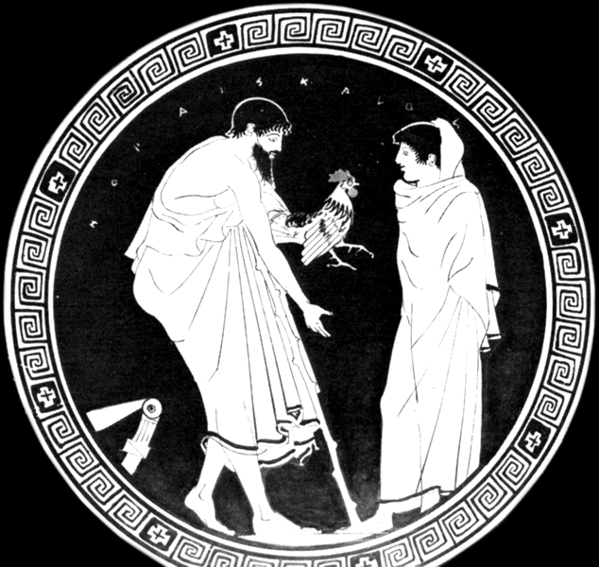
ho pais kalos,
“the boy is attractive”
Rooster gift
(Attic RF)

Slide 16
Choose Your Lenses
Butler or Foucault?

Slide 17
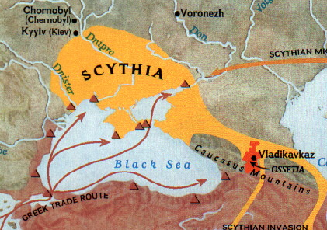
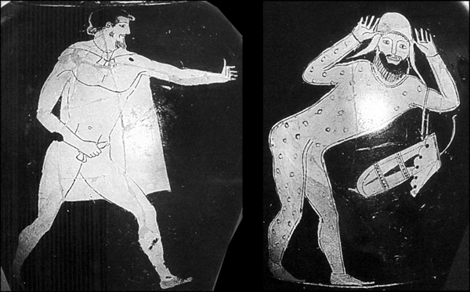
Athenian Wine Jug circa 460 BCE
Greek: “I am Eurymedon”
Scythian: “I am bent over”
Notes:
I want to ask if the reading from the Hippocratic Airs, Waters, Places evokes any of the preceding in Foucault, in particular, his “sexual-social isomorphism” scheme. I’m willing to consider the visual evidence too on the screen.
AWP = self-avowed medical-scientific treatise dealing with environmental factors in physiology, not just as relates to health but also to explaining physical and dispositional variation among various ethnic groups: greeks and non-greeks.
including a group of allegedly effeminate men scythia – men who “perform the deeds of women and talk like women.”
adduces the mythological explanation, then profers a greek-scientific explanation (“as divine as any other” cause = “natural causes”). blood-letting behind the ear to treat hip-ailments due to horse-back riding. but that interfers with the passage of semen to the genitalia. when these horsemen try but fail at intercourse with women, they (a) feel they have been punished by gods for something, (b) role-play women.
compare hdt on scythians punished with effeminacy for dishonoring a temple of aphrodite at ascalon in palestine, (b) reversed roles among the egyptians.

Slide 18
Ps-Demosthenes: Erotic Essay
Basic info
Analysis
Mid 300s (?) Athens
Anonymous
Rhetorical show piece
Prologue (“erotic part”)
Praise
Instruction
Notes:
3-part div: "erotic part," eulogy, protreptic.
erotic part = prologue + statement of aim: to prove speaker’s eunoia and win the boy’s philia.
praise includes that of boy’s “discreetness of conduct” – sophrosune.
13. “manly glance”
17-19. praise of social skills. associates widely but without reproach for vulgar association.
20. the admirers = erastai. sophronos behavior toward same.
23. andreia (“courage”), esp in athletics. applies self to honorable citizen sports (chariot racing, actually, an aristocratic sport) – conduct decorous in terms of status.
33 ff. protretic. esp. praise of philosophical study.
41. "And yet, since intelligence commands the province of speaking and deliberating, and philosophy confers facility in each of these, what reason can there be why we should refuse to get a firm grasp of this study, through which we shall become masters of both alike?“
44. cf. following: "but especially is this true of the knowledge that deals with practical affairs and political discussions.“ we’re talking about preparing epicrates for a career in public life.

Slide 19
Quotes (choose your lenses)
“[Because] most erotic compositions attach shame … to those about whom they are written, [I have] taken precautions” (1)
“… it it is of the utmost importance for young men … to possess beauty in respect of person, self-discipline in respect of soul, … manliness in respect of both, and … charm in respect of speech.” (2)
Notes:
these are rules as to the performance of gender…
at the same time, text seems very consistently to connect problematics of pederasty with publicity: the dangers esp to the reputation of the eromenos, and the consequent caution of youths to consort with pederastic admirers (erastai).
danger of shame to subject of discourse:
“Observing also that, generally speaking, most erotic compositions attach shame rather than honor to those about whom they are written, he has taken precautions that this should not happen in his case, and has written only what he says he is convinced of by his judgement, believing that an honest lover would neither do anything shameful nor request it.”
All men would agree with me, I believe, that it is of the utmost importance for young men of your age to possess beauty in respect of person, self-discipline in respect of soul, and manliness in respect of both, and consistently to possess charm in respect of speech.

