Slide 1
Born This Way?
Ideologies of eros in Plato’s Symposium

Slide 2
Journal Prompt
Does Plato's Symposium seem to validate or to undercut Foucault and/or Halperin
Notes:
journal prompt: “Does Plato's Symposium seem to validate or to undercut Foucault and/or Halperin in the matter of whether people generally have, most places and most times, understood sexuality more or less the same way? Do such modern concepts of "homosexual" or "heterosexual" apply here? How so or how not?”

Slide 3
Discussion
the aristoph myth implies an essentialist view of sexuality
they all have different views
male biased
  heavenly – nothing female
  earthly aphrod

Slide 4
Agenda
Writer’s Corner …
  Name That Mistake
Recap and Update
  Sexual “Codes” & Sexualities in Aeschines and Plato

Slide 5
Writer’s Corner …
Name That Mistake

Slide 6
Plagiarism!
wordy
ital
The Ancient Grecian play Medea caused a tremendous stir when it was first performed. The evil that I do, I understand full well,
But a passion drives me greater than my will.
dropped quote, MLA citation issues
unsubstantiated claim

Slide 7
Recap and Update
Sexual “Codes” & Sexualities in Aeschines and Plato

Slide 8
Is ____ gay?

Slide 9
Misgolas
“He is bent on that sort of thing [pederasty] like one possessed, and is accustomed always to have about him [male] singers or cithara-players” (41)
Notes:
but couldn’t he be bi? and isn’t the salient point his lack of self-control, not preference?

Slide 10
Timarchus
“Timarchus was … just the person for the thing that Misgolas wanted to do, and Timarchus wanted to have done.” (41)
“What shall we say when a young man … keeps the most expensive flutegirls and harlots? When he gambles and pays nothing himself but another man always pays for him?” (75)
Notes:
by why does tim want it?

Slide 11
Plato’s Symposium …

Slide 12
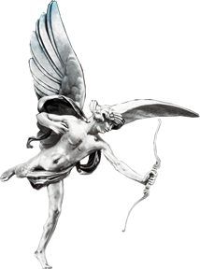
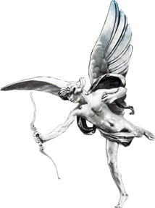
Symposium: Erotic Dichotomies
male | female
Uranian (“Heavenly”) | Pandemian (“Vulgar”)
spiritual | carnal
male-pederastic | “other” (lesbian, heteroerotic)
temperate | intemperate
asymmetrical | symmetrical

Slide 13
Symposium: Interlocking Arguments
Speaker | Speech
Phaedrus | Eros the Ancient
Pausanias | the two loves
Eryximachus | [ditto]
Aristophanes | “my other half”
Agathon | Eros the Youthful
Socrates | Eros the daimōn
Alcibiades | Socrates’ temperate intemperance
Notes:
INTRO REMARKS
This work, entitled Symposium (Greek sumposion, "drinking party"), was written ca. 380-370 BCE — that's not much better than a guess.
dramatic date: Of Agathon's drinking party: exactly 416 BCE. Of Apollodorus' recollection of it, sometime around 405.
The dramatic situation is that the tragic poet Agathon (a character in Aristophanes' Ladies' Day, which we'll be reading soon) has won the prize for tragedy; he is throwing yet another party to celebrate. (The previous night, he, his troupe, and many of the same friends went on a real bender.) Here, the main thread is a kind of party game: guests at Agathon's party have to give speeches in praise of love.
Socrates' love speech is saved for last, but there is much of interest in what precedes. Plus, there is a fascinating epilogue as the drunken Alcibiades bursts in.
ANALYSIS
larger argument
seems to be to find ways to justify/rationalize eros. all other gods praised; the deficiency in eros’s case (dangerous god, traditionally source of disease) perhaps understandable
Phaedrus, Agathon
phaedrus stresses manly, martial, self-sacrificial qualities. that stands in contrast to Agathin’s soft, delicate,yet powerful eros.
Pausanias
seeks to map out a space for a “respectable” love-madness; hence his uranian-pandemian dichotomy
Eryximachus
seems to find p’s love-dichotomy baffling. is intent on mapping out a “good” eros as a “harmonizing” force in nature, health, music.
Aristophanes, Socrates
sort of an attempt make it make sense of p for e. ar supplies a quasi-biological aetiology for p’s dichotomy, which for ar comes out as a trichotomy: male-gay, female gay, straight
but his rolly-polly people anticipate diotimean-socratic love: love as deficiency, the desire to achieve wholeness again, to reunite, in Socrates, with the idea of the good
socr seeks to reconcile p’s dichotomy: the lower love not unrelated to the higher – a carnal manifestation of the soul’s desire to be reunited with the idea of the beautiful. socially, an expression of the desire to “birth” ideas in a younger host. diotimean-pederastic eros and its metaphysical emphasis (the ladder of love) thus exhibit symmetric and asymmetrical elements related to, yet divergent from, conventional pederasty
Alcibiades
alcibiades, who undertakes to praise not eros,but socrates, poses a seemingly inane riddle: what is the most amazing thing about socrates? it is, well, that he is so amazing
socrates, it turns out, embodies a dichotomy that rather sums up much of the preceding argument: god in a satyr’s skin
yet what many find to be exasperating about socrates, his style of socratic teaching, using hackneyed comparisons, etc., turn out to be precisely the locus of his divinity
you might say that it is we who superimpose the satyr-skin on the god within
at the same time, Alcibiades fails to be wowed by Socrates’ supposedly irresistible satyr-song
in Alcibiades’ case, at least, Socratic eros, a chaste eros founded on good-will and directed toward the betterment of the love object, fails

Slide 14
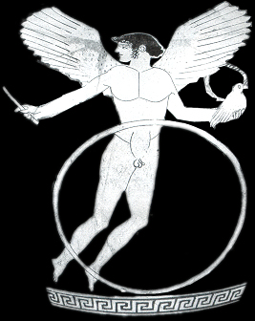
Eros as paidika (love object)
Notes:
Cosmic-Primeval (Roman silver medallion, Budin Origin fig. 2a))
In Hesiod, Eros is one of the four primeval gods
Chaos
Ge (Earth)
Tartarus (Underworld)
Eros
cosmic force: through eros, everything
“Aphrodisian Eros”
Aphrodite as mother of aspects of her sexual persona
Eros
Himeros
Pothos
Peitho
Eros as attendant spirit

Slide 15
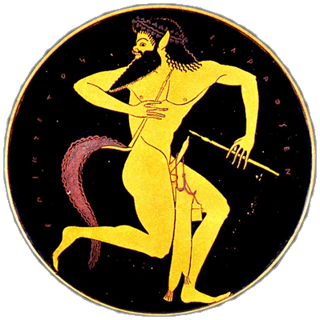
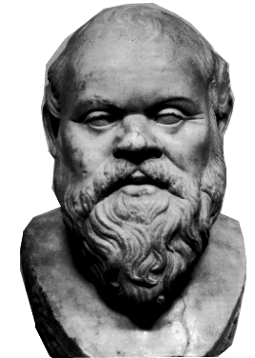
Socrates as Satyr / Silen
Socrates
Satyr with pipes and holder,
Athenian cup, Epiktetos
circa 510 BCE

Slide 16
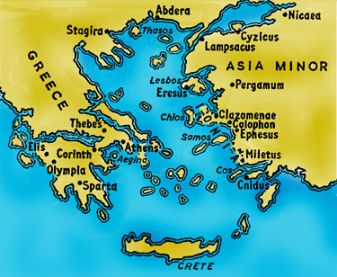
Erotic Law Codes? (Pausanias’ Speech)
Nomos =
  “Law”
  “Convention”
“Law Codes”
  Elsewhere
    Elis, Boeotia
    Ionia
  “Here”
Notes:
I want to start by recalling for you the distinction, whether simplistic or not, that f draws between medieval moral codes dealing with forbidden and alllowed acts, and the ancient greek and roman sexual morality focused not so much on the what of sex as on its how, with particular focus on more and less honorable styles.
so, lets relate that to what pausanias refers as “nomos, which our translation renders as “law” and “code” (law code).
question: is paus thinking in terrms of licit and illicit (which would tend to challenge what f thinks) or something else?
nomos
“law”
“convention”
“Law Codes”
ἐν ῎Ηλιδι μὲν γὰρ καὶ ἐν Βοιωτοῖς, καὶ οὗ μὴ σοφοὶ λέγειν, ἁπλῶς νενομοθέτηται καλὸν τὸ χαρίζεσθαι ἐρασταῖς, καὶ οὐκ ἄν τις εἴποι οὔτε νέος οὔτε παλαιὸς ὡς αἰσχρόν, ἵνα οἶμαι μὴ πράγματ᾽ ἔχωσιν λόγῳ πειρώμενοι πείθειν τοὺς νέους, ἅτε ἀδύνατοι λέγειν· τῆς δὲ Ἰωνίας καὶ ἄλλοθι πολλαχοῦ αἰσχρὸν νενόμισται, ὅσοι ὑπὸ βαρβάροις οἰκοῦσιν. τοῖς γὰρ βαρβάροις διὰ τὰς τυραννίδας αἰσχρὸν τοῦτό γε καὶ ἥ γε φιλοσοφία καὶ ἡ φιλογυμναστία (182b–c)
“… while in all the other states of Hellas the laws that deal with love are so simple and well defined that they are easy enough to master, our own code is most involved” (p. 536)
Elsewhere
Elis, Boeotia
“In Elis and Boeotia, for instance, and wherever else the peoplel are naturally inarticulate, it has been definitely ruled that it is right for the lover to have his way”
Ionia
“On the other hand, in Ionia and many other countries under oriental rule, the very same thing is held to be disgraceful. Indeed, the oriental thinks ill not only of love but also of philosophy and sport, on account of the despotism under which he lives.”
“Here” (i.e., at Athens)
the “law” (“custom”?) is complex (i.e., not simpl good or bad but a mix of good and bad)
to be forebearant as regards the somewhat embarassing plight of the lover – his “slavery” to overpowering passion
to judge the actions of lovers and beloveds to the extent that they reflect honorably upon both classes
as to whether philia, “friendly feeling” is formed (love of soul), a feature of “heavenly” eros (socially committed love affair)
or whether lover seeks momentary pleasure, beloved, monetary gain, a feature of “vulgar” or “earlthly” eros (mutually exploitative love affair)
again: is paus thinking in terrms of licit and illicit (which would tend to challenge what f thinks) or something else?

Slide 17
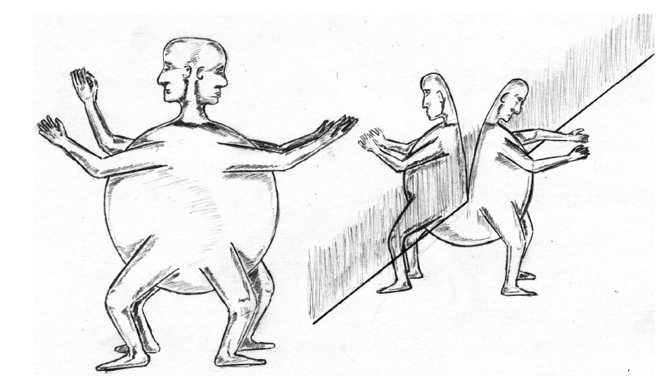
Aristophanes’ Myth
Essentialist or Constructionist?
Notes:
on the face of it, arisophanes seems to elaborate a scheme that clashes with what f would have us understand as ancient greek notions of desire: “To the Greek way of thinking, what made it possible to desire a man or woman was simply the appetite that nature had implanted in a man’s heart for ‘beautiful’ human beings” (Foucault HS II)
but does it? couldn’t aristophanes maybe be outlining – perhaps performing – a social script that is replicated in the manner butler envisions for gender ID?
“Men who are slices of the male are followers of the male, and show their masculinity throughout their boyhood by the way they make friends with men, …” [aristophanes describes “available” eromenoi, like alcibiades] “I know there are some people who call them shameless, but they are wrong. it is not immodesty that leads them to such pleasures, but daring, fortitude, and masculinity – the very virtues that they recognize and welcome in their lovers – which is proved by the fact that in after years they are the only men who show any real manliness in public life. and so, when they themsleves have come to manhood, their in trun is lavished upon boys.” [aristophanes seems to be invoking foucauldian notions of peerastic honor maybe with a comic twist [the dishonorable as honorable], but he’s also still devleoping his idea in terms of innate sexual preference]

Slide 18
Butler on Social Construction
“To publish one’s act in language is in some sense the completion of the act” (Butler AC)
"... gender [but maybe sexuality too?] is an act which has been rehearsed, much as a script … requires individual actors” (“Performative Acts,” in Performing Feminisms 1990)
http://www.cla.purdue.edu/english/theory/genderandsex/modules/butlerperformativity.html
Notes:
"Within speech act theory, a performative is that discursive practice that enacts or produces that which it names" (Bodies that matter 13)
"... gender is an act which has been rehearsed, much as a script survives the particular actors who make use of it, but which requires individual actors in order to be actualized and reproduced as reality once again" ("Performative Acts," Performing Feminisms 1990)

Slide 19
Is Diotimian erōs Pederasty?
And is it honorable?
Notes:
or is it philsophy, or philosophical pederasty? to what degree can we view it as conventional pederasty? at which point does its philosophical character interfer with the foucauldian model?
489 ff. acc. to diotima, love is wanting the good forever. purpose of love: "giving birth to beauty, whether in body or in soul." procreation as the model for all sexuality, homo- or heteroerotic. "All of us are pregnant, Socrates, both in body and in soul, and as soon as we come of age, we naturally desire to give birth." Love is drawn to beauty, b/c beauty is closer to the divine. What love ultimately desires is immortality through reproduction.
490 ff. our material and spritual substance constantly changes and is renewed. so too our knowledge. for mortals, constant renewal is the only available means to duration and preservation, our substitute for immortality. so ambition is a form of this eros for immortality, and so on. a higher kind of preservation, undying glory, is the aim of heroic self-sacrifice. note the analogical reasoning: from biological-procreative attraction to homoerotic attraction to philosophical attraction. the idea here is the student's desire - eros - for a teacher. that certainly introduces an element of symmetry and reverses the usual pattern. from the perspective of conventional pederasty, this is all backwards. so the teacher is a birther, like a midwife.
492 ff. the ladder of love. diotima is talking about what we would call the acculturaltion and education of the boy, the beloved, the eromenos. but it leads, ultimately, not to an honorable role in society, but to philosophical illumination. and this eromenos is actuated by his own eros, and kind pregnancy or concupiscence for wisdom. the lover ultimately yearns for the beautiful itself, the form of beauty, something immortal and unchanging. desire for beauty itself gives birth no longer to images of virtue but to virtue itself.
we see an example of the pupil desiring the teacher – the eromenos desiring the erastes – in alc. but the beauty/ugliness, shame/honor paradoxes there complicate things…

