Slide 1
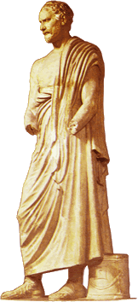
Aeschines’ Against Timarchus
Is Timarchus “Gay”?
Demosthenes

Slide 2
Timarchus’ “Crime”: Resonates Today?
Timarchus “guilty” because:
“… the man who has made traffic of the shame of his own body, [is] ready to sell the common interests of the city also” (29)
Notes:
Would you agree/disagree with the notion that there is a connection between sexual, financial, and political patterns of behavior, as Aeschines (author of the speech) would seem to want us to think? (See especially dokimasia rhetoron, below.) Does that apply to our times as much as to any other time or place? Or is it a cultural construction?
aeschines explaining the rationale behind the self-prostitution clause of the dokimasia rhetoron law.

Slide 3
Does That Resonate Today?
we punish people for their private lives
  we’d expect an explanation/apology
  we’re also very forgiving
past/present: people care about if their being lied to
  sincerity thing

Slide 4
Agenda
Paper Chase
  Academic Honesty
Recap
  Foucault and Pederasty
Aeschines’ Against Timarchus
  Speech and Ideologies
Adventures in Critical Thinking
  Is ____ “gay”?

Slide 5
Paper Chase
Academic Honesty

Slide 6
Recap
Foucault and Pederasty

Slide 7
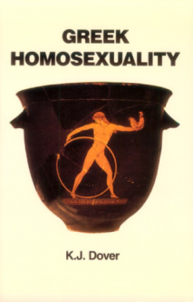
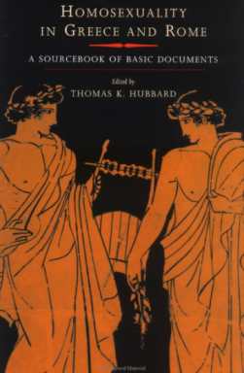
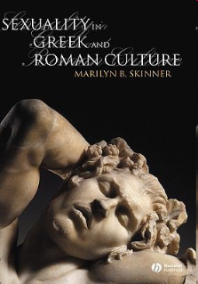
Vocabulary of Pederasty…
affect
eros
epithumia
philia
actors
erastes
eromenos
  paidika
  kalos k’agathos
  kinaidos
    euruproktos
    katapugon
values
sophrosune v. akolasia
enkrateia v. akrasia
andreia v. malakia
Notes:
to state this in foucauldian terms: classical athens, like the modern west, had discourses of sexual subjectivity. these discourses exercised power over individuals. they defined the parameters of identity, a social potent realm. modern parameters: sexuality mostly in terms of sexual preference (especially as a psychiatric diagnosis). classical athenian males (note narrowness of applicability): sexual self-control and moderation as one axis of larger issues of self-control and moderation – degree of success in achieving. the need to win the battle over self and desires in order not to come across socially as a loser.
honor/shame versus guilt/innocence, within a basically masculinist schema, as shown il f’s “sexual-social isomorphism” equivalent good/bad pairings. question: does that apply to the moral systems invoked in aeschines’ against timarchus?
HS2 64-5. sophrosune (moderation) and its opposite akolasia (indiscipline) contrasted with enkrateia (continence) and its opposite, akrasia (incontinence, inability to control self). the virtue of the enkrates in proportion to strength of desires. sophrosune as the goal of enkrateia.
biblio
Dover, K. J. Greek Homosexuality. 2 ed. Cambridge, Mass., 1989.
Hubbard, Thomas K., ed. Homosexuality in Greece and Rome: A Sourcebook of Basic Documents. Berkeley: University of California Press, 2003.
Skinner, Marilyn B. Sexuality in Greek and Roman Culture. Malden, MA: Blackwell, 2005.

Slide 8
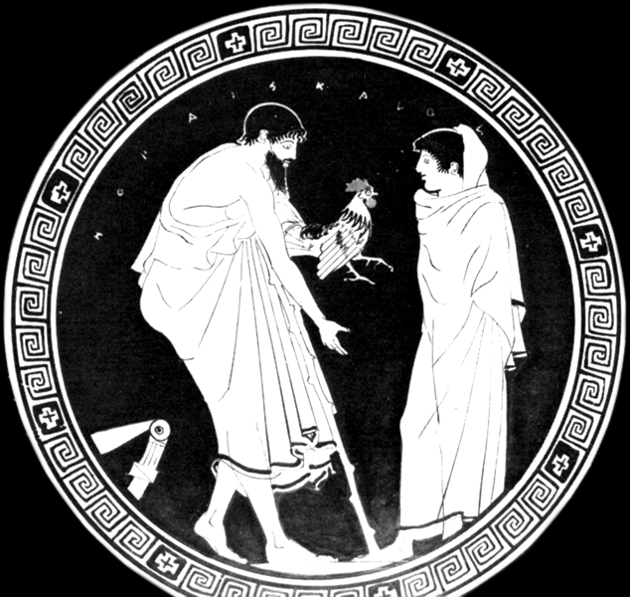
ho pais kalos,
“the boy is attractive”
Rooster gift
(Attic RF)

Slide 9
Aeschines’ Against Timarchus
Speech and Ideologies

Slide 10
Speech: Analysis
Introduction (1-6)
  Democracy and law
Laws (7-36)
  Various legislation
  Dokimasia rhētorōn
Narration (37-70)
  Timarchus’
    sexual career
    financial mismanagement
Proofs (71-192), including…
  erōs dikaios (“just lust”) v. porneia (“prostitution”)
Conclusion (193-196)

Slide 11
Dokimasia rhētorōn
Sanctioned act: assembly speech +
  Parental abuse
  Military dereliction
  Self-prostitution
  Inheritance squandering
Process: jury trial
Penalty: loss of political rights
Notes:
jury: In civil cases a dikasterion of 201 or (if the value of the dispute was over a thousand drachmas) 401 jurors was chosen by lot, in political trials 501 to 2,501 jurors are attested, and once even 6,000. (brills)

Slide 12
(Alleged) Rationale
“… the man who has made traffic of the shame of his own body, [is] ready to sell the common interests of the city also” (29)
Notes:
or who has beaten his parents, or spent through his inheritance, or deserted his military post

Slide 13
“Sexual-Social Isomorphism” Cont’d
masculine | ~ | feminine
moderate (sōphrōn) | ~ | immoderate (akolastos)
chaste beloved | ~ | whore (pornos)
hero | ~ | coward
thrifty | ~ | spendthrift
patriot | ~ | traitor
aka “asymmetry hypothesis”
Notes:
that allows us to add a few pairings to f’s schema. note that this isn’t just an uninformative good/bad set of contrasts. even with the additions, it still revolves around the association of self-control and moderation with masculine values, the opposite with failed masculinity, which in the sexist discourse of the time could be equated with effeminacy.

Slide 14
Sin?
“… on the one side men who have been loved with a chaste love, and on the other men who sin against themselves…” (156)
sōphrosunē versus hamartia

Slide 15
Adventures in Critical Thinking
Is ____ “gay”?

Slide 16
Misgolas
“He is bent on that sort of thing [pederasty] like one possessed, and is accustomed always to have about him [male] singers or cithara-players” (41)
Notes:
but couldn’t he be bi? and isn’t the salient point his lack of self-control, not preference?

Slide 17
Timarchus
“Timarchus was … just the person for the thing that Misgolas wanted to do, and Timarchus wanted to have done.” (41)
“What shall we say when a young man … keeps the most expensive flutegirls and harlots? When he gambles and pays nothing himself but another man always pays for him?” (75)
Notes:
by why does tim want it?

