Slide 1
50/50?
Marriage, Gender, and Reciprocity in Xenophon’s Oeconomicus

Slide 2
Agenda
Art, Concluded
  Sexual Values, a Democratic Transformation?
Xenophon’s Oeconomicus
  Introduction
  Sequestration of the Sexes
    Actuality or Social Fiction?
  Sex and the Married Woman
    Do/How do eros and Marriage Mix?
  (Un)equal Partnership?
    Marriage and Gender Roles in Oeconomicus

Slide 3
Art, Concluded
Sexual Values, a Democratic Transformation?

Slide 4
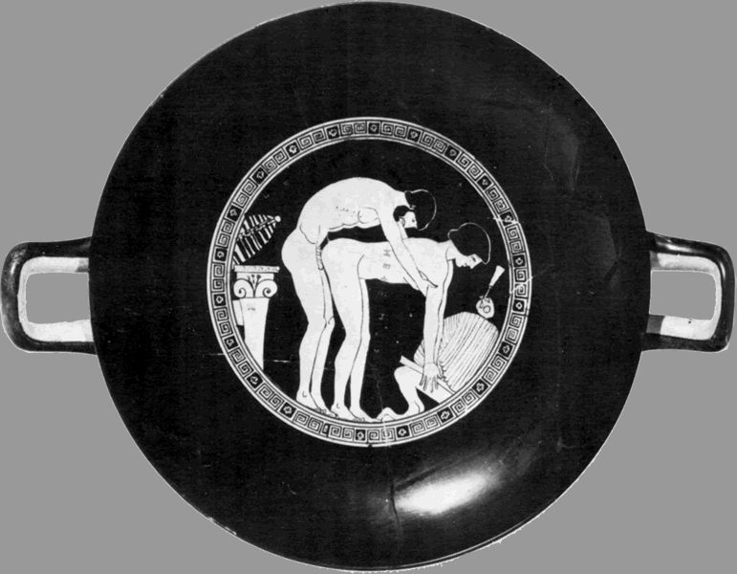
Inside of Attic Red Figure drinking cup (kylix): man/woman sexual congress.
(Man says, “Keep quiet!” or “Keep still!”)

Slide 5
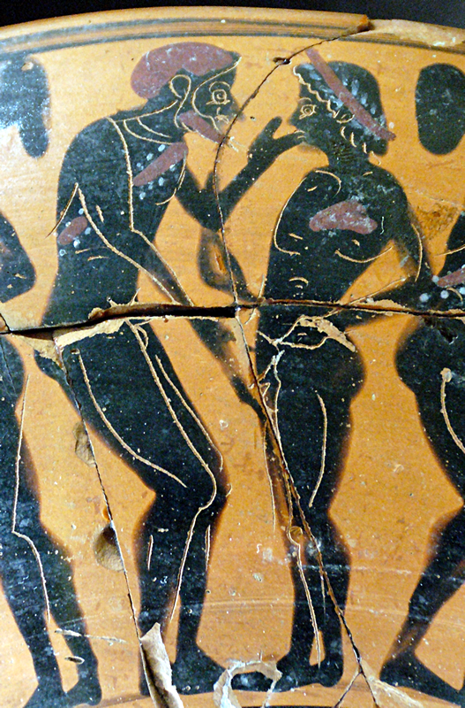
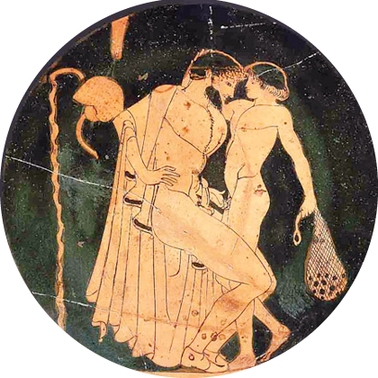

Slide 6
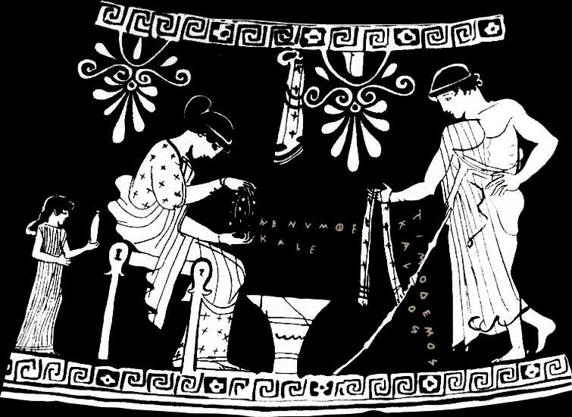
hē numphē kalē, “The bride is beautiful.”
Timodēmos kalos, “Timodemos is handsome.”
Attic Red Figure alabastron
Notes:
Scene from alabastron (small scented-oil jar, like what small girl holds), Athenian, ca. 465 BCE. Woman plaiting a wedding/courtship wreath. Youth offering fringed scarf. Woman’s inscription: hē numphē kalē, “The bride is beautiful.” Youth’s: Timodēmos kalos, “Timodemos is handsome.” I.e., kalos-inscriptions meaning “So-and-so is sexually desirable,” or “I love so-and-so.” Girl, probably a slave, brings oil likely to be used here when bride and groom consummate marriage. Sort of, then, propaganda-“pornography” promoting citizen marriage using imagery of (pederastic?) courtship.
“The emotions that sustain the city”
3. broader context: "the emotions that sustain the city ... including those related to sexuality and gender." (i.e., procreative eros???) "social patterns were manifested and maintained" in the production of cultural artifacts, including, performances, texts, and objects etc. vase painting as vector of, and factor affecting, sex/gender values. "vase painting as a medium of social communication."
Democratic transformation
male egocentric eros => matrimonial eros
3. thesis: "Over the course of two centuries, vase paintings moved from a strictly male-oriented, egocentric eroticism to one that was emotionally based, aimed in good part at a feminine audience that had previously been neglected." [i.e., that the vases were propaganda of a sort, and reflected a shift in the direction of encouraging procreative eros with a view to producing legitimate children.]
6-7. 2nd thesis statement. "The follow- | ing discussion will show how the popular, mass-produced genre (daily life) scenes on Athenian pottery of the sixth and fifth centuries B.C. help the people (dêmos) of Athens acquire the sense of corporate identity that made possible the radical democracy of the fifth century." disclaimers as to appearance of inappropriate ideological bias. simply claims of effiency on what i'd term the level of propaganda.
“Feedback response” model
3-4. the "feedback response" model as, e.g., applied to the romance novel. for ancient athens, we don't have proper audience reception data; hence we should see change in themes as change in audience expectations
evidence, argumentation
8-9. probable explanation of fall-off in scenes: change in athenian tastes and political norms. ealier vases stress release from restraint - dionysian themes. "male emotional self-expression (orgê) of various forms." relative absence of affection or even pleasure in comparison to hostility, anger. by a certain point, emergance of "male dominance and female submission." lack of female perspective.
26. 450s-430s => eros "invades" matrimonial scenes to make explicit the element of desire between man and woman. sutton's idea being that these scenes are, in a sense, meant to encourage athenian women to embrace the role as wives.
26. 450s-430s => eros "invades" (figuratively as well as thematically) matrimonial scenes to make explicit the element of desire between man and woman. sutton's idea being that these scenes are, in a sense, meant to encourage athenian women to embrace the role as wives. (but why athenian brides as the targeted audience?? shouldn't it be men??)

Slide 7
Cantarella, Eva. Bisexuality in the Ancient World. Trans. Cormac O'Cuilleanain. 2 ed. New Haven and London: Yale University Press, 2002. Print.
Dover, K. J. Greek Homosexuality. 2 ed. Cambridge, Mass., 1989.
Hubbard, Thomas K. “Popular Perceptions of Elite Homosexuality in Classical Athens.” Arion 6 (1998): 48–78. [Reconsideration of Dover, Foucault, Halperin.]
Sutton, Robert F. “Pornography and Persuasion on Attic Pottery.” Pornography and Representation in Greece and Rome. Ed. Amy Richlin. New York: Oxford University Press, 1992. 3–35.

Slide 8
Xenophon’s Oeconomicus
Introduction

Slide 9
Text/Author Facts
Xenophon the Athenian
  ca. 430 to ca. 349 BCE
Oeconomicus
  Socratic dialogue
  themes
    kalokagathia
    enkrateia
    oikonomia
    kosmos
For Xenophon, Ps-Demosthenes:
Foucault, Michel. “Part Three. Economics.” Trans. Robert Hurley. The History of Sexuality. Volume 2: The Use of Pleasure. New York: Pantheon Books, 1978. 141–84. Print.
Notes:
Xenophon the Athenian
ca. 430 to ca. 349 BCE
Oeconomicus
Socratic dialogue
themes
kalokagathia
85. the honorable tekhnai.
96. i.e., isch has a manly tan.
97. isch boasts of capable wife such that he does not need to spend life indoors. hence a good wife as necessary accoutrement to kalokagathia.
enkrateia
75. on the purchase of a prostitute as potentially harmful to mental, physical, financial condition. comparison to a drug that drives one mad. v. proper use of friends. conflates pleasure addiction with malakia etc. - equates with bad household management. slavery to pleasure etc.
77. ff. socr's paradox of his wealth and cr's povery. implies a degree of extravagance on cr's part.
oikonomia
structure
intro (Socrates, Critobulus)
main body (Socrates, Ischomachus)
education of wife
99. more on the purpose of hetero- marriage: perpetuation of species, support in old age, each partner to complement the other materially (men, production; women, management, child-care, clothes, cooking). natural-kind explanation of the differences of sexes, for the two sorts of work.
100. women naturally inclined to love chidren more. women more timid. "memory and power of attention," temperance, equally distributed. 7.27. καὶ τὸ ἐγκρατεῖς δὲ εἶναι ὧν δεῖ εἰς τὸ μέσον ἀμφοτέροις κατέθηκε. "The power of being temperate also in what is necessary he has conferred in equal measure upon both, and has allowed that whichsoever of the two is superior in this virtue, whether the man or the woman, shall receive a greater portion of the benefit arising I from it.“
7.30. συνεπαινεῖ δέ, ἔφη φάναι, καὶ ὁ νόμος αὐτά, συζευγνὺς ἄνδρα καὶ γυναῖκα· καὶ κοινωνοὺς ὥσπερ τῶν τέκνων ὁ θεὸς ἐποίησεν, οὕτω καὶ ὁ νόμος <τοῦ οἴκου> κοινωνοὺς καθίστησι. '" The law, too," I told her,' he proceeded,'" gives its approbation to these arrangements, by uniting the man and the woman; and as the divinity has made them partners, as it were, in their offspring, so the law ordains them to be sharers in household affairs."
farming
the art of ruling

Slide 10
Sequestration of the Sexes
Actuality or Social Fiction?
Notes:
we have at various points discussed the issue of the supposed separation - or sequestration - of the sexes in classical greek, esp. athenian - households, a point that is supported by several bits of literary evidence, including some from the work read for today.

Slide 11
“I pointed out to her also the situation of the apartment for the females, separated from that of the men by a door fastened with a bolt, that nothing improper may be taken out, and that the servants may not have children without our knowledge...”
(Oeconomicus p. 109)
Notes:
ischomachus in xenophon’s oec is recounting to socrates conversations he has had with his unnamed wife. in the course of that, he remarks:
I pointed out to her also the situation of the apartment for the females, separated from that of the men by a door fastened with a bolt, that nothing improper may be taken out, and that the servants may not have children without our knowledge
that, along with passages like one from a murder trial speech by lysias (a speech in which we hear about a house whose women’s quarters, the gunaikonitis, occupies, so it seems, the second floor of the speaker’s house), suggests a discrete part of the typical house of a propertied classical athenian man as set aside for the women residing there. the impression we are left with by these passages is that athenians, at least if they could afford it, sought to sequester their women in a part of the house to which only those women plus their male kin could have access. why? evidently, as has been proposed for similar housing arrangements in other cultures, to prevent access to those women by men not the master of the house or his close kin, and thus to insure the legitimacy of the master’s supposed children, and along with that, his masculine honor.
that explanation was for long accepted by classical scholars; it informs, for instance, a study as important as pomeroy’s book on ancient greek women: Goddesses, Whores, Wives, and Slaves: Women in Classical Antiquity, originally published in 1974.
but, as has been pointed out in studies more recent than that, the literary sources uniformaly reflect a male perspective and pursue very androcentric rhetorical aims. we have, therefore, reason to question those conclusions, and related ideas about the rigid seclusion of women to the domestic sphere.

Slide 12
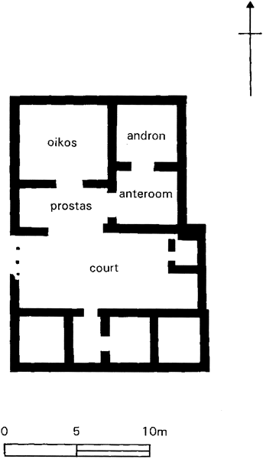
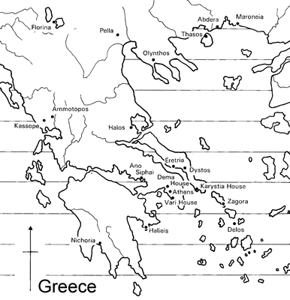
Greek House: Abdera, Thrace (300s BCE)
Abdera
Athens
entrance
Nevett, Lisa C. House and Society in the Ancient Greek World. New studies in Archaeology. Cambridge and New York: Cambridge University Press, 1999.
Notes:
more recently, lisa nevett has looked into the question using archaeological evidence.
now, she has not been able to confirm or refute the conclusions of pomeroy and others, nor has she proposed a definitive interpretation for passages like the one just quoted.
she has, however, in examining the evidence for classical greek houses from a variety of places throughout the ancient greek world, noticed patterns allowing her to offer a more nuanced interpretation of our quote.
what she proposes is that classical greek houses probably did not feature discrete and well defined spaces exclusive to each of the two sexes, or at least one, a women’s quarters, from which non-kin men ordinarily would have been excluded, whether by a heavily bolted door or otherwise.
rather, what she tends to see is the oikia , the ouse itself, as space over which access was controlled by the householder, and to which access would be granted to outsiders in controlled ways.
a lot of this has to do with the andron, a room first and foremost associated, as its name suggests, with men’s socializing - the symposium.
in several of the houses for which the evidence is good, it seems that guests would likely be admitted immediately to the open court, really, the heart of the ancient greek house, and a space offering direct or indirect access to other spaces within.
this guest - we’re assuming a male guest - would then be conducted to the andron, whose placement and access in effect could cut it off from the rest of the house.
in effect, that andron became for the duration of a symposium, an exclusive space for male merry-makers and their entertainers of whatever sex, and the rest of the house, a kind of off-limits space. we’ll actually see something like in euripides’ alcestis.

Slide 13
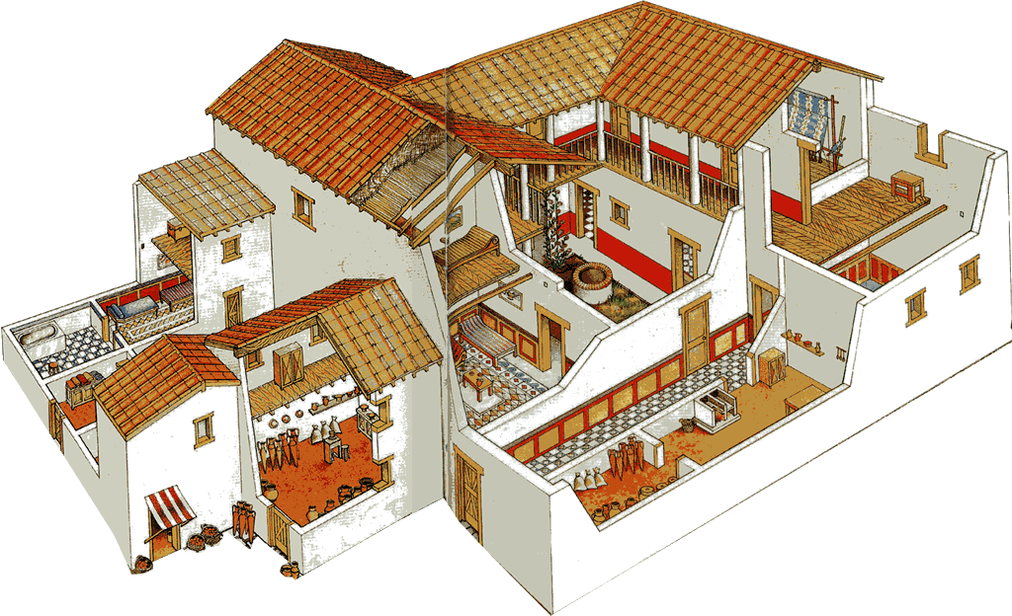
andron
Greek House (oikia), Olynthus, 4th cent. BCE (reconstruction)
Notes:
otherwise, however, the rest of the house will have been accessible to occupants of both sexes, and rooms evidently put to multiple use, including perhaps the andron.
thus we see no strict sequestration of women any more than we see them excluded from space external to the houses in which they lived. indeed, we have good reason to believe that, the farther down the socio-economic ladder one went, the greater the likelihood that the women of the house would have had to participate in breadwinning outside its walls.
at the same time, the ideology of sequestration remained strong - not wholly a social fiction, though an idea that derived strength from the prestige it lent to the well-to-do householder.

Slide 14
Sex and the Married Woman
Do/How do eros and Marriage Mix?

Slide 15
Two Quotes…
“We [Athenian men] have prostitutes for the sake of pleasure, concubines for meeting our bodily needs day-to-day, but wives for having legitimate children” (Against Neaera p. 191)
“Seeing her … painted over … that she might appear still fairer than she really was…, ‘Tell me,’ said I, ‘…should I seem, as an intimate associate, more worthy of your love, if … I should take care … that it be healthy and strong, … or if … I should paint myself with vermilion…?’ ”* (Oec. p. 112)
* Larger context has to do with sharing of bodies, i.e., to sex.
Notes:
does quote 2 validate or challenge quote 1?
(is marriage is erotic for x’s ischomachus, isn’t its eroticism still instrumental in seeking the good of the household? i.e., doesn’t this at some level validate the ideology enunciated in ps-D?)

Slide 16
(Un)equal Partnership?
Marriage and Gender Roles in Oeconomicus

Slide 17
Quotes
“ ‘… is there any one to whom you intrust a greater number of important affairs than to your wife?’ … ‘And is there any one with whom you hold fewer discussions…?’ ” (Socrates to Critobulus, p. 84)
“ ‘The law, too, … gives its approbation …; and as the divinity has made them partners … in their offspring, so the law ordains them to be sharers (koinonoi) in household affairs’ ” (Ischomachus, p. 100)
Notes:
77. ff. socr's paradox of his wealth and cr's povery. implies a degree of extravagance on cr's part.
“ ‘The law, too, … gives its approbation …; and as the divinity has made them partners … in their offspring, so the law ordains them to be sharers in household affairs’ ” (p. 100)
7.30. συνεπαινεῖ δέ, ἔφη φάναι, καὶ ὁ νόμος αὐτά, συζευγνὺς ἄνδρα καὶ γυναῖκα· καὶ κοινωνοὺς ὥσπερ τῶν τέκνων ὁ θεὸς ἐποίησεν, οὕτω καὶ ὁ νόμος <τοῦ οἴκου> κοινωνοὺς καθίστησι.
85. "But I consider that a wife, who is a good partner in household management, has equal influence with her husband for their common prosperity. Resources come into the house for the most part by the exertions of the husband, but the larger portion of them is expended under the management of the wife, and, if affairs be well ordered, the estate is improved; but if they are conducted badly, the property is diminished." 3.15. νομίζω δὲ γυναῖκα κοινωνὸν ἀγαθὴν οἴκου οὖσαν πάνυ ἀντίρροπον εἶναι τῷ ἀνδρὶ ἐπὶ τὸ ἀγαθόν. ἔρχεται μὲν γὰρ εἰς τὴν οἰκίαν διὰ τῶν τοῦ ἀνδρὸς πράξεων τὰ κτήματα ὡς ἐπὶ τὸ πολύ, δαπανᾶται δὲ διὰ τῶν τῆς γυναικὸς ταμιευμάτων τὰ πλεῖστα.
102-103. "But you will experience the greatest of pleasures, if you show yourself superior to me, and render me your servant, and have no cause to fear that, as life advances, you may become less respected in your household, but may trust that, while you grow older, the better consort you prove to me, and the more faithful guardian of your house for your children, so much the more will you be esteemed by your family. For what is good and honourable," I added, " gains increase of respect, not from beauty of person, but from merits directed to the benefit of human life." 7.42. τὸ δὲ πάντων ἥδιστον, ἐὰν βελτίων ἐμοῦ φανῇς, καὶ ἐμὲ σὸν θεράποντα ποιήσῃ, καὶ μὴ δέῃ σε φοβεῖσθαι μὴ προϊούσης τῆς ἡλικίας ἀτιμοτέρα ἐν τῷ οἴκῳ γένῃ, ἀλλὰ πιστεύῃς ὅτι πρεσβυτέρα γιγνομένη ὅσῳ ἂν καὶ ἐμοὶ κοινωνὸς καὶ παισὶν οἴκου φύλαξ ἀμείνων γίγνῃ, τοσούτῳ καὶ τιμιωτέρα ἐν τῷ οἴκῳ ἔσει.

Slide 18
Question
Is there an ideology (Butler would call it a “script”) of partnership or parity in Ischomachus’ house? Of inequality?
  Speech acts validating same?
Notes:
Is there an ideology (Butler would call it a “script”) of partnership in Ischomachus’ house? Speech acts validating same?
the wife's praying arguably suggests her speech acts of commitment to a script that isch will deliver to her. (pp. 97-98)
p. 98: emphasis on pooling of resources. emphasis on property, on shared interests. an interlacing of parity and partnership with inequality. the wife as koinonos. husband brings in resources. wife tends to spend them (p. 85).
the physical house as analogue to social structure of inhabitants: everything in its proper place, husband vis-à-vis wife, wife vis-à-vis slaves. stress on the aesthetic value assigned to order – to kosmos. to inequality?
Female norms:
but the wife is male-like in the exercise of administrative duties in the house: the wife as nomophulax. then, wife as inspector general of army. as boule, as a queen (110). “manly understanding” (112 - ἀνδρικήν γε ἐπιδεικνύεις τὴν διάνοιαν τῆς γυναικός. "nobleness of mind" = her swift obedience). i.e., husband is to wife as wife is to slaves. fits into the “isomorphic structuring” mapped out by fouc.: male:female :: masculine:feminine :: outside:inside :: tan:fair. what’s ok for a woman isn’t for a man: p. 85, the honorable tekhnai. versus bausanikai. latter indoor and effeminizing, unliberal, uncivic, antisocial.
>> note the essentialist view. it is arguably a culturally constructed view. women as indoors, men as out. women as more loving of children that men. [complementary abilities, rolls.] one way to think about these ideologies is this. they pretend to be descriptive but are in fact prescriptive. they are scripts laying out in advance what's to happen. normative inequality justified aesthetically, that which is kosmion, that which is prepon.

