Slide 1
Chapter 5
GRK 101

Slide 2
Announcements
New course, “Myths of the Olympians”
Tutor!! Olivia Condos
  Works with University Tutoring Services
  Starfish contact? I’d email her @ ocondos1@binghamton.edu

Slide 3

Ὁ λύκος, “The Wolf”
Oral Greek...

Slide 4
Contract Verbs in -α: ὁράω, “I see” (stem: ὁρα-)

Slide 5
Contract Verbs in -α: ὁράω, “I see” (stem: ὁρα-)

Slide 6


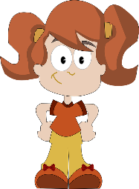
Vocab
ὁράω (alpha-contract verb)
ὁ λύκος, acc. τὸν λύκον
  οἱ λύκοι, acc. τοὺς λυκους
ἡ κόρη, acc. τὴν κόρην
  αἱ κόραι, acc. τὰς κόρας

Slide 7
Article + δέ
Vocab
Practice
αὐτήν “her”
αὐτόν “him”
αὐτούς / αὐτάς “them”
ὁ δέ, ἡ δέ, τὸ δέ, οἱ δέ, etc.
ἡ μὲν κόρη τὸν λύκον ὁρᾷ
  ὁ δὲ αὐτήν οὐχ ὁρᾷ
ὁ μὲν λύκος τὴν κόρην ὁρᾷ
  ἡ δὲ αὐτὸν οὐχ ὁρᾷ
ἡμεῖς τοὺς λύκους ὁρῶμεν
  [But the wolves don’t see us]

Slide 8



Vocab
ἐγώ
  ἡμεῖς
σύ
  ὑμεῖς
αὐτοῦ, αὐτῆς, αὐτοῦ
αὐτῶν, αὐτῶν, αὐτῶν

Slide 9
Personal Pronouns Drill
 | 1st per | 2nd per | 3rd per
singular | “I” | “you” | “he”/“she”/ “it”
 | masc/fem | masc/fem | masc | fem | neut
nom
gen
dat
acc
plural | “we” | “you(-all)” | “they”
nom
gen
dat
acc

Slide 10
Personal Pronouns Drill
 | 1st per | 2nd per | 3rd per
singular | “I” | “you” | “he”/“she”/ “it”
 | masc/fem | masc/fem | masc | fem | neut
nom | ἐγώ | σύ
gen | ἐμοῦ / μου | σοῦ / σου | αὐτοῦ | αυτῆς | αὐτοῦ
dat | ἐμοί / μοι | σοί / σοι | αὐτῷ | αὐτῇ | αὐτῷ
acc | ἐμέ / μέ | σέ / σε | αὐτόν | αὐτήν | αὐτό
plural | “we” | “you(-all)” | “they”
nom | ἡμεῖς | ὑμεῖς
gen | ἡμῶν | ὑμῶν | αὐτῶν | αυτῶν | αὐτῶν
dat | ἡμῖν | ὑμῖν | αὐτοῖς | αὐταῖς | αὐτοῖς
acc | ἡμᾶς | ὑμᾶς | αὐτούς | αὐτάς | αὐτά

Slide 11







Personal Pronouns Drill
ἐγώ, μου/ἐμοῦ
ἡμεῖς, ἡμῶν
σύ, σου/σοῦ
ὑμεῖς, ὑμῶν
αὐτοῦ, αὐτης, αὐτοῦ
ὁρῶ...
  αὐτήν
  αὐτόν
  αὐτό
  αὐτάς
  αὐτούς
  αὐτά
  τὴν κόρην αὐτήν
αὐτὴ ὁρᾷ με

Slide 12
Greek Religion
Civ Reading

Slide 13
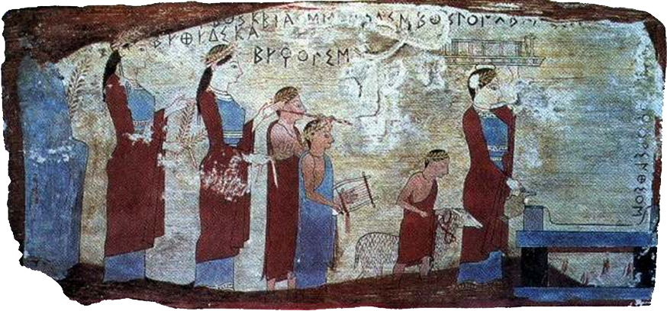
concepts, terms
hiera (neut. plur.) “sacred things” = SACRIFICE (noun)
“victim” = (animal) offering
reciprocity
Ram led to sacrifice

Slide 14
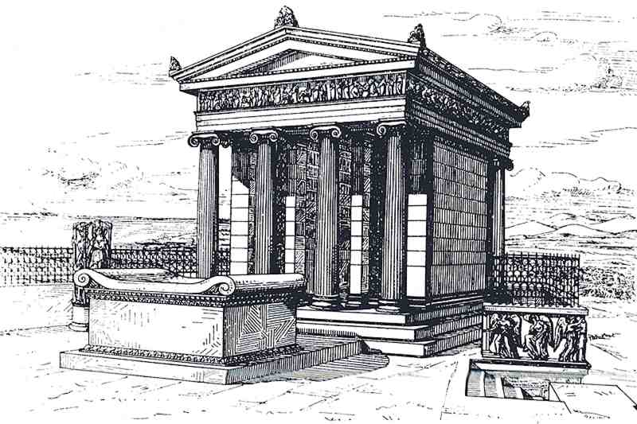
religious space: the temple
naos
altar
Athena Nike (Athens, Acropolis)

Slide 15
temple (cont.)
N
pronaos (entry porch)
east
altar (sacrifice)
naos (god’s statue, offerings)
main focus
temenos (sacred area) wall

Slide 16
Epithets, Function: Aphrodite
epithet | meaning | function
Ourania | Heavenly | marriage, childbirth
Pandemos | “Everyone’s” | marriage, politics, prostitution
Hegemone | Leader-Guide | Military, civic,coming-of-age
Kolias | “She of Cape Kolias” | marriage, fertility
en kēpōi | “In the Gardens” | marriage, fertility (?)
Pontia | of the sea | navigation

