Slide 1
chapter 10
athenaze – grk 101

Slide 2
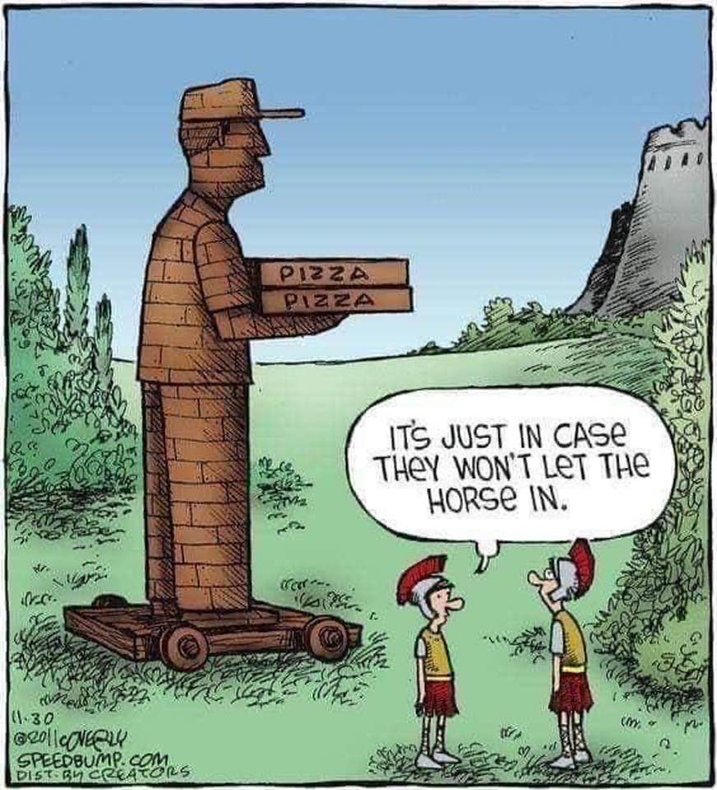

Slide 3
Future Grid
 | indicative
 | sing. | plur.
1st
2nd
3rd
 | infinitive
 | participle

Slide 4
λαλῶμεν ἑλληνιστί
ἔχω principal parts
ἔχω, ἕξω/σχήσω, ἔσχον
ποιέω, ___?___, ἐποίησα
Vocab
πῶς ἔχεις;
ἔχω καλῶς/κακῶς/μέσως
τήμερον =
αὔριον =
χαίρετε ὦ μαθηταί κτλ (κτλ. = καὶ τὰ λοιπὰ, “etc.”)
ὦ ___· πῶς ἔχεις τήμερον;
ὦ ___· πῶς ἕξεις αὔριον;
ἕξω καλῶς/κακῶς/μέσω
οὐκ οἶδα, ὦ διδάσκαλε
τί ποιεῖς τήμερον; πότερον...
μανθάνεις, ἢ
ἀναγιγνώσκεις, ἢ
ἐσθίεις

Slide 5
Παιδεύω, principle parts 1st 3 of 6)
λύω (present system)
λύσω (future act/middle system)
ἔλυσα (aorist [simple past] act/middle system)
λέλυκα (perfect act system)
λέλυμαι (perfect mid/passive system)
ἐλύθην (aorist passive system)

Slide 6
Types of Future, Stem and Endings...
Regular Sigmatic Future
Other Future
λύω λύσω
Double-consonant sigmatic
πέμπω πέμψω (= πέμ-πσ-ω)
Sigmatic with consonant (δ, τ, θ, ζ)
σπεύδω σπεύσω
Contract verbs
φιλέω φιλήσω
τιμάω τιμήσω
θεάομαι θεάσομαι (-ᾱ-)
Special -ίζω verbs
κομίζω κομιῶ (ε-contr)
Deponent future
ἀκούω ἀκούσομαι
Mix-and-matches, irregulars
βαδίζω βαδιοῦμαι
γίγνομαι γενήσομαι
βοάω βοήσομαι
εὑρίσκω εὑρήσομαι
ἔχω ἕξω/σχήσω
To be continued…

Slide 7
Βάλλω (throw), κάμνω (be/become tired), ἔρχομαι (go)
(Semi-)Irregular Future

Slide 8
 | indicative |  | infinitive |  | participle
 | sing. |  | βαλεῖν | to be going to throw | βαλῶν, βαλοῦσα, βαλοῦν βαλοῦντος, βαλούσης, βαλοῦντος | going to throw, in order to throw
1st | βαλῶ | I’ll throw
2nd | βαλεῖς | you’ll throw
3rd | βαλεῖ | he/she/it will throw
 | plur.
1st | βαλοῦμεν | we’ll throw
2nd | βαλεῖτε | you’ll throw
3rd | βαλοῦσι(ν) | they’ll throw

Slide 9
 | indicative |  | infinitive |  | participle
 | sing. |  | βαλεῖν | to be going to throw | βαλῶν, βαλοῦσα, βαλοῦν βαλοῦντος, βαλούσης, βαλοῦντος | going to throw, in order to throw
1st | βαλῶ | I’ll throw
2nd | βαλεῖς | you’ll throw
3rd | βαλεῖ | he/she/it will throw
 | plur.
1st | βαλοῦμεν | we’ll throw
2nd | βαλεῖτε | you’ll throw
3rd | βαλοῦσι(ν) | they’ll throw

Slide 10
 | indicative |  | infinitive |  | participle
 | sing. |  | καμεῖσθαι | to be going to be tired | καμούμενος, καμουμένη, καμούμενον | going to be tired, in order to be tired
1st | καμοῦμαι | I’ll be tired
2nd | καμεῖ | you’ll be tired
3rd | καμεῖται | he/she/it will be tired
 | plur.
1st | καμούμεθα | we’ll be tired
2nd | καμεῖσθε | you’ll be tired
3rd | καμοῦνται | they’ll be tired

Slide 11
 | indicative |  | infinitive |  | participle
 | sing. |  | καμεῖσθαι | to be going to be tired | καμούμενος, καμουμένη, καμούμενον | going to be tired, in order to be tired
1st | καμοῦμαι | I’ll be tired
2nd | καμεῖ | you’ll be tired
3rd | καμεῖται | he/she/it will be tired
 | plur.
1st | καμούμεθα | we’ll be tired
2nd | καμεῖσθε | you’ll be tired
3rd | καμοῦνται | they’ll be tired

Slide 12
ἔρχομαι “go”
 | indicative |  | imperative |  | infinitive |  | participle
 | FUT |  | PRES |  | FUT/PRES |  | FUT/PRES
1st | εἶμι |  |  |  | to go ἰέναι |  | going ἰών ἰοῦσα ἰόν
2nd | εἶ |  | ἴθι
3rd | εἶσι(ν)
1st | ἴμεν
2nd | ἴτε |  | ἴτε
3rd | ἴασι(ν)

Slide 13
ἔρχομαι “go”
 | indicative |  | imperative |  | infinitive |  | participle
 | FUT |  | PRES |  | FUT/PRES |  | FUT/PRES
1st | εἶμι |  |  |  | to go ἰέναι |  | going ἰών ἰοῦσα ἰόν
2nd | εἶ |  | ἴθι
3rd | εἶσι(ν)
1st | ἴμεν
2nd | ἴτε |  | ἴτε
3rd | ἴασι(ν)

Slide 14
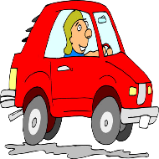
λαλῶμεν ἑλληνιστί (Let’s speak Greek!)
τί ποιεῖς νῦν (“right now,” present time, present tense); πότερον...
τὴν σφαῖραν βάλλεις, ἢ
ἔρχει πρὸς τὸ ἄστυ, ἢ
οὐ ποιήσεις οὐδέν· κάμνεις γάρ
καὶ αὔριον· τί ποιήεις (fut time and tense);

Slide 15
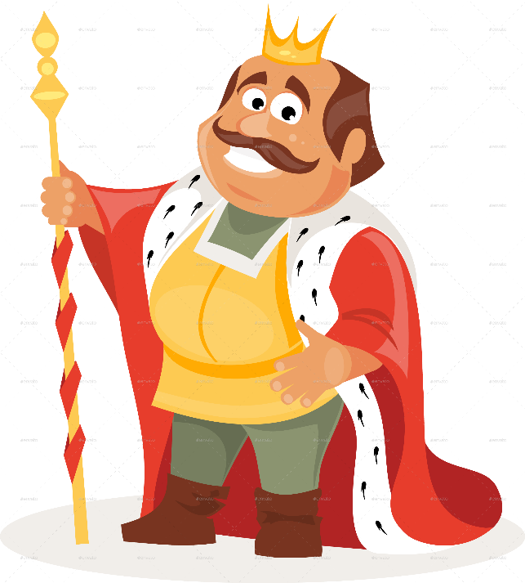
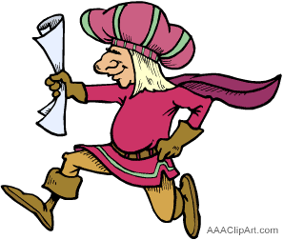
λαλῶμεν ἑλληνιστί
τί ποιεῖ ὁ βασιλεύς;
ἄγγελος, -ου, ὁ
ἀκούω ἀκούσομαι ἤκουσα
λόγος, -ου, ὁ

Slide 16
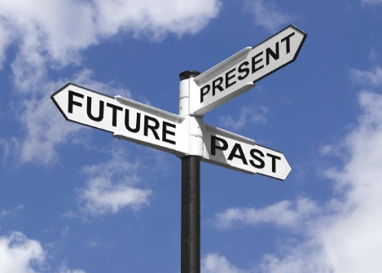
λαλῶμεν ἑλληνιστί
τίνες εἰσὶ
αἱ τότε;
αἱ νῦν;
αἱ ἔπειτα;

Slide 17
λαλῶμεν ἑλληνιστί
Impersonal Verbs
Infinitve Phrases
ἔξεστι (+ dative)
δεῖ (+ acc.)
καιρός ἐστι
(οὐ) δυνατόν ἐστι
τὴν σφαῖραν βάλλειν, ἢ
ἔρχεσθαι πρὸς τὸ ἄστυ, ἢ
Question words
ἆρα
ποῖ
πόθεν
πότε
ποῦ
πῶς
τί; τίς/τί;

Slide 18
λαλῶμεν ἑλληνιστί
πότερον ἔξεστί τινι / δεῖ τινα / καιρός ἐστι / δυνατόν ἐστι
τὴν σφαῖραν βάλλειν, ἢ
ἔρχεσθαι πρὸς τὸ ἄστυ, ἢ
ἆρα εἶ ὡς
σώσουσα τὸν παῖδα;
θεᾱσομένη τὰς τραγουδίας;

