Slide 1
Passive Voice
GRK 102

Slide 2
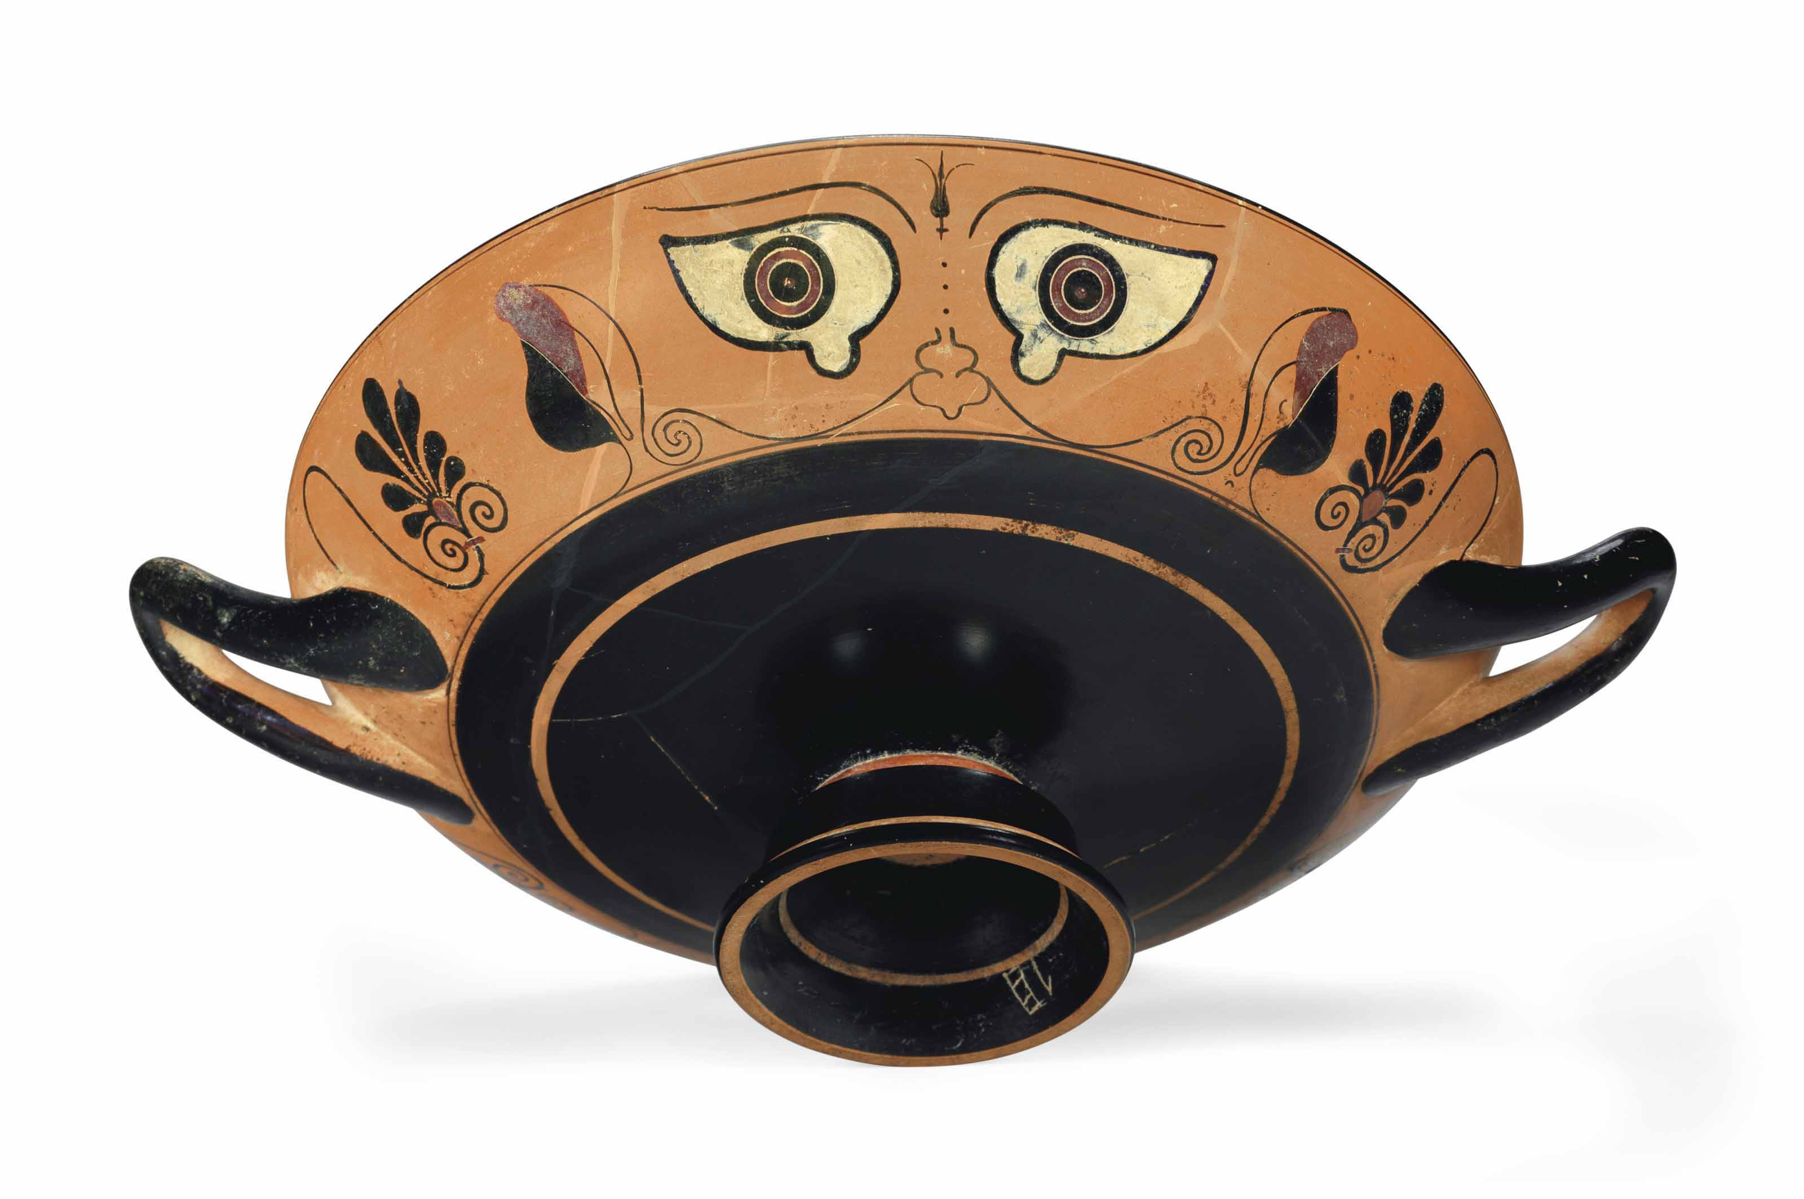
Notes:
AN ATTIC BLACK-FIGURED CHALCIDISING EYE-CUP
CIRCA 520 B.C.
https://www.christies.com/lotfinder/Lot/an-attic-black-figured-chalcidising-eye-cup-circa-520-6101992-details.aspx

Slide 3
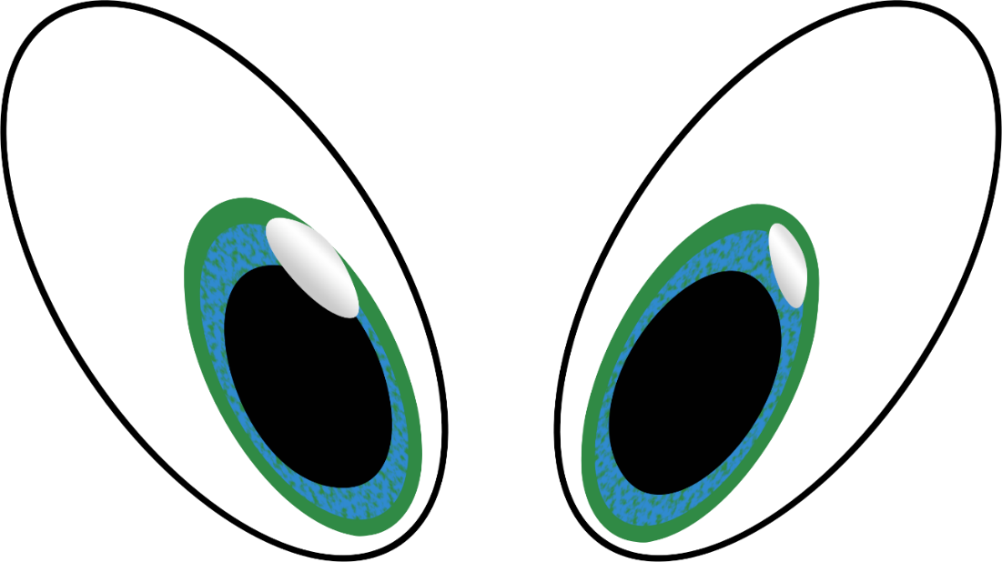
βλέπω, βλεψω, ἔβλεψα
ὁράω, ὄψομαι, εἶδον
ὁ οφθαλμός, τοῦ ὀφθαλμοῦ

Slide 5


λαλῶμεν ἑλληνιστί — λέξεις
λύω (ἐνεργητικῶς)
  λύομαι (μέσως)
λύομαι (παθητικῶς)
ὁ λῃστής, τοῦ λῃστοῦ / ἡ λῃστρίς, τῆς λῃστρίδος
ὁ ἀνήρ, τοῦ ἀνδρός, τὸν ἄνδρα
ἡ γυνή, τῆς γυναικός, τὴν γυναῖκα
τὸ ξίφος, τῷ ξίφει

Slide 6
Passive Practice…
ἡ Μυρρίνη λύει τὴν παῖδα ξίφει (τὸ ξίφος, τοῦ ξιφους, dat., “with a sword”)
ἡ παῖς ποιεῖ τὴν σπόνδην (libation)
ὁ Ἀθηναῖος τιμᾷ τὸν στρατηγόν (general) λογοις (“with speeches”—case?)
ὁ ἔμπορος δηλοῖ τὸ ἀργύριον τῷ ναυκλήρῳ

Slide 7
Quotes
ἀλλ᾽— Ἡρακλῆος γὰρ ἀνικήτου γένος ἐστέ —
θαρσεῖτ᾽· οὔπω Ζεὺς αὐχένα λοξὸν ἔχει.
οὐ παντὸς ἀνδρὸς ἐς Κόρινθόν ἐσθ᾽ ὁ πλοῦς

Slide 8
Morphology Quiz and Drill
Princ prts καταλαμβάνω, κεῖμαι, συναγείρω. Forms of κεῖμαι (present indic, imperat., inf., PTC; imperf. indic.)

Slide 9
Princ prts καταλαμβάνω
καταλαμβάνω
καταλήψομαι
κατ-έ-λαβον

Slide 10
Princ Pts κεῖμαι
κεῖμαι
κείσομαι
No aorist!

Slide 11
Princ Pts συναγείρω
συν-αγείρω
συν-αγερῶ (-έω)
συν-ήγειρα

Slide 12
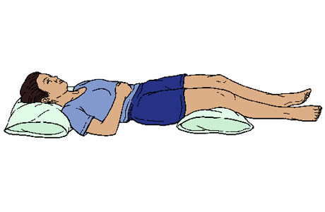
Τί ποιεῖ αὕτη; (οὐ καθεύδει!)

