Slide 1
Sparta and Corinth
Civilization, GRK 102

Slide 2
τεθνάμεναι γὰρ καλὸν ἐνὶ προμάχοισι πεσόντα
ἄνδρ᾽ ἀγαθὸν περὶ ἧι πατρίδι μαρνάμενον·

Slide 3
Comments
Sparta
Corinth
Little to say on women either place
Pro
  stability
  “aggressive military”
  “Local autonomy was granted to nearby states”
  agōgā
Con
  cruelty to infants, to helots
  militaristic
  controlling aristocracy
  imperialist
    “continually trying to expand there borders”
Pro
  wealth
  port, more work
Con
  unstable politics, tyranny

Slide 4
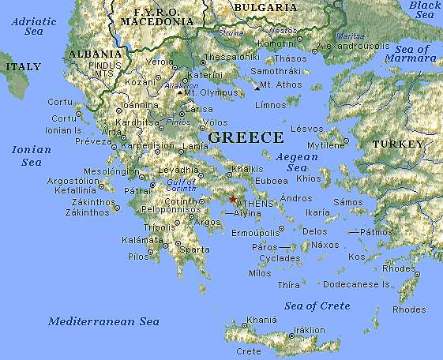
Corinth
Sparta

Slide 5
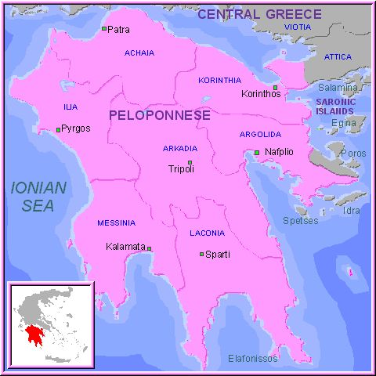

Slide 6
Linguistic, Historical, Cultural Notes
Dialect: Attic
  ἡ Μοῦσα
  λέγουσι “they say”
Dialect: Doric
  standard Doric
    ἁ Μοῖσα
    λέγοντι
  Laconian (Spartan)
    ἁ Μῶhα
    μυθίδοντι “they say”
Korinthos aphneios
  “rich Corinth”
Sparta, Lakedaimon
  early archaic period
    cultural center
  post-Messenian Wars
    “Lycurgan constitution”

Slide 7
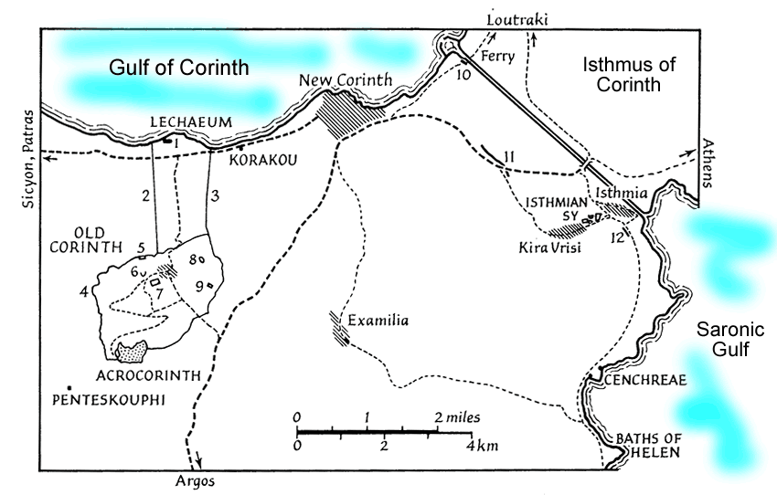
Corinth and the Isthmus

Slide 8
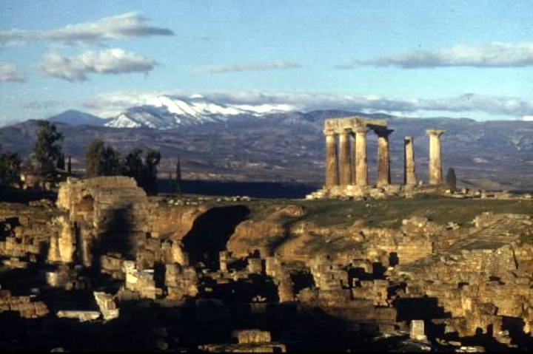
Corinth: Temple of Apollo

Slide 9
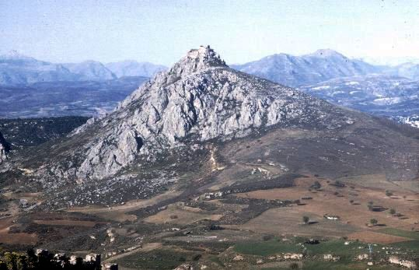
Corinth: Acrocorinth

Slide 10
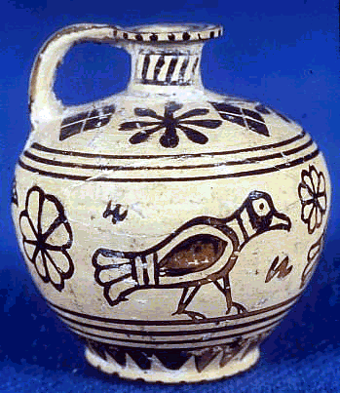
Protocorinthian Aryballos, ca. 720–690 BCE

Slide 11
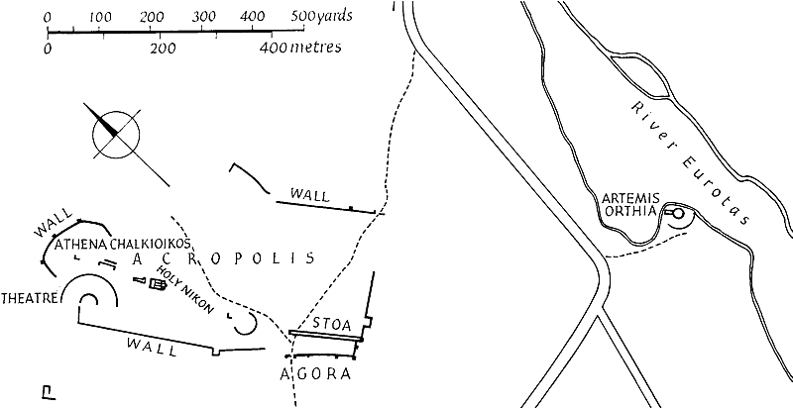
Plan of Ancient Sparta

Slide 12
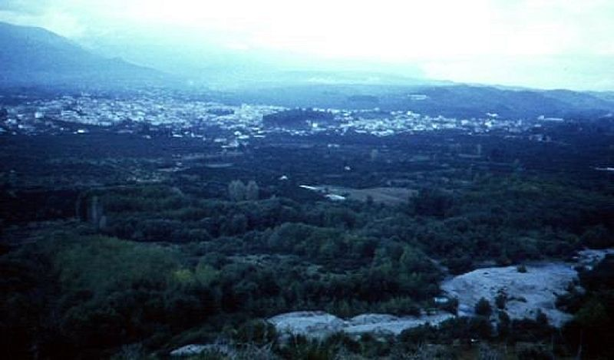
Sparta: View from Meneleum

Slide 13
“Suppose the city of Sparta to be deserted, and nothing left but the temples and ground plan: distant ages would be very unwilling to believe that the power of the Spartans was at all equal to their fame.”
Thucydides

